Slide 1
On Waking-Up Multiple WUR Stations
Date: 2017-01-15
Authors:
Name | Affiliation | Address | Phone | Email
Jianhan Liu | Mediatek | 2840 Junction Ave, San Jose, CA 95134, USA | +1-408-526-1899 | jianhan.Liu@mediatek.com
Tianyu Wu
Russell Huang
Thomas Pare
James Wang

Slide 2
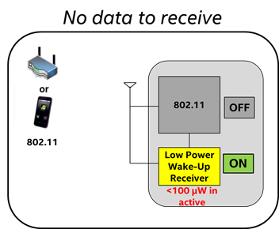
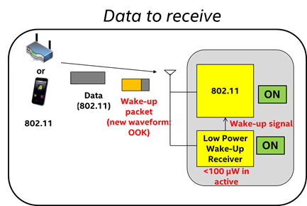
General use of WUR in WLAN
Wake-up Radio (WUR) WLAN System = Main radio (Regular Wi-Fi radio) + Wake-up Radio (WUR)
Main radio (802.11): for user data transmission and reception
User data is transmitted and received by the main radio
Main radio is off unless there is data to transmit or receive
WUR wakes up the main radio when there is a packet to receive
WUR: not for data communication, only serves as a simple switch to “wake-up” the main radio
WUR is a low-cost low power consumption receiver
Target power consumption < 1 mW in the active state
Using Simple modulation scheme such as On-Off-Keying (OOK) and Narrow bandwidth

Slide 3
Multiple User (MU) Wake-up Signal Transmission
To achieve the similar range coverage as the WLAN, a WUR needs to operate on narrow bands, for example, the channel band-width for wake-up signals can be about 1MHz, 2MHz, 4MHz or 5MHz.
Multi-user format of wake-up signal transmission
Packet format: Legacy/HT/VHT/HE Preamble + frequency division multiplexing access (FDMA) on/off keying (OOK) modulation
Legacy/HT/VHT/HE Preamble is for spoofing the Legacy, HT, VHT and HE stations and protecting the wake-up signal transmissions.
MU-Wake-Up Packet

Slide 4
Cascaded Wake-Up Signal Transmission
When an AP needs to wake up a few WUR stations that are operating on the same channel, AP can use cascaded wake-up sequences transmission.
The duration field in the SIG filed of the legacy/HT/VHT/HE preamble should be large enough to protected the transmission of all cascaded wake-up signals.

Slide 5
Advantages of Enabling Multiple User (MU) Wake-up
High efficiency
Since the wake-up signals is narrow band, it takes long time to transmit. MU wake-up scheme can significantly enhance the spectral efficiency.
Spoofing preamble does not need to send many times.
Good match with11ax MU transmission
11ax already introduced OFDMA transmission, which is similar to FDMA MU wake-up signal transmission.
11ax MU packet can be directly used to deliver data to multiple WUR stations after MU wake-up signals.
Reduce latency
When there are a lot of WUR stations need to be waked-up and to receive packet from AP, MU wake-up scheme can greatly reduce latency.

Slide 6
Straw Poll
Do you agree that IEEE 802.11ba shall provide Multiple User wake-up schemes?

