Slide 1
Privacy Issues in 802.11 Networks
Date: 2016-11-08
Authors:
Name | Affiliations | Address | Phone | email
Mathieu Cunche | Univ. Lyon, INSA Lyon, Inria, CITI |  |  | mathieu.cunche@insa-lyon.fr
Juan Carlos Zuniga | SIGFOX |  |  | j.c.zuniga@ieee.org
Mathy Vanhoef | KU Leuven |  |  | mathy.vanhoef@cs.kuleuven.be
Célestin Matte | Univ. Lyon, INSA Lyon, Inria, CITI |  |  | celestin.matte@insa-lyon.fr

Slide 2
This presentation in a nutshell
Tracking of 802.11 devices is easy
There are growing market and population concerns about privacy issues with connected devices
MAC randomization has been proposed to prevent tracking - but it is not enough !
Other information contained in frames can be used for tracking

Slide 3
802.11 and privacy
Many individuals carry a 802.11 enabled device, e.g. smartphone
802.11 station are exposed to passive tracking
Unique identifier: MAC address
Available in clear-text in every frame
Active service discovery
Probe requests broadcast by unassociated stations
Up to 3/min [1]

Slide 4
Physical tracking using 802.11
Rise of physical tracking systems based on 802.11
Set of monitoring nodes collecting identifiers
Applications of physical tracking :
Physical analytics (frequency and duration of visits)
Road monitoring (travel time estimation)
Surveillance
Growing concern of civil society
FTC – Nomi (US)¹, CNIL – JCDecaux (France)²
Problem known since mid 2000's [2][3] but not addressed until now ...
1. https://www.ftc.gov/news-events/press-releases/2015/04/retail-tracking-firm-settles-ftc-charges-it-misled-consumers
2. http://marketinglaw.osborneclarke.com/advertising-regulation/jc-decauxs-pedestrian-tracking-system-blocked-by-french-data-regulator/

Slide 5
MAC address Randomization (theory)
MAC address Randomization in WLAN [3]:
Periodically change the MAC address to a random value (pseudonym)
Potential problems with random MAC
MAC address is supposed to be globally unique
Risk of identifier collision
May disrupt other services/protocols
OK for service discovery mode
Collisions will have little impact
No other services/protocols
Possibly difficult for associated stations
Collisions are rare but problematic
Changing MAC address require to re-auth
Might exhaust resources (DHCP)

Slide 6
MAC Address Randomization (practice)
MAC address randomization adopted by the industry
iOS¹, Android², Linux³, Windows 10⁴
Random MAC only used in probe requests
Except for Windows 10
Field experiments at IETF for associated mode [5]
Ad-hoc implementation since no specification
¹ B. Misra. iOS 8 MAC randomization – analyzed! http://blog.airtightnetworks.com/ios8-mac- randomization-analyzed/
² Android 6.0 changes. Retrieved from https://developer.android.com/about/versions/
marshmallow/android-6.0-changes.html, 2015.
³ E. Grumbach. iwlwifi: mvm: support random MAC address for scanning. Linux commit effd05ac479b.
⁴ W. Wang. Wireless networking in Windows 10. In Windows Hardware Engineering ommunity
conference (WinHEC), Mar. 2015.

Slide 7
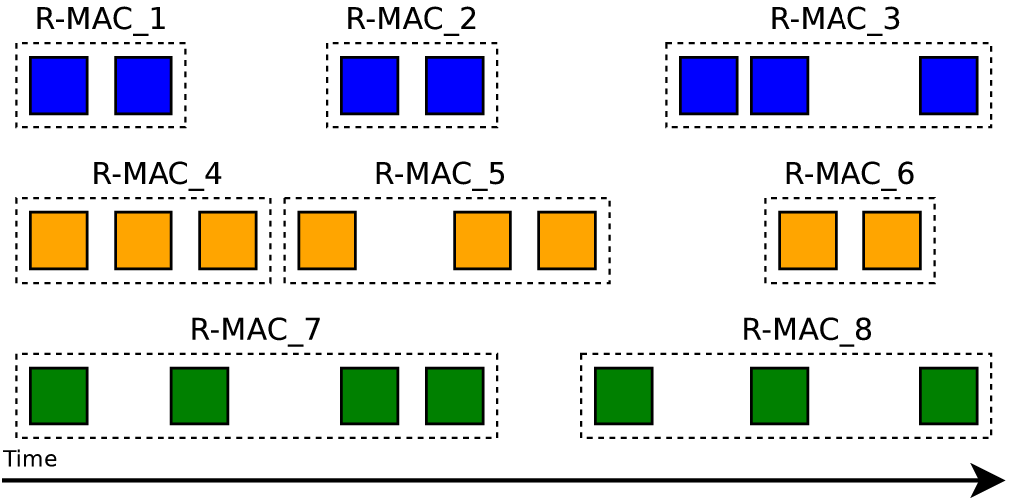
Attacker model
Capabilities : passive monitoring of 802.11 channels
Active attacks are possible
Objective: track individuals over time
Group together frames with distinct MAC address pseudonym but belonging to the same device
Using frame contents and timing

Slide 8
Other means to track 802.11 devices
Content-based attacks
Information Elements
WPS UUID
Predictable fields
Sequence number
Scrambler seed
Active attacks
Fake AP (Karma attack)
Hotspot2.0
Timing attacks

Slide 9
Results from academic research
“Why MAC Address Randomization is Not Enough: An Analysis of Wi-Fi Network Discovery Mechanisms” [5]
“How talkative is your mobile device?: an experimental study of Wi-Fi probe requests“ [1]
“The scrambler attack: A robust physical layer attack on location privacy in vehicular networks” [9]
“Defeating MAC Address Randomization Through Timing Attacks Timing attacks” [10]

Slide 10
Information Elements (IEs)
Information Elements (Tags or Tagged parameters)
Embedded in 802.11 frames
Not mandatory
Used to advertise support of functionalities
Ex: Supported Rates, High Throughput capabilities …
Study of IE in the wild [5]
Analysis of IE found in 3 datasets (160 000+ devices)
IE based fingerprinting
Large number of IE embedded in frames
IEs with multiple parameters
IEs provide enough entropy to uniquely identify a device within a large group
160 000

Slide 11
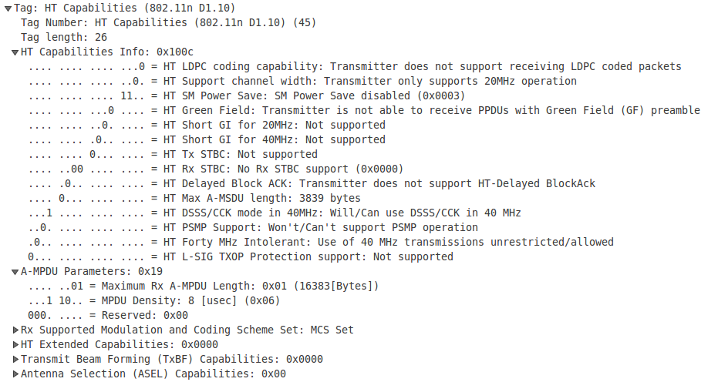
Information Elements (IEs)
HT Capabilities information element
160 000

Slide 12
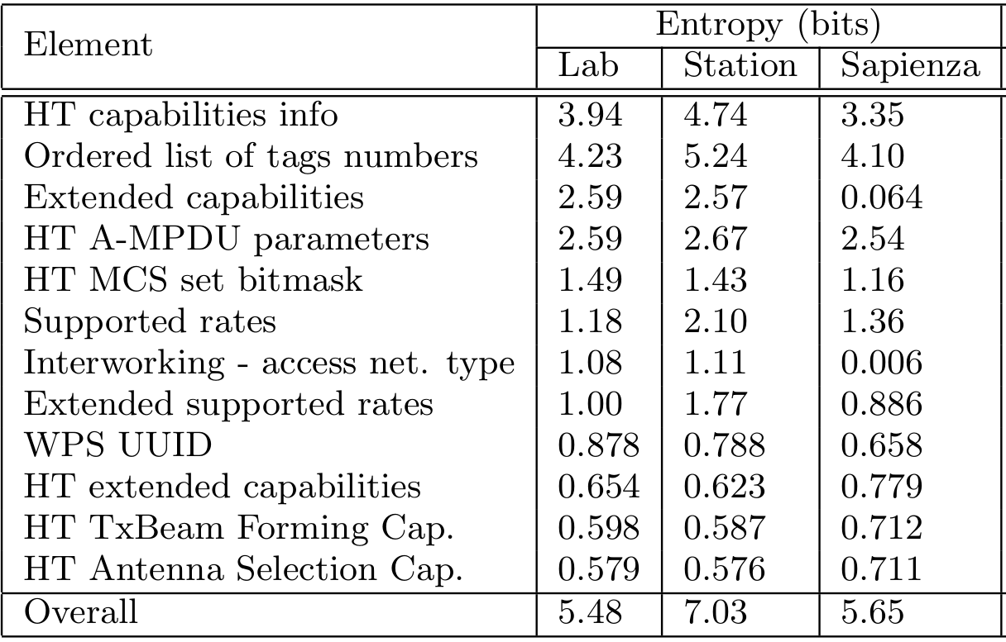
Information Elements (IEs)
Identifying information provided by IE in considered datasets
160 000

Slide 13
Information Elements : WPS UUID
WPS Information Element
WPS (Wi-Fi Protected Setup) protocol simplifies device pairing
WPS compatible devices can include a WPS IE
WPS IE includes a UUID field
Tracking threat of WPS UUID [5]
UUID is by definition a unique identifier: can be used for tracking
UUID is computed by hashing the MAC address [6]
Can be reversed back to the real MAC address
Brute-force attack led to successful reversing in 92% of cases

Slide 14
Predictable fields
Predictable field : non constant field whose value can be predicted from the previous frames
Example : sequence number field
Frame counter included in 802.11 header
Predictable : simple increment
Sequence number field in iOS random MAC
Counter not reset upon MAC address change [1]
Can be used to defeat MAC randomization
Source: J. Freudiger

Slide 15
Predictable fields: scrambler seed
802.11 PHY Scrambler seed [7]
Embedded in OFDM frames
Seed used to initialize PRNG generating the scrambling sequence
No specification on how to generate the seed sequence
“the initial state of the scrambler shall be set to a pseudorandom nonzero state” (18.3.5.5)

Slide 16
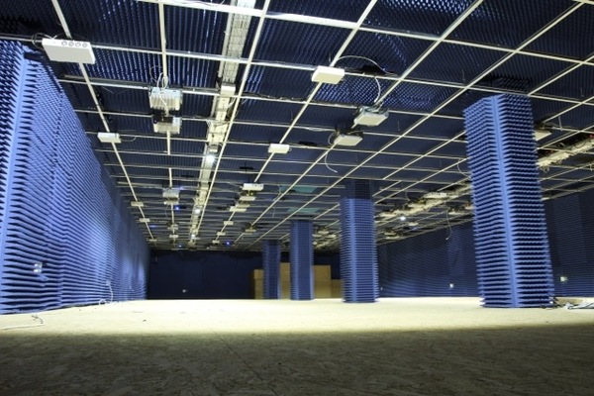
Predictable fields: scrambler seed (cont’d)
Collecting scrambler seeds
Part of the PHY layer: not available at the MAC layer
Standard hardware not helpful here
Solution: use Software Defined Radio
Implementation of 802.11 based on Gnuradio + USRP + Faraday Room
Inria FIT CortexLab

Slide 17
Predictable fields: scrambler seed (cont'd)
The scrambler seed : a predictable field
Observed patterns in real world implementations [9][5]
Freewheeling : state of the LFSR at the end of a frame is reused for the next frame
Constant seed (or limited to a small set)
Incremental: seed value is incremented by one at each frame
Scrambler seeds can be used to track 802.11 transmitters

Slide 18
Active attacks
Karma attack [5]
Stations switch back when their real MAC address when attempting to associate with the AP
Attack : Create a fake AP with popular SSID
Collect real MAC address of STA attempting to associate
Hotspot 2.0 based attack [5]
HS2.0 (802.11u)[8]: protocol allowing roaming
STA sends ANQP queries to AP to retrieve list of available services
STA switches back to their real MAC address when querying
Query also contains predictable counter that might help tracking
Attack : create AP advertising HS2.0 capabilities
Collect real MAC address of querying STAs

Slide 19
Timing attacks
Timing in active service discovery
Probe sent at regular interval
Timing features of probe requests
Interval between probe requests within a burst
Interval between bursts
Observed timing of probe requests can be used for tracking [10]
Channel order could also be exploited [11]

Slide 20
Summary
MAC randomization is a good protection against privacy issues but can currently be defeated by advanced attacks
Presented list of attacks is not exhaustive
Other privacy issues in 802.11 specifications
Identifying implementation-specific usage of multiple optional parameters in frames
Identifying implementation-specific generation of (pseudo-)random parameters
Correlating state changes of different parameters between themselves, and/or with incremental counters
Too much freedom in specification can lead to implementation fingerprinting, which opens up privacy and security issues

Slide 21
Further thoughts
How often should identifiers be changed (frequency)?
Should we provide recommendation on how to generate (pseudo-)random parameters? e.g.
MAC address,
scrambler seeds,
Unlinkability of consecutive values

Slide 22
Straw Poll
Do you think 802.11 specifications should include privacy recommendations about the usage of its protocols and parameters?
Y:
N:
A:

Slide 23
References
[1]J. Freudiger, “How talkative is your mobile device?: an experimental study of Wi-Fi probe requests,” in Proceedings of the 8th ACM Conference on Security & Privacy in Wireless and Mobile Networks, 2015, p. 8.
[2]J. Pang, B. Greenstein, R. Gummadi, S. Seshan, and D. Wetherall, “802.11 User Fingerprinting,” in Proceedings of the 13th Annual ACM International Conference on Mobile Computing and Networking, New York, NY, USA, 2007, pp. 99–110.
[3]M. Gruteser and D. Grunwald, “Enhancing location privacy in wireless LAN through disposable interface identifiers: a quantitative analysis,” Mobile Networks and Applications, vol. 10, no. 3, pp. 315–325, 2005.
[4] C. J. Bernardos, J. C. Zúńiga, and P. O’Hanlon, “Wi-Fi internet connectivity and privacy: Hiding your tracks on the wireless Internet,” in 2015 IEEE Conference on Standards for Communications and Networking (CSCN), 2015, pp. 193–198.

Slide 24
References
[5]M. Vanhoef, C. Matte, M. Cunche, L. S. Cardoso, and F. Piessens, “Why MAC Address Randomization is Not Enough: An Analysis of Wi-Fi Network Discovery Mechanisms,” in Proceedings of the 11th ACM on Asia Conference on Computer and Communications Security, New York, NY, USA, 2016, pp. 413–424.
[6]P. Leach, M. Mealling, and R. Salz. A universally unique identifier (UUID) URN namespace. RFC 4122 (Proposed Standard), July 2005.
[7]IEEE Std 802.11-2012. Wireless LAN Medium Access Control (MAC) and Physical Layer (PHY) Specifications, 2012.
[8] IEEE Std 802.11u. Wireless LAN Medium Access Control (MAC) and Physical Layer (PHY) Specifications: Amendment 9: Interworking with External Networks, 2011.

Slide 25
References
[9]B. Bloessl, C. Sommer, F. Dressier, and D. Eckhoff, “The scrambler attack: A robust physical layer attack on location privacy in vehicular networks,” in 2015 International Conference on Computing, Networking and Communications (ICNC), 2015, pp. 395–400.
[10]C. Matte, M. Cunche, F. Rousseau, and M. Vanhoef, “Defeating MAC Address Randomization Through Timing Attacks,” in Proceedings of the 9th ACM Conference on Security & Privacy in Wireless and Mobile Networks, New York, NY, USA, 2016, pp. 15–20.
[11]O. Waltari and J. Kangasharju, “The Wireless Shark: Identifying WiFi Devices Based on Probe Fingerprints,” in Proceedings of the First Workshop on Mobile Data, New York, NY, USA, 2016, pp. 1–6.

Slide 26
Backup

Slide 27
Datasets
Datasets of probe requests

