Slide 1
Multi-BF Procedure for 11ay
Date: 2016-11-08
Authors:
Name | Company | Address | Phone | Email
Kyungtae Jo | LG Electronics |  |  | kyungtae.jo@lge.com
SungJin Park |  |  |  | allean.park@lge.com
HanGyu Cho |  |  |  | hg.cho@lge.com
JinMin Kim |  |  |  | jinmin1230.kim@lge.com
Saehee Bang |  |  |  | saehee.bang@lge.com
Sang G. Kim |  |  |  | sanggook.kim@lge.com

Slide 2
Introduction
Motion on multi-BF in coping with polarization antenna was approved and the following text was incorporated into SFD [1]:
“The 11ay beamforming protocol supports multi-beamforming for multiple array antennas. Multi-beamforming means that a transmitter simultaneously sends SSW frames in multiple polarized directions. 11ay provides the means of multi-beamforming capability exchange in which the initiator and responders exchange the information on whether they have the capability of multi-beamforming.”
This contribution provides details on multi-beamforming by simultaneously transmit sectors through dual-polarization antenna.

Slide 3
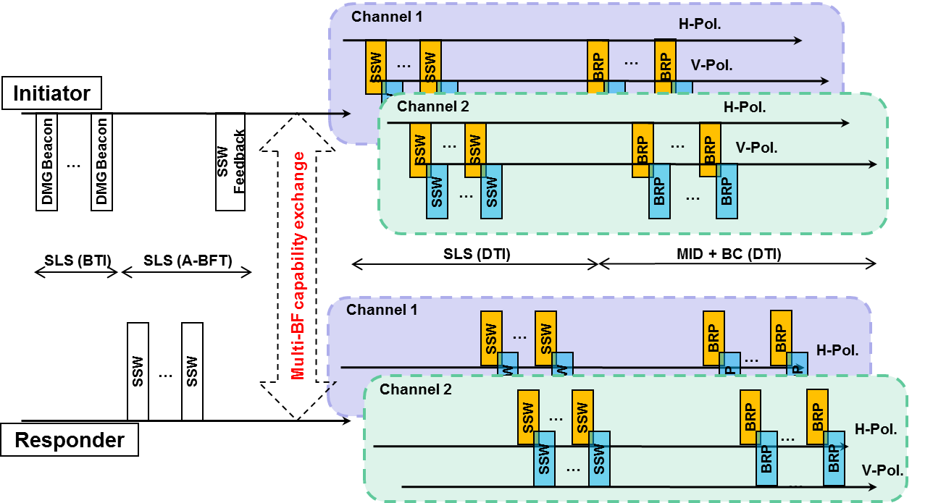
Recap: Multi-beamforming for 11ay [2]
Before entering DTI, Multi-BF capability exchange may be done, in which the initiator and responders exchange the information about BF and MIMO capabilities including ‘Multi-BF capability indication bit’.
According to the indicators, BRP phase is set up and proceeded through dual-polarized antenna in parallel.

Slide 4
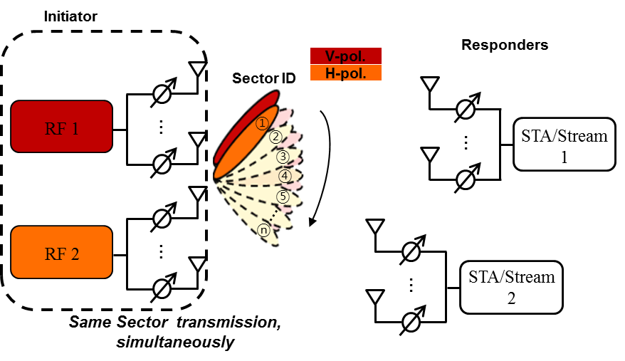
Multi-BF with Same Sector through Polarized Antenna
Initiator transmits sectors with the same sector ID through dual polarization antenna.
Initiator can perform BFs for all responders regardless of the polarization capability of responders.

Slide 5
Multi-BF Capability
Signaling in EDMG Capabilities element for 11ay
The following text is included in SFD [1]:
“A non-AP or non-PCP EDMG STA declares that it is an EDMG STA by transmitting the EDMG Capabilities element.”
BF capability can exchange by EDMG Capabilities element for 11ay.
EDMG Capabilities element can be composed based on DMG Capabilities element.
Field | Bit | Description
STA Dual-pol. BF Support | 0 | BF in single-pol. channel is supported.
 | 1 | BF in dual-pol. channel is supported.
Field | Bit | Description
PCP/AP Dual-pol. BF Support | 0 | BF in single-pol. channel is supported.
 | 1 | BF in dual-pol. channel is supported.

Slide 6
Multi-BF Capability Exchange
EDMG Capabilities element exchange including Multi-BF capability
First, PCP/AP transmits EDMG Capabilities element to STAs.
EDMG Capabilities element includes the information whether PCP/AP can support the dual-polarization.
The responders transmit EDMG Capabilities element with multi-BF capability of STAs to PCP/AP after they received EDMG Capabilities element with multi-BF capability of PCP/AP.
Beam refinement procedures between PCP/AP and STAs proceed through dual-polarized antenna allocated by multi-BF capability exchanges.

Slide 7
Summary
This contribution details the proposed BF procedures based on multi-beam refinement in dual-polarized antenna to support beamformed communications for 11ay.

Slide 8
Straw poll/motion #1
Do you agree to modify the current SFD text
“The 11ay beamforming protocol supports multi-beamforming for multiple array antennas. Multi-beamforming means that a transmitter simultaneously sends SSW frames in multiple polarized directions.”
as follows
“The 11ay beamforming protocol supports multi-beamforming for multiple array antennas. Multi-beamforming means that a transmitter sends a SSW frame simultaneously in same sectors through polarized antennas”

Slide 9
Straw poll/motion #2
Do you agree to add the following text into SFD?
“11ay shall define the Multi-BF capabilities using EDMG Capabilities element to perform the Multi-BF.”

Slide 10
References
11-15-1358-09-00ay-11ay Spec Framework
K. Jo, et al., “Multi-Beamforming in Polarized Channels for 11ay,” IEEE 11-16/ 0092r1.
K. Jo, et al., “Generalized Multi-Beamforming for 11ay,” IEEE 11-16/ 0398r1.

