Slide 1
Quasi-deterministic Channel Model for a Server Room at 60 GHz
Date: 2016-11
Authors:
Name | Affiliations | Address | Phone | email
Peter Papazian | NIST | Boulder, CO, USA | +1 (303) 497-7078 | peter.papazian@nist.gov
Jae-Kark Choi | NIST | Gaithersburg, MD, USA | +1 (301) 975-6049 | jae-kark.choi@nist.gov
Ruoyu Sun | NIST | Boulder, CO, USA | +1 (303) 497-6698 | ruoyu.sun@nist.gov
Jian Wang | NIST | Gaithersburg, MD, USA | +1 (301) 975-8012 | jian.wang@nist.gov
Jelena Senic | NIST | Boulder, CO, USA | +1 (303) 497-6166 | jelena.senic@nist.gov
Camillo Gentile | NIST | Gaithersburg, MD, USA | +1 (301) 975-3685 | camillo.gentile@nist.gov
Yeh Lo | NIST | Boulder, CO, USA | +1 (303) 497-669 | yeh.lo@nist.gov
Kate Remley | NIST | Boulder, CO, USA | +1 (303) 497-3652 | kate.remley@nist.gov

Slide 2
Abstract
This document presents the parameters of the Quasi-deterministic (QD) channel model for a server room at 60 GHz, in support of the IEEE 802.11ay data-center usage case. The channel sounder, measurement campaign, and parameter-extraction methods are also presented.

Slide 3
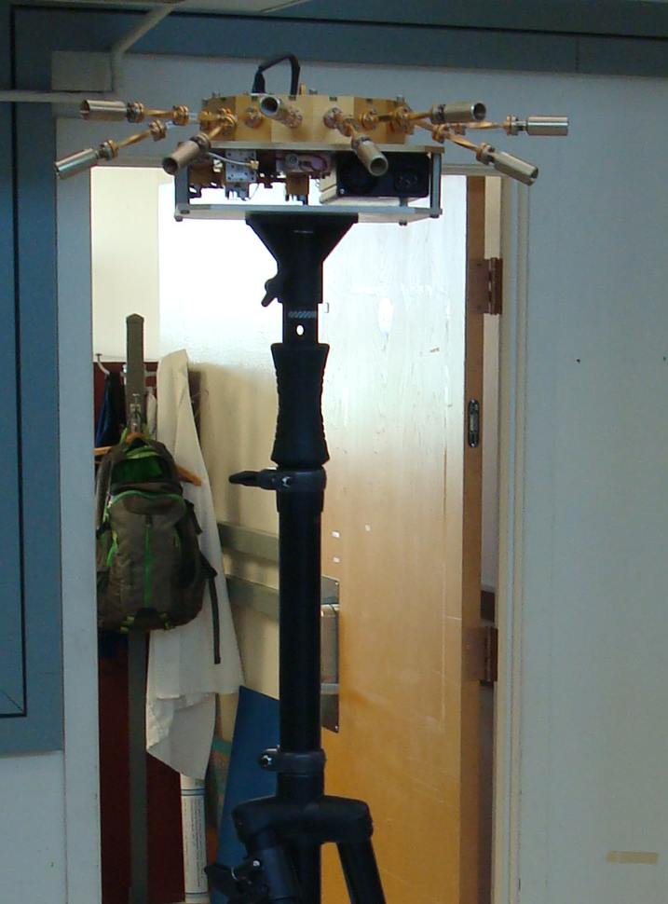
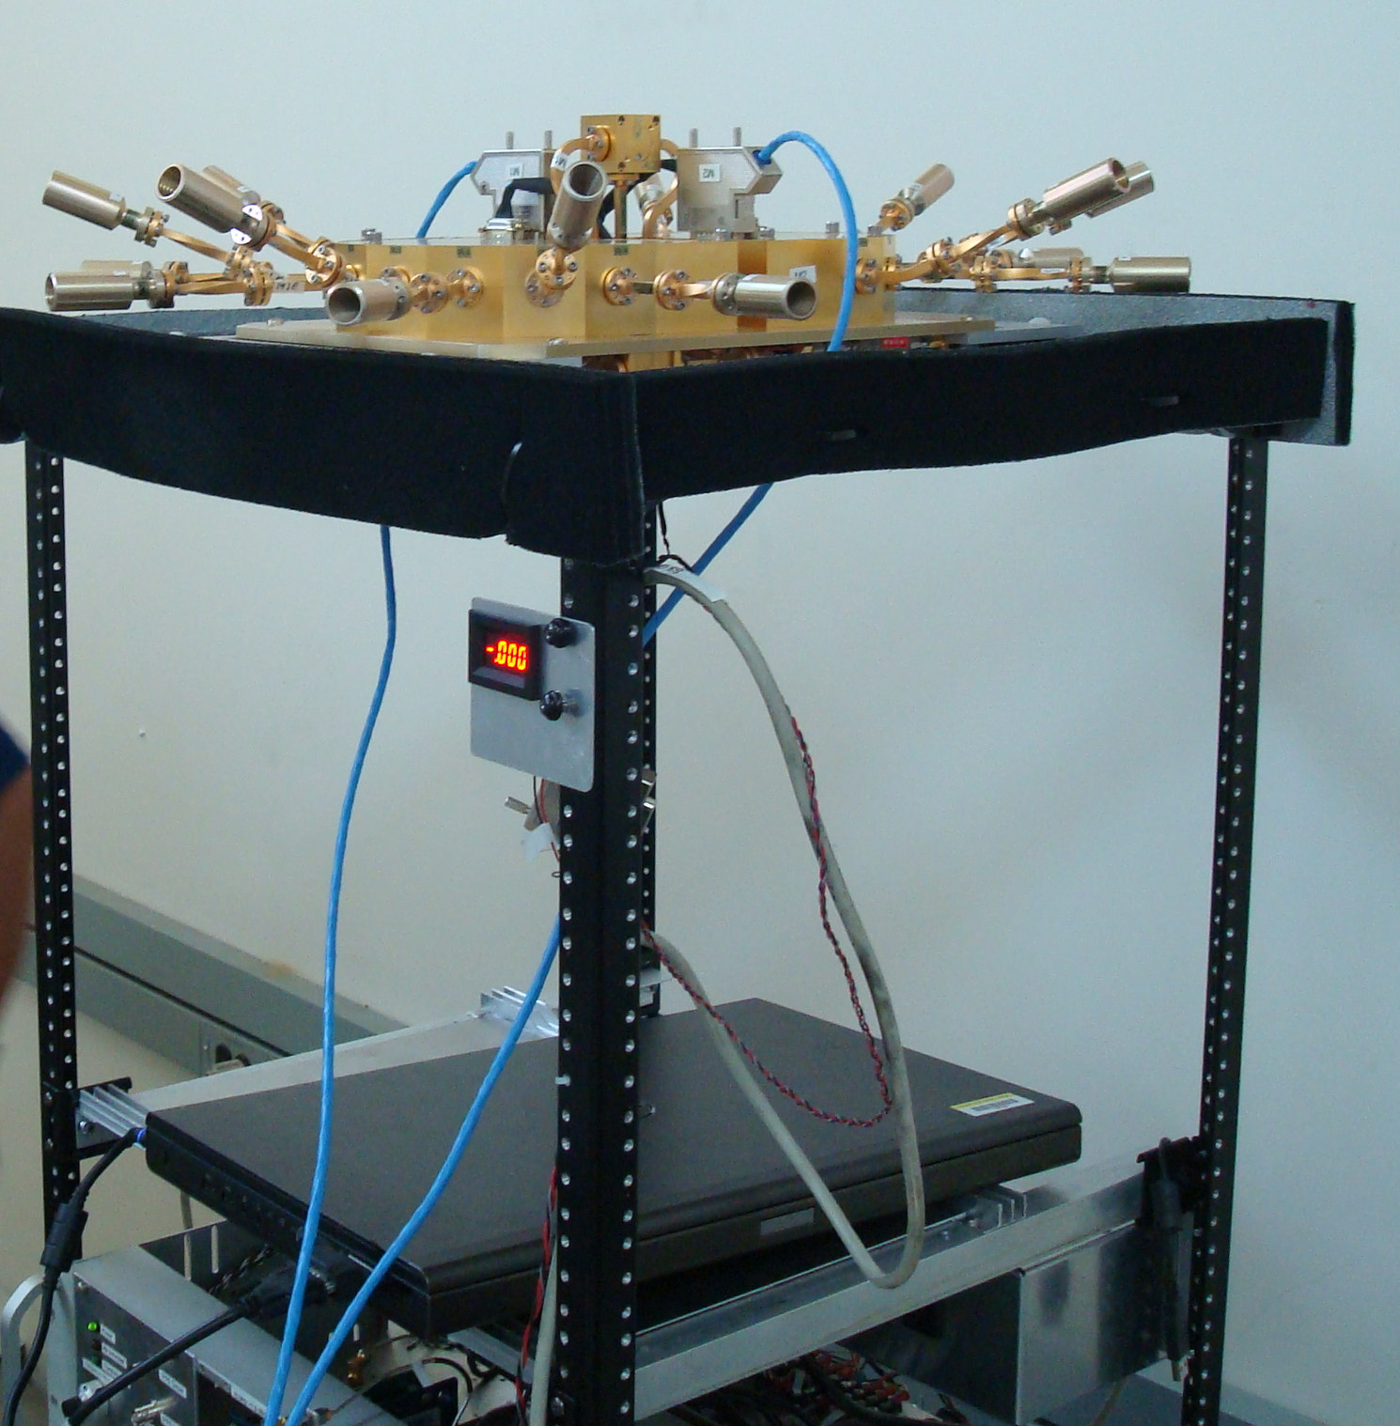
60 GHz Channel Sounder
TX ARRAY MOUNTED ON TRIPOD
8 antennas, gain = 18.1 dBi, beamwidth = 22.5º
azimuth / elevation field-of-view = 180º / 45º
TX power = 20 dBm
RX ARRAY MOUNTED ON ROBOT
16 antennas, gain = 18.1 dBi, beamwidth = 22.5º
azimuth / elevation field-of-view = 360º / 45º
One measurement over all 8 TX antennas x 16 RX antennas takes 262 µs to sweep
Can extract AZ / EL AoD and AZ / EL AoA
60.5 GHz center frequency / 2 GHz bandwidth

Slide 4
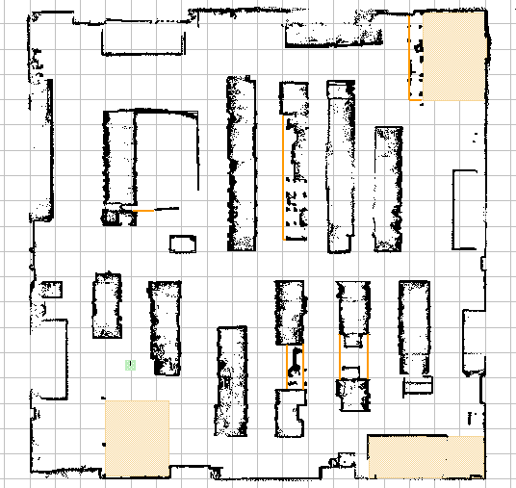
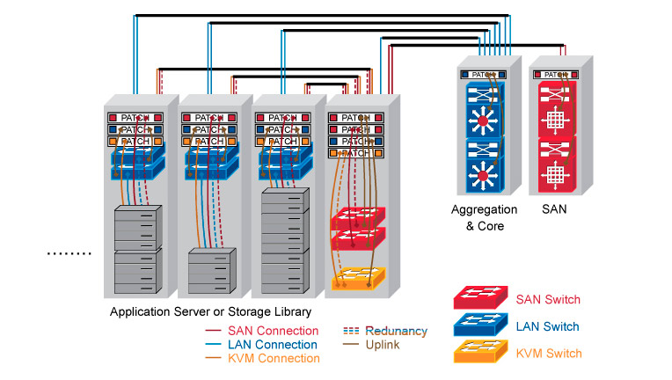
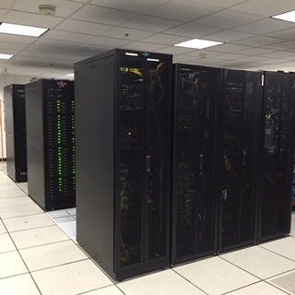
Server-room Environment
RACKS
COLUMNS
IEEE 802.11ay DATA-CENTER USAGE CASE
Rx
NOAA SERVER ROOM
(Boulder, CO)
FLOOR PLAN
(generated through laser-guided robot,
each grid square = 1 m²)
In support of IEEE 802.11ay data-center usage case 4 (doc. 802.11-2015/0625-03)
Rack heights are 1.96 – 2.0 m
Walls and columns are covered with drywall
Dropped ceiling at 2.56 m height made from acoustic tiles
Dimensions of server room are 18 m x 18 m

Slide 5
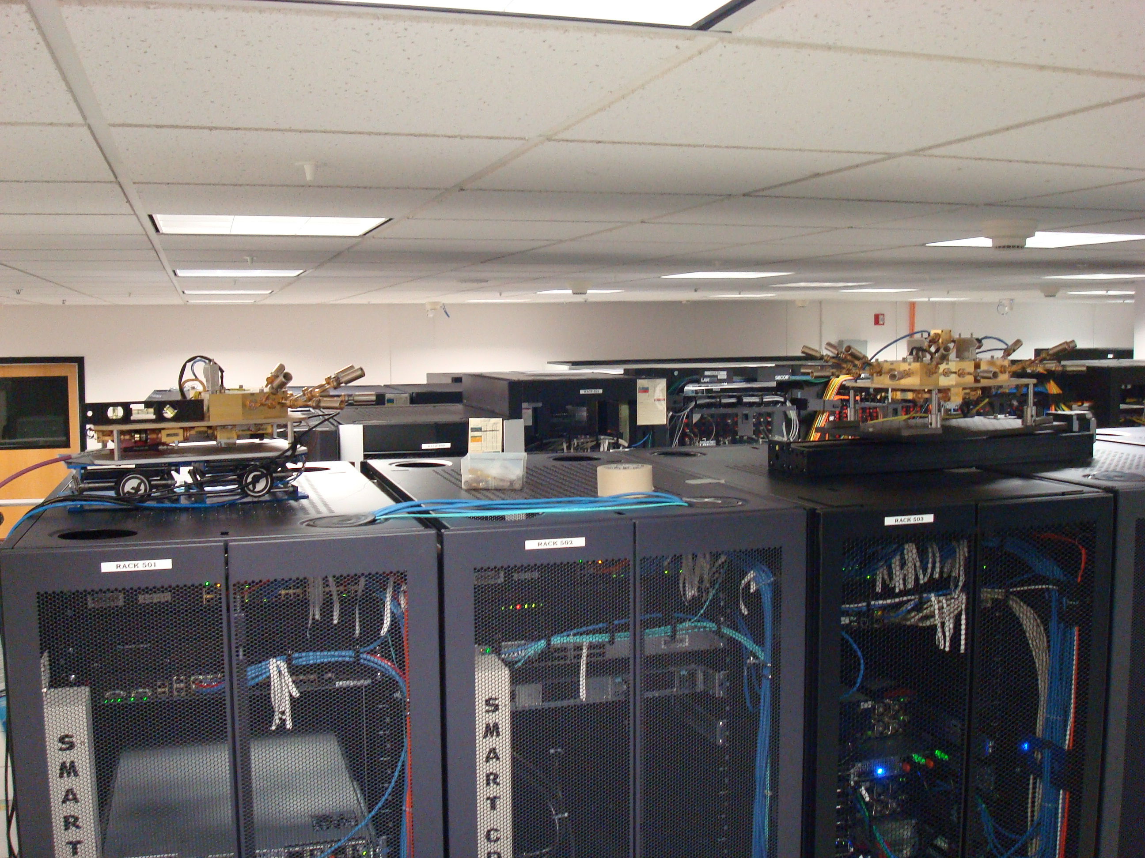
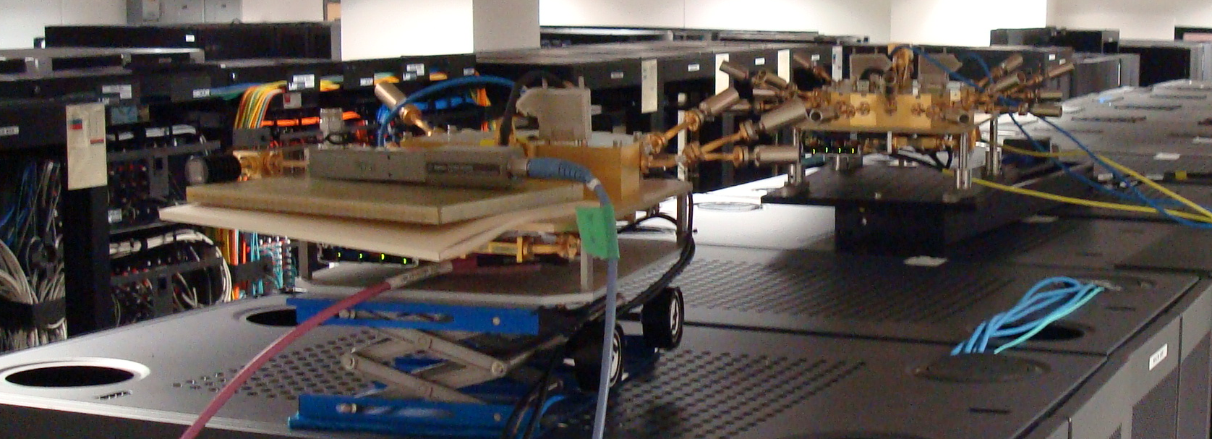
Measurement Campaign
TX
TX
RX
RX6
RX7
SIDE VIEW
RX1
RX2
RX3
RX
TX
RX4
RX5
ANGLE VIEW
RX8
TX and RX antenna centers aligned at 19 cm above racktop
Single TX location
8 RX locations:
  3 intra-rack (RX1 - RX3) : 4.8 m – 6.1 m
  5 inter-rack (RX4 – RX8) : 6.4 m – 12.5 m
  At each RX position, 8 measurements were taken within λ spacing (5 mm) by moving the RX on a positioner
FLOOR PLAN

Slide 6
Multipath-component Clustering
AZ AoD (deg)
AZ AoD (deg)
AZ AoA (deg)
delay (ns)
AZ AoA (deg)
delay (ns)
Rx
AZ AoA (deg)
AZ AoA (deg)
delay (ns)
delay (ns)
PATH LOSS MPCs
CLUSTERED MPCs
(each cluster shown as separate color)
For each RX location, the multipath components (MPCs) are extracted
MPCs are indexed according to path loss, delay, and angle (AZ / EL x AoD / AoA)
The MPCs from the 8 measurements are then combined then automatically clustered

Slide 7
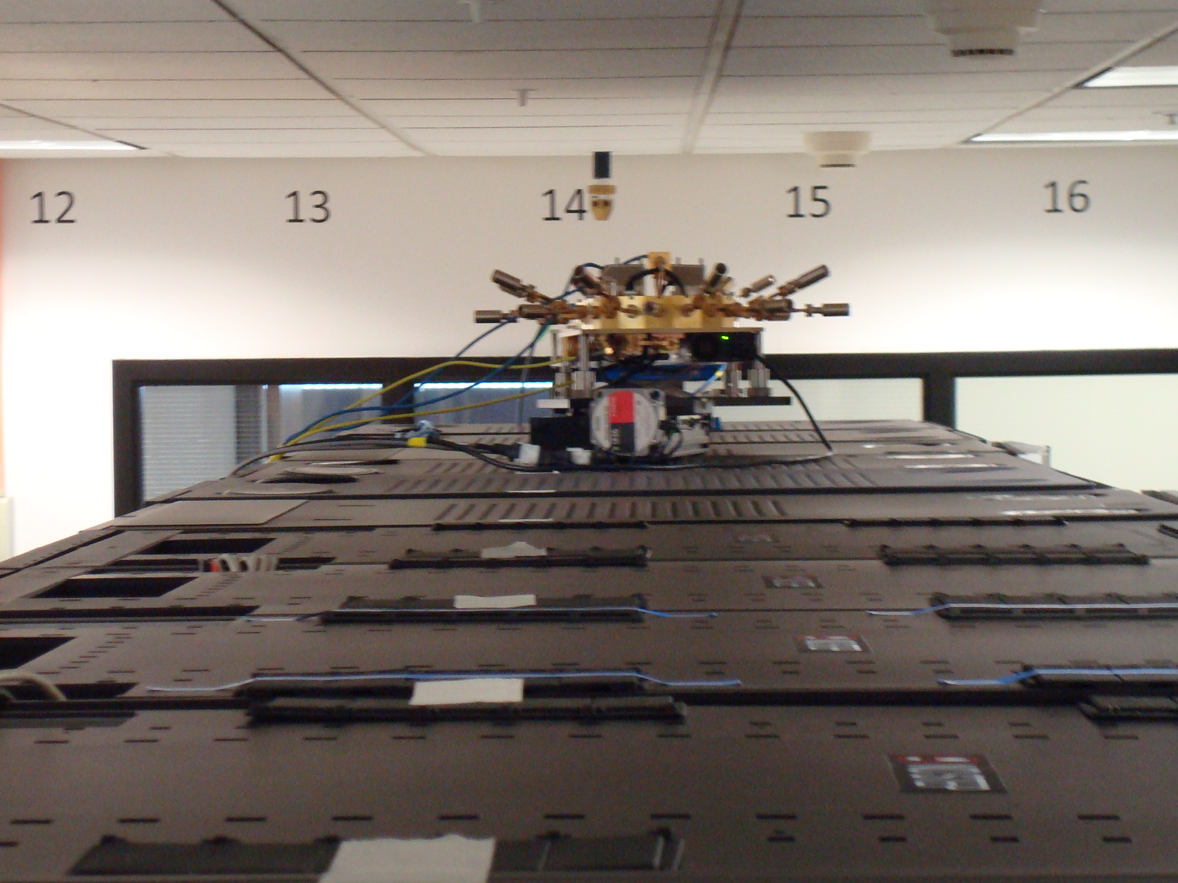
Classification: Ceiling and Racktop Reflections
CEILING REFLECTION
RX
TX
RX
RACKTOP REFLECTION
RACKSIDE FRONT VIEW
RACKTOP VIEW
TX and RX antenna elements are pointed at 0º and 22.5º in elevation so that both of these reflections can be seen

Slide 8
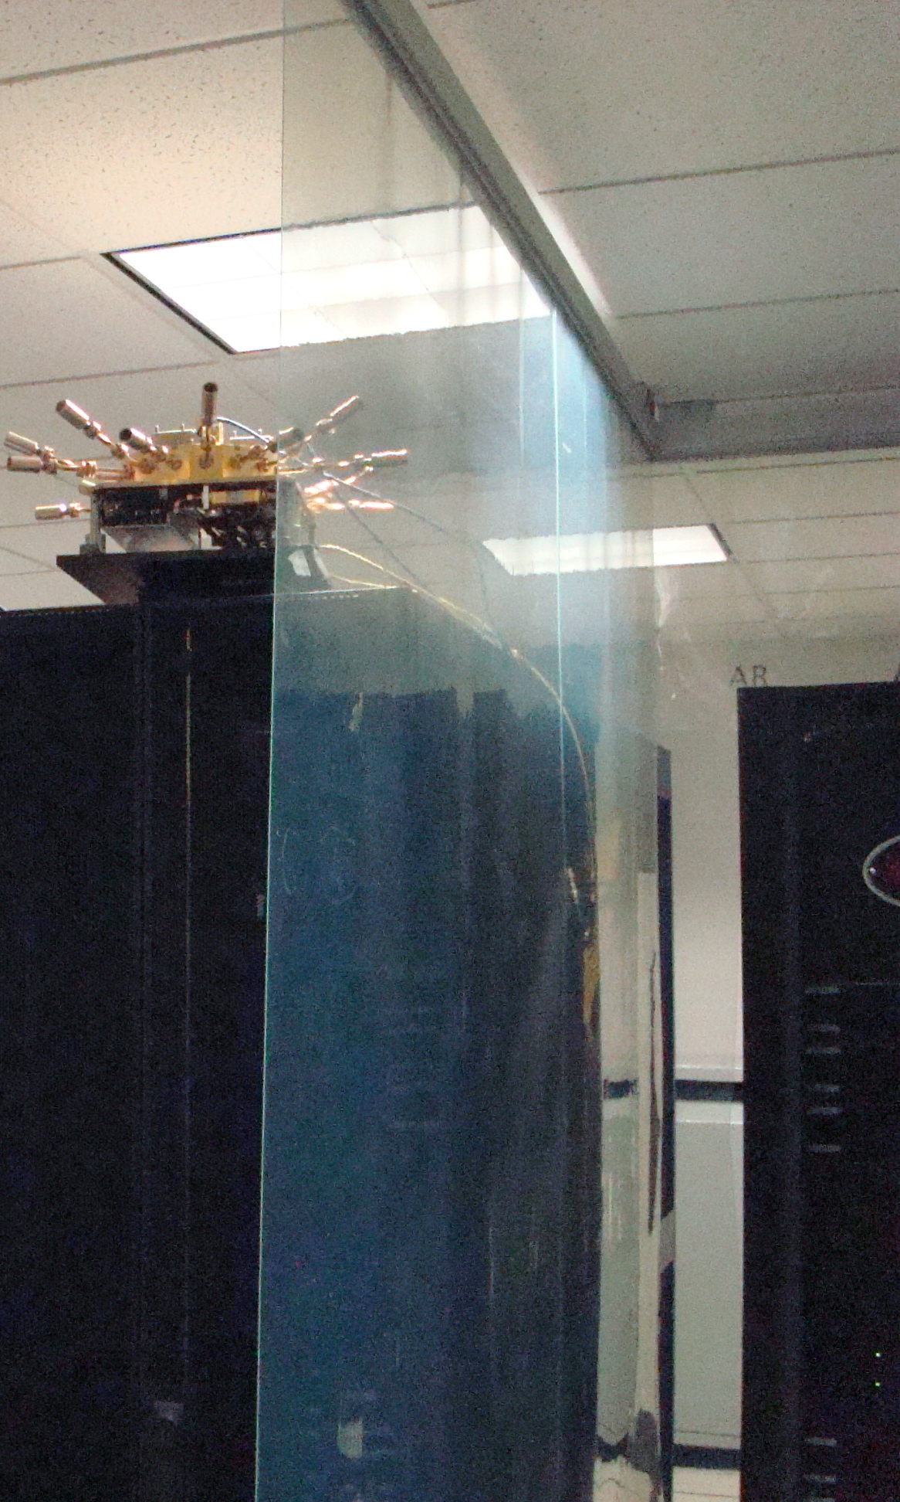
Classification: Curtain Reflection
CURTAIN
TX
RX6
RX7
RX1
RX2
RX3
SUPERCOMPUTER RACK
RX4
RX5
RX8
RACKTOP VIEW
AIR CURTAIN
FLOOR PLAN
Air curtain made from conductive material (to concentrate cooling) placed close to supercomputers
Average reflection loss of curtain is 0.1 dB
Creates strong reflections in environment (some examples shown)

Slide 9
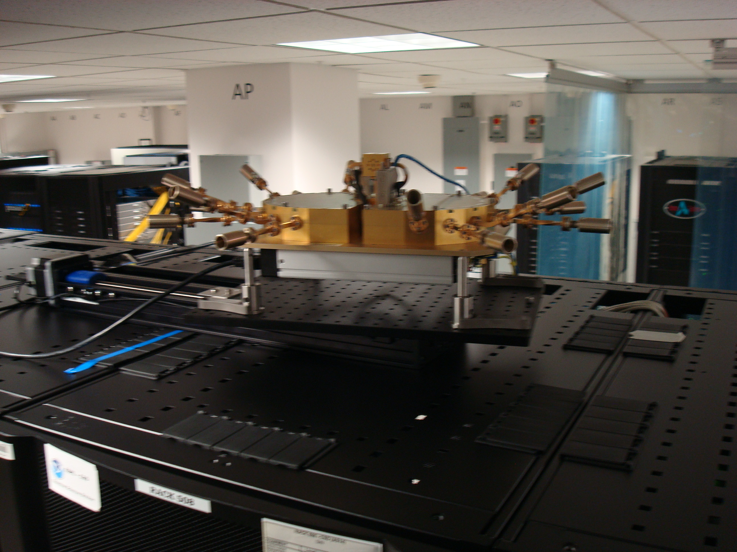
Classification: Wall Reflection and Column Reflection
COLUMN
BACKWALL
TX
WALL
REFLECTION
RX6
RX7
RX1
RX2
RX3
RX
COLUMN
REFLECTION
RX4
RX5
RX8
Having AoD information in addition to AoA is very useful when associating measured MPCs to raytraced MPCs
Walls and columns are grouped into the same class because they are both covered with drywall

Slide 10
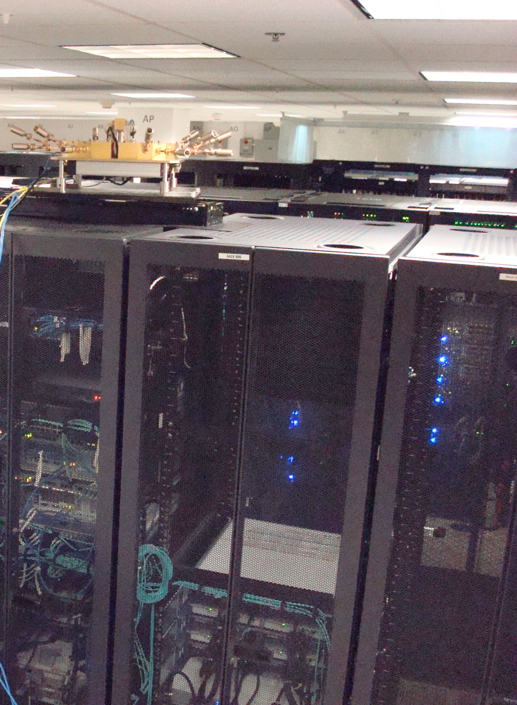
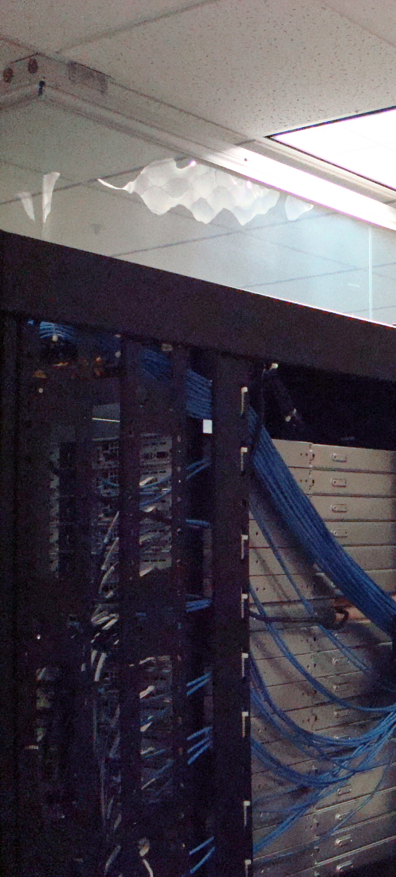
Classification: Rackside Reflection
TX
RX6
RX7
RX1
RX2
RX3
RX4
RX5
RX8
RACKSIDE
FRONT VIEW
FLOOR PLAN
RACKSIDE
BACK VIEW
Given that the racks are below the TX-RX heights, specular reflections from racksides do not exist
However clusters of diffuse components from racksides still detectable, even though the average reflection loss is large (15.9 dB)
Often there are multiple clusters from the same rack given the complex side profiles (caged door on front side and open back side with dense cabling) and variety of devices inside

Slide 11

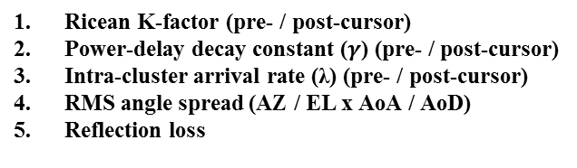


Reduction of QD* Cluster Parameters
cursor
(dominant
component)
RMS spread
Power (dB)
diffuse
components
Power (dB)
$$1/λ$$
1/$γ$
pre-cursor
post-cursor
Angle (deg.)
delay (ns)
Ricean K-factor (pre- / post-cursor)
Power-delay decay constant ($γ$) (pre- / post-cursor)
Intra-cluster arrival rate (λ) (pre- / post-cursor)
RMS angle spread (AZ / EL x AoA / AoD)
Reflection loss
K-factor = $\frac{dominant power}{ pre− /post−cursor total diffuse power}$
Cursor reflection loss
*“Quasi-deterministic Approach to mmWave Channel Modeling in Non-stationary Environment,” Maltsev, Pudeyev, Karls,
Bolotin, Morozov, Weiler, Peter, Keusgen, Globecom 2014.

Slide 12
Summary of Parameter-extraction Steps
  CLUSTERING:
    Measured MPCs at each location are clustered
  2. REDUCTION:
  QD parameters of each cluster are reduced
  CLASSIFICATION:
    Delay, AoA, and AoD of the cluster cursor is compared to raytraced reflections in order to classify reflection type (ceiling, racktop, curtain, wall, column, or rackside)
  4. AGGREGATION:
    Clusters are assigned reflection type associated with their cursor and their statistics aggregated accordingly
Over 40 clusters from 8 RX locations used to aggregate data

Slide 13
Comprehensive QD Model Parameters
 | Ricean K-factor (dB) |  |  |  | γ, power-delay decay constant (ns) |  |  |  | λ, intra-cluster arrival rate (1/ns) |  |  |  | RMS angle spread** (deg.) |  | Reflection loss (dB)
 | pre-cursor |  | post-cursor |  | pre-cursor |  | post-cursor |  | pre-cursor |  | post-cursor
Reflection Type | µ | σ | µ | σ | µ | σ | µ | σ | µ | σ | µ | σ | µ | σ | µ | σ
Ceiling |  |  | 12.4 | 6.2 |  |  | 0.74 | 0.53 |  |  | 1.93 | 1.96 | 2.5 | 1.6 | 7.6 | 2.6
Racktop* |  |  |  |  |  |  |  |  |  |  |  |  |  |  | 6.8 | 1.1
Curtain |  |  | 7.3 | 4.4 |  |  | 0.95 | 0.58 |  |  | 1.17 | 0.34 | 3.6 | 1.2 | 0.1 | 1.2
Wall / Column | 8.2 | 6.2 | 7.9 | 3.7 | 0.37 | 0.52 | 0.89 | 0.70 | 2.54 | 1.57 | 1.41 | 1.06 | 3.2 | 1.7 | 7.4 | 1.3
Rackside | 8.5 | 4.6 | 7.8 | 5.3 | 2.50 | 3.51 | 3.33 | 1.97 | 0.75 | 0.64 | 1.05 | 1.11 | 3.7 | 1.4 | 15.9 | 4.3
Only first-order reflections considered in this model
Diffuse components in racktop clusters too few in number to reduce intra-cluster parameters from them (seem to be insignificant)
Power-delay decay constant of rackside clusters significantly larger than other classes due to highly rich scattering environment
* Valid only for intra-rack TX-RX configurations
** Average over AZ / EL x AoA / AoD

Slide 14
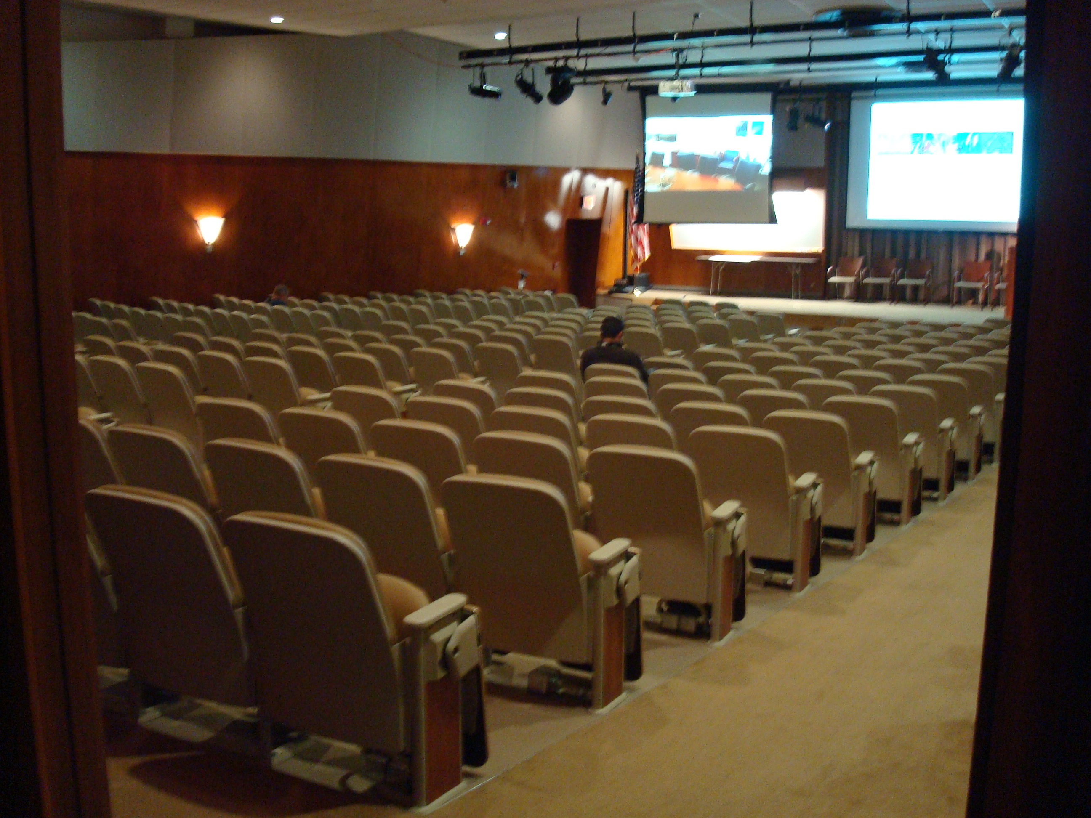
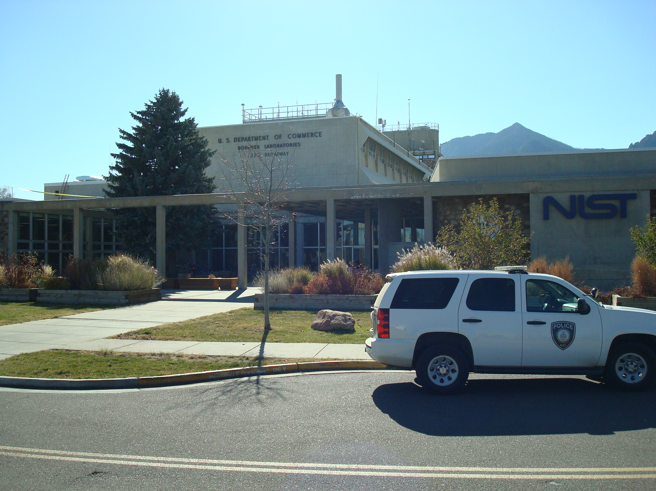
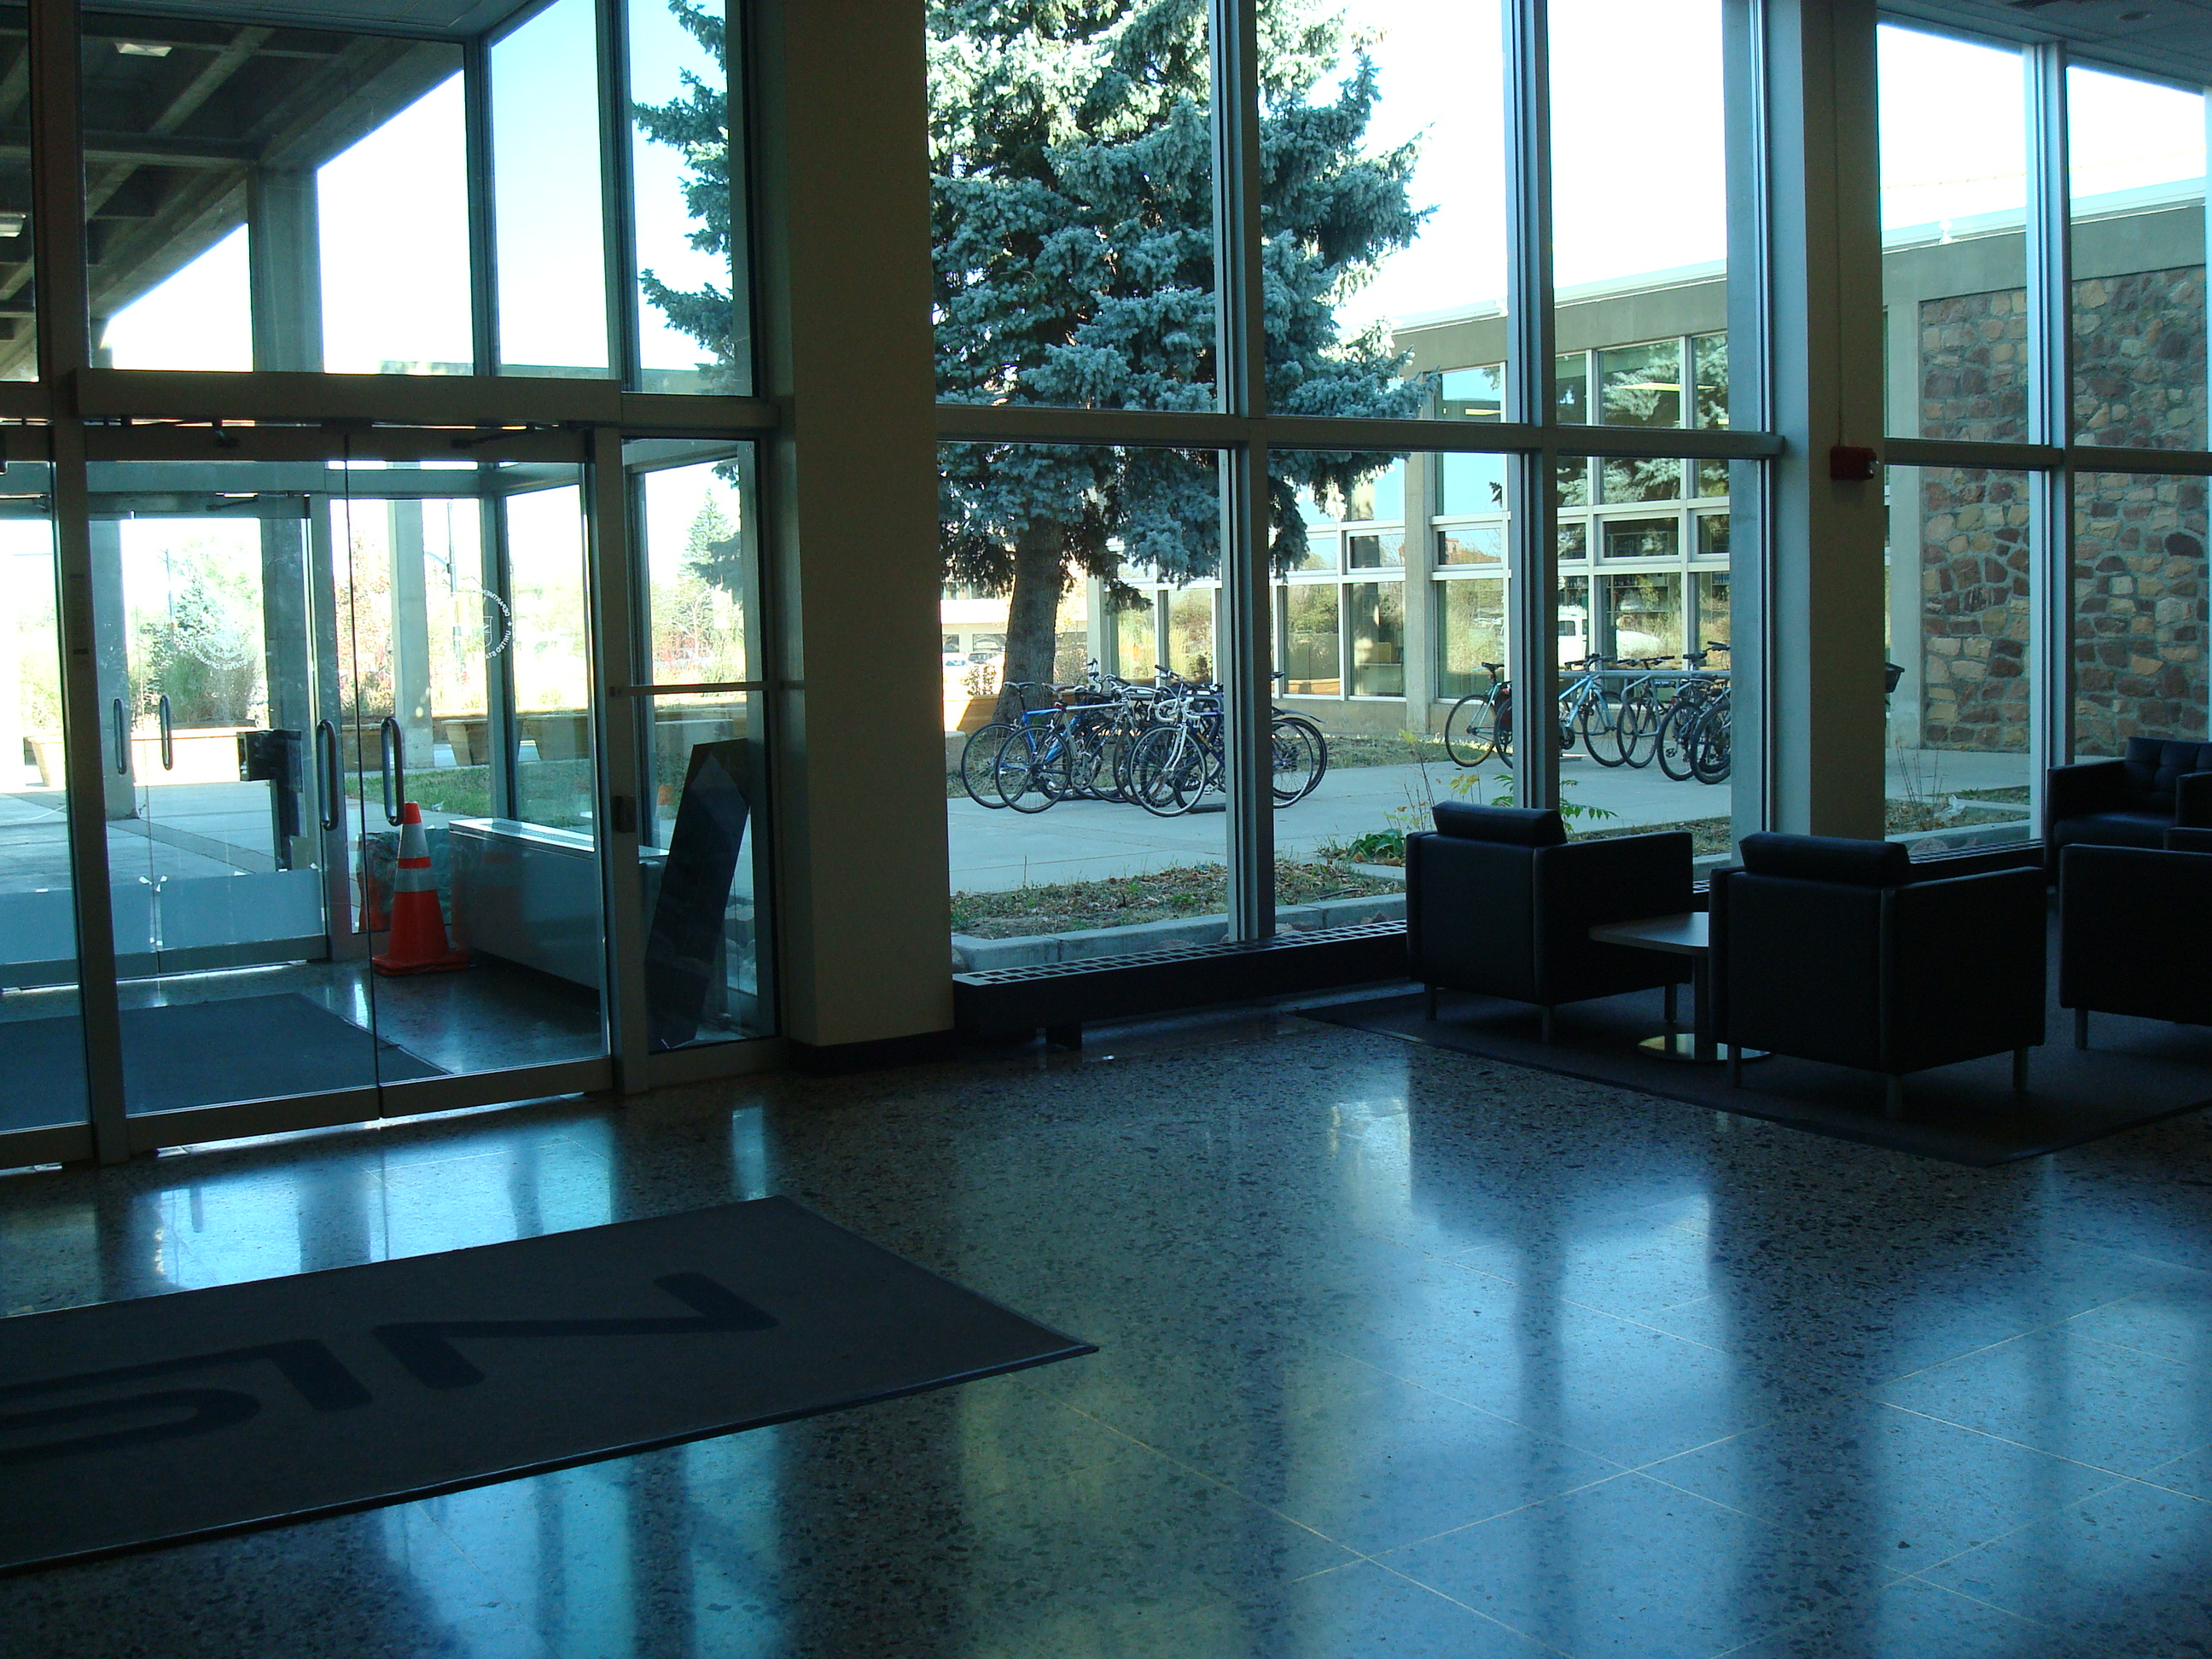
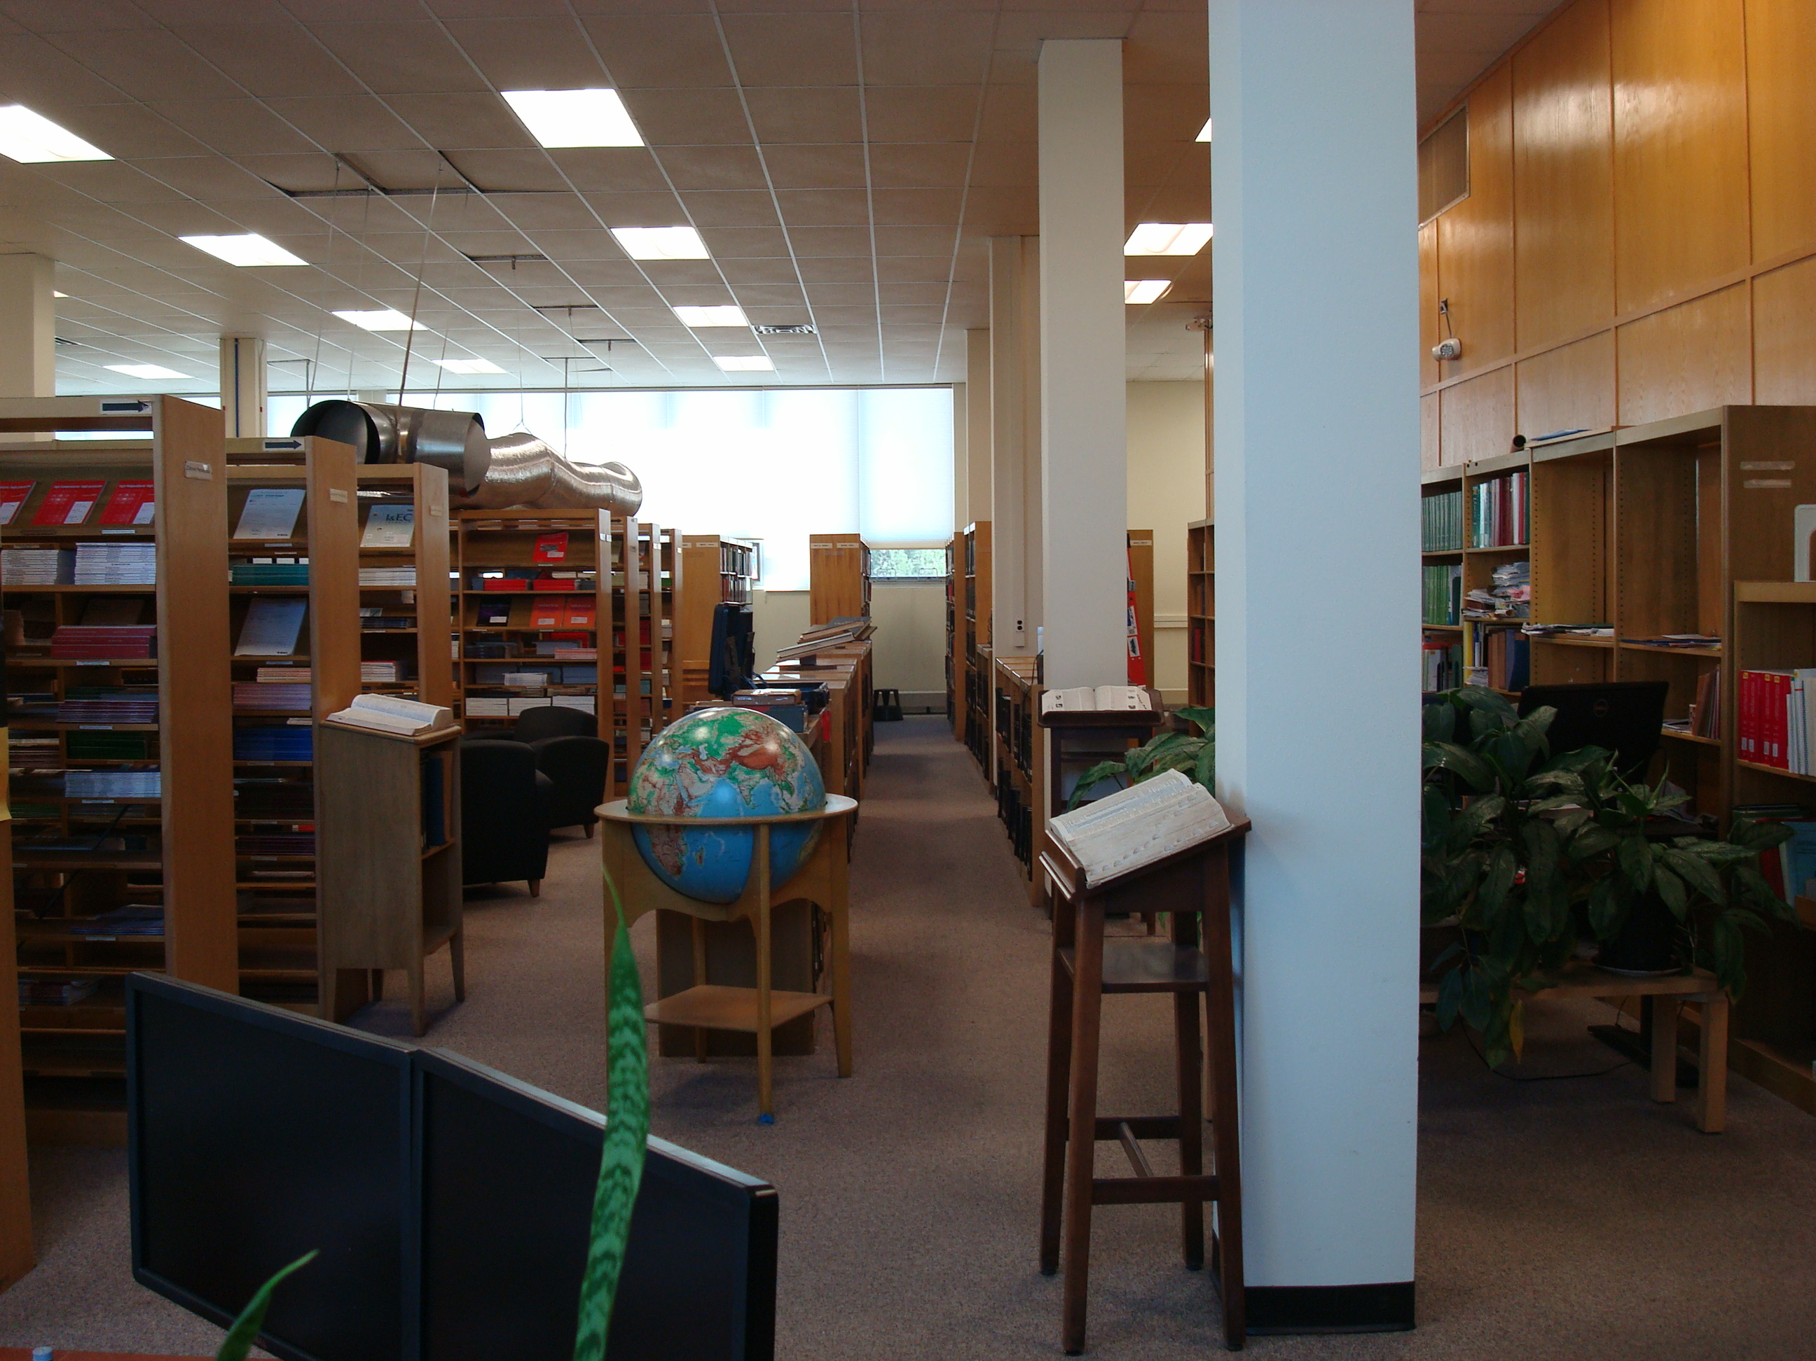
Surveyed Environments
AUDITORIUM
OPEN-SQUARE AREA
LOBBY
LIBRARY
What is the priority for IEEE 802.11ay?

