Slide 1
DL MU-MIMO Hybrid BF w/o CSI Feedback for 11ay
Date: 2016-11-xx
Authors:

Slide 2
Introduction
In [1], DL MU-MIMO scheme and CSI feedback for 802.11ay was introduced.
DL MU-MIMO throughput might be degraded due to CSI feedback overhead.
When AP can form multiple sharp beams, it enables DL MU-MIMO w/o CSI feedback.

Slide 3
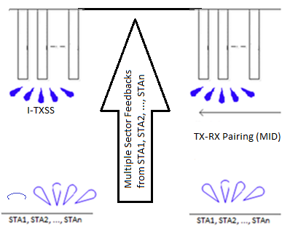
Overall Flow of MU-MIMO[1]
Step 1:
I-TXSS for TX Sector reduction,
Step 2:
Collect multiple TX sector feedbacks from STAs
Step 3:
TX-RX Pairing (MID) (combined TXSS + R-RXSS after TX sector reductin)
Step 4:
Collecting CSI feedbacks from STAs
Step 5:
MU-MIMO Transmission
AP
CSI feedback from STAs
STA
STA
STA
RX typically in Omni

Slide 4
CSI Feedback in 11ad
CSI can be reported in Channel Measurement Feedback element of BRP frame in 11ad
Payload size of the frame is calculated as
MAC Header(28) + FCS(4) + Body(14 + x) = 46 + x [octets]
x: Channel Measurement Feedback Element size
BRP frame
Octets
2
2
6
6
6
2
4
0-2328
4
Frame Control
Duration
Address 1
Address 2
Address 3
Sequence Control
HT Control
Frame Body
FCS
Octets
1
1
1
4
7
x
Category
Unprotected DMG Action
Dialog Token
BRP Request field
DMG Beam Refinement element
Channel Measurement Feedback element
CSI
Octets
1
1
N_{meas}
2N_{taps}N_{meas}
N_{taps}
N_{meas}
Element ID
Length
SNR
Channel Measurement
Tap Delay
Sector ID Order
N_{meas}: number of measurements
N_{taps}: number of taps

Slide 5
CSI Feedback Overhead
CSI feedback consumes about 3us ~ 4us per STA when each STA reports SNR & Channel measurement with MCS4 in 11ad
STF + CEF + Header : 2.5us
Payload length: 0.4 ~ 1.7us
Payload size: 46 + x octets
Channel Measurement Feedback element size(x): 2 + N_{meas} + 2N_{meas} octets (N_{meas}: up to 64) (when N_{taps} = 1)
MCS4 (Single Carrier): data rate is 1152Mbps
Total duration of CSI feedback from all STAs in MU-MIMO operation is estimated as several us or more.
Thus, DL MU-MIMO operation that cause little interference between STAs w/o CSI feedback is preferred.
Channel Measurement Feedback element
Octets
1
1
N_{meas}
2N_{meas}
Element ID
Length
SNR
Channel Measurement

Slide 6
DL MU-MIMO w/o CSI
When AP forms broad beams for DL MU-MIMO operation,
large interference occurs between beams
CSI is important to mitigate interference
But when AP forms sharp beams for DL MU-MIMO operation,
large interference does not occur between beams
CSI feedback (Step4) is not needed
MU-MIMO with broad beam
MU-MIMO with sharp beam
AP
STA
AP
STA
large interference
little interference
STA
STA

Slide 7
Conclusions
CSI feedback overhead in DL MU-MIMO operation is evaluated.
When AP forms sharp beams, DL MU-MIMO can be performed w/o CSI feedback.

Slide 8
STRAW POLL 1
Do you agree to insert the following text into the SFD “11ay supports MU-MIMO BF with or without CSI feedback.“
Yes
No
Abstain

Slide 9
Reference
[1] IEEE 802.11-16/0405r1, “11ay DL MU-MIMO BF Training and User Selection”

