Slide 1
Discussions for Non-contiguous Channel Bonding
Date: 2016-05-16
Authors:

Slide 2
Introduction
11ax D0.1 specifies non-contiguous channel bonding as follows [1]
The HE PHY provides support for 20 MHz, 40 MHz, 80 MHz and 160 MHz contiguous channel widths and support for 80+80 MHz non-contiguous channel width.
Tones of one or more secondary channels in 80 MHz and 160 (80+80) MHz could be nulled when using OFDMA PPDU transmission.
The modes of non-contiguous channel bonding are TBD.
The non-contiguous channels within primary or secondary 80 MHz only exists at AP side.
In this submission, we discuss several issues related to the non-contiguous channel bonding
signaling of non-contiguous channel bonding in SIG-A/B
transmission of the center 26-tone RU when the adjacent channel is nulled
interferences to OBSS on-going transmissions in nulled channels

Slide 3
HE-SIG-A’s BW field
L-STF
L-LTF
L-
SIG
R
L-
SIG
HE-
SIG-A
HE-
SIG-B
HE-
STF
HE-
LTF(s)
PSDU(s)
HE MU PPDU
In HE MU PPDU, SIG-A’s BW field is TBD that may accommodate more bandwidth options than in SU case
11ax may extend SIG-A’s BW field to explicitly signal non-contiguous bandwidth options (e.g. P20+S40)
Not many bit spaces left for the BW field
16 bits are remained for Spatial Reuse, TXOP, and BW fields
Field | # of Bits
UL/DL | 1
BSS Color | 6
Spatial Reuse | TBD
TXOP Duration | TBD
Bandwidth | >=2
SIG-B MCS | 3
SIG-B DCM | 1
SIG-B Num of SYM | 4
SIG-B Compression | 1
Num of HE-LTF SYM | 3
CP+LTF Size | 3
LDPC Extra SYM | 1
Packet Extension | 3
CRC | 4
Tail | 6
Total | 36 +SR+TXOP+BW =52

Slide 4
HE-SIG-B’s Common Block field
A
P20
L-Part
HE-
SIG-A
HE-SIG-B
(A,C)
HE-
STF/LTF
RU (A1)
...
RU (An)
B
S20
Dup.
L-Part
Dup.
HE-
SIG-A
HE-SIG-B
(B,D)
RU (Bn)
...
RU (Bn)
C
S40A
Dup.
L-Part
Dup.
HE-
SIG-A
HE-SIG-B
(A,C)
RU (X)
RU (C1)
...
D
S40B
Dup.
L-LTF
Dup.
HE-
SIG-A
HE-SIG-B
(B,D)
RU (Cn)
RU (D1)
...
RU (Dn)
1st content
channel
HE-SIG-B
(A,C)
RA
A
RA
C
C/T
STA
A1
...
STA
An
C/T
C/T
STA
C1
...
STA
Cn
C/T
TBD
STA
X
C/T
2nd content
channel
HE-SIG-B
(B,D)
RA
B
RA
D
C/T
STA
B1
...
STA
Bn
C/T
STA
D1
...
STA
Dn
C/T
*C/T: CRC/Tail
Common Block field
User Specific field
Two HE-SIG-B content channels are parallel-decoded at receiving STAs
In Common Block, RU allocation subfield signals RU arrangements in frequency domain and the number of User specific subfields
RU allocation subfield may signal “Null RU” indices to signal non-contiguous PPDU options (currently many TBD index ranges)

Slide 5
Signaling of non-contiguous channel-bonding
A
P20
L-Part
HE-
SIG-A
HE-SIG-B
(A,C)
HE-
STF/LTF
RU (A1)
...
RU (An)
B
S20
Dup.
L-Part
Dup.
HE-
SIG-A
HE-SIG-B
(B,D)
RU (Bn)
...
RU (Bn)
C
S40A
Dup.
L-Part
Dup.
HE-
SIG-A
HE-SIG-B
(A,C)
RU (X)
RU (C1)
...
D
S40B
Dup.
L-LTF
Dup.
HE-
SIG-A
HE-SIG-B
(B,D)
RU (Cn)
RU (D1)
nulled channel
...
RU (Dn)
(A) BW
(B) Common Block
AP can signal non-contiguous channel based PPDU constructions by
(A) Using SIG-A’s BW field
(B) Using SIG-B’s Common Block (RU allocation subfield)
(C) Using both SIG-A & SIG-B

Slide 6
Signaling of non-contiguous channel bonding
Objectives
Support various non-contiguous channel bonding options
Minimum signaling overhead on SIG-A/B
Limitations/Requirements
PPDU shall occupy Primary 20MHz
Support parallel decoding of SIG-B content channels
Fixed location of the second SIG-B content channel
Limit non-contiguous channel bonding rule to always occupy Primary 40
Flexible location of the second SIG-B content channel (within Primary 80)
Signal the location of the second SIG-B channel in SIG-B
No ambiguity on the number of common blocks in SIG-B
With SIG-A’s signaling, receiving STAs should know the number of common blocks in each SIG-B content channel

Slide 7
Option (A) SIG-A only signaling
L-Pre
SIG-A
SIG-B
1
HE-
STF
/LTF
MU
Data
1st SIG-B
Content Channel
Dup.
L-Pre
Dup.
SIG-A
SIG-B
2
Dup.
L-Pre
Dup.
SIG-A
Dup.
SIG-B
1
2nd SIG-B
Content Channel
Location of the
2nd SIG-B Channel
Dup.
L-Pre
Dup.
SIG-A
Dup.
SIG-B
2
...
BW
...
Comm.
Block
User
Specific
Size of the Common Block
(A) Using SIG-A’s BW field
Extend SIG-A’s BW field to signal non-contiguous channel bandwidth options (e.g. P20+S40)
BW field should clearly indicate the location of the 2nd SIG-B content channel (if it is not fixed) and the size of the common block

Slide 8
Option (B) SIG-B only signaling
CCA
(idle)
A
P20
L-Part
SIG-A
SIG-B
(A,C)
HE-
STF/LTF
RU (A1)
...
RU (An)
CCA
(idle)
B
S20
Dup.
L-Part
Dup.
HE-
SIG-A
SIG-B
(B,D)
RU (Bn)
...
RU (Bn)
CCA
(idle)
C
S40A
Dup.
L-Part
Dup.
HE-
SIG-A
Dup.
SIG-B
(A,C)
RU (X)
RU (C1)
...
CCA
(busy)
D
S40B
Dup.
L-LTF
Dup.
HE-
SIG-A
Dup.
SIG-B
(B,D)
RU (Cn)
RU (D1)
nulled channel
...
RU allocation
RU (Dn)
indices | #1 | #2 | #3 | #4 | #5 | #6 | #7 | #8 | #9 | # of Entries
... | ... |  |  |  |  |  |  |  |  | ...
TBD | 242 Null |  |  |  |  |  |  |  |  | 1
TBD | 484 Null |  |  |  |  |  |  |  |  | 1
TBD | 996 Null |  |  |  |  |  |  |  |  | 1
 | ...
HE-SIG-B
(A,C)
RA
A
RA
C
C/T
STA
A1
...
STA
An
C/T
C/T
STA
C1
...
STA
Cn
C/T
HE-SIG-B
(B,D)
RA
B
RA
D
C/T
STA
B1
...
STA
Bn
C/T
STA
D1
...
STA
Dn
C/T
(B) Using SIG-B’s Common Block field
SIG-A signals the current 4 BW options (20/40/80/160)
Add additional Null RU indices to the current RU allocation definition (currently there are many TBD index ranges)
RU allocation subfield signals “242/484/996 Null” to indicate nulled secondary channels
No user specific subfields are sent corresponding to the Null RUs
No additional signaling overheads on SIG-A/B bit fields compared to the current design
The Null RU indices can be reused in MU-MIMO signaling load balancing scenarios [2]

Slide 9
Option (C) SIG-A+SIG-B signaling
(C) Using both SIG-A and SIG-B to signal non-contiguous channel bonding options
SIG-A
SIG-A’s BW field signals limited information for non-contiguous PPDU BW
Even with the limited signaling, there should be no ambiguity of
Location of secondary SIG-B content channel (if it is dynamic)
Number of SIG-B’s common block
SIG-B
Further signaling of nulled secondary RUs

Slide 10
Transmission of the center 26-tone RU
L-Part
HE-
SIG-A
HE-SIG-B
(A,C)
HE-
STF/LTF
RU (A1)
...
RU (An)
Dup.
L-Part
Dup.
HE-
SIG-A
HE-SIG-B
(B,D)
RU (Bn)
...
RU (Bn)
the center 26-tone RU should also be nulled
Dup.
L-Part
Dup.
HE-
SIG-A
HE-SIG-B
(A,C)
RU (X)
RU (C1)
...
nulled
secondary channel
Dup.
L-LTF
Dup.
HE-
SIG-A
HE-SIG-B
(B,D)
RU (Cn)
RU (D1)
...
RU (Dn)
In 80MHz OFDMA, there is a center 26-tone RU and its signaling within HE-SIG-B content channels is TBD (e.g. 1st or 2nd, fixed or dynamic)
In non-contiguous channel PPDU, when a secondary channel adjacent to the center 26-tone RU is nulled, the center 26-tone RU also should be nulled
HE-SIG-B signaling should explicitly identify the existence of the center 26-tone RU even with the decoding failure of one SIG-B content channel

Slide 11
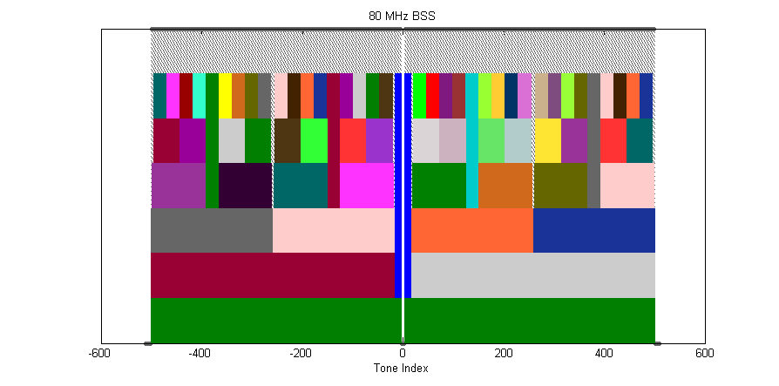
Interferences to OBSS
P20MHz
S20MHz
S40MHz
Nulled 20MHz
80MHz
Spectral Mask
(example)
may interfere OBSS’s on-going transmissions in nulled channels
Non-contiguous PPDU transmission may interfere OBSS’s on-going transmission due to the limited guard carriers adjacent to the nulled channel
TGax needs further discussions on how to minimize OBSS interferences in non-contiguous channel bonding

Slide 12
Conclusions
In this submission, we discussed several issues related to the non-contiguous channel bonding
Signaling of non-contiguous channel bonding by using SIG-A, SIG-B or SIG-A/B
Transmission of the center 26-tone RU in non-contiguous channel bonding
How to minimize interferences to on-going OBSS PPDUs in nulled channels

Slide 13
References
[1] 11-16/0024r1, Proposed TGax draft spec
[2] 11-16/0039r1, RU Allocation in SIG-B
[3] 11-16/0045r1, Flexible Wider Bandwidth Transmission
[4] 11-16/0059r1, Non-contiguous Channel Bonding in 11ax
[5] 11-16/0397r2, HE-SIG-B signaling discussions

Slide 14
Straw poll
Do you agree to add the following underlined text into 11ax SFD ?
3.1 General
The non-contiguous channel bonding will be supported in 802.11ax by:
Transmitting using OFDMA PPDU format by nulling the tones of one or more secondary channels in 80 MHz and 160 (80+80) MHz;
Modes for non-contiguous channel bonding are TBD;
Non-contiguous channels within primary or secondary 80 MHz only exists at AP side.
When a secondary channel adjacent to a center 26-tone RU is nulled, the center 26-tone RU is also nulled.
Y/N/A

