Slide 1
Channel Model for Outdoor Open Area Access Scenarios
Date: 2016-03-15
Authors:

Slide 2
Abstract
In this contribution, the channel measurement results in an outdoor environment in Niigata university campus at an mm-wave band of 58.5 GHz assuming an open area outdoor hotspot access scenario will be introduced.
Notes:
In our contribution, the channel measurement results in an outdoor environment in Niigata university campus at an mm-wave band of 58.5 GHz assuming an open area outdoor hotspot access scenario will be introduced.
Our contribution will include the following.
First, the dominant propagation mechanism is discussed by comparison between the measurement and ray-tracing simulation which identified up to the third order specular reflection from walls and ground, the penetration into glass, and the first order diffraction. The polarization properties of the observed dominant multi-path components will also be described by using their polarimetric path gain.
Second, the statistical channel parameters of random ray component are presented based on the existing quasi-deterministic (Q-D) approach.
For extraction of statistical channel parameters, the ray-tracing simulation calibrated by some measurement results was used to increase the number of channel realizations.
The proposed model (CM2) regards the first-order wall reflected paths from nearby surrounding buildings as well as the LoS and ground reflected paths as deterministic components. Then, the statistical properties of the other random components were parameterized.

Slide 3
Outline
Background
Channel measurement
Ray tracing simulation
Mechanism identification results
Channel modeling
Summary

Slide 4
Introduction
IEEE802.11ay
  Multi-Gb/s data throughput for WLANs
  In May 2015, the IEEE802.11 TGay group started for development of the new standard enhancing the efficiency and performance of existing IEEE 802.11ad specification providing WLANs connectivity in 60 GHz band
Increase the data transmission rates defined in IEEE 802.11ad from 7 Gbps up to 30 Gbps for growing demands of new broadband indoor and “outdoor applications”
Notes:
As you know, for multi-Gb/s data throughput for WLANs, in May 2015, the IEEE802.11 TGay group started for development of the new standard enhancing the efficiency and performance of existing IEEE 802.11ad specification providing WLANs connectivity in 60 GHz band.
It aims to increase the data transmission rates defined in IEEE 802.11ad from 7 Gbps up to 30 Gbps for growing demands of new broadband “outdoor applications” as well as indoor applications.

Slide 5
Channel Models
Indoor scenarios:
  Extension based on existing IEEE802.11ad model [3]
Outdoor scenarios:
  Extensive ray-tracing simulations and the results of new measurements are needed
  Existing MiWEBA model [1]
Our contribution
  Measurement campaign in an outdoor open area hot spot access scenario
  Investigation of dominant propagation mechanisms
  Channel model parameter extraction (Q-D model)
Notes:
The new channel models applicable for evaluation of the IEEE 802.11ay systems performance should be developed.
For indoor scenarios, extension of IEEE802.11ad indoor model is considered.
However, for outdoor scenarios, the channel models should be extended based on the existing channel models, or new model should be developed by using extensive ray-tracing simulations and the results of new experimental measurements, e.g., MiWEBA model.
Our contribution includes as following.
From the measurement campaign in an outdoor open area hot spot access scenario, dominant propagation mechanisms are discussed.
Further, the statistical channel parameters are presented based on the existing quasi-deterministic (Q-D) approach.
For extraction of statistical channel parameters, the ray-tracing simulation calibrated by some measurement results was used to increase the number of channel realizations.

Slide 6
Measurement Campaign

Slide 7




Mm-Wave MIMO Channel Sounder
Hardware configuration [6]
  Baseband: MIMO software defined radio testbed
  RF: commercial product (V60TXWG1/V60RXWG1, VubIQ)
  Feature
    Double directional measurement：rotating high gain horn antennas
    Full polarimetric measurement: dual-polar 2x2MIMO
Sounding signal：Newman phase multi-tone
$$φ_{n}=\frac{n^{2}π}{N}$$
$2B (=1/F_{s}$)
$T_{sym} (=1/Δ_{f}$)
phase
$$ℱ$$
time
Frequency
Notes:
For the developed channel sounder, we built up the system using a MIMO software defined radio testbed for baseband and commercial products of RF transceiver.
It is featured by double directional measurement rotating high gain horn antennas at both sides of Tx and Rx and full polarimetric measurement by using dual-polar 2x2 MIMO configuration.
The sounding signal was chirp sequence so called Newman phase multitone, where each sub-carrier has different phase as you can see this equation.

Slide 8
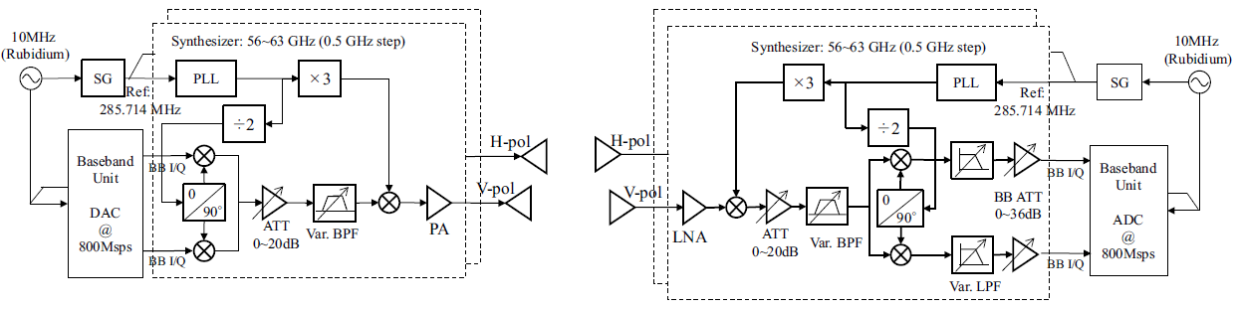
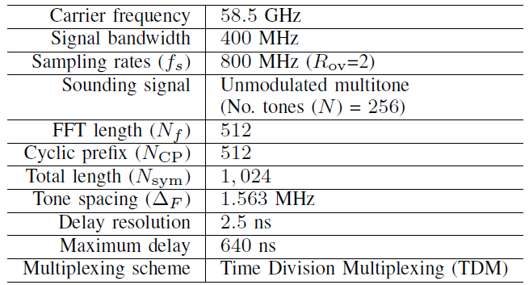
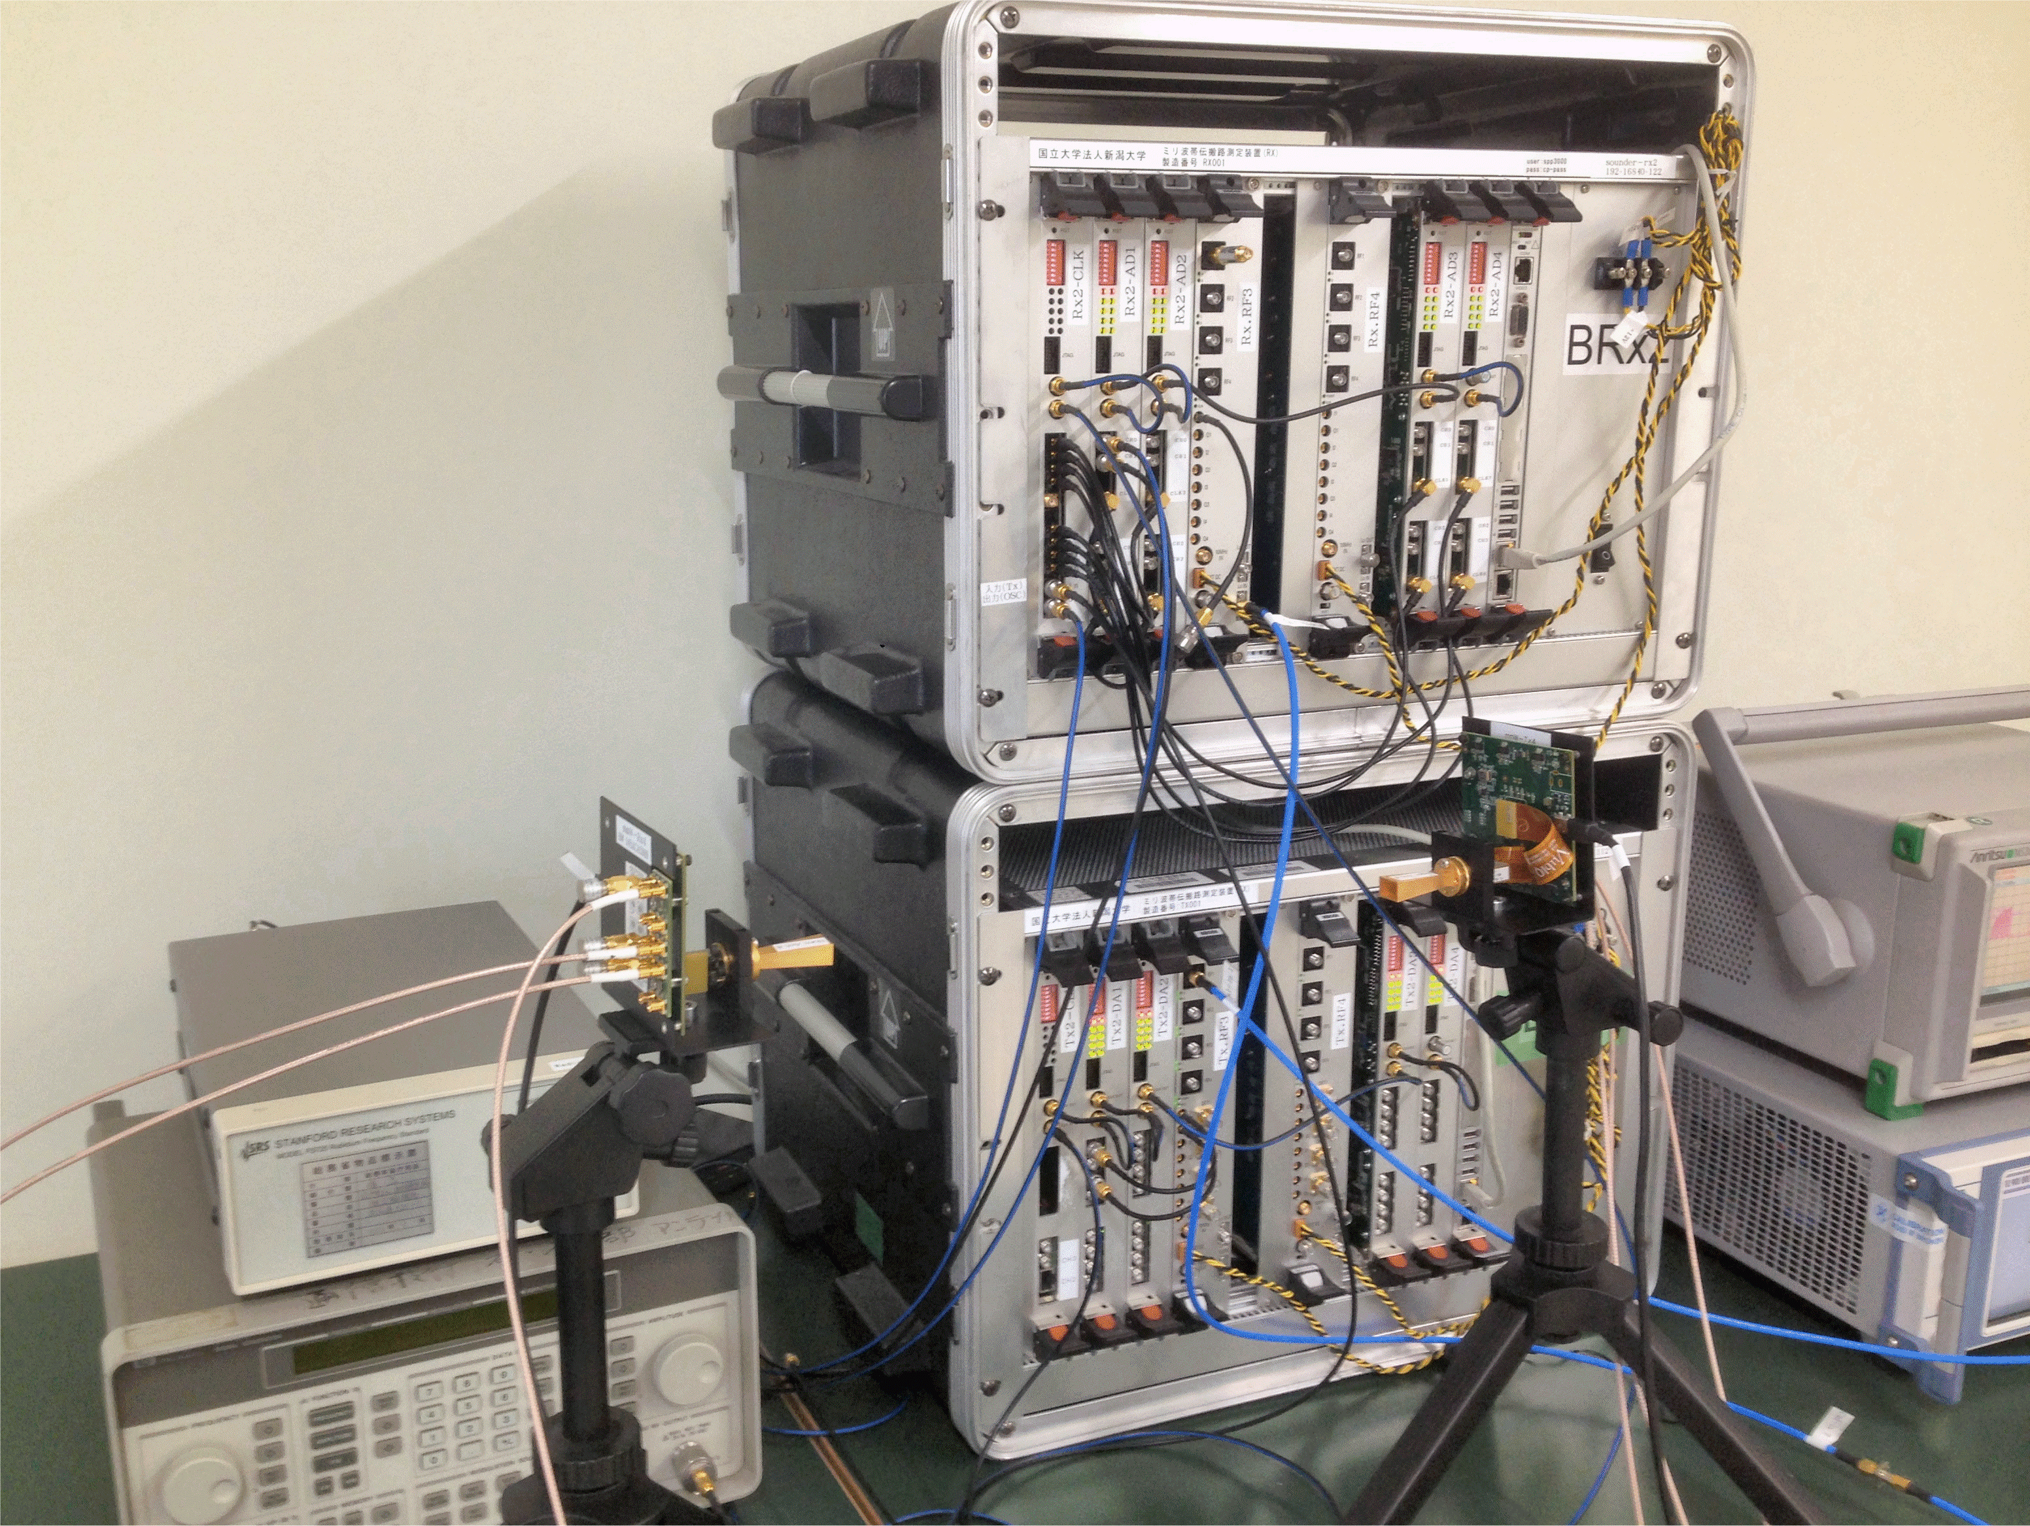
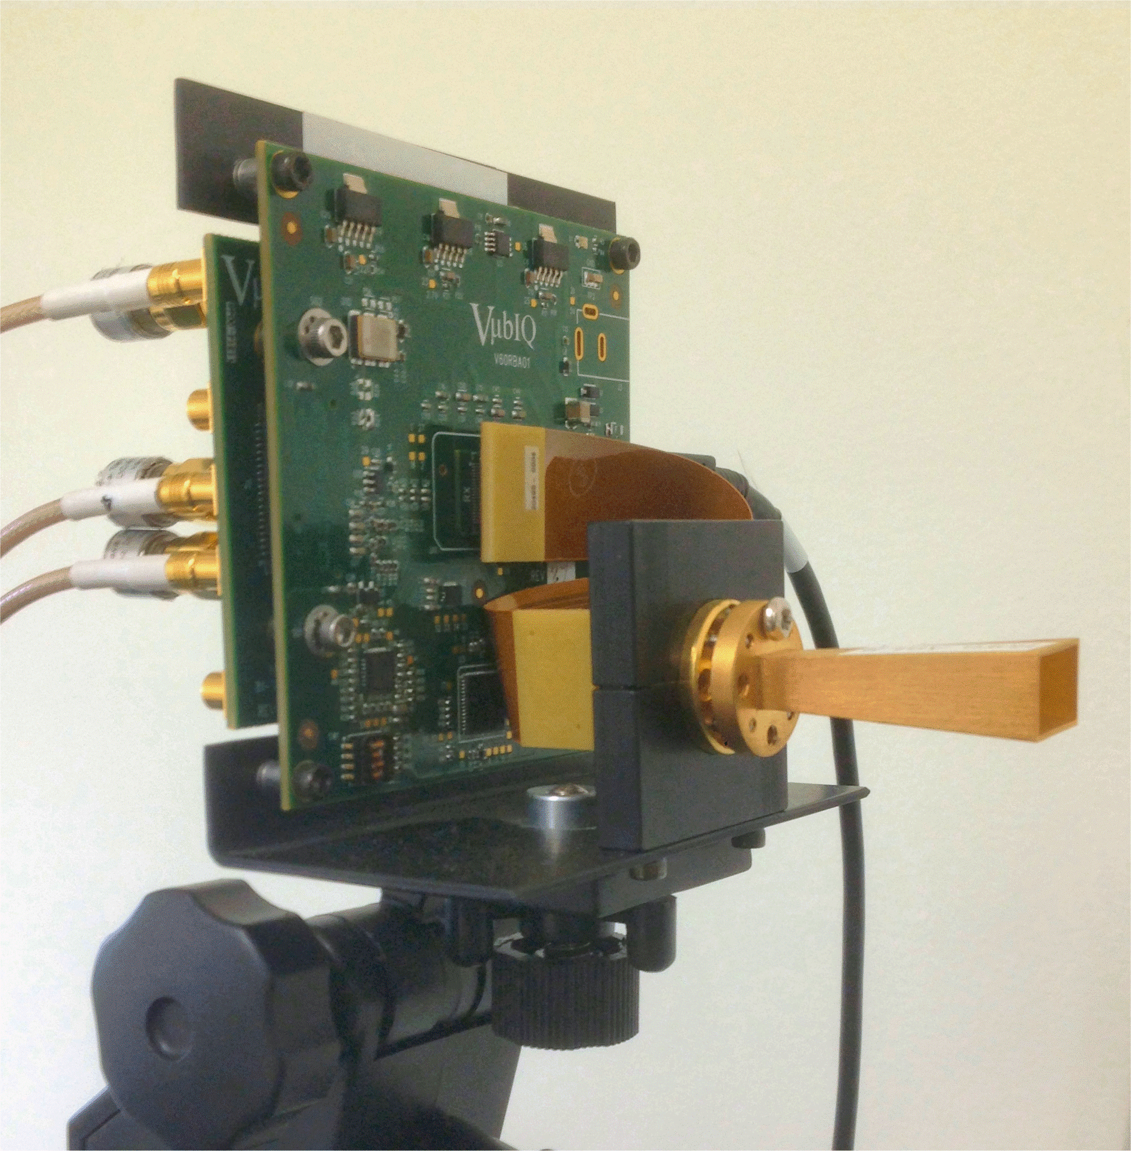
Channel Sounder Specifications
Rx BB
Rx
RF
Tx
RF
Tx BB
Notes:
The circuit schematic of the developed sounder is shown here. Based on 285MHz external LO, the PLL generates 17GHz, and then converted into 60GHz by frequency multiplier.
The exact frequency is 58.5 GHz with bandwidth of 400MHz. Tx power is 10dBm.
The number of multitone is 256, measurable maximum delay is 640ns. You can see the photograph of the system.

Slide 9
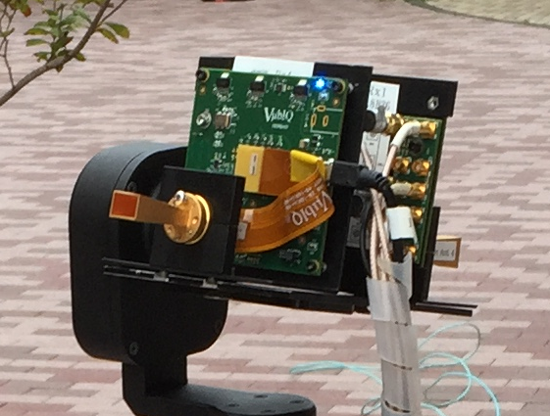
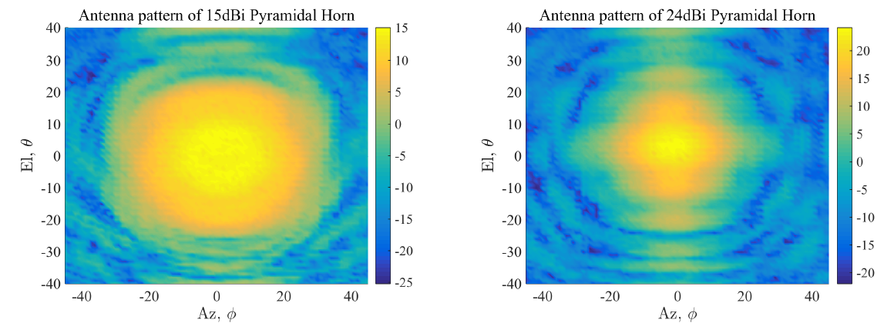




Channel Sounder Specifications (cont’d)
Full polarimetric double-directional measurement
Tx Antenna | 24dBi Pyramidal Horn
Rx Antenna | 15dBi Pyramidal Horn
Tx Antenna Rotation | Az:-180~+180, El:-24~+24 Step:12 deg.
Rx Antenna Rotation | Az:-180~+180, El:-30~+30 Step:30 deg.
Horn Antenna
$$φ‐pol$$
$$θ‐pol$$
Azimuth,$φ$
Elevation,$θ$
Notes:
As in the right figure, two antennas in different polarization are mounted for dual-polar measurement.
For directional channel acquisition, pyramidal horn antennas at both sides of Tx and Rx were panned and tilted in azimuth and elevation directions for obtaining channel transfer function for the specific angle.
The gains and beam width (HPBW) are 24 dBi and 12 degrees for Tx, and 15 dBi and 30 degrees for Rx, respectively.
The antenna radiation patterns are shown in these figures.

Slide 10
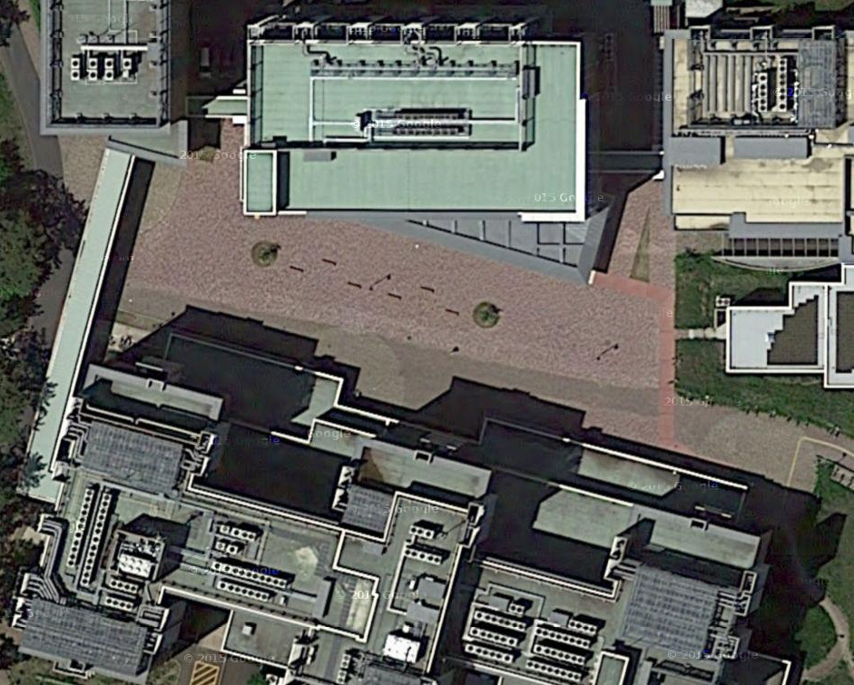
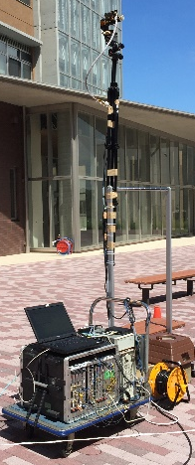
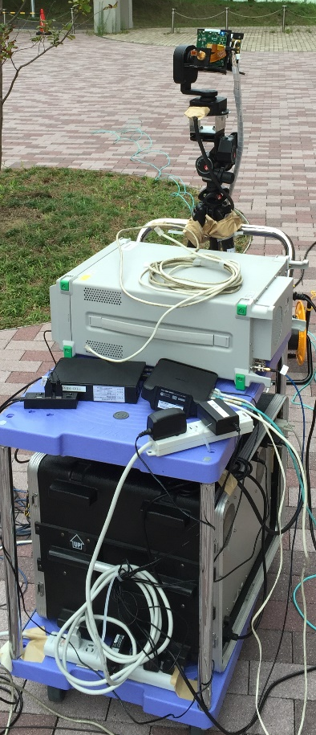
Measurement Campaign
University campus open square
Obstructed LoS (OLoS)
3m
1.35m
BS
MS_pos1
MS_pos3
MS_pos2
Line of Sight(LoS)
10m
Map data @Google, ZENRIN
Base Station(BS)
Mobile Station(MS)
Notes:
The measurement campaign was conducted in the area as shown here where some buildings are located at 20~30m far away from the BS antenna.
The distance between BS and MS antennas was approximately 30 m.
BS was located at around the center of the area and the channel transfer functions were measured at three MS positions.
MS pos1 and MS pos2 were in LoS condition and MS pos3 was in obstructed-LoS (OLoS) condition.
The antenna heights were 3 m for BS and 1.35 m for MS.

Slide 11


Data Processing
Double directional channel impulse response
Double directional angle delay power spectrum (DDADPS)
AoA
AoD
Polarization
$$h_{qp}\left(τ,θ_{i},φ_{j},θ_{m}^{′},φ_{n}^{′}\right)=ℱ^{−1}\left\{H_{qp}\left(f,θ_{i},φ_{j},θ_{m}^{′},φ_{n}^{′}\right)\right\}$$
$$p∈\left\{θ,φ\right\}$$
$$q∈\left\{θ,φ\right\}$$
$$P_{qp}\left(τ,θ_{i},φ_{j},θ_{m}^{′},φ_{n}^{′}\right)={\left|h_{qp}\left(τ,θ_{i},φ_{j},θ_{m}^{′},φ_{n}^{′}\right)\right|}^{2}$$
Notes:
I would like to briefly explain the data processing.
From measured angle-resolved channel transfer function for each polarization combination, the double directional channel impulse response is obtained by Fourier transform.
Double directional angle delay power spectrum (DDADPS) is defined as its power value.

Slide 12
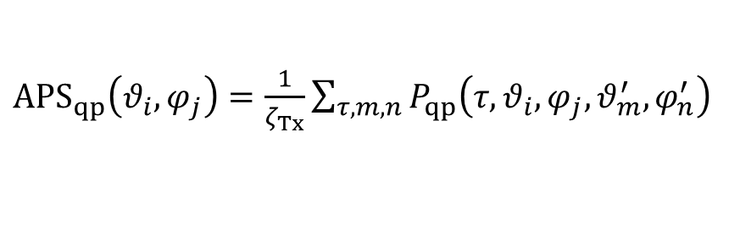
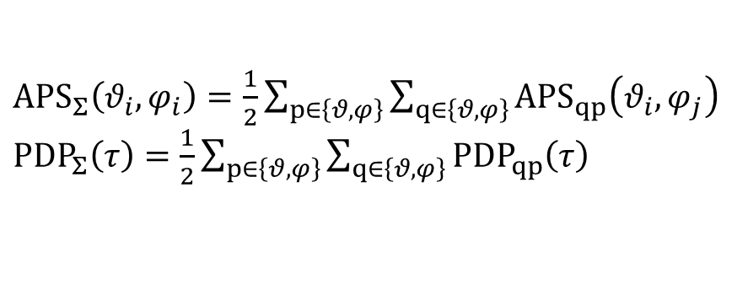
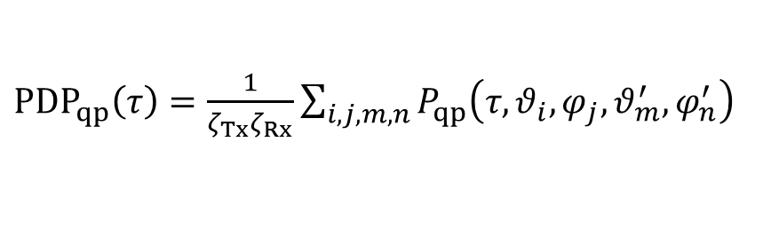
Data Processing (cont’d)
Synthetic spectrum (omni-directional)
Polarization combination
Angular power
spectrum
${APS}_{qp}\left(θ_{i},φ_{j}\right)=\frac{1}{ζ_{Tx}}\sum_{τ,m,n}{P_{qp}\left(τ,θ_{i},φ_{j},θ_{m}^{′},φ_{n}^{′}\right)}$
Power delay profile
${PDP}_{qp}\left(τ\right)=\frac{1}{ζ_{Tx}ζ_{Rx}}\sum_{i,j,m,n}{P_{qp}\left(τ,θ_{i},φ_{j},θ_{m}^{′},φ_{n}^{′}\right)}$
Gain correction
${APS}_{Σ}\left(θ_{i},φ_{i}\right)=\frac{1}{2}\sum_{p∈\left\{θ,φ\right\}}{\sum_{q∈\left\{θ,φ\right\}}{{APS}_{qp}\left(θ_{i},φ_{j}\right)}}$
${PDP}_{Σ}\left(τ\right)=\frac{1}{2}\sum_{p∈\left\{θ,φ\right\}}{\sum_{q∈\left\{θ,φ\right\}}{{PDP}_{qp}\left(τ\right)}}$
Notes:
Then, the omni-directional angular power spectrum (APS) at MS and the power delay profile (PDP) are synthesized by summing up the angle and delay domains as you can see this equations
Finally, we obtained APS and PDP combined by full polarimetric components.

Slide 13
Ray Tracing Setup
concrete
Frequency | 58.5 GHz
Antenna | Omni directional
Polarization | 0 and 90 deg.
Reflection count | 3 | 2
Penetration count | 2 | 2
Diffraction count | 0 | 1
Calculation method | Imaging method
Ground material | earth
glass
MS_pos1
LoS
OLoS
BS
(MS_pos1,2)
(MS_pos 3)
MS_pos2
MS_pos3
copper
Notes:
On the other hand, we also conducted RT simulation based on the 3D model over here.
3 Reflections and 2 penetrations were considered for LoS condition, but 2 reflections, 2 penetrations, and 1 diffraction were calculated for OLoS.

Slide 14
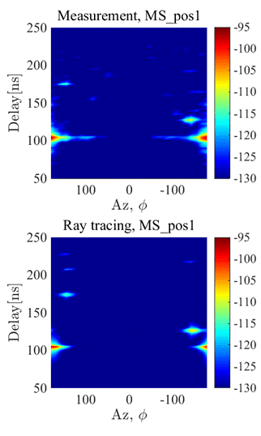
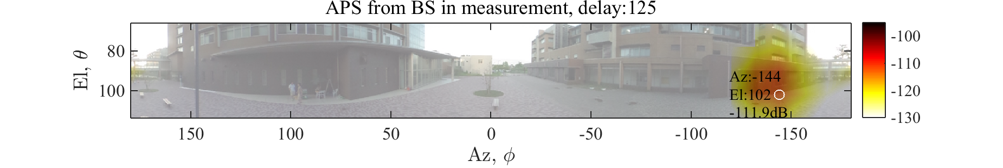
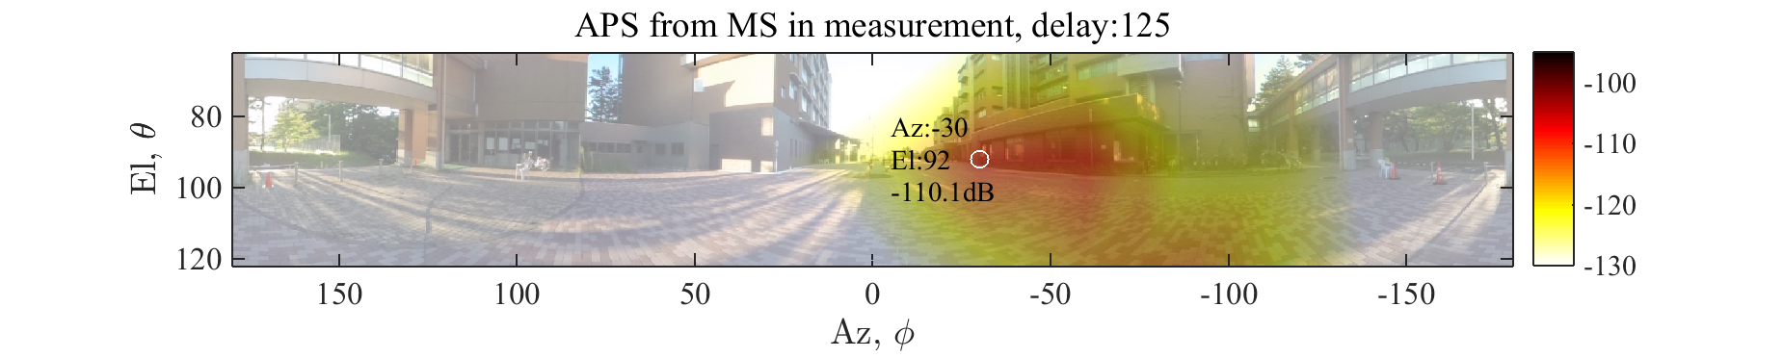
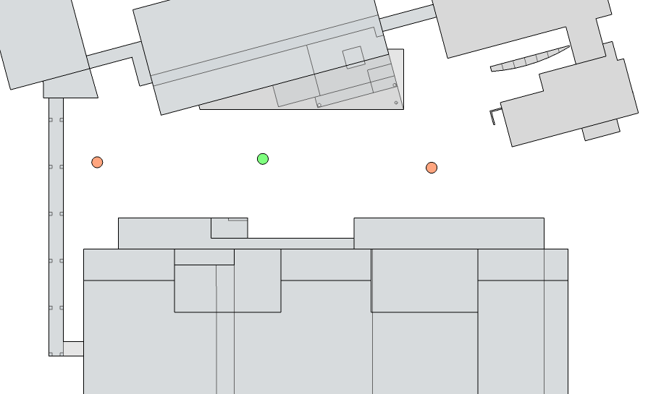
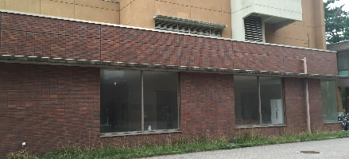
Propagation Mechanism (MS_pos1)
Single-Bounce Wall (SW) Reflection
SW/DW : Single-/ Double bounce Wall
ADPS@BS
DW
Tree
SW
LoS
DW
SW
MS
BS
$$+φ$$
$$φ=0$$
LoS
$$−φ$$
Notes:
For identifying the propagation mechanism for MS pos1, the angle-delay power spectrum at BS are shown here.
Upper and lower figures are the measurement and the ray tracing results, respectively.
We can see that the RT is well matched to the measurement showing only few reflected paths other than LoS.
The path with delay of 125 ns is identified as a single-bounce reflection from the wall by using measured angular power spectrum and the ray tracing result.

Slide 15
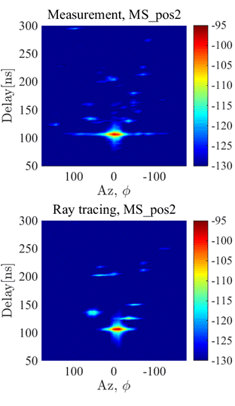
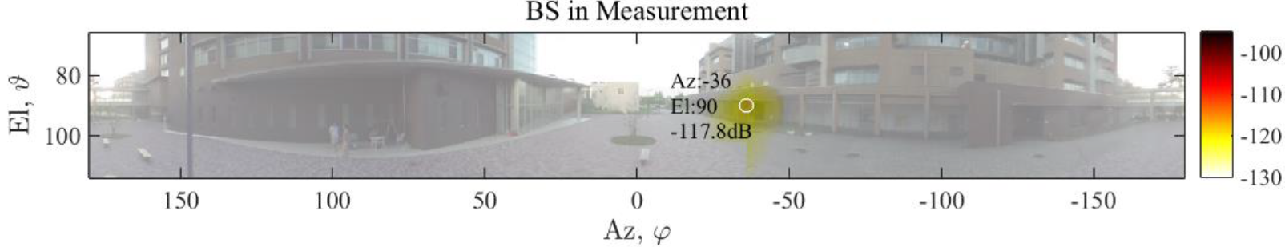
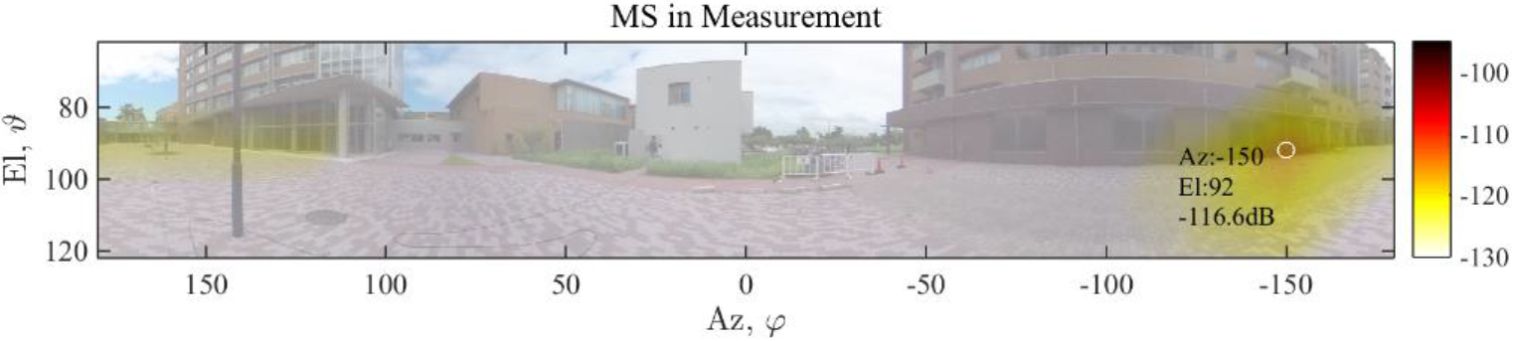

Propagation Mechanism (MS_pos2)
Single-Bounce Wall (SW) Reflection
DW
Weather
shed
DW
SW
SW
SW
Lamppost
LoS
DW
DW
MS
$$+φ$$
SW
SW
BS
$$φ=0$$
SW
LoS
$$−φ$$
Notes:
For MS_pos2, there are several multi-path components with single and double bounce but the power is not so significantly large.
In this figure, strongest single-bounce wall reflection is illustrated.

Slide 16
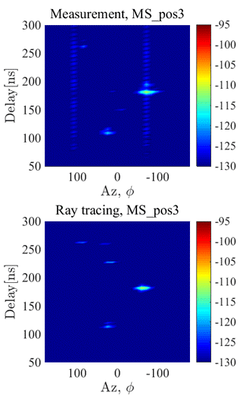
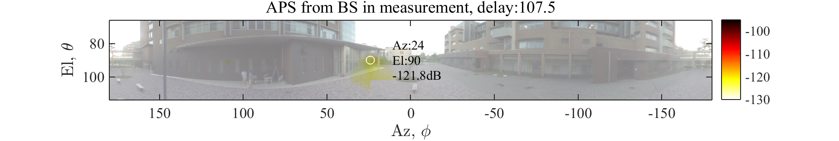
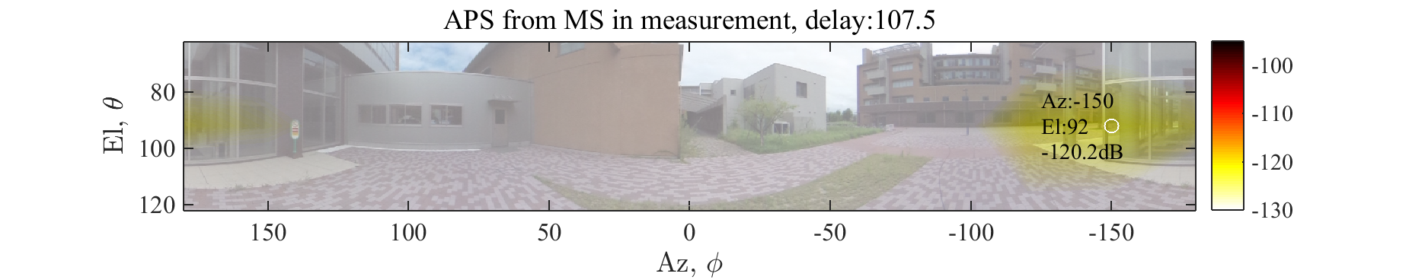
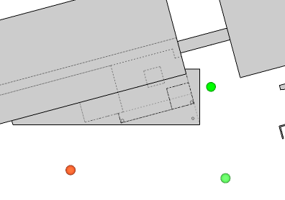
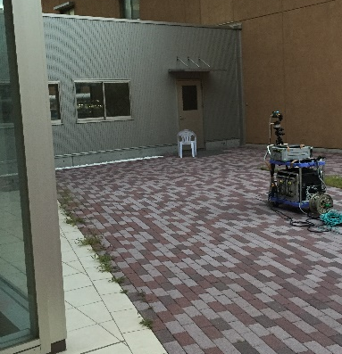

Propagation Mechanism (MS_pos3)
Edge Diffraction (ED)
ED : Edge Diffraction
DW
Weather
shed
SW
ED
DW
MS
SW
$$+φ$$
ED
$$φ=0$$
BS
$$−φ$$
Notes:
For MS_pos3 which is in obstructed-LoS condition, you can see that there are only few components of edge diffraction, single and double bounce reflection.
For edge diffraction, we can confirm it from these APS and is traced as you can see. The diffraction point is the metallic pillar.

Slide 17
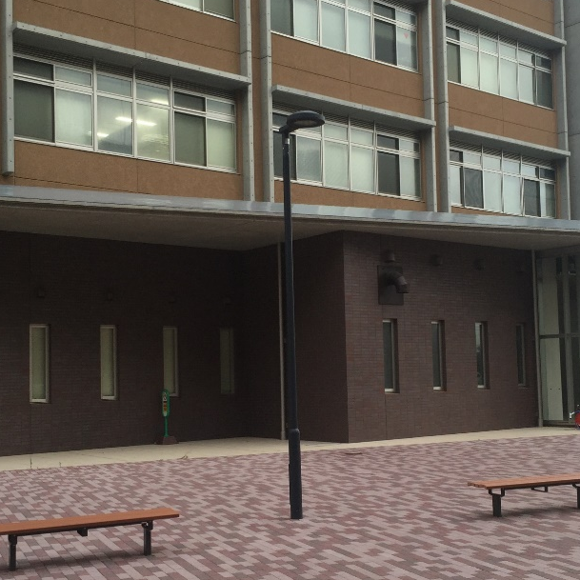
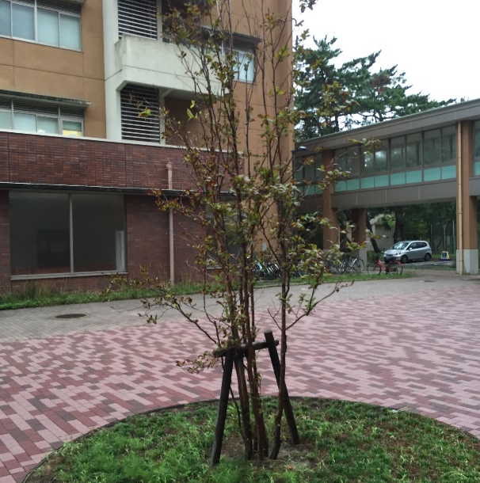
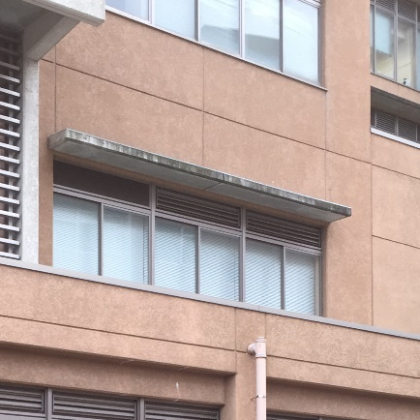
Scattering
Scattering
Interacting Obj. | Lamppost
Path gain | -112.6dB
Difference from direct path | -17.3dB
Interacting Obj. | Tree
Path gain | -115.5dB
Direct path from direct path | -17.7dB
Interacting Obj. | Weather Shed
Path gain | -115.5dB
Direct path from direct path | -17.7dB
Scattering
-17.7~-17.3 dB
Single-bounce
-16~-10 dB
Double-bounce
-19~-15 dB
Diffraction
-17.25 dB
Notes:
The ray tracing could successfully generate the dominant multi-path components.
The following scattering objects could not be modelled, and in reality relatively small power to the LoS component was observed in the measurement.
In summary, the relative power of the single-bounce and double-bounce reflection is ranged between -16 and -10, and -19 and -15, respectively.

Slide 18
Propagation Mechanism Summary
Strong single-bounce reflection from nearby buildings should be deterministically modeled
Notes:
This table shows the list of all observed paths for three MS positions.
From this results, we can see that strong single-bounce reflection from nearby buildings should be deterministically modeled.

Slide 19
Channel Modeling

Slide 20

IEEE802.11ay Outdoor Channel Model
Quasi-deterministic model based on MiWEBA [2]
Deterministic components
  LoS, Ground reflection, Near-wall reflection
  Determined by the location of Tx and Rx in the surrounding environment
Random components
  Reflection from far-away static objects
  and random objects
  Statistically modeled
Tx
Tx
ランダム成分
H_{Tx}
直接波
地面反射
Rx
Rx
φ
H_{Rx}
L
Open area model [2]
Notes:
IEEE802.11ay outdoor channel models are based on Quasi-deterministic model based on MiWEBA.
In this model, the approach builds on the representation of the millimeter-wave channel impulse response comprised of a few strong deterministic components (called D-rays) and a number of relatively weak random rays (called R-rays).
The deterministic components make the major contribution into the signal power, usually can be clearly identified as reflection from scenario-important macro objects, e.g., LoS, Ground reflection, and Near-wall reflection which are determined by the location of Tx and Rx in the surrounding environment.
On the other hand, the random components includes the reflections from far-away static objects and random objects which are statistically modeled.

Slide 21
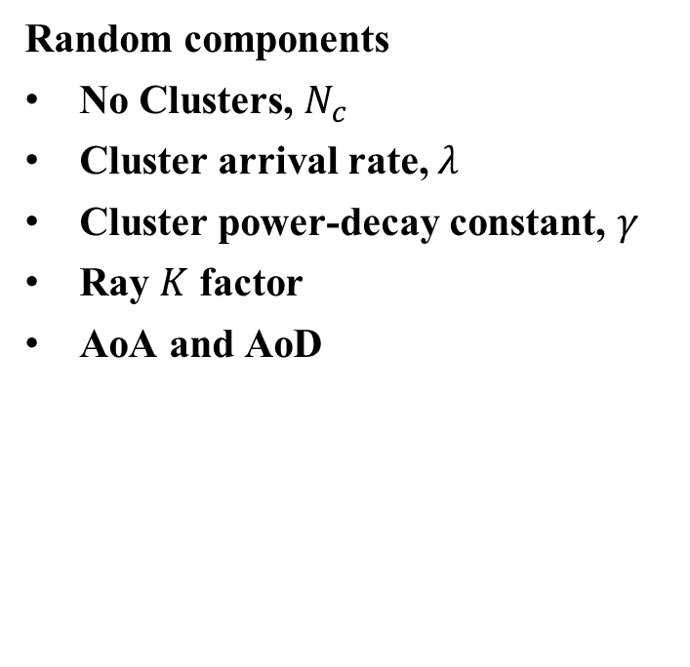
Channel Parameters
Deterministic components
Loss is calculated by Friis equation and Fresnel reflection equation
AoA (Angle-of-arrival), AoD (Angle-of-departure) and delay are determined by the location of Tx and Rx
Random components
No Clusters, $N_{c}$
Cluster arrival rate, $λ$
Cluster power-decay constant, $γ$
Ray $K$ factor
AoA and AoD
D-Ray
LoS Ray
R-Ray Cluster
Power
K
R-Ray
τ₀
τ₀+τ₁
time
1/λ
Notes:
The channel parameters of these two components are as following.
For deterministic components, loss is calculated by Friis equation and Fresnel reflection equation and
AoA (Angle-of-arrival), AoD (Angle-of-departure) and delay are determined by the location of Tx and Rx
The parameters of the random components includes No Clusters, 𝑁_𝑐, Cluster arrival rate, 𝜆, Cluster power-decay constant, 𝛾, Ray 𝐾 factor, AoA and AoD

Slide 22
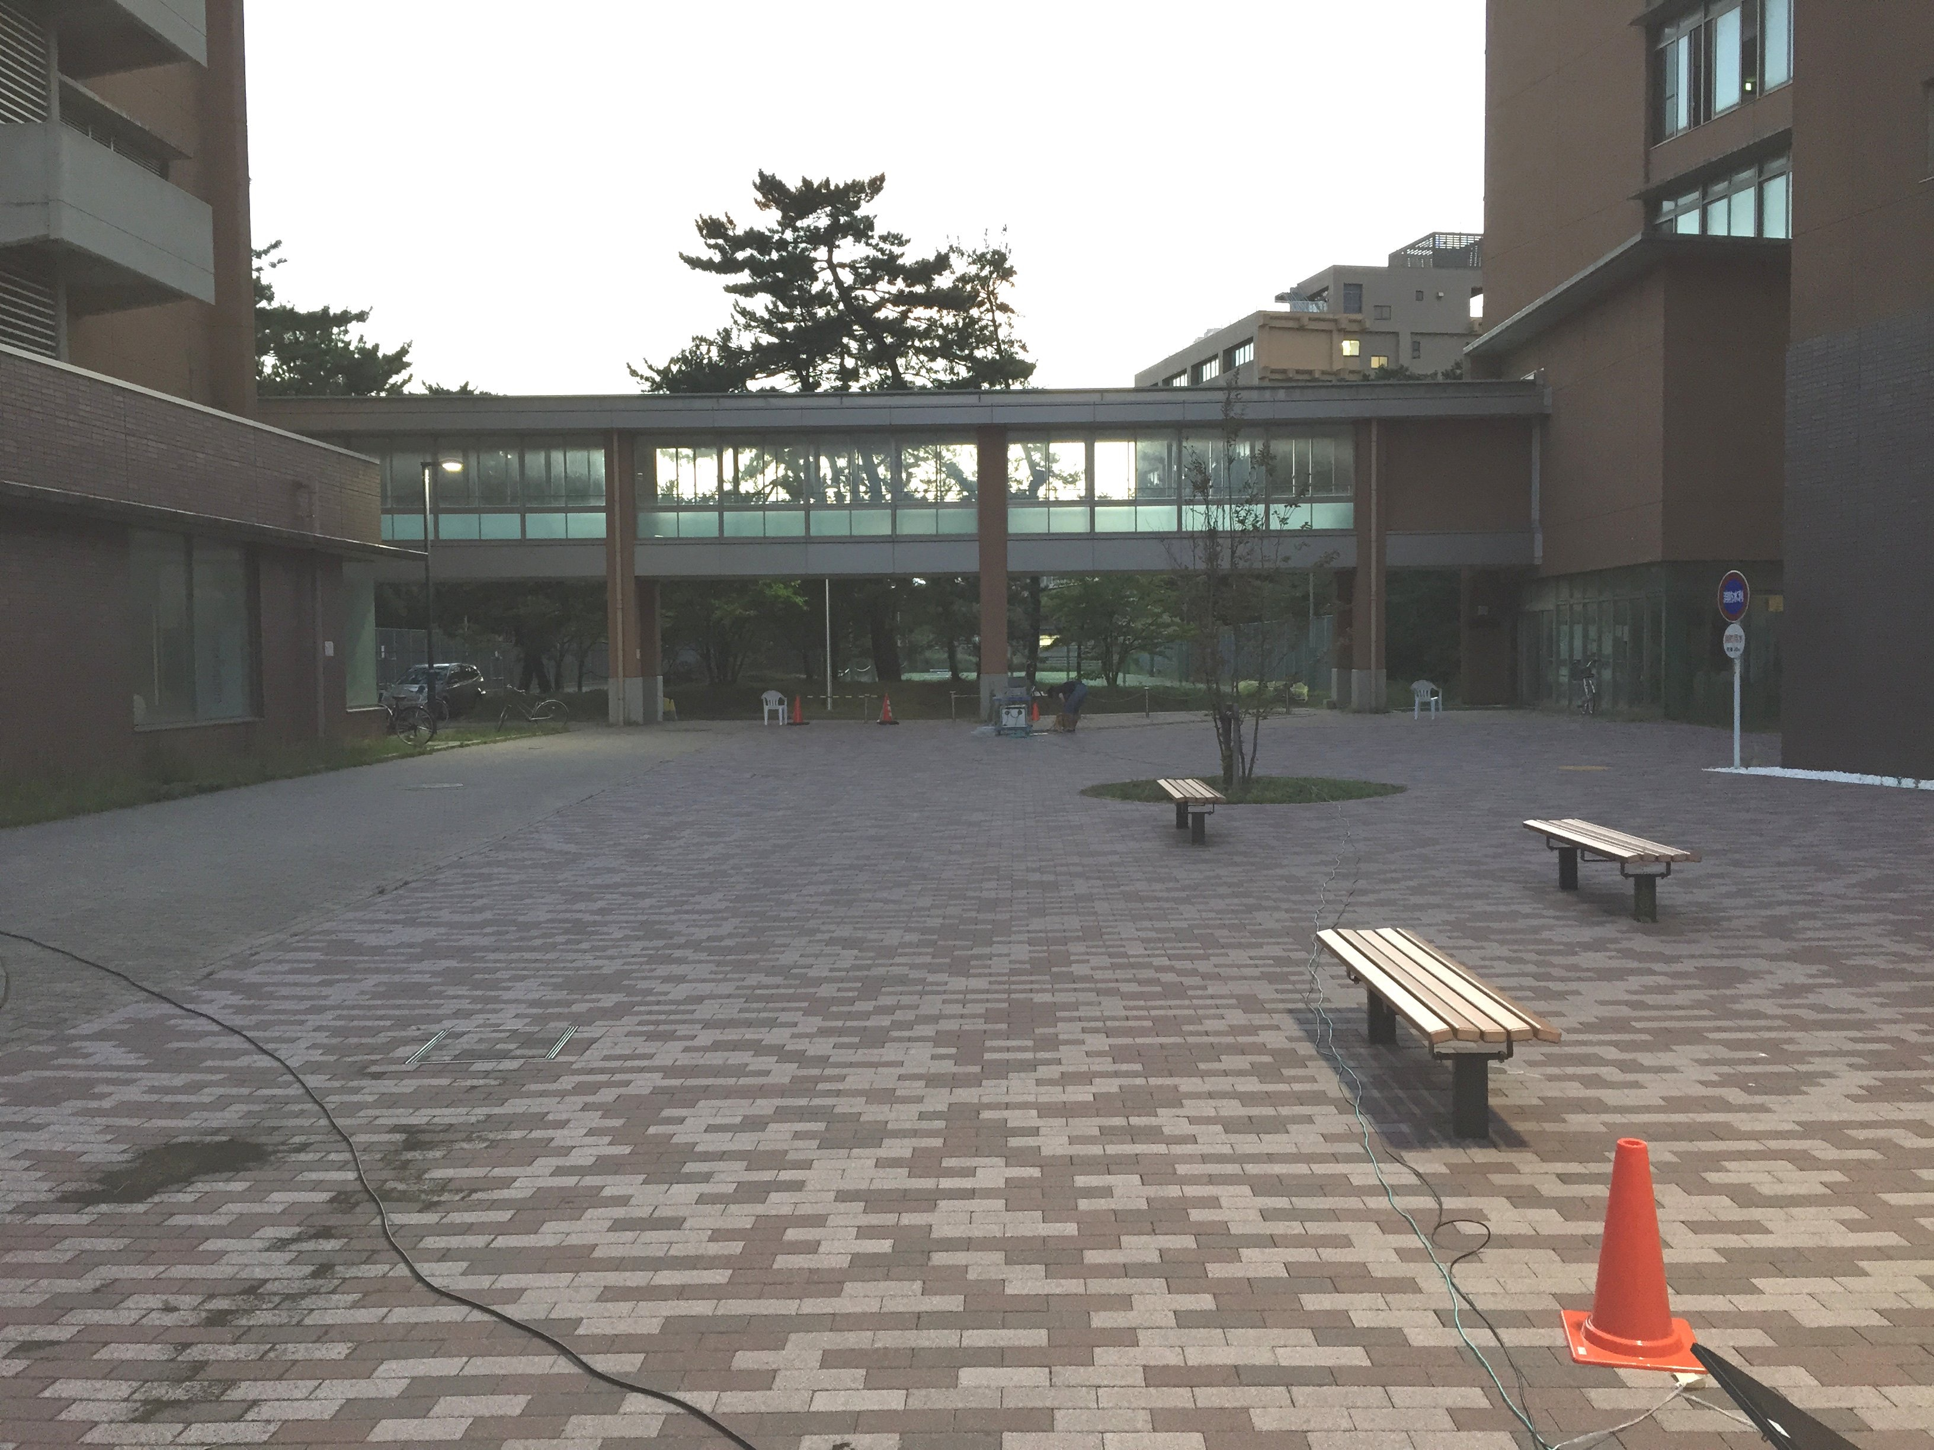
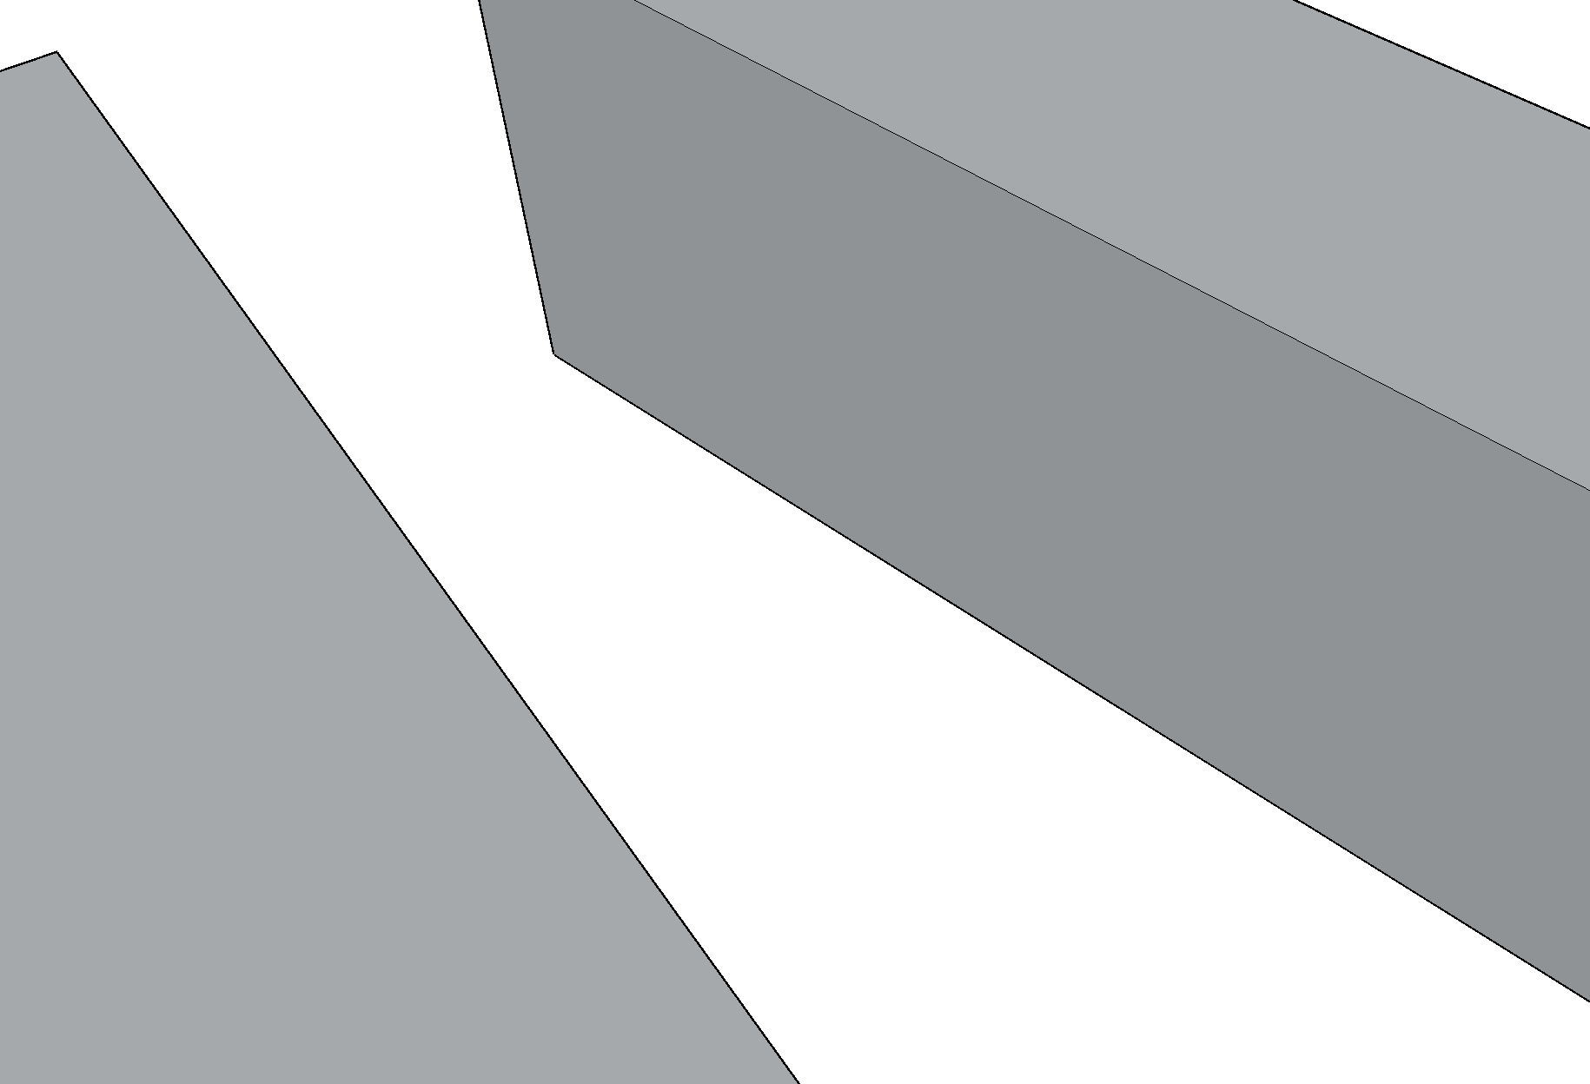
Developed Channel Models
CM1
Existing open area model
D-Ray: LoS and GR
CM2
Reflection from nearby buildings are taken into account as D-Ray
D-Ray: LoS, GR and single-bounce reflections from near walls
Tx
Tx
ランダム成分
H_{Tx}
直接波
Tx
地面反射
Rx
Rx
φ
H_{Rx}
Rx
L
Open area model [2]
Notes:
In this contribution, we evaluated two kind of models of CM1 and CM2.
CM1 is the same model as the existing open area model where LoS and Ground reflections are only considered as D-ray components.
However, as you can see in this figure, there are some surrounding buildings like a street canyon in the measurement environment.
Therefore, in CM2, the reflection from nearby buildings are taken into account as D-Ray, namely, D-Ray includes LoS, GR and single-bounce reflections from near walls.

Slide 23
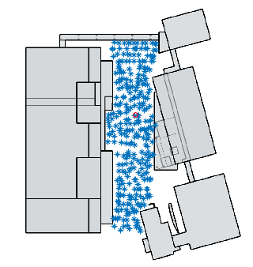
Developed Channel Models
Statistical parameters of R-Ray were extracted from ray tracing simulations
RT sim (Ref. cnt <=3)
Randomly selected 305 MS points
Elimination of LoS and GR
Removal of single-bounce wall reflection
（>-10dB LoS)
RT sim
（Ref. cnt<=1)
BS
Bandwidth limit &
Peak detection
R-Ray Parameterization
Notes:
For extraction of statistical channel parameters, the ray-tracing simulation calibrated by some measurement results was used to increase the number of channel realizations.
As you can see in this figure, the RT results were collected for randomly selected 305 MS points.
In the right side, the data processing flow is shown. From the ray tracing simulation with reflection counts up to 3, the LoS, GR and dominant wall reflections are removed.
Then, the statistical properties of the other random components were parameterized with the obtained paths from bandwidth limit and peak detection.

Slide 24
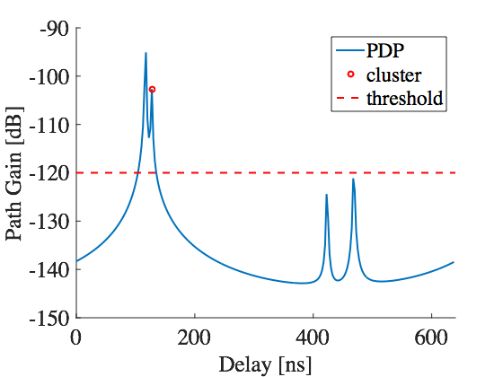
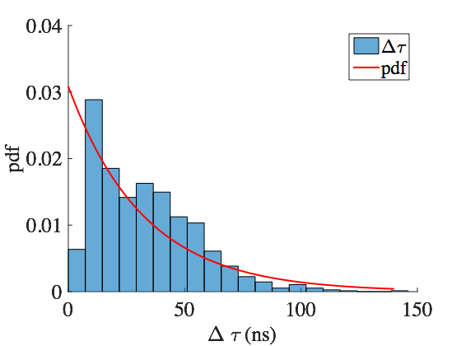


Delay Domain Parameters
D-Ray
LoS Ray
No. Clusters, $N_{c}$
  Peak detection with -120 dB threshold
Delay parameters
  Cluster delay, $τ_{k}$
  Exponential distribution
  Cluster arrival rate, λ
  $E\left[Δτ\right]=1/λ$
  where $Δτ=τ_{k}−τ_{k−1}$
K
R-Ray Cluster
Power (Exp decay)
R-Ray
τ₀
τ₀+τ₁
time
1/λ
$$p\left(τ_{k} | τ_{k−1}\right)=λe^{−λ(τ_{k}−τ_{k−1})}$$
Structure of impulse response
ピーク検出例
遅延時間差の確率密度分布
Notes:
First, the delay domain parameters based on the right figure are obtained as following.
In ray tracing simulation, the objects with simple and smooth surface are only modeled. and thus a detected ray is regarded as a cluster.
The clusters are extracted by peak detection with -120 dB threshold as you can see in lower left figure.
For the detected clusters, number of clusters and cluster delay which is modeled by exponential distribution, and cluster arrival rate.

Slide 25
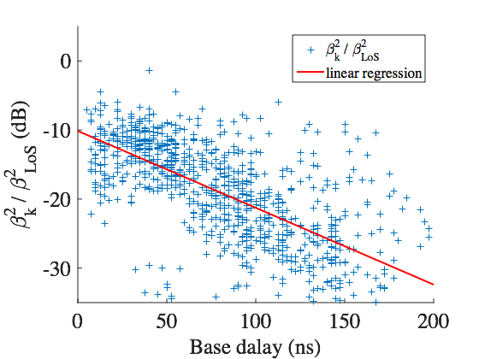
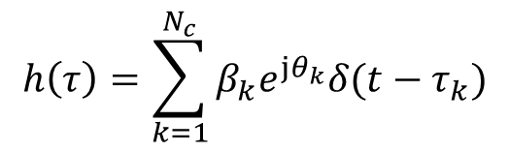


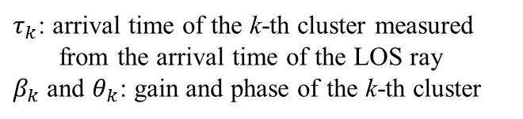
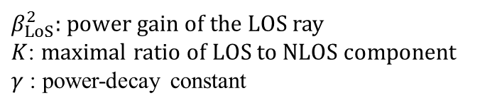
Delay Domain Parameters (Cont’d)
D-Ray
LoS Ray
Impulse response
Average gain
K
R-Ray Cluster
Power (Exp decay)
R-Ray
$$h\left(τ\right)=\sum_{k=1}^{N_{c}}{β_{k}e^{jθ_{k}}δ(t−τ_{k})}$$
$τ_{k}$: arrival time of the k-th cluster measured
from the arrival time of the LOS ray
$β_{k}$ and $θ_{k}$: gain and phase of the k-th cluster
τ₀
τ₀+τ₁
time
1/λ
Structure of impulse response
$$\overline{β_{k}^{2}}≡\overline{β^{2}\left(τ_{k}\right)}=\overline{β^{2}\left(0\right)}e^{−τ_{k}/γ}$$
where $\overline{β^{2}\left(0\right)}=β_{LoS}^{2}/K$
$β_{LoS}^{2}$: power gain of the LOS ray
$K$: maximal ratio of LOS to NLOS component
$γ$: power-decay constant
Notes:
The channel impulse response is represented by the linear combination of individual clusters as this expression.
Beta and theta denote gain and phase of the cluster.
The relative gain of the cluster in terms of the base delay is obtained by commonly used exponential decay model as you can see in the right figure.

Slide 26

Angular Domain Parameters
(Cluster Angle)
Azimuth angle
  Uniform distribution
Elevation angle
  Uniform distribution
  Depends on Tx and Rx position
  Normalized elevation angle
$$\hat{θ}=\frac{θ−θ_{D0}}{\left|θ_{D0}−θ_{G0}\right|}$$
D0: Direct path
G0: Ground Reflection
ピーク検出例
遅延時間差の確率密度分布
Notes:
Regarding the angular domain parameters of the random ray components, cluster angles are modeled by some well known distribution functions.
Azimuth angles of AoA and AoD can be modeled by uniform distribution which is quite reasonable for any general environments.
Elevation angles can also be modeled by uniform distribution, but the coverage range should be flexible because they are determined by Tx and Rx position as you can see the upper right figure.
Normalized elevation angle as expressed here is introduced.

Slide 27
Angular Domain Parameters
(Cluster Angle)
CM2
Notes:
This slide shows PDFs of cluster angles, namely, azimuth and elevation of AoA, and azimuth and elevation of AoD, respectively.
All empirical distributions are modeled by uniform distribution where the parameters were obtained by the least square method.

Slide 28
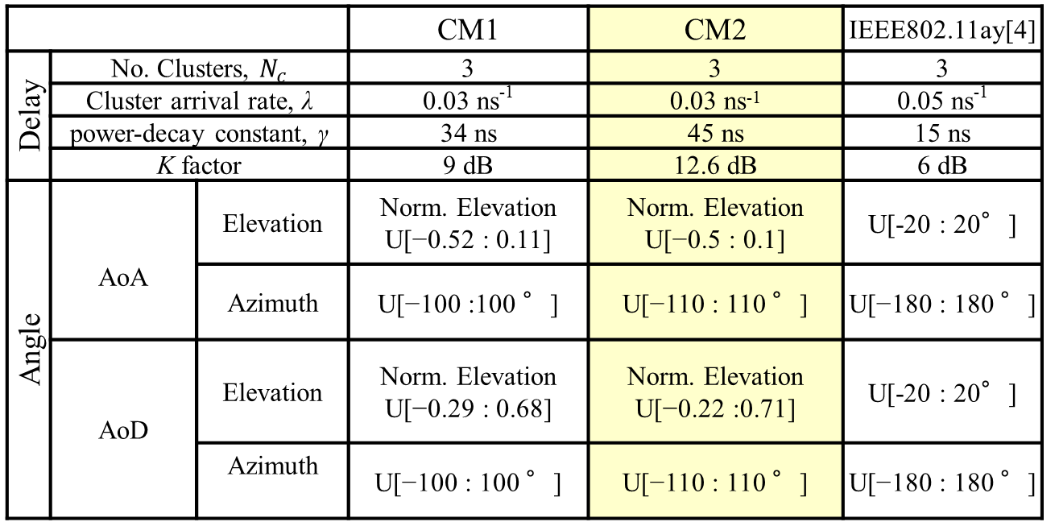
Summary of R-Ray Parameters
 |  |  | CM1 | CM2 | IEEE802.11ay[4]
Delay | No. Clusters, $N_{c}$ |  | 3 | 3 | 3
 | Cluster arrival rate, λ |  | 0.03 ns⁻¹ | 0.03 ns⁻¹ | 0.05 ns⁻¹
 | power-decay constant, γ |  | 34 ns | 45 ns | 15 ns
 | K factor |  | 9 dB | 12.6 dB | 6 dB
Angle | AoA | Elevation | Norm. Elevation U[−0.52 : 0.11] | Norm. Elevation U[−0.5 : 0.1] | U[-20 : 20°]
 |  | Azimuth | U[−100 :100 °] | U[−110 : 110 °] | U[−180 : 180 °]
 | AoD | Elevation | Norm. Elevation U[−0.29 : 0.68] | Norm. Elevation U[−0.22 :0.71] | U[-20 : 20°]
 |  | Azimuth | U[−100 : 100 °] | U[−110 : 110 °] | U[−180 : 180 °]
[3] MiWEBA, FP7 ICT-2013-EU-Japan, http://www.miweba.eu
Notes:
This table summarizes the R-Ray parameters of CM1, CM2 (which excluded single-bounce wall reflections) and existing MiWEBA model.
Regarding delay domain characteristic, the power decay constant of the proposed model is smaller than MiWEBA model.
On the other hand, in the angular characteristic, the proposed model has much wider distribution in azimuth.
In this work, the elevation is newly modeled by the normalized angle for Tx and Rx position dependency.

Slide 29
Summary
The dominant propagation mechanism in an outdoor open area environment
  Reflection: single-bounce (-16~-10dB), double-bounce (-19~-15 dB)
  Diffraction (-17.25 dB)
Statistical parameters of R-Ray from ray tracing simulation
  New model (CM2) considers the reflection from the nearby walls as D-Ray
Future works
  Detail investigation of the objects causing non-specular reflection
  Further measurements and channel modeling

Slide 30
References
[1] MiWEBA, FP7 ICT-2013-EU-Japan, http://www.miweba.eu
[2] METIS, FP7 ICT-317669-METIS, http://www.metis2020.eu
[3] “Channel Models for 60 GHz WLAN Systems,” IEEE Document 802.11-09/0334r8, May 2010.
[4] “Channel Models for IEEE 802.11ay,” IEEE Document 802.11-15/1150r2, Sept. 2015.
[5] Minseok Kim, Karma Wangchuk, Shigenobu Sasaki, Kazuhiko Fukawa, Jun-ichi Takada, “Development of Low Cost Mm-Wave Radio Channel Sounder and Phase Noise Calibration Scheme,” COST Action IC1004(EU), TD(15)12036, Jan. 2015 (Dublin, Ireland).
[6] Minseok Kim, Kento Umeki, Karma Wangchuk, Jun-ichi Takada, Shigenobu Sasaki, “Polarimetric Mm-Wave Channel Measurement and Characterization in a Small Office,” Proc. PIMRC 2015, Aug. 2015.

Slide 31
Elevation Angle

