Slide 1
LP-WUR (Low-Power Wake-Up Receiver) Follow-Up
Date: 2016-03-14
Authors:

Slide 2
Introduction
In the November meeting, LP-WUR (low-power wake-up receiver) [1] was introduced to WNG and received strong support for standardization in the 802.11 WG
Result of the following straw poll in [1]:
“Do you support the basic concept of the LP-WUR technique in this presentation for standardization in the 802.11WG?
Y: 65, N: 1, A: 51”
In the January meeting, the basic concept of LP-WUR was introduced in LRLP TIG [2]
In this presentation, we present details of LP-WUR
Wakeup packet design
Wakeup packet generation
Functions of LP-WUR

Slide 3
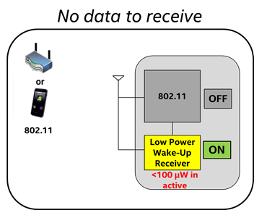
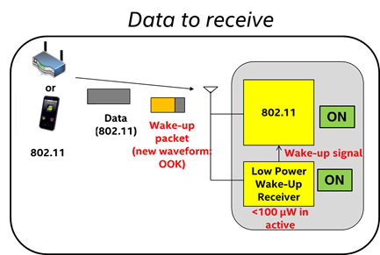
Recap: Low-Power Wake-Up Receiver (LP-WUR) as Companion Radio for 802.11
Comm. Subsystem = Main radio (802.11) + LP-WUR
Main radio (802.11): for user data transmission and reception
Main radio is off unless there is something to transmit
LP-WUR wakes up the main radio when there is a packet to receive
User data is transmitted and received by the main radio
LP-WUR: not for user data; serves as a simple “wake-up” receiver for the main radio
LP-WUR is a simple receiver (doesn’t have a transmitter)
Active while the main radio is off
Target power consumption < 100 µW in the active state
Simple modulation scheme such as On-Off-Keying (OOK)
Narrow bandwidth (e.g. < 5 MHz)
Target transmission range: LP-WUR = Today’s 802.11

Slide 4
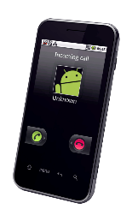
Recap: Design and Operation of LP-WUR
Transmission range
or
Data
Packet
802.11 = LP-WUR
Transmitter
Receiver
802.11
802.11
802.11
802.11
ON
OFF
OFF
+
ON
802.11
Wake-up Packet
Wake-up signal
LP-WUR
ON
Wake-up Packet
Extremely low power receiver design (< 100 uW)
- Small and simple OOK demodulator
802.11 preamble for coexistence
Use L-SIG to protect the packet
This is for 3rd party legacy stations
This is not decoded by LP-WUR
(L-SIG: legacy SIGNAL field)
Payload of wakeup packet modulated with On-Off Keying (OOK)
Payload = [Wakeup preamble | MAC header (Receiver address) | Frame body | FCS]
OOK modulation can be done using OFDM transmitter with modification (OFDM: orthogonal frequency division multiplexing; FCS: frame check sequence)

Slide 5
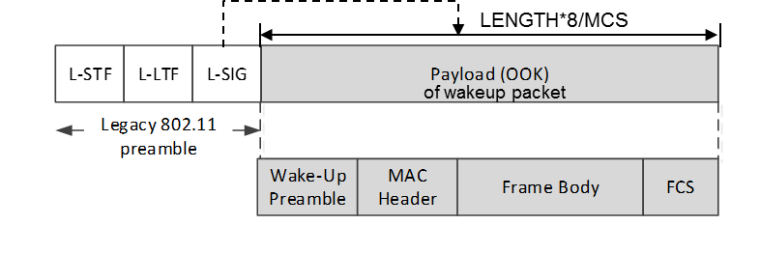
802.11 Compatible Wakeup Packet Design
Wakeup packet = Legacy 802.11 preamble (OFDM) + new LP-WUR signal waveform (OOK)
Legacy 802.11 preamble provides coexistence with legacy STAs
802.11 stations can detect beginning of this packet
802.11 stations know end of this packet
CRC
Wakeup packet may carry other information
Receiver address
Wakeup preamble (e.g. PN sequence)
Example signal waveform
1bit /1 OFDM symbol period (= 4usec) = 250kbps
Legacy 802.11
preamble
Wake-up
preamble
MAC Header + Frame Body + FCS

Slide 6
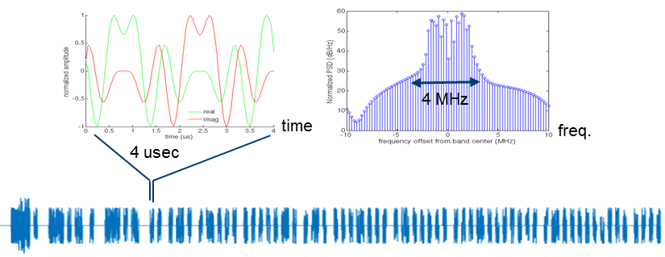
Wakeup Packet Generation Using OFDM Transmitter
OOK pulse design:
Reuse 802.11 OFDM transmitter for OOK pulse generation
Example:
Subcarrier width = 312.5 kHz, OOK pulse BW = 13 subcarriers (4.06 MHz)
s= {13 subcarrier tone sequence}
X_{t} = IFFT(s), followed by 0.8 µsec cyclic prefix extension → 4us symbol period

Slide 7
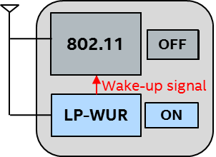
LP-WUR Function
LP-WUR receives and decodes a wakeup packet without any help from the 802.11 radio
LP-WUR
RF/Analog Front-end
Digital Baseband
Simple Packet Parser

Slide 8
Summary
We presented the details of LP-WUR
Wakeup packet design
Wakeup packet generation
LP-WUR functions

Slide 9
References
[1] IEEE 802.11-15/1307r1, “Low-power wake-up receiver for 802.11”
[2] IEEE 802.11-16/0027r0, “LP-WUR (Low-Power Wake-Up Receiver): Enabling Low-Power and Low-Latency Capability for 802.11”

