Slide 1
Results for Beacon Collisions
Date: 2016-03-02
Authors:
Name | Affiliation | Address | Phone | Email
Evgeny Khorov | IITP |  |  | khorov@frtk.ru
Dmitry Bankov | IITP |  |  | bankov@iitp.ru
Anton Kiryanov | IITP |  |  | kiryanov@iitp.ru
Sigurd Schelstraete | Quantenna |  |  | sigurd@quantenna.com
Huizhao Wang | Quantenna |  |  | hwang@quantenna.com

Slide 2
Motivation
At Jan’16 meeting we have proposed the beacon collision avoidance mechanism [doc.: IEEE 802.11-16/0017r0]
The feedback from the group:
The problem existence shall be proved in simulation scenarios [IEEE 802.11-14/0980r16]

Slide 3
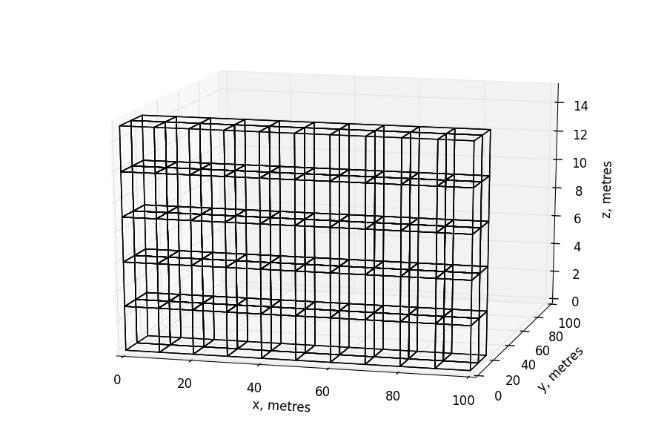
Residential Scenario
10 flats in a row
5 floors
2 rows

Slide 4
Path Loss Model
$$PL\left(d\right)= 40.05 + 20∙\log_{10}{\frac{f_{c}}{2.4}}+20∙\log_{10}{\min\left(d,5\right)} +$$
$$\left(d>5\right)∙ 35∙\log_{10}{\frac{d}{5}}+ 18.3∙F^{\frac{F+2}{F+1}−0.46} + 5∙W$$
W: number of walls traversed in x-direction plus number of walls
traversed in y-direction
F: number of floors traversed
f_{c}: frequency [GHz]
d: distance [m]
d

Slide 5
Beacon Collisions
Beacon collision = collision at a STA between a beacon from its own AP and a beacon from an alien AP.
Since the signal from its own AP is typically much higher than the signal from an alien AP (located in the neighbor flat)
a beacon collision occurs when both the following conditions are met
Time condition: beacons overlap in time, and alien beacon starts earlier than own beacon.
Location condition: the STA receives an alien beacon, while its own AP does not.

Slide 6
Beacon Collision Time Condition
What is the probability for a STA that a beacon from one hidden AP overlaps with its own AP’s beacon and alien beacon starts earlier?
Assuming that BI=100 or 500 ms, and beacon duration is 500 us, the probability is 0.5% or 0.1% for one hidden AP.
For how long will the beacons collide?
While the standard states that the clock drifting shall be less than 100ppm, in real devices it is less than 10ppm.
If the clock drifting of the APs is in opposite direction and it is 10 ppm, the beacons will collide for 25 seconds.
Note that constant clock drifting in opposite directions is the best case. In fact, the clock drifting is a random process, so beacons will collide for much longer time.
Different beacon intervals cannot solve the problem, since APs transmit data in addition to beacons.

Slide 7
Beacon Collision Location Condition
Beacon collision is possible,
if the STA hears the beacons from an alien AP,
while its own AP does not
$$P_{TX}=18 dBm$$
d₁
$$P_{STA}=P_{TX}−PL(d_{1})$$
$$P_{thr}$$
AP
$$P_{AP}=P_{TX}−PL(d_{2})$$
STA
d₂
Location Conditions:
$$P_{AP}< P_{thr}< P_{STA}$$
AP

Slide 8
Beacon Collision Location Condition
Beacon collision is possible,
if the STA hears the beacons from an alien AP,
while its own AP does not.
d₁
AP
$$∆P$$
Taking into account fading
and different antenna gain
STA
d₂
$$P_{AP}< P_{thr}$$
$$P_{STA}> P_{thr}+∆P$$
AP

Slide 9
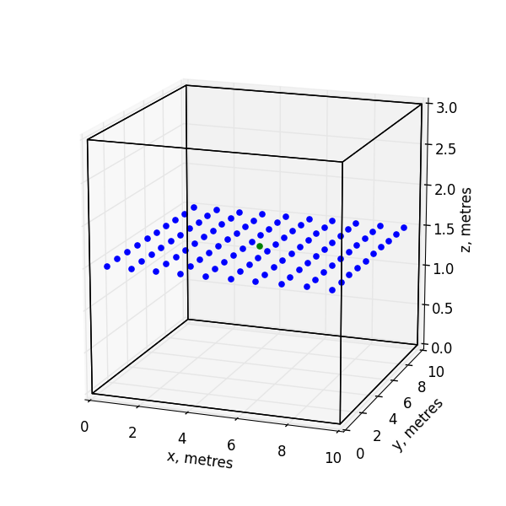
Locations of STAs and APs in the Flats
Possible STA locations
AP

Slide 10
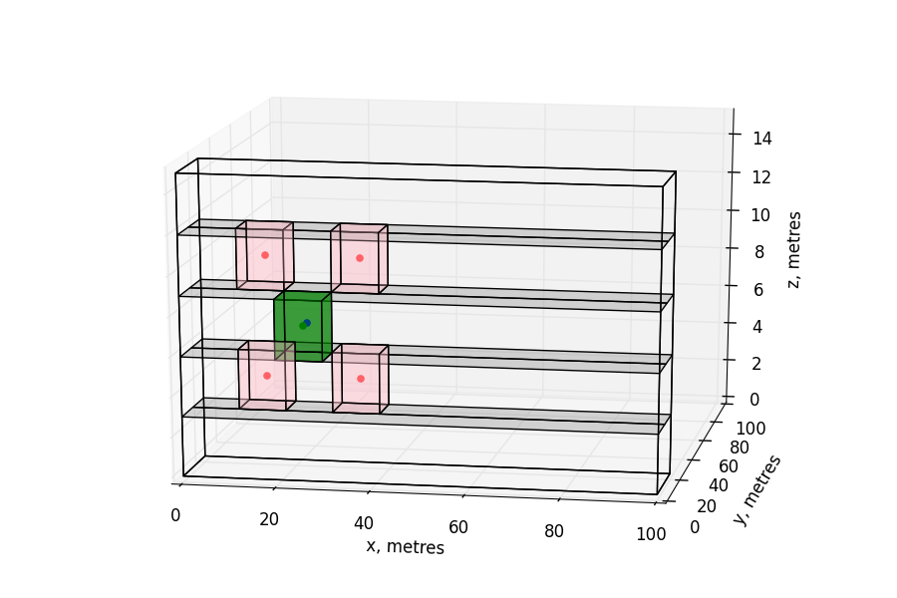
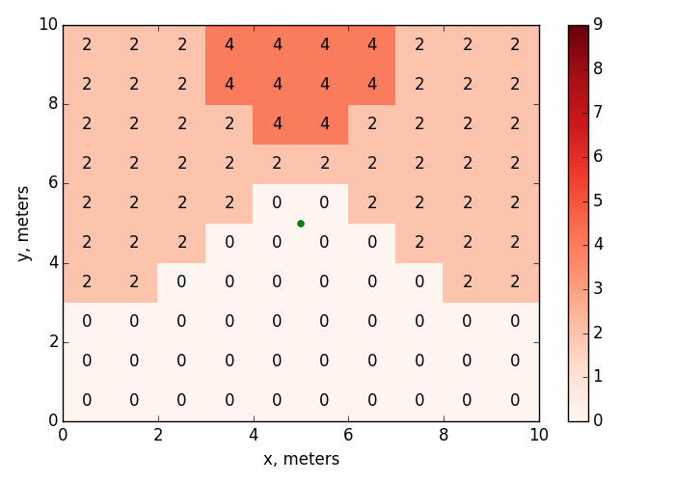
Number of Hidden APs for Which Location Condition is Met in a Non-edge Flat With APs in the Center
AP
4 alien APs can kill the beacon.
They are not direct neighbors
$$P_{thr}=−86 dBm$$
$$∆P=0$$

Slide 11
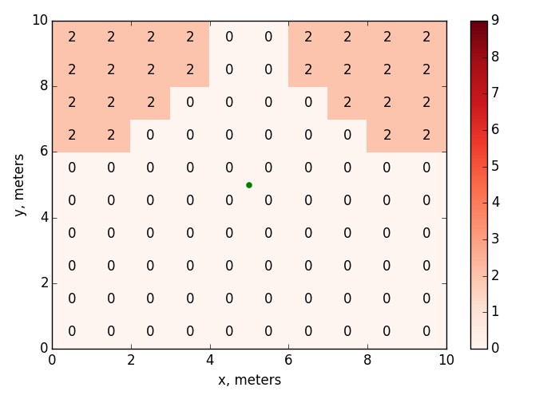
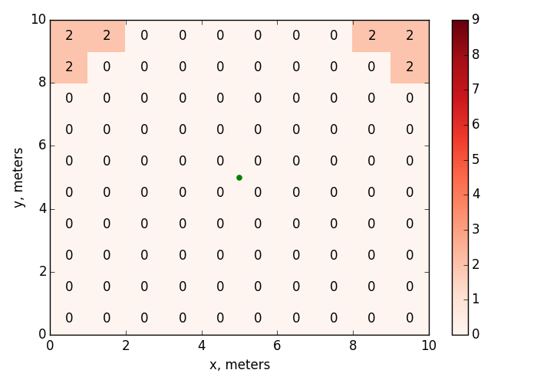
Influence of $∆P$
$$∆P=3 dB$$
$$∆P=6 dB$$
AP
AP

Slide 12
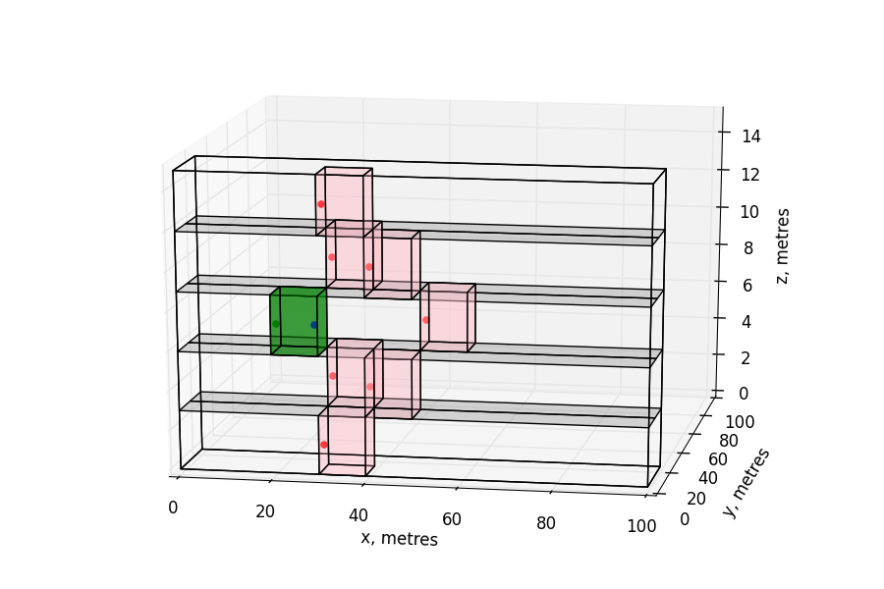
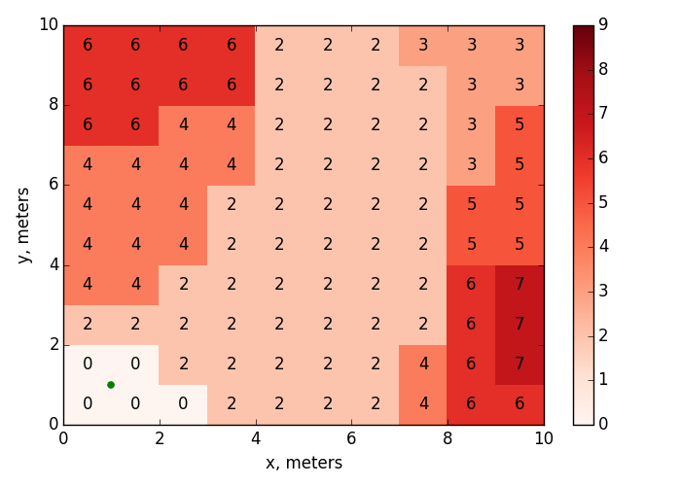
Number of Hidden APs for Which Location Condition is Met in a Non-edge Flat With APs in the Corner
7 alien APs can kill the beacon.
They are not direct neighbors
AP
$$P_{thr}=−86 dBm$$
$$∆P=0$$

Slide 13
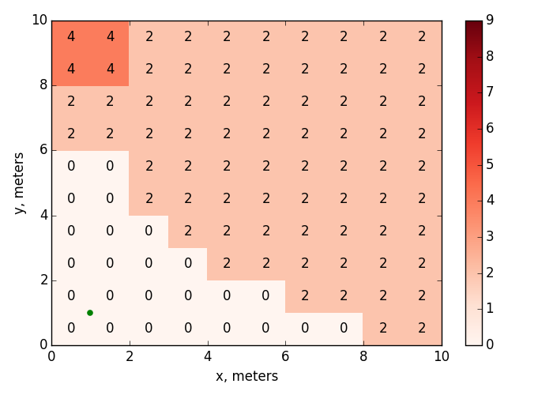
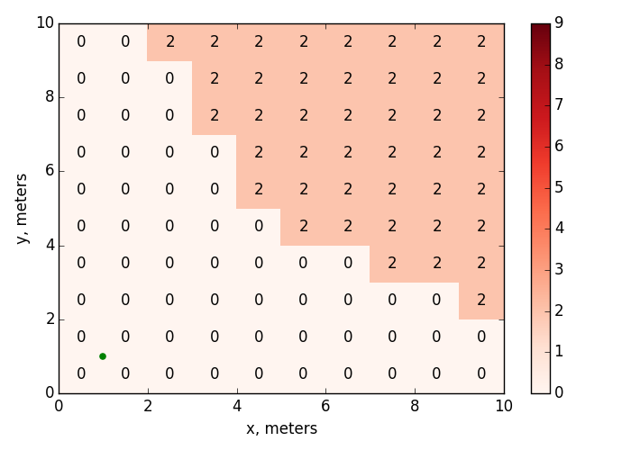
Influence of $∆P$
$$∆P=3 dB$$
$$∆P=6 dB$$
AP
AP

Slide 14
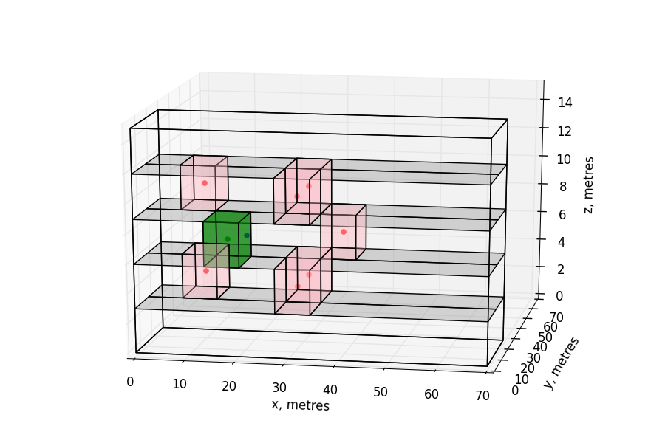
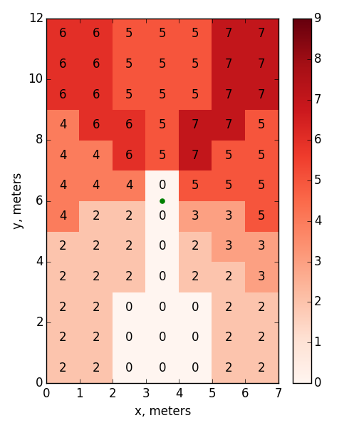
Number of Hidden APs for Which Location Condition is Met in a Non-edge Flat With APs in the Center of Non-square Rooms
AP
7 alien APs can kill the beacon.
They are not direct neighbors
$$P_{thr}=−86 dBm$$
$$∆P=0$$

Slide 15
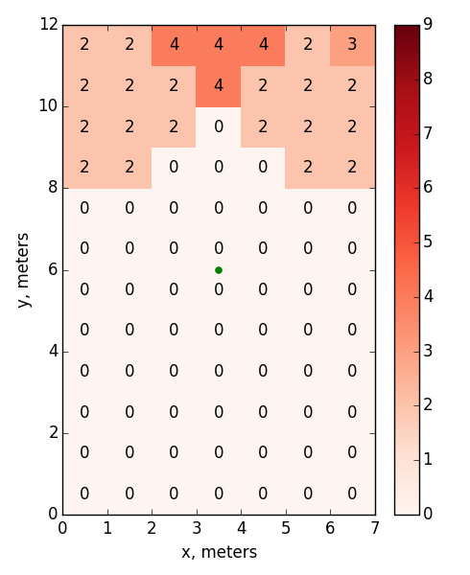
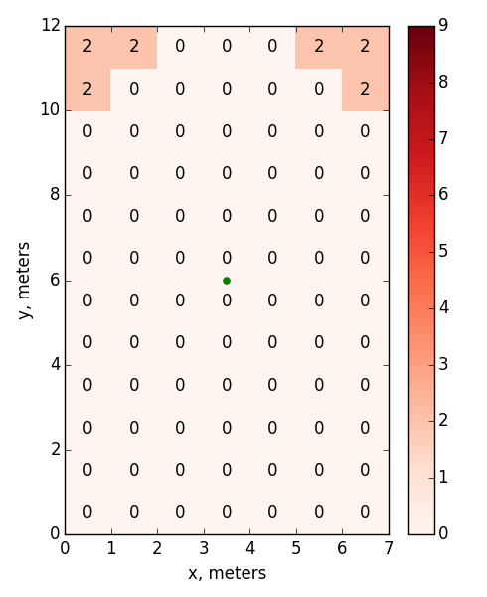
Influence of $∆P$
$$∆P=3 dB$$
$$∆P=6 dB$$
AP
AP

Slide 16
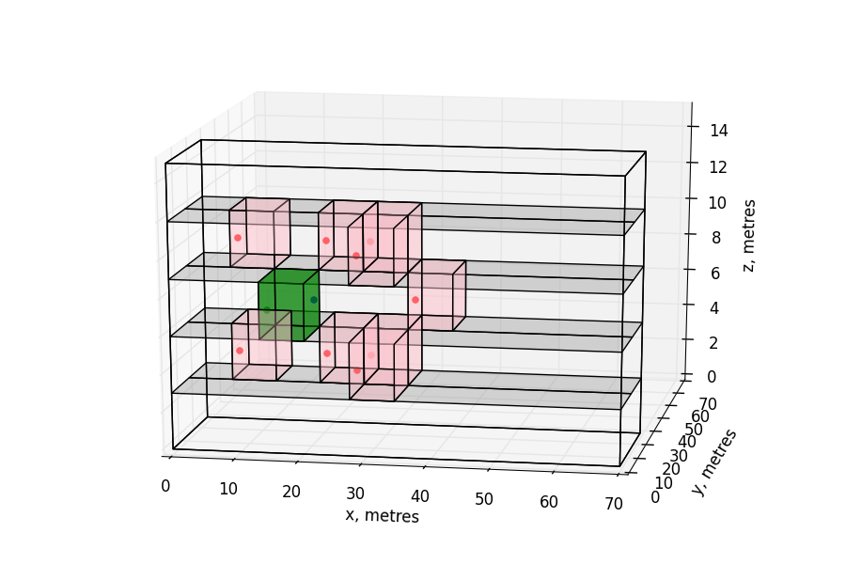
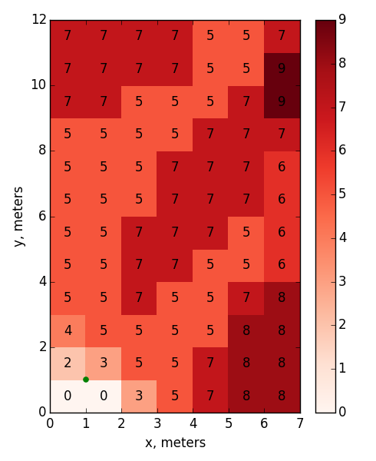
Number of Hidden APs for Which Location Condition is Met in a Non-edge Flat With APs in the Corner of Non-square Rooms
9 alien APs can kill the beacon.
They are not direct neighbors
AP
$$P_{thr}=−86 dBm$$
$$∆P=0$$

Slide 17
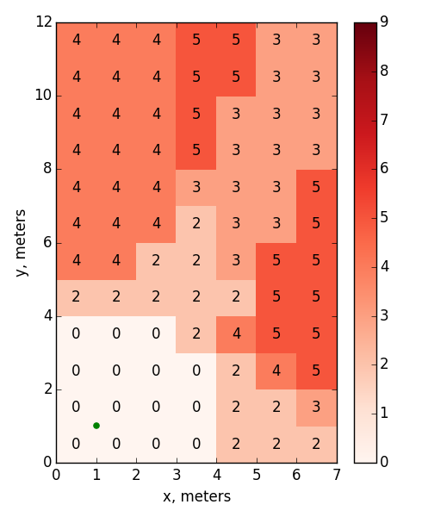
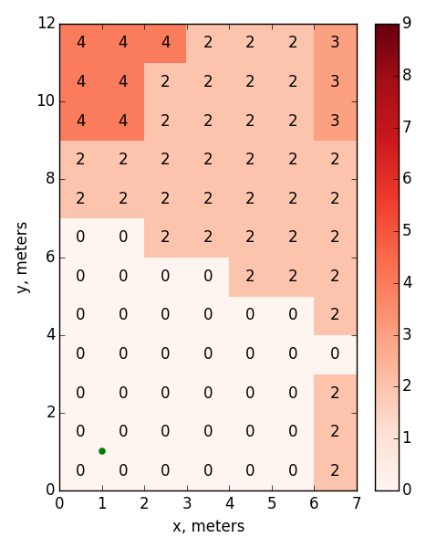
Influence of $∆P$
$$∆P=3 dB$$
$$∆P=6 dB$$
AP
AP

Slide 18
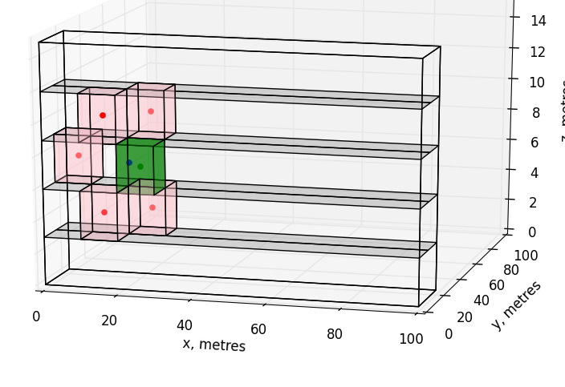
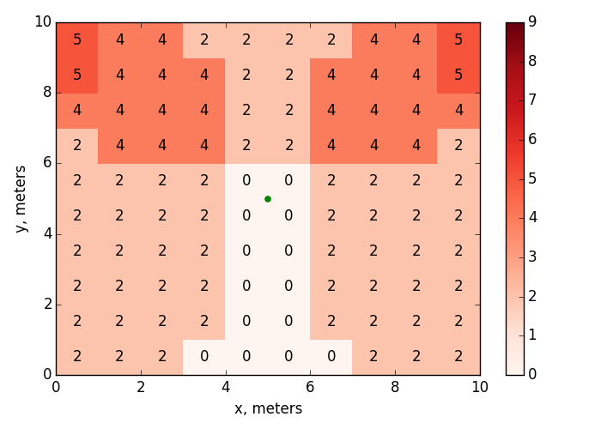
Number of Hidden APs for Which Location Condition is Met in a Non-edge Flat
Corner neighbor
of a neighbor
AP
5 alien APs can kill the beacon
$$P_{thr}=−76 dBm$$
$$∆P=0$$

Slide 19
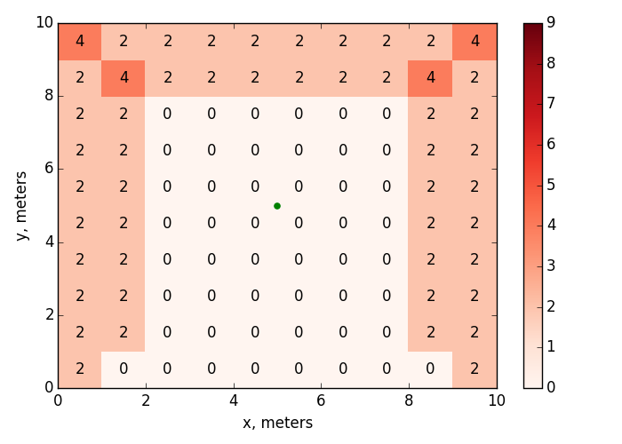
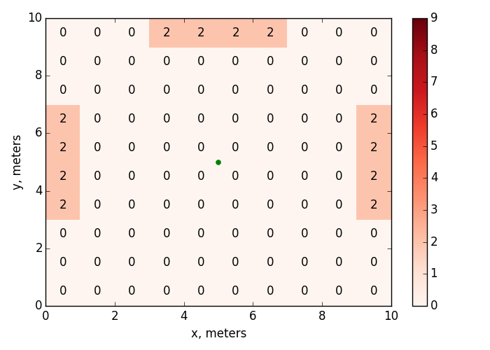
Influence of $∆P$
$$∆P=3 dB$$
$$∆P=6 dB$$

Slide 20
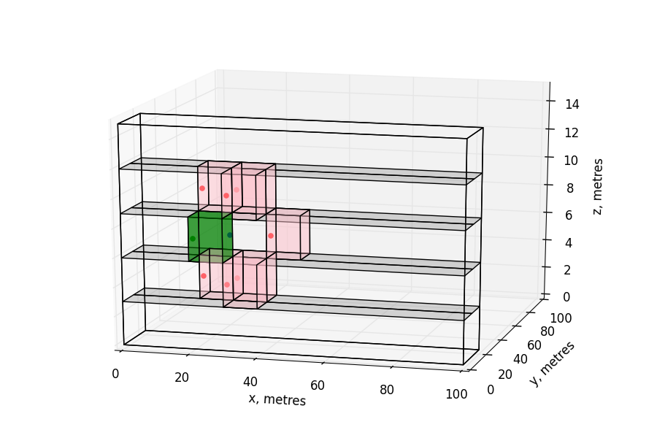
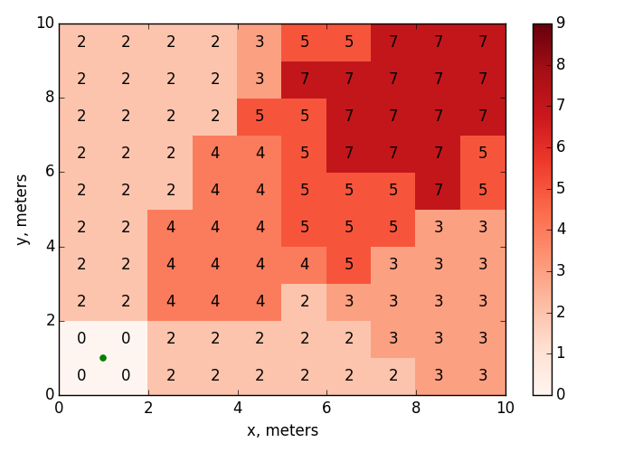
Number of Hidden APs for Which Location Condition is Met in a Non-edge Flat With APs in the Corner
7 alien APs can kill the beacon.
They are not direct neighbors
AP
$$P_{thr}=−76 dBm$$
$$∆P=0$$

Slide 21
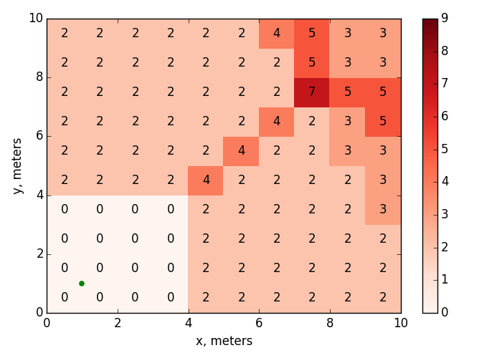
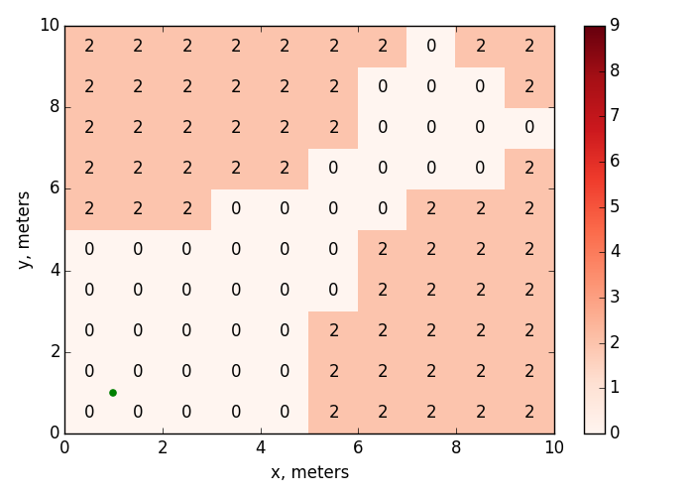
Influence of $∆P$
$$∆P=3 dB$$
$$∆P=6 dB$$
AP
AP

Slide 22
Conclusion
Collisions of beacons sent by hidden APs are typical for the residential scenario, which is a key scenario for 802.11ax.
The probability of a beacon collision depends on a particular scenario. In the residential scenario, up to 9 neighboring APs can send beacons which collide with the beacons send by the AP in the flat.
Different beacon intervals cannot solve the problem, since apart from beacons APs also transmit data.

Slide 23
Straw Poll
Do you agree that TGax should address beacon collision problem?

