Slide 1
Multi-Beamforming in Polarized Channels for 11ay
Date: 2016-01-18
Authors:
Name | Company | Address | Phone | Email
Kyungtae Jo | LG Electronics |  |  | kyungtae.jo@lge.com
SungJin Park | LG Electronics |  |  | allean.park@lge.com
HanGyu Cho | LG Electronics |  |  | hg.cho@lge.com
JinMin Kim | LG Electronics |  |  | jinmin1230.kim@lge.com
Saehee Bang | LG Electronics |  |  | saehee.bang@lge.com
Sanggook Kim | LG Electronics |  |  | sanggook.kim@lge.com

Slide 2
Introduction
This contribution intends to investigate how the BF training procedures in 11ad is modified to support the simultaneous steering of the beams for multiple sectors/multiple stations using cross-polarization.

Slide 3
Motivation
In 11ay, MIMO systems exhibit a reduced performance since the LOS component overwhelms the multipath components in the received signal.
In order to improve the performance of MIMO systems in LOS scenario, techniques such as antenna polarization have been employed to obtain higher rank.
Moreover, part of the existing infrastructure uses cross-polarized antenna elements, which could be used to support both polarization diversity and polarization multiplexing.

Slide 4
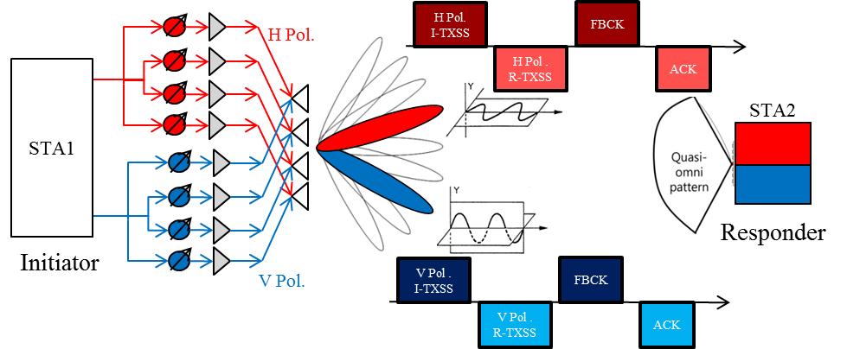
Proposal : Multi-beamforming using polarization (1/2)
Simultaneous beam-steering in horizontal and vertical polarization channel for 11ay SISO/SU-MIMO link
An antenna array is composed of multi beam array (MBA) with dual-polarization.
TX antennas for STA1 are configured to support 2 sectors/beams with orthogonal polarization.
TX/RX use calibrated sectors for steering with horizontal and vertical polarizations, simultaneously.
Approach to consider to reduce the time required for BF operations

Slide 5
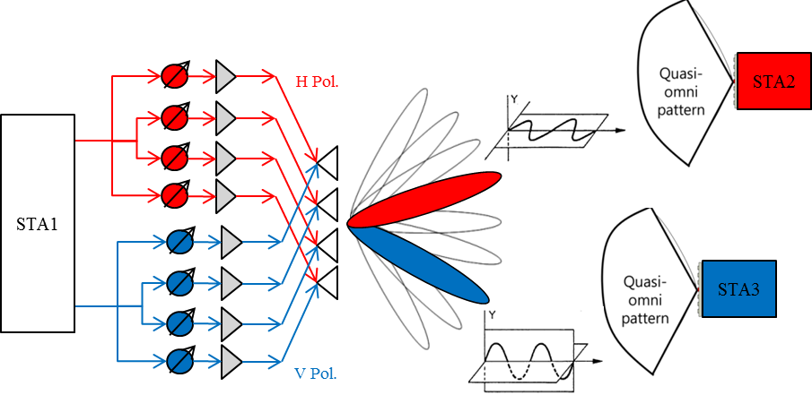
Proposal : Multi-beamforming using polarization (2/2)
Simultaneous beam-steering in horizontal and vertical polarization channel for 11ay MU-MIMO link
TX antenna array for STA1 is shared by the multiple RF chains/streams/channels.
Ideally cross-polarized antennas for STA1 are able to support BF training of STA2, STA3 without spacing far enough from one another to avoid interference, simultaneously.
Not only for diversity but also for SNR maximization and interference suppression
Additional degree of freedom ⇒ beamforming, multiplexing

Slide 6
Summary
In this contribution, multi-BF training approach through cross-polarized channels are proposed to consider to reduce the time required for BF operations to support SISO and MIMO/MU-MIMO transmissions for 11ay.

Slide 7
Straw poll/motion
Insert the following in the SFD “The 11ay beamforming protocol supports multi-beamforming for multiple array antennas. Multi-beamforming means that a transmitter simultaneously sends SSW frames in multiple polarized directions.”

