Slide 1
NDP Announcement for HE Sequence
Date: 2015-11-09
Authors:

Slide 2
Abstract
This presentation questions the necessity of signaling in the NDP Announcement frame, the presence of trigger frame for HE DL sounding sequence.

Slide 3
VHT DL Sounding Sequence
9.31.5.2 [1]
If the STA’s AID is in the first (or only) STA Info field, then it shall transmit the feedback a SIFS after the VHT NDP. The other STAs in the STA Info field will be polled.
VHT NDP-A
SIFS
NDP
SIFS
SIFS
Beamforming Report Poll
SIFS
SIFS
Beamforming Report Poll
SIFS
AP
STA 1
VHT Compressed Beamforming
STA 2
VHT Compressed Beamforming
STA 3
VHT Compressed Beamforming

Slide 4
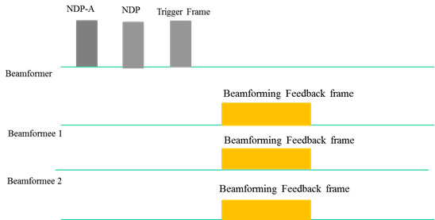
HE DL Sounding Sequence
We have the following in the current SFD [2]:
NDP-A is the initiation frame for the HE DL Sounding process.
Trigger frame is used to solicit the STAs to send their Beamforming feedback frame using the UL MU mode
Figure 14 -- Illustration of DL Sounding Sequence

Slide 5
Trigger frame in HE DL Sounding Sequence
HE DL Sounding sequence:
Beamforming frames sent in UL MU PPDU by all the STAs solicited by the Trigger frame
Is this the only way to receive feedback from STAs?
AP may also want to get the feedbacks one-by-one/ successively from each STA
Similar to the VHT sounding sequence
For robustness sake
The combination of target STAs that are triggered may not be appropriate for UL-MU.

Slide 6
Trigger frame in HE DL Sounding Sequence
If such a sequence is allowed for HE DL sounding procedure, need a mechanism to distinguish this sequence from the one with Trigger frame
The arrival of Trigger frame after NDP frame is not known to the STAs until the actual start time of the Trigger frame
This case is different from multiplexing of BA/ACK responses for DL data
Trigger frames are aggregated with the data frames
HE
NDP-A
SIFS
HE NDP
SIFS
SIFS
Beamforming Report Poll
SIFS
SIFS
Beamforming Report Poll
SIFS
AP
STA 1
HE Compressed Beamforming
To allow such sequence, a signaling bit is necessary in the HE NDP Announcement frame.
STA 2
HE Compressed Beamforming
STA 3
HE Compressed Beamforming

Slide 7
Summary
The necessity to enable successive feedback response in HE DL sounding sequence was considered.
A signaling bit in the HE NDP Announcement frame to distinguish between the sequence with a trigger frame is necessary.

Slide 8
References
[1] IEEE Std 802.11ac-2013
[2] 802.11-15/0132r9 “Specification Framework for TGax”

Slide 9
Straw Poll 1
Do you agree to add a sequence similar to the VHT sounding sequence that does not include a trigger frame and where the sounding feedback frames are sent in SU PPDUs for HE DL sounding sequence?
Y:N:A =
HE
NDP-A
SIFS
HE NDP
SIFS
SIFS
Beamforming Report Poll
SIFS
SIFS
Beamforming Report Poll
SIFS
AP
STA 1
HE Compressed Beamforming
STA 2
HE Compressed Beamforming
STA 3
HE Compressed Beamforming

Slide 10
Straw Poll 2
Do you agree to add the following text to the SFD?:
4.6 The amendment shall define a mechanism to signal the presence of a trigger frame, a SIFS interval after the NDP frame in the HE DL sounding sequence. When there is no trigger frame, the sounding feedback frames are sent in SU PPDUs same as in the VHT sounding sequence.
Y:N:A =

