Slide 1
Discussion on Deep and Shallow Sleep States
Date: 2015-09-14
Authors:
Name | Affiliations | Address | Phone | Email
Ghosh Chittabrata | Intel | 2200 Mission College Blvd., Santa Clara, CA, 95054 | +1-415-244-8904 | chittabrata.ghosh@intel.com

Slide 2
Abstract
The Simulations Scenario document [1] described the common power model parameters in Deep Sleep, Shallow Sleep, Listen, Receive, and Transmit states
Current consumption in all the states, except the Deep Sleep state, are well defined for 20MHz, 40MHz, and 80MHz channel bandwidths
However, current consumption in Deep Sleep state in either of the channel bandwidths is not defined in [1]
In this contribution, we propose specific values for current consumption in Deep Sleep state
We also propose to modify the current definition of Deep Sleep and Shallow Sleep states

Slide 3
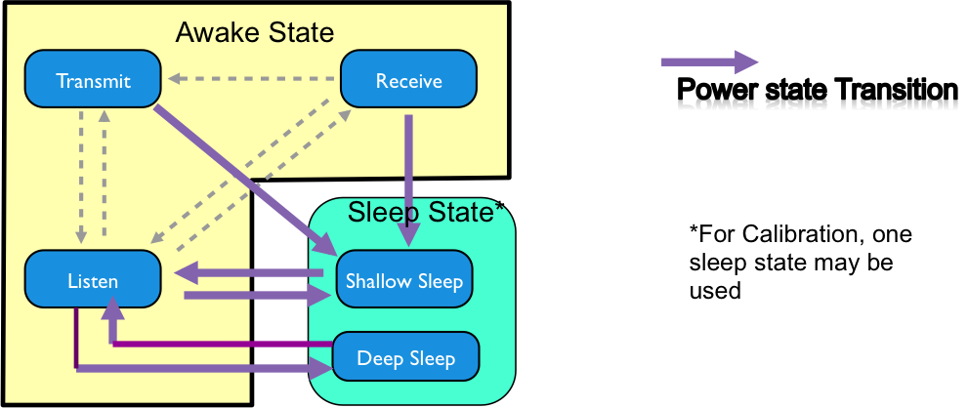
Different State Transitions in 802.11ax

Slide 4
Various Power States Definition in [1]
Based on contribution [2], the Simulation Scenarios document [1] of IEEE 802.11ax specifies the following common power model parameters for all simulation scenarios
Power State parameters
Average Current Consumption [mA] Voltage = 1.1V, Band = { 2.4 GHz, 5 GHz }, NSS = { 1 }, Number of TX/RX antennas = { 1 }, TX power per antenna = { 15 dBm }
Power State | Bandwidth = { 20 MHz } | Bandwidth = { 40 MHz } | Bandwidth = { 80 MHz }
Transmit | 280 mA | 280 mA | 280 mA
Receive | 100 mA | 140 mA | 200 mA
Listen | 50 mA | 60 mA | 75 mA
Shallow Sleep | 0.9 mA | 0.9 mA | 0.9 mA
Deep Sleep | TBD | TBD | TBD

Slide 5
Proposed Current Consumption in Deep Sleep
We propose to replace the TBD values for Deep Sleep state in the Simulation Scenarios document [1] of IEEE 802.11ax
Power State parameters
Average Current Consumption [mA] Voltage = 1.1V, Band = { 2.4 GHz, 5 GHz }, NSS = { 1 }, Number of TX/RX antennas = { 1 }, TX power per antenna = { 15 dBm }
Power State | Bandwidth = { 20 MHz } | Bandwidth = { 40 MHz } | Bandwidth = { 80 MHz }
Transmit | 280 mA | 280 mA | 280 mA
Receive | 100 mA | 140 mA | 200 mA
Listen | 50 mA | 60 mA | 75 mA
Shallow Sleep | 0.9 mA | 0.9 mA | 0.9 mA
Deep Sleep | 0.09mA | 0.09mA | 0.09mA

Slide 6
Deep and Shallow Sleep State Definition [1]
Deep Sleep [2] power state is defined as a sleep state with the least (non-zero) power consumed and the longest transition time to Listen state.
Shallow Sleep [2] power state is defined as a sleep state when the STA consumes more power but transitions faster to Listen state when compared to the Deep Sleep power state
Proposed modifications to Deep and Shallow Sleep state definition:
Deep sleep power state of a wireless module is defined as a sleep state with the wireless radio turned off, i.e., RF, baseband and MAC processors are all switched off. The only power consumed by the wireless module is leakage power.
Shallow sleep power state of a wireless module is defined as a sleep state with baseband and MAC processors turned on, but RF is switched off.

Slide 7
Power and Latency Transitions Among States in IEEE 802.11ax [1, 3]
Power Transition parameters
State Transitions | Transition Time (ms) | Average Power Consumption (mW)
Transmit Listen | T_{TL}=0.01ms | 75mW
Receive ⬄ Listen | 0.001ms | 55mW
Listen Transmit | T_{LT} = 0.01ms | P_{LT} = 100mW
Transmit Shallow Sleep | T_{TS}=0.01ms | P_{TS} = 15mW
Receive Shallow Sleep | T_{RS}=0.2ms | PRS = 15mW
Listen Shallow Sleep | T_{LS}=0.2ms | PLS = 5mW
Shallow Sleep Listen | 0.5 ms (T_{SL})
Listen Deep Sleep | T_{LD} | P_{DS} = 5mW
Deep Sleep Listen | T_{SDL} = 3ms

Slide 8
Proposed Latency in Transition from Deep Sleep to Listen State in [1]
Power Transition parameters
State Transitions | Transition Time (ms) | Average Power Consumption (mW)
Transmit Listen | T_{TL}=0.01ms | 75mW
Receive ⬄ Listen | 0.001ms | 55mW
Listen Transmit | T_{LT} = 0.01ms | P_{LT} = 100mW
Transmit Shallow Sleep | T_{TS}=0.01ms | P_{TS} = 15mW
Receive Shallow Sleep | T_{RS}=0.2ms | PRS = 15mW
Listen Shallow Sleep | T_{LS}=0.2ms | PLS = 5mW
Shallow Sleep Listen | 0.5 ms (T_{SL})
Listen Deep Sleep | T_{LD} | P_{DS} = 5mW
Deep Sleep Listen | T_{SDL} = 10ms

Slide 9
Conclusion
In this submission, we have proposed current consumption values in Deep Sleep state for 20MHz, 40MHz, and 80MHz channel bandwidths
We have also proposed to modify definition of Shallow and Deep Sleep states
Finally, we have proposed to modify the latency in transition from Deep Sleep to Listen state

Slide 10
References
[1] S. Merlin et. al., “TGax Simulation Scenarios,” IEEE 11-14-980r14, July 2015
[2] C. Ghosh et. al., “Sleep states in-IEEE 802.11ax Simulation Scenarios,” IEEE 11-15-314r2, March 2015
[3] C. Ghosh et. al., “Power Consumption and Latency Values in State Transitions for IEEE 802.11ax Simulation Scenarios,” IEEE 11-15-0576r0, May 2015

Slide 11
Straw poll 1
Do you agree to define the current consumption value in Deep Sleep state in the Simulation Scenarios document as proposed in Slide 5?

Slide 12
Straw poll 2
Do you agree to include the modified definition for Shallow and Deep Sleep state in the Simulation Scenarios document as discussed in Slide 6?

Slide 13
Straw poll 3
Do you agree to modify the transition time from Deep Sleep to Listen state in the Simulation Scenarios document as proposed in Slide 8?

