Slide 1
Channel Sounding for 802.11ay
Date: 2015-07-15
Authors:

Slide 2
Abstract
In this presentation, we show the first 60 GHz ultra-wide-band measurement results at a large entrance hall scenario. We show that the coverage of 60 GHz can be very large. Another points which we like to discuses are the calibration problems of the AGC.
We like also to discuss the requirements for the outdoor measurement campaigns.

Slide 3
Outline
Motivation
60 GHz Entrance Hall Measurements
Measurement results
Result discussion
Conclusion

Slide 4
Motivation
ISM-band at 60 GHz
  Free and wide bandwidth available (up to 7 GHz)
  WLAN/WiGig (.11ad) and WPAN (.15.3.c)
Advanced system concepts → define measurement and modelling requirements
  Massive MIMO/pencil beam-forming → large spatial bandwidth
  Adaptive or switched selection beam-forming to mitigate shadowing
  Channel bonding → large bandwidth
Propagation channel measurements
  Double directional measurements are needed to characterized the full channel
  Polarization is an important aspect
  High dynamic range are essential to measure the different propagation effects
Channel characterization for different usage cases

Slide 5
Summary of Measurement Activities
# | Applications and Characteristics | Propagation conditions | Experimental setup description | Responsible companies
1 | Ultra Short Range (USR) Communications -Static,D2D, -Streaming/Downloading | LOS only, Indoor <10cm | TBD | TBD
2 | 8K UHD Wireless Transfer at Smart Home -Umcompressed 8K UHD Streaming | Indoor, LOS with small NLOS chance, <5m | Living room environment, 8 TX by 16 RX, stationary | NIST
3 | Augmented Reality/Virtual Reality Headsets and Other High-End Wearables -Low Mobility, D2D -3D UHD streaming | Indoor, LOS with small NLOS chance <10m | Living room environment, 8 TX by 16 RX, non-stationary | NIST
4 | Data Center 11ay Inter-Rack Connectivity -Indoor Backhaul with multi-hop* | Indoor, LOS only <10m | Server room environment, 8 TX by 16 RX, stationary | NIST
5 | Video/Mass-Data Distribution/Video on Demand System - Multicast Streaming/Downloading - Dense Hotspots | Indoor, LOS/NLOS <100m | Entrance large hall, lecture room | Huawei, Intel
6 | Mobile Offloading and Multi-Band Operation (MBO) -Multi-band/-Multi-RAT Hotspot operation | Indoor/Outdoor, LOS/NLOS <100m | Indoor: Entrance large hall/ Outdoor: Above roof top to street level | Huawei
7 | Mobile Fronthauling | Outdoor, LOS <200m | Above roof top to street level | Huawei
8 | Wireless Backhauling -Small Cell Backhauling with single/multi-hop | Single hop: outdoor, LOS <1km Multi hop: Outdoor, LOS <150m | Above roof top, street level | Huawei, Intel

Slide 6
60 GHz Entrance Hall Measurements

Slide 7
Dual Polarimetric Ultra-Wideband Channel Sounder (DP-UMCS)
TX Module
PA min. 23 dBm
RX Module
Step
Attenuator
LNA
Gain : 35 dB
H Pol.
CH 1
UWB Sounder TX
0 – 3.5 GHz
3.5 GHz - 10.5 GHz
H Pol.
Switch
UWB Sounder RX
0 – 3.5 GHz
3.5 GHz - 10.5 GHz
56 - 66 GHz
56 - 66 GHz
V Pol.
Step
Attenuator
CH 2
LNA
Gain : 35 dB
V Pol.
PA min.
23dBm
Multiplier
X8
Multiplier
X8
Optical link
7 GHz
Oscillator
Optical link
7 GHz BW up to 10 GHz measurable bandwidth
Maximum excess delay of 606 ns (180 m) in CS version 1
Dual polarization measurement capability
25 dB AGC (Automatic Gain Control) with 3.5 dB steps
High instantaneous dynamic range: up to 75 dB
Multi-Link and Massive MIMO capabilities
Double directional measurements (with 1 TX and 2 RX)

Slide 8
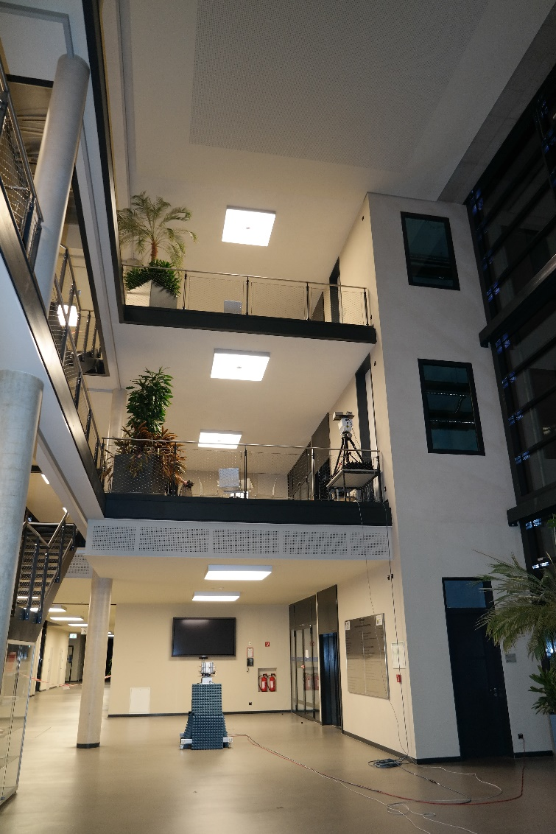
Entrance Hall Scenario
Dimensions:
7 x 25m x 9m
Class and metal
3 different floors

Slide 9
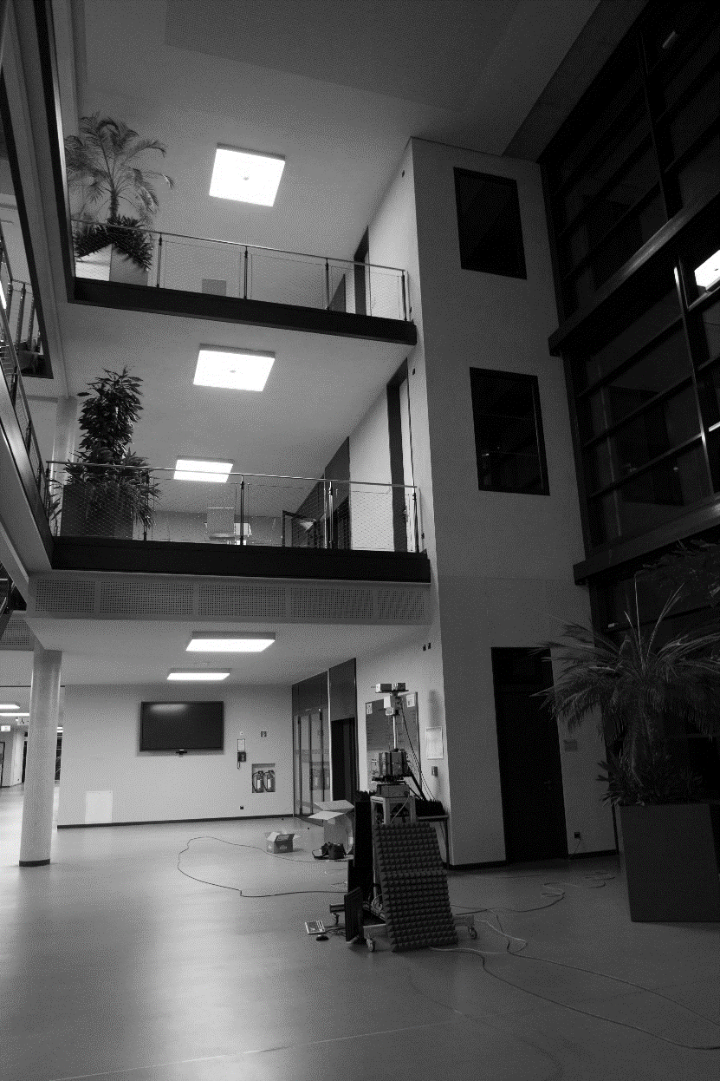
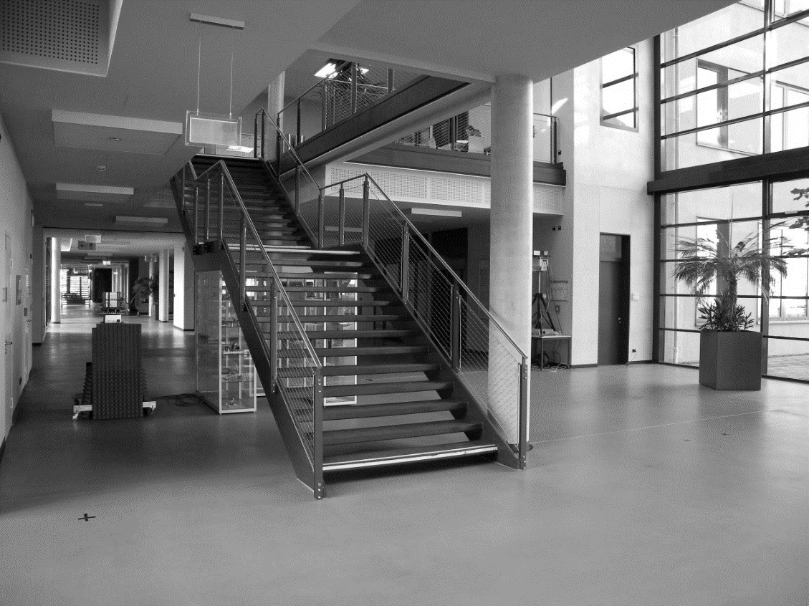
Entrance Hall Scenario
Entrance Hall of Zuse – Bau at TU Ilmenau
1 Tx Positions (1 Tx in the ground floor)
9 Rx Positions (all in the ground floor)
Tx 1
Rx 14
Rx 10
Rx 4
Rx 9
Rx 2
Rx 3
Rx 1
Rx 2
Rx 1

Slide 10
Measurement Set-Up
Static access point scenario
Tx:
  Located on the side of the wall
  Height from ground 2.5 m
  30°HBW of the antenna
Rx:
  Located at several points in the hall
  Height 1.4m
  30°HBW of the antenna
Scanning at Tx and Rx stage via positioners
Tx: Azimuth -90°... 30° 90° Elevation -90°…30°…90°
Rx: Azimuth -180°…30°…150°
-
2.8m
5m
Rx 1
+
Azimuth 0°
C
Rx 9
Rx 2
5m
Rx 3
A
-
Rx 10
5m
Tx X
Azimuth 0°
+
B
Rx 4
Rx 14
Rx 12
Rx 13

Slide 11
Measurement results

Slide 12
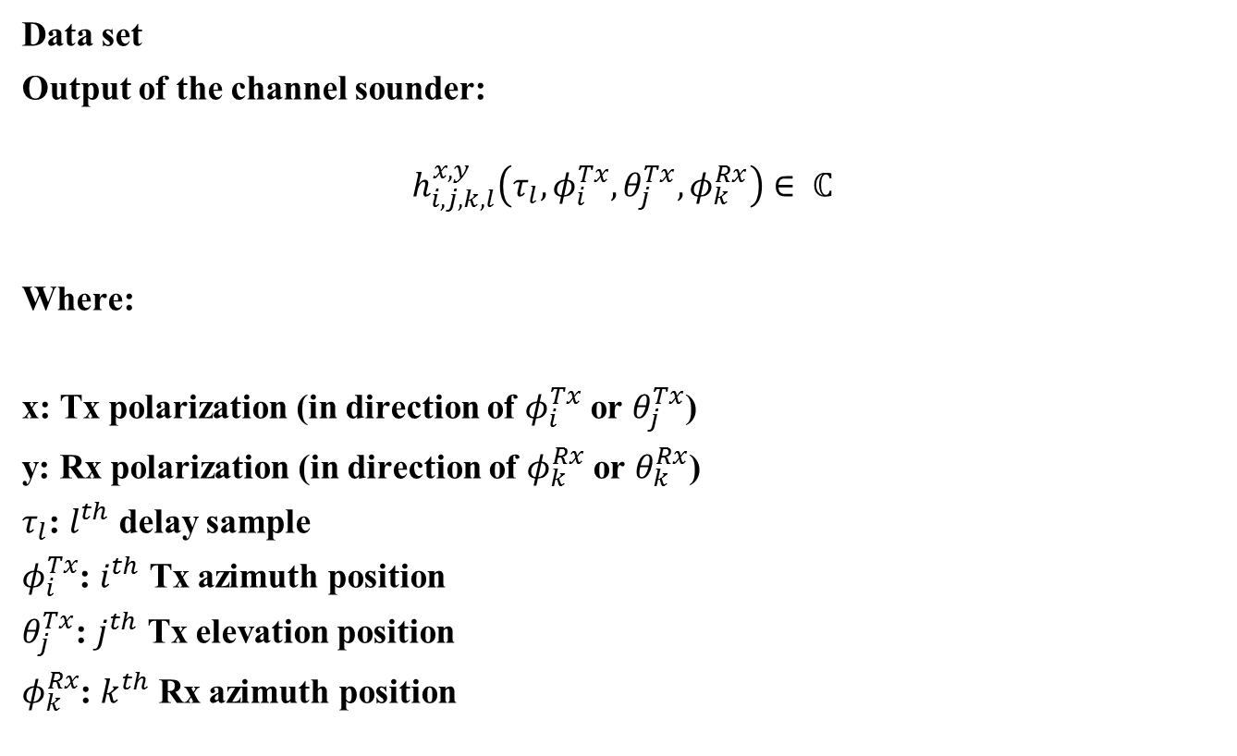
Data Set
Data set
Output of the channel sounder:
$$h_{i,j,k,l}^{x,y}\left(τ_{l},φ_{i}^{Tx},θ_{j}^{Tx},φ_{k}^{Rx}\right)∈ ℂ$$
Where:
x: Tx polarization (in direction of $φ_{i}^{Tx}$ or $θ_{j}^{Tx}$)
y: Rx polarization (in direction of $φ_{k}^{Rx}$ or $θ_{k}^{Rx}$)
$τ_{l}$: $l^{th}$ delay sample
$φ_{i}^{Tx}$: $i^{th}$ Tx azimuth position
$θ_{j}^{Tx}$: $j^{th}$ Tx elevation position
$φ_{k}^{Rx}$: $k^{th}$ Rx azimuth position

Slide 13
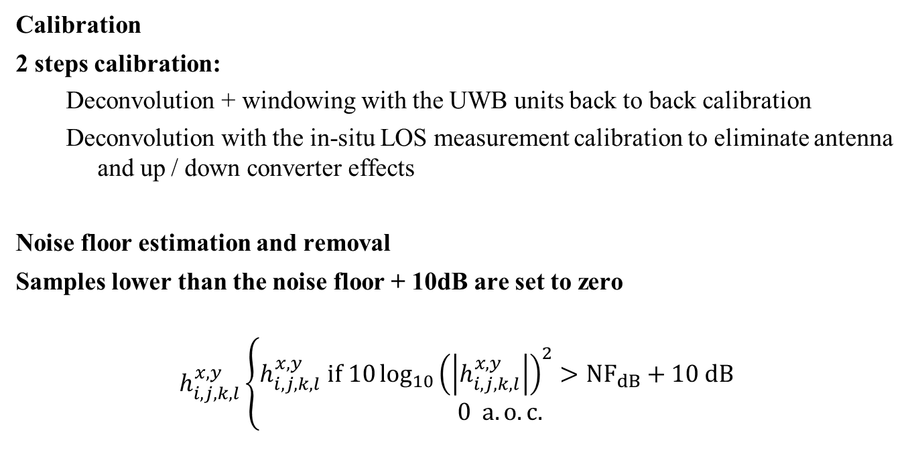
Data Pre-processing
Calibration
2 steps calibration:
  Deconvolution + windowing with the UWB units back to back calibration
  Deconvolution with the in-situ LOS measurement calibration to eliminate antenna and up / down converter effects
Noise floor estimation and removal
Samples lower than the noise floor + 10dB are set to zero
$$h_{i,j,k,l}^{x,y}\left\{\begin{aligned}h_{i,j,k,l}^{x,y} if 10\log_{10}{{\left(\left|h_{i,j,k,l}^{x,y}\right|\right)}^{2}>NF_{dB}+10 dB } \\ 0 a.o.c.\end{aligned}\right.$$

Slide 14
Tx 1 – Rx 1 pLOS
Normalized Power Elevation / Azimuth Profile at Tx
Normalized Power Azimuth / Azimuth Profile at Tx and Rx

Slide 15
Tx 1 – Rx 9 NLOS
Normalized Power Elevation / Azimuth Profile at Tx
Normalized Power Azimuth / Azimuth Profile at Tx and Rx

Slide 16
Tx 1 – Rx 12 pLOS
Normalized Power Elevation / Azimuth Profile at Tx
Normalized Power Azimuth / Azimuth Profile at Tx and Rx

Slide 17
Tx 1 – Rx 13 NLOS
Normalized Power Elevation / Azimuth Profile at Tx
Normalized Power Azimuth / Azimuth Profile at Tx and Rx

Slide 18
Power Angular Profile of all Receivers
The azimuth plane have a bigger impact than the elevation plane on the Path loss of the 60 GHz channel
But we use here antennas withe a
3dB beamwidth of 30°

Slide 19
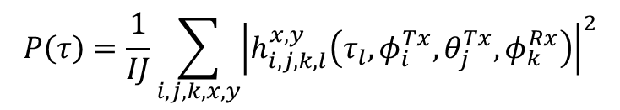
Calculation
Power Delay Profile
$$P\left(τ\right)=\frac{1}{IJ}\sum_{i,j,k,x,y}{{\left|h_{i,j,k,l}^{x,y}\left(τ_{l},φ_{i}^{Tx},θ_{j}^{Tx},φ_{k}^{Rx}\right)\right|}^{2}}$$

Slide 20
PDP Tx 1
Power Delay Profile Rx 1
Power Delay Profile Rx 2
Power Delay Profile Rx 3
Power Delay Profile Rx 4

Slide 21
PDP Tx 1
Power Delay Profile Rx 9
Power Delay Profile Rx 10
Power Delay Profile Rx 12
Power Delay Profile Rx 13

Slide 22
List of Parameters
Tx | Rx | LOS / NLOS | DS [ns] | MED [ns] | AS at Tx [°] | ES at Tx [°] | AS at Rx [°] | Rx Energy [dB]
1 | 1 | pLOS | 27,04 | 173,18 | 71,59 | 55,42 | 86,03 | 8,23
1 | 2 | pLOS | 33,53 | 207,25 | 67,40 | 54,67 | 79,68 | 7,69
1 | 3 | pLOS | 39,87 | 160,59 | 64,29 | 47,97 | 84,16 | 7,47
1 | 4 | pLOS | 40,97 | 154,81 | 66,35 | 49,44 | 77,66 | 9,19
1 | 9 | NLOS | 28,10 | 116,14 | 53,50 | 41,22 | 73,38 | 2,77
1 | 10 | NLOS | 44,08 | 213,62 | 69,15 | 46,17 | 80,89 | 2,68
1 | 12 | pLOS | 34,99 | 160,14 | 52,91 | 43,71 | 36,17 | 3,35
1 | 13 | NLOS | 58,35 | 200,00 | 70,25 | 50,74 | 34,47 | -3,01
1 | 14 | pLOS | 25,44 | 114,07 | 50,89 | 59,07 | 73,19 | 9,85
DS: delay spread. Calculated with a dynamic range of 20 dB.
MED: maximum excess delay. Calculated with a dynamic range of 20 dB.
AS: azimuth spread (at the Rx calculated for the cyclic angles since 360°measurements were available).
ES: elevation spread.
Rx Energy: un-calibrated data
The AGC was not de-embedded

Slide 23
Result discussion
Double directional measurements
All was full polarimetric
9 positions
The azimuth plane at Tx has a greater impact on the power
Delay spread
  For LOS is the DS with a threshold of 20 dB smaller than 40ns
  For NLOS is the DS with a threshold of 20 dB smaller than 60ns
Maximum Access Delay
  For LOS is the DS with a threshold of 20 dB smaller than 210ns
  For NLOS is the DS with a threshold of 20 dB smaller than 220ns
Measurement issues
  AGC calibration wasn’t performed → problems in the Insitu calibration with the high power
  Only azimuth scan at the RX →Outdoor measurement with 1 TX and 2 RX and azimuth and elevation scan on booth side

Slide 24
Conclusion/Discussion
We present 60 GHz entrance hall measurements
  Measurement bandwidth of 7 GHz → analysis of channel bonding possible
  The capability of MIMO measurements
  The unambiguous range (606 ns) of the CS system is to small for this scenarios
  Polarization effects are clearly visible
Next Steps
  Extension of the calibration → AGC calibration for dual pol. waveguide systems
  Outdoor: Above roof top to street level measurements
    How many measurement points are required/meaningful? → measuring time
    Which resolution for the azimuth and elevation scan?→ measuring time
    Which range for the azimuth and elevation for the different scenarios are useful?
    → measuring time
Notes:
5G systems at mm-wave require SNR optimisation → and this will be only done with dual polarisation

