Slide 1
MU-RTS/CTS for DL MU
Date: 2015-07-13
Name | Affiliation | Address | Phone | Email
Po-Kai Huang | Intel | 2200 Mission College Blvd., Santa Clara, CA 95054, USA | +1-408-765-8080 | po-kai.huang@intel.com
Xiaogang Chen |  |  |  | xiaogang.c.chen@intel.com
Robert Stacey |  |  |  | robert.stacey@intel.com
Qinghua Li |  |  |  | quinghua.li@intel.com
Eldad Perahia |  |  |  | eldad.perahia@intel.com
Shahrnaz Azizi |  |  |  | shahrnaz.azizi@intel.com
Chittabrata Ghosh |  |  |  | chittabrata.ghosh@intel.com
Laurent Cariou |  |  |  | laurent.cariou@intel.com
Rongzhen Yang |  |  |  | rongzhen.yang@intel.com

Slide 2
Authors (continued)
Name | Affiliation | Address | Phone | Email
Hongyuan Zhang | Marvell | 5488 Marvell Lane, Santa Clara, CA, 95054 | 408-222-2500 | hongyuan@marvell.com
Yakun Sun |  |  |  | yakunsun@marvell.com
Lei Wang |  |  |  | Leileiw@marvell.com
Liwen Chu |  |  |  | liwenchu@marvell.com
Jinjing Jiang |  |  |  | jinjing@marvell.com
Yan Zhang |  |  |  | yzhang@marvell.com
Rui Cao |  |  |  | ruicao@marvell.com
Sudhir Srinivasa |  |  |  | sudhirs@marvell.com
Saga Tamhane |  |  |  | sagar@marvell.com
Mao Yu |  |  |  | my@marvel..com
Edward Au |  |  |  | edwardau@marvell.com
Hui-Ling Lou |  |  |  | hlou@marvell.com

Slide 3
Authors (continued)
Name | Affiliation | Address | Phone | Email
Albert Van Zelst | Qualcomm | Straatweg 66-S Breukelen, 3621 BR Netherlands |  | allert@qti.qualcomm.com
Alfred Asterjadhi |  | 5775 Morehouse Dr. San Diego, CA, USA |  | aasterja@qti.qualcomm.com
Bin Tian |  | 5775 Morehouse Dr. San Diego, CA, USA |  | btian@qti.qualcomm.com
Carlos Aldana |  | 1700 Technology Drive San Jose, CA 95110, USA |  | caldana@qca.qualcomm.com
George Cherian |  | 5775 Morehouse Dr. San Diego, CA, USA |  | gcherian@qti.qualcomm.com
Gwendolyn Barriac |  | 5775 Morehouse Dr. San Diego, CA, USA |  | gbarriac@qti.qualcomm.com
Hemanth Sampath |  | 5775 Morehouse Dr. San Diego, CA, USA |  | hsampath@qti.qualcomm.com
Menzo Wentink |  | Straatweg 66-S Breukelen, 3621 BR Netherlands |  | mwentink@qti.qualcomm.com
Richard Van Nee |  | Straatweg 66-S Breukelen, 3621 BR Netherlands |  | rvannee@qti.qualcomm.com
Rolf De Vegt |  | 1700 Technology Drive San Jose, CA 95110, USA |  | rolfv@qca.qualcomm.com
Sameer Vermani |  | 5775 Morehouse Dr. San Diego, CA, USA |  | svverman@qti.qualcomm.com
Simone Merlin |  | 5775 Morehouse Dr. San Diego, CA, USA |  | smerlin@qti.qualcomm.com
Tevfik Yucek |  | 1700 Technology Drive San Jose, CA 95110, USA |  | tyucek@qca.qualcomm.com
VK Jones |  | 1700 Technology Drive San Jose, CA 95110, USA |  | vkjones@qca.qualcomm.com
Youhan Kim |  | 1700 Technology Drive San Jose, CA 95110, USA |  | youhank@qca.qualcomm.com

Slide 4
Authors (continued)
Name | Affiliation | Address | Phone | Email
Ron Porat | Broadcom |  |  | rporat@broadcom.com
Matthew Fischer |  |  |  | mfischer@broadcom.com
Sriram Venkateswaran
Leo Montreuil
Andrew Blanksby
Vinko Erceg
Kiseon Ryu | LG Electronics | 19, Yangjae-daero 11gil, Seocho-gu, Seoul 137-130, Korea | +82-1023566164 | kiseon.ryu@lge.com
Jinyoung Chun |  |  |  | jiny.chun@lge.com
Hyeyoung Choi
Jinsoo Choi |  |  |  | js.choi@lge.com
Jeongki Kim |  |  |  | jeongki.kim@lge.com
Suhwook Kim |  |  |  | suhwook.kim@lge.com
Hyeyoung Choi |  |  |  | hy0117.choi@lge.com
Dongguk Lim |  |  |  | dongguk.lim@lge.com
Eunsung Park |  |  |  | esung.park@lge.com
Jinmin Kim |  |  |  | jinmin1230.kim@lge.com
HanGyu Cho |  |  |  | hg.cho@lge.com

Slide 5
Authors (continued)
Name | Affiliation | Address | Phone | Email
Phillip Barber | Huawei | The Lone Star State, TX |  | pbarber@broadbandmobiletech.com
Peter Loc |  |  |  | peterloc@iwirelesstech.com
Le Liu |  | F1-17, Huawei Base, Bantian, Shenzhen | +86-18601656691 | liule@huawei.com
Jun Luo |  | 5B-N8, No.2222 Xinjinqiao Road, Pudong, Shanghai |  | jun.l@huawei.com
Yi Luo |  | F1-17, Huawei Base, Bantian, Shenzhen | +86-18665891036 | Roy.luoyi@huawei.com
Yingpei Lin |  | 5B-N8, No.2222 Xinjinqiao Road, Pudong, Shanghai |  | linyingpei@huawei.com
Jiyong Pang |  | 5B-N8, No.2222 Xinjinqiao Road, Pudong, Shanghai |  | pangjiyong@huawei.com
Zhigang Rong |  | 10180 Telesis Court, Suite 365, San Diego, CA 92121 NA |  | zhigang.rong@huawei.com
Rob Sun |  | 303 Terry Fox, Suite 400 Kanata, Ottawa, Canada |  | Rob.Sun@huawei.com
David X. Yang |  | F1-17, Huawei Base, Bantian, Shenzhen |  | david.yangxun@huawei.com
Yunsong Yang |  | 10180 Telesis Court, Suite 365, San Diego, CA 92121 NA |  | yangyunsong@huawei.com
Zhou Lan |  | F1-17, Huawei Base, Bantian, SHenzhen | +86-18565826350 | Lanzhou1@huawei.com
Junghoon Suh |  | 303 Terry Fox, Suite 400 Kanata, Ottawa, Canada |  | Junghoon.Suh@huawei.com
Jiayin Zhang |  | 5B-N8, No.2222 Xinjinqiao Road, Pudong, Shanghai | +86-18601656691 | zhangjiayin@huawei.com

Slide 6
Authors (continued)
Name | Affiliation | Address | Phone | Email
Fei Tong | Samsung | Innovation Park, Cambridge CB4 0DS (U.K.) | +44 1223 434633 | f.tong@samsung.com
Hyunjeong Kang |  | Maetan 3-dong; Yongtong-Gu Suwon; South Korea | +82-31-279-9028 | hyunjeong.kang@samsung.com
Kaushik Josiam |  | 1301, E. Lookout Dr, Richardson TX 75070 | (972) 761 7437 | k.josiam@samsung.com
Mark Rison |  | Innovation Park, Cambridge CB4 0DS (U.K.) | +44 1223 434600 | m.rison@samsung.com
Rakesh Taori |  | 1301, E. Lookout Dr, Richardson TX 75070 | (972) 761 7470 | rakesh.taori@samsung.com
Sanghyun Chang |  | Maetan 3-dong; Yongtong-Gu Suwon; South Korea | +82-10-8864-1751 | s29.chang@samsung.com
Yasushi Takatori | NTT | 1-1 Hikari-no-oka, Yokosuka, Kanagawa 239-0847 Japan |  | takatori.yasushi@lab.ntt.co.jp
Yasuhiko Inoue |  |  |  | inoue.yasuhiko@lab.ntt.co.jp
Yusuke Asai |  |  |  | asai.yusuke@lab.ntt.co.jp
Koichi Ishihara |  |  |  | ishihara.koichi@lab.ntt.co.jp
Akira Kishida |  |  |  | kishida.akira@lab.ntt.co.jp
Akira Yamada | NTT DOCOMO | 3-6, Hikarinooka, Yokosuka-shi, Kanagawa, 239-8536, Japan |  | yamadaakira@nttdocomo.com
Fujio Watanabe |  | 3240 Hillview Ave, Palo Alto, CA 94304 |  | watanabe@docomoinnovations.com
Haralabos Papadopoulos |  |  |  | hpapadopoulos@docomoinnovations.com

Slide 7
Authors (continued)
Name | Affiliation | Address | Phone | Email
James Yee | Mediatek | No. 1 Dusing 1st Road, Hsinchu, Taiwan | +886-3-567-0766 | james.yee@mediatek.com
Alan Jauh |  |  |  | alan.jauh@mediatek.com
Chingwa Hu |  |  |  | chinghwa.yu@mediatek.com
Frank Hsu |  |  |  | frank.hsu@mediatek.com
Thomas Pare | Mediatek USA | 2860 Junction Ave, San Jose, CA 95134, USA | +1-408-526-1899 | thomas.pare@mediatek.com
ChaoChun Wang |  |  |  | chaochun.wang@mediatek.com
James Wang |  |  |  | james.wang@mediatek.com
Jianhan Liu |  |  |  | Jianhan.Liu@mediatek.com
Tianyu Wu |  |  |  | tianyu.wu@mediatek.com
Russell Huang |  |  |  | russell.huang@mediatek.com
Bo Sun | ZTE | #9 Wuxingduan, Xifeng Rd., Xi’an, China |  | sun.bo1@zte.com.cn
Kaiying Lv |  |  |  | lv.kaiying@zte.com
Yonggang Fang |  |  |  | yfang@ztetx.com
Ke Yao |  |  |  | yao.ke5@zte.com.cn
Weimin Xing |  |  |  | xing.weimin@zte.com.cn

Slide 8
Authors (continued)
Name | Affiliation | Address | Phone | Email
Thomas Derham | Orange |  |  | thomas.derham@orange.com
Brian Hart | Cisco | 170 W Tasman Dr, San Jose, CA 95134 |  | brianh@cisco.com
Pooya Monajemi |  |  |  | pmonajem@cisco.com
Joonsuk Kim | Apple | Cupertino, CA | +1-408-974-5967 | joonsuk@apple.com
Aon Mujtaba |  |  |  | mujtaba@apple.com
Guoqing Li |  |  |  | guoqing_li@apple.com
Eric Wong |  |  |  | ericwong@apple.com
Chris Hartman |  |  |  | chartman@apple.com

Slide 9
Abstract
MU features such as OFDMA and MU-MIMO have been introduced in SFD [1]
However, for DL MU, hidden node may exist, and there is no efficient mechanism to protect the transmission from hidden node
This contribution proposes to define a frame, called MU-RTS in this presentation, that solicits simultaneous CTS responses to protect DL MU from hidden node

Slide 10
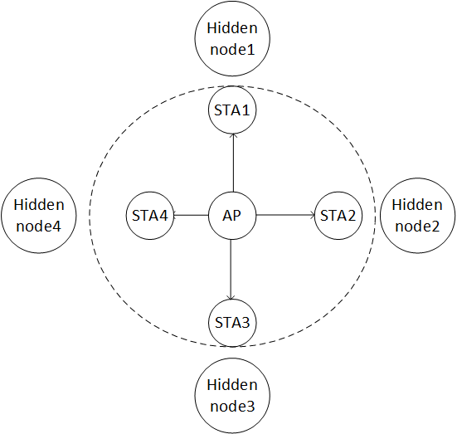
Background
Hidden node is not new for .11 protocol
For DL MU, such as DL OFDMA, small bandwidth may be allocated, which increases the data duration and require protection against hidden nodes
MU protection has been considered in 11ac [2-5] to improve performance, but there are either high overhead associated with sequential RTS/CTSs or no full protection (Summary provided in the next slide)

Slide 11
MU protection proposal in 11ac
Proposal [2-5]
Sequential RTS/CTS
Single RTS/CTS
CTS-to-self
MU-RTS + sequential CTS
Potential issues
Higher overhead than single RTS/CTS
No full protection
Require a new frame with trigger ability and fine CTS timing

Slide 12
Proposal
Propose to define a frame, called MU-RTS in this presentation, that solicits simultaneous CTS responses to protect DL MU transmission
Similar to trigger frame [6], MU-RTS provides
Time synchronization among MU STAs based on the end of the MU-RTS
Frequency offset correction based on the common AP reference
MU-RTS will have signaling to identify the solicited STAs
The CTS responses will be transmitted simultaneously to reduce overhead and need to be exactly the same, i.e., the same scramble seed and data rate

Slide 13
Proposal
To have the same scramble seed and data rate for simultaneous CTS responses, propose the following
The scramble seed of simultaneous CTS is same as the scramble seed of the frame which triggers simultaneous CTS.
The transmission rate of simultaneous CTS shall use the primary rate based on the rate or MCS of the frame that triggers simultaneous CTS.

Slide 14
Discussion
Performance of simultaneous CTS responses
Our simulations indicate that performance of simultaneous CTS responses is similar to SU CTS and may be better than SU CTS (See Appendix for analysis)
No collision detection for each user
Due to simultaneous CTS responses, AP does not know who respond CTS, and there are no collision detection
Note that collision will happen when AP transmits DL MU directly
If there are hidden nodes, the scheme still improves efficiency by resolving hidden nodes (See Appendix for analysis)
NAV cancellation
NAV cancellation could be defined for 11ax STAs
If AP knows no STA responds CTS, then AP could send CF-End
Otherwise, AP could simply proceed with DL transmission

Slide 15
Conclusion
Efficient MU protection mechanism should be designed to protect DL MU transmission from hidden node
In this contribution, we propose the following DL MU protection mechanism
a frame that solicits simultaneous CTS responses to protect DL MU transmission

Slide 16
Straw poll #1
Do you agree to add the following text into 11ax SFD?
The spec shall define a frame that solicits simultaneous CTS responses to protect DL MU transmission
Yes:
No:
Abstain

Slide 17
Straw poll #2
Do you agree to add the following text into 11ax SFD?
The scramble seed of simultaneous CTS is same as the scramble seed of the frame which triggers simultaneous CTS. The transmission rate of simultaneous CTS shall use the primary rate based on the rate or MCS of the frame that triggers simultaneous CTS.
Yes:
No:
Abstain

Slide 18
Reference
11-15-0132-05-00ax-spec-framework.docx
11-10-1124-02 Multi-RTS Proposal
11-10-1067-00 Multiple CTSs in MU-MIMO Transmission
11-10-0335-01 Considerations on MU-MIMO Protection in 11ac
11-10-1293-03 Performance evaluation of MU-RTS under OBSS environment
11-15-0365-00 UL MU Procedure

Slide 19
Appendix – Simulation for Simultaneous CTS Responses
Setting:
1 antenna at STA and 1 antenna at AP
AP with one antenna emulates the reception at neighboring STAs
Considered Scenarios
SU CTS: one STA transmits CTS in uplink
MU CTS: four STAs transmit CTS in uplink
Tx power offset for 4 STAs (0dB/-3dB/-6dB/-9dB)
Fixed delay for 4 STAs (0ns/200ns/400ns/800ns; 0ns/1600ns/400ns/800ns)
The 1st STA (0dB power offset) is considered for PER calculation

Slide 20
Results
The gain of MU-CTS comes from the diversity of different Tx delay
Note that the BPSK modulated CTS is very robust to frequency offset. We try 1kHz CFO for each station, and the PER curve is almost the same as CFO error free

Slide 21
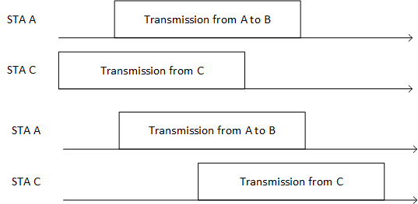
Appendix – Improvement for Hidden Node
Classify two events:
Collision: transmission fails at the preamble
Hidden Nodes: transmission succeeds at the preamble, but part of the transmission is destroyed by transmission from hidden node
Example: STA A and STA C are hidden. For transmission from STA A to STA B,
Collision
Hidden Node

Slide 22
Appendix – Improvement for Hidden Node
Assumption for overhead
Common CTS frame – 40 us
SIFS – 16 us
MU-RTS
20us legacy preamble
MAC header 20 bytes (Size of RTS)
M users * 14 bits (AID)
Length: 20us +M*(14)/6 us+160/6=47+3*M us
Total overhead:
MU-RTS+SIFS+Common CTS+SIFS => 119+3*M us

Slide 23
Appendix – Improvement for Hidden Node
Efficiency Analysis
Assume that there are M users
Assume for each user
Ph: probability of hidden node
α: portion of destroyed packets under hidden node
Pc: probability of collision
T: Txop duration
Equal share of the bandwidth with average data rate D
Data Transmitted without protection with duration T: Eo
M*D*T[(1-Pc)(1-Ph)+(1-Pc) (1-α)Ph) $=\text{M}\text{∗}\text{D}\text{∗}\text{T}$(1-Pc) (1-αPh)
Data Transmitted with duration T and protection: E1
M*D*T(1-Pc)$\frac{T}{T+Overhead}$ =M*D*T (1-Pc) $\frac{T}{T+119+3∗M}$

Slide 24
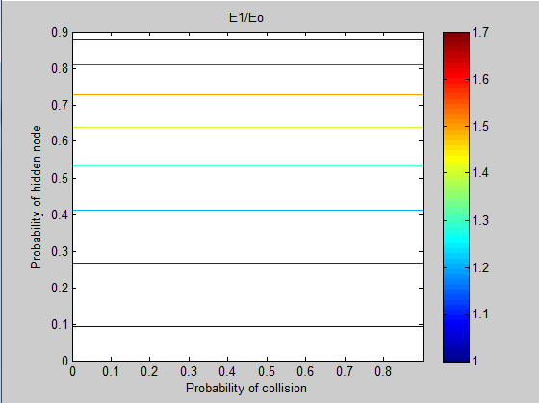
Results of E1/Eo
Let M=9, T=3000us, α=0.5
When Ph>0.1, protection has better efficiency
Note that similar conclusion can be obtained from different parameter settings

