Slide 1
IEEE 802 JTC1 Standing Committee
Slides for IEEE 802 EC opening
13 July 2015
Authors:
Name | Company | Phone | email
Andrew Myles | Cisco | +61 2 84461010 +61 418 656587 | amyles@cisco.com

Slide 2
The IEEE 802 JTC1 SC has two slots at the Hawaii plenary meeting, but will probably only use one slot
Tuesday
14 July 2015, PM1
Thursday
16 July 2015, PM1
Call to Order
Select recording secretary <- important!
Approve agenda
Conduct meeting according to agenda
Recess
Call to Order
Select recording secretary <- important!
Conduct meeting according to agenda
Adjourn

Slide 3
IEEE 802 JTC1 SC has a high level list of agenda items to be considered in Hawaii
Abstract of main agenda items
  Review status of SC6 interactions
    Review liaisons of drafts to SC6
    Review notifications of projects to SC6
    Review status of FDIS ballots
    Review the new Central desktop process FDIS tracking process
  Discuss various matters relating to Belgium SC6 meeting
    Hear report from HoD

Slide 4
The new Central Desktop area for the “Adoption of IEEE 802 standards by ISO/IEC JTC1” is ready to go
  IEEE-SA staff have completed the first iteration of the Central Desktop area for the Adoption of IEEE 802 standards by ISO/IEC JTC1
  The public view of the process is up and running
    See https://ieee-sa.centraldesktop.com/802psdo/
  WG Chairs (and some others) will have management access (after today), which will allow them to update the process steps
  Training will be available to WG Chairs from IEEE-A staff as they need to use the new tool

Slide 5
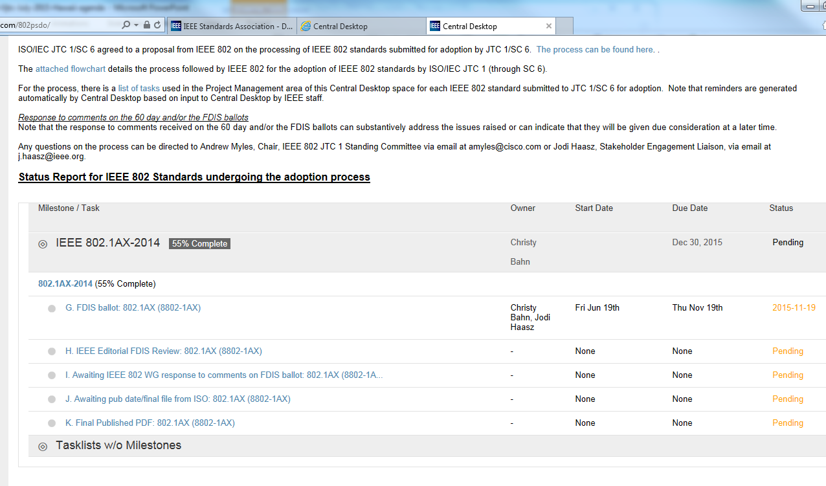
The new Central Desktop area for the “Adoption of IEEE 802 standards by ISO/IEC JTC1” is ready to go

Slide 6
IEEE 802 has pushed 13 standards completely through the PSDO ratification process
IEEE 802 standard | 60 day pre-ballot | 5 month FDIS ballot | Comments resolved by IEEE
802.11 | Passed (2012) | Passed in 2012 | Liaised in Nov 2013
802.1X | Passed (2013) | Passed (21 Oct 2013) | Liaised in Jan 2014
802.1AE | Passed (2013) | Passed (21 Oct 2013) | Liaised in Jan 2014
802.1AB | Passed (May 2013) | Passed (18 Dec 2013) | Liaised in May 2014
802.1AR | Passed (May 2013) | Passed (18 Dec 2013) | Liaised in May 2014
802.1AS | Passed (May 2013) | Passed (18 Dec 2013) | Liaised in May 2014
802.3 | Passed (2013) | Passed (16 Feb 2014) | Not required
802.11aa | Passed (Feb 2013) | Passed (28 Jan 2014) | Liaised in July 2014
802.11ad | Passed (Feb 2013) | Passed (28 Jan 2014) | Liaised in July 2014
802.11ae | Passed (Feb 2013) | Passed (28 Jan 2014) | Liaised in July 2014
802.22 | Passed (May 2014) | Passed (Feb 2015) | Not required
802.1AEbw | Passed (Jan 2014) | Passed (Feb 2015) | Liaised in April 2015
802.1AEbn | Passed (Jan 2014) | Passed (Feb 2015) | Liaised in April 2015

Slide 7
IEEE 802 has ten standards in the pipeline for ratification under the PSDO
IEEE 802 standard | 60 day pre-ballot |  | 5 month FDIS ballot |  | Comments resolved
802.11ac | Passed | Sep 2014 | Closes | 11 Jul 15 | Sent in Nov 2014
802.11af | Passed | Sep 2014 | Closes | 11 Jul 15 | Sent in Nov 2014
802 | Passed | Oct 2014 | Closes | 2 Nov 15 | Sent in Feb 2015
802.1Xbx | Closed | 19 Mar 15 | Waiting | - | Sent in Jun 2015
802.1Q-Rev | Closed | 13 Mar 15 | Waiting | - | Sent in Jun 2015
802.1AX | Closed | 30 May 15 | Closes | 19 Nov 15 | No comments
802.1BA | On hold | - | - | - | -
802.1BR | On hold | - | - | - | -
802.3.1 | Passed | Oct 2014 | Passed | 19 Jun 15 | No comments
802.22a | On hold |  | - |  | -

Slide 8
The SC will hear a report on the SC6 meeting in Ghent in May 2015: not much happened!
  Adrian Stephens was the IEEE 802 HoD at the SC6 meeting
    His report is https://mentor.ieee.org/802.11/dcn/15/11-15-0728-00-0jtc-may-jtc1-sc6-meeting-hod-report.ppt; extract of report is in following pages
    Note: Adrian was HoD for IEEE 802, not IEEE-SA
  Jodi Haasz was in attendance representing IEEE-SA
  Generally, not much of interest happened in WG1 or WG7
    IEEE 802 reported – with newly discovered interest in 802.14 from SC6
    No interesting decisions were made
    Some possibility of telcons in the future
    Leadership changed
    Next meeting in Xi’an in late Feb 2016

Slide 9
There are likely actions for IEEE 802 EC and WG Chairs coming out of this week’s SC meeting
IEEE 802 EC
  Friday: Appoint Vice Chair
  …

