Slide 1
TGax PHY Ad Hoc May 2015 Meeting Agenda
Date: 2015-05-11
Authors:

Slide 2
IEEE 802.11 TGax High Efficiency WLAN PHY Ad Hoc
Co-Chairs:
Yakun Sun (Marvell)
Jianhan Liu (Mediatek)
Bo Sun (ZTE)

Slide 3
Agenda Items
Call meeting to order
Patent policy, etc. (Call for Potentially Essential Patents)
Set and approve agenda
Review ad hoc rules
Technical Presentations approved by 802.11ax for presentation this week, and related straw polls
Any other technical presentations

Slide 4
Meeting Protocol, Attendance, Voting & Document Status
Please announce your affiliation when you first address the group during a meeting slot
Cell Phones to be silent or Off
Register your attendance via https://imat.ieee.org while on meeting SSID (e.g. Verilan-secure)
Make sure your badges are correct
If you plan to make a submission be sure it does not contain company logos or advertising
Questions on Voting status, Ballot pool, Access to Reflector, Documentation, Member’s Area
Contact Jon Rosdahl – jrosdahl@ieee.org
Slide 4

Slide 5
Patent Policy and Other Guidelines
Following 5 slides

Slide 6
Instructions for the WG Chair
The IEEE-SA strongly recommends that at each WG meeting the chair or a designee:
Show slides #1 through #4 of this presentation
Advise the WG attendees that:
The IEEE’s patent policy is consistent with the ANSI patent policy and is described in Clause 6 of the IEEE-SA Standards Board Bylaws;
Early identification of patent claims which may be essential for the use of standards under development is strongly encouraged;
There may be Essential Patent Claims of which the IEEE is not aware. Additionally, neither the IEEE, the WG, nor the WG chair can ensure the accuracy or completeness of any assurance or whether any such assurance is, in fact, of a Patent Claim that is essential for the use of the standard under development.
Instruct the WG Secretary to record in the minutes of the relevant WG meeting:
That the foregoing information was provided and that slides 1 through 4 (and this slide 0, if applicable) were shown;
That the chair or designee provided an opportunity for participants to identify patent claim(s)/patent application claim(s) and/or the holder of patent claim(s)/patent application claim(s) of which the participant is personally aware and that may be essential for the use of that standard
Any responses that were given, specifically the patent claim(s)/patent application claim(s) and/or the holder of the patent claim(s)/patent application claim(s) that were identified (if any) and by whom.
The WG Chair shall ensure that a request is made to any identified holders of potential essential patent claim(s) to complete and submit a Letter of Assurance.
It is recommended that the WG chair review the guidance in IEEE-SA Standards Board Operations Manual 6.3.5 and in FAQs 12 and 12a on inclusion of potential Essential Patent Claims by incorporation or by reference.
Note: WG includes Working Groups, Task Groups, and other standards-developing committees with a PAR approved by the IEEE-SA Standards Board.

Slide 7
Participants, Patents, and Duty to Inform
All participants in this meeting have certain obligations under the IEEE-SA Patent Policy. Participants:
“Shall inform the IEEE (or cause the IEEE to be informed)” of the identity of each “holder of any potential Essential Patent Claims of which they are personally aware” if the claims are owned or controlled by the participant or the entity the participant is from, employed by, or otherwise represents
“Personal awareness” means that the participant “is personally aware that the holder may have a potential Essential Patent Claim,” even if the participant is not personally aware of the specific patents or patent claims
“Should inform the IEEE (or cause the IEEE to be informed)” of the identity of “any other holders of such potential Essential Patent Claims” (that is, third parties that are not affiliated with the participant, with the participant’s employer, or with anyone else that the participant is from or otherwise represents)
The above does not apply if the patent claim is already the subject of an Accepted Letter of Assurance that applies to the proposed standard(s) under consideration by this group
Quoted text excerpted from IEEE-SA Standards Board Bylaws subclause 6.2
Early identification of holders of potential Essential Patent Claims is strongly encouraged
No duty to perform a patent search
Slide #1

Slide 8
Patent Related Links
All participants should be familiar with their obligations under the IEEE-SA Policies & Procedures for standards development.
Patent Policy is stated in these sources:
IEEE-SA Standards Boards Bylaws
http://standards.ieee.org/guides/bylaws/sect6-7.html#6
IEEE-SA Standards Board Operations Manual
http://standards.ieee.org/guides/opman/sect6.html#6.3
Material about the patent policy is available at
http://standards.ieee.org/board/pat/pat-material.html
If you have questions, contact the IEEE-SA Standards Board Patent Committee Administrator at patcom@ieee.org or visit http://standards.ieee.org/board/pat/index.html
This slide set is available at http://standards.ieee.org/board/pat/pat-slideset.ppt
Slide #2

Slide 9
Call for Potentially Essential Patents
If anyone in this meeting is personally aware of the holder of any patent claims that are potentially essential to implementation of the proposed standard(s) under consideration by this group and that are not already the subject of an Accepted Letter of Assurance:
Either speak up now or
Provide the chair of this group with the identity of the holder(s) of any and all such claims as soon as possible or
Cause an LOA to be submitted
Slide #3

Slide 10
Other Guidelines for IEEE WG Meetings
All IEEE-SA standards meetings shall be conducted in compliance with all applicable laws, including antitrust and competition laws.
Don’t discuss the interpretation, validity, or essentiality of patents/patent claims.
Don’t discuss specific license rates, terms, or conditions.
Relative costs, including licensing costs of essential patent claims, of different technical approaches may be discussed in standards development meetings.
Technical considerations remain primary focus
Don’t discuss or engage in the fixing of product prices, allocation of customers, or division of sales markets.
Don’t discuss the status or substance of ongoing or threatened litigation.
Don’t be silent if inappropriate topics are discussed … do formally object.
---------------------------------------------------------------
See IEEE-SA Standards Board Operations Manual, clause 5.3.10 and “Promoting Competition and Innovation: What You Need to Know about the IEEE Standards Association's Antitrust and Competition Policy” for more details.
Slide #4

Slide 11
Ad Hoc Groups Operation
Straw Polls are only allowed during Ad Hoc group meeting // no motions, anyone can vote
A straw poll affecting the Spec Framework has to start with,
Do you agree to add to the TG Specification Frame work document?
A straw poll needs to achieves at least 75% to be converted to a motion at the TG level.
Each Presentation will be limited to 20 minutes.

Slide 12
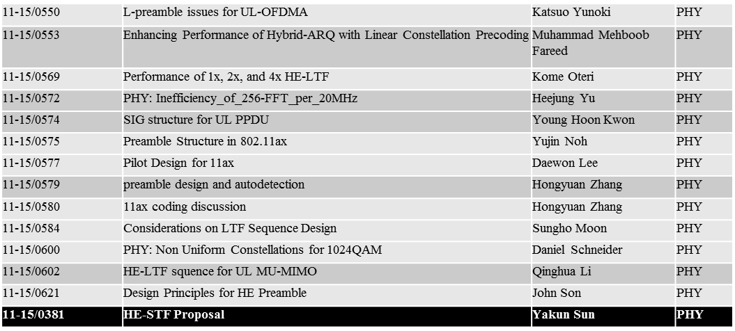
Submissions (PHY)

