Slide 1
IEEE 802.11 TGay Use Cases
Date: 2015-5
Authors:

Slide 2
Abstract
This document discusses the use cases for 11ay which are in line with requirements within 11ay proposed PAR/CSD documents.

Slide 3
Usage Model 1: Ultra Short Range (USR) Communications
Pre-Conditions:
User has WLAN connectivity between a portable/mobile device (e.g., tablet, smart phone) and a fixed device (e.g., tollgate, kiosk).
Application:
Users can download mass data (e.g. video/audio clip, e-magazine, picture library etc.) from a fixed device. 100 jpeg (picture) files of 5MB takes 0.6 second over a single hop 10Gbps link.
Jitter is not critical. The key metric is the user’s time spent to do a transfer. Less than 1 second is acceptable. 1-5 seconds may be acceptable. More than 5 seconds may not be acceptable.
Environment:
Environments can be variable, e.g., crowded public space such as train stations, airports, shopping mall, office.
Link distance can typically be up to 10 cm.
Typically transmissions are Line of Sight.
All devices will typically be stationary during usage.
Traffic Conditions:
Only a single portable/mobile device can access to a fixed device at a time with simply best-effort rates.
There is typically no interference from other mm-wave links due to ultra short link distance.
Traffic is unidirectional.
Use Case:
User places a portable/mobile device in a definite position relative to a fixed device.
Secure pairing between the portable/device device and the fixed device is completed without user configuration.
The pre-selected application is launched and the pre-selected task (e.g., download video clip) is started.
The application exits when task is complete.

Slide 4
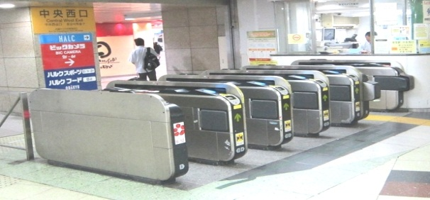

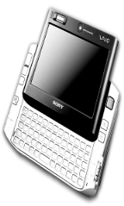


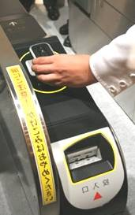





Usage Model 1: USR Communications
Rapid content transfer between a portable /mobile device (e.g., tablet, smart phone) and a fixed device or between two portable/mobile devices within a ultra short separation
  Assumption: 1:1
  Fast link setup: < 100msec
  Transaction time: <1sec
  Ultra short link distance: <10cm
  Very low power consumption for portable/mobile device: < 400mW
  Target data rate: 10 Gbps
@ 70% MAC-App efficiency | Size | 11ay Device | 11ad Device
4K UHD movie | 60 GB | 1.1 min @ 10Gbps | 11.4 min@1Gbps
HD movie | 5 GB | 5.7 sec @ 10Gbps | 57.1 sec @ 1Gbps
SD movie | 1.5 GB | 1.7 sec @ 10Gbps | 17.1 sec @ 1Gbps
Picture library | 1 GB | 1.1 sec @ 10Gbps | 11.4 sec @ 1Gbps
4K movie trailer | 1.2 GB | 1.4 sec @ 10Gbps | 13.7 sec @ 1Gbps
HD movie trailer | 100 MB | 0.1 sec @ 10Gbps | 1.1 sec @ 1Gbps
E-magazine | 250 MB | 0.3 sec @ 10Gbps | 2.8 sec @ 1Gbps
Train Station
Kiosk
Movie, video/audio clip, magazine, newspaper, etc.
Movie, video/audio clip, picture library, etc.
Video/audio clip, magazine, newspaper, etc.

Slide 5
Usage Model 2: 8K UHD Wireless Transfer at Smart Home
Pre-Conditions:
11ay is interfaced between a source device (e.g. set-top box, blu-ray player, tablet, smart phone) and a sink device (e.g. smart TV, thin display) to stream 8K UHD contents at home.
Environment:
Devices are operating in close proximity at home. Typical distance between devices are < 5m.
When it comes to the link between a set-top box and a thin display (or smart TV), the set-top box can be inside a table which may provide some SNR loss.
Application:
At least 28 Gbps data rate is required for a link to stream uncompressed 8K UHD streaming (60 frames per second, 24 bits per pixel, 4:2:2 Chroma sampling at minimum).
Jitter <5ms, delay<5ms.
Traffic Conditions
Only a single link may exist at a time.
There is typically no interference from other mm-wave links at home.
Traffic is mostly unidirectional.
Use Case
Split TV: TV is on the wall as a thin display and set-top box works as a controller, wirelessly interfaced by 11ay to replace wired interfaces.
Smart display (Mirroring): Uncompressed 8K UHD streaming is through smart TV. 8K UHD video can be real-time transferred from smartphone/tablet to smart TV. When user enters home, the video which the user is watching in his/her smart phone is seamlessly played in the smart TV.

Slide 6
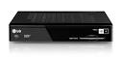
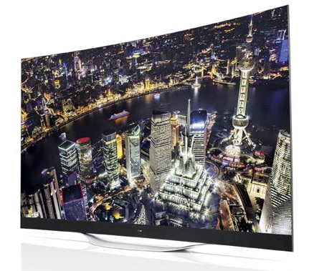
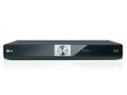

Usage Model 2: 8K UHD Wireless Transfer at Smart Home
Requirements
- Provides full rate >28 Gbps
- High QoS/QoE (latency < 5ms, jitter<5ms)
- P2P
8K UHD
Service
Replacement
of wired interface
Set-top box
(TV controller)
Wireless Transfer
from fixed device
Blu-ray player
TV or Display
Wireless Transfer
from mobile device
Smart phone/Tablet

Slide 7
Usage Model 3: Augmented Reality/Virtual Reality Wearable devices
Pre-Conditions:
AR/VR Wearable devices (e.g. augmented/virtual reality goggles, etc.) and their managing devices (e.g. gaming console, smartphone, etc.) are equipped with 11ay interfaces.
The device and its managing device form a PBSS. All desired media content, processing power, and control needed by the devices reside on the managing device (i.e. internet connectivity not required).
Application:
User plays game using his AR/VR goggles communicate with the managing device (e.g. gaming console, smartphone, etc.). User uses the wearable (e.g. body sensor) communicates with managing device to store/process data and receive control information.
All devices must be able to tolerate moderate user movements
For AR/VR devices and some wearable devices, data rate at ~20 Gbps, latency < 5 ms, jitter <5 ms, PER<10E-2.
Environment:
All Devices operate in home or in public.
At home < 4 interferers. In public (e.g. commuter train) up to 500 potential interferers. Interferers have varying QoS requirements.
Transmissions (both desired signal and interference) can be LOS or NLOS. The device-to-device link is < 5m .
Traffic Conditions:
Potential obstruction of LOS. and interference from other 11ay users (e.g. other wearables, access points, etc.)
Devices may be stationary or moving (pedestrian speed) while in use.
Use Case:
AR/VR wearable devices
User plays games by wearing his AR/VR goggle.
The goggle communicates with the game console at the end of living room.
User constantly moves in order to adjust to the virtual reality environments.
QoS/QoE requirements are met.

Slide 8

Usage Model 3: Augmented Reality/Virtual Reality wearable devices
AR/VR wearable devices are used in home and public
AR/VR is touting close-to-reality user experience with 3D video and 7.1 audio
  The wearable device is subject to low level movement (neck roll, pitch, yaw, etc.)
  The video quality can support up to 3D 4K
  The operating environment is usually indoor <= 10 ft
  Current products include Sony HMZ-T3 and VR glasses by Oculus
Features | Requirements | Notes
Distance | 10ft | Sony HMZ T1 supports up to 7ft Wireless HD
Video Quality | 3D 4K [1] | HDMI 2.0
Range of Motion for head-worn wearable | Neck Roll [2] | 0.17 (s/60deg)
 | Neck Pitch[2] | 0.14(s/60deg)
 | Neck Yaw[2] | 0.13 (s/60deg)
Range of motion for wearables and handhelds | Pedestrian speeds

Slide 9
Usage Model 4: Data Center 11ay Inter-Rack Connectivity
Pre-Conditions:
Data Center employs the 11ay interfaces as the secondary/tertiary interfaces in lieu of fiber optics failure. The Data Center is fully operational with high demands of 99.99% of reliability and availability
Application:
The ToR switch can transmit /receive via the 11ay interface to reach the EoR switch through multiple hops. The EoR switch can reach the hub switch through the 11ay interfaces. The data being stored transfers at ~40 Gbps, disruption tolerance is <100msec, PER<10E-2 [1].
The data could traversal multiple hops (<=5) in order to reach the EoR switches.
Environment:
Devices are operating in specialized environments with sustainable temperature, humidity and other physical quality of air flow. Transmissions are mostly LOS. Distances between adjacent racks are standard rack width and distance between adjacent rows are ~4’
Traffic Conditions:
Potential interference from environmental factors and noise.
Use Case:
The main fiber 10GEthernet interface is down
The ToR switch quickly detects the failure and wakes up the dormant 11ay interface ASAP
Data continuously flows over the 11ay interface to the next EoR switch within 100ms
No administrator’s intervention to restore the Network

Slide 10
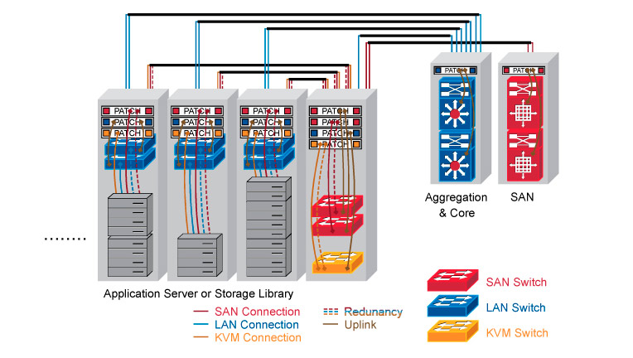
Usage Model 4: Data Center
Links | Link Capacity | Link Description | PER< [3] | Distance | Link Setup time | Security (Confidentiality/Integrity)
A<->B | >10Gbps | ToR connects to EoR | 10^-2 | 20’’ [5] | <100ms | C/I
A<->C | >10Gbps | ToR connects to EoR | 10^-2 | 40’’ | <100ms | C/I
A<->D | >10Gbps | ToR connects to EoR | 10^-2 | 60’’ | <100ms | C/I
A<->E | >20Gbps | EoR to Aggregated Switch (Multi-hop) | 10^-2 | 4 ‘ | <100ms | C/I
E<->F | >20Gpbs | Aggregated Switch to SAN switch | 10^-2 | 4’ | <100ms | C/I
E
F
D
C
B
A
11ay interfaces are best suit for backup interfaces when the fiber links are failed during emergency or network devices maintenances,
As back up interfaces, no active link up are needed all the time but when the failure is occurred, the backup links are required to be quickly setup (<100 msec [4] setup time)
Some of 11ay interfaces function as multi-hop links, i.e A<->E, Maximum # of hops <=5

Slide 11
Usage Model 5: Video/Mass-Data Distribution/Video on Demand System
Pre-Conditions:
The 11ay interfaces are deployed in ceilings of large room/space.
Multiple users have 11ay connectivity between user-devices (fixed or portable) and The 11ay interfaces.
Application:
The HD video/mass-data information can be distributed to the individual users simultaneously (broadcast). For example, there are multiple screens that show the same video in a exhibition or gymnasium. Students watch the same courseware on the screen of their own device.
Users can use VOD system to watch moves/videos in which they are interested.
Environment:
Environment can be highly variable, e.g. crowded public place, classroom, waiting room at train station/airport, in flight, train, ship, bus, exhibition, gymnasium, etc.
A ceiling installation for 11ay AP is recommended because the mm-wave links might be easily blocked by obstacles such as furniture, human body on the floor.
The device can be a potable or mobile device, or can be fixed deployed such as large-screen TV, touch screens in the back of the seat in flight/train, etc.
Transmissions can be LOS or NLOS. Distance between far corners of the room are <100m.
Traffic Conditions:
One or more devices can access to a 11ay interface to form a service set. Multiple links and data streams have varying QoS, reliability, and throughput requirements, some with simply best-effort rates (downloading), others with a certain data rate and QoS requirements(video, VoIP, etc.)
Data steam can be broadcast (one point to multiple point).
The devices might be stationary or might be used with low-mobility during usage.
The traffic could be transmitted in the point to multipoint fashion.
Use Case:
One or more communication links are set up between user devices and 11ay interfaces.
Users receive the same video/massive-data in broadcast mode or request video/video gaming/audio via VOD system respectively.

Slide 12
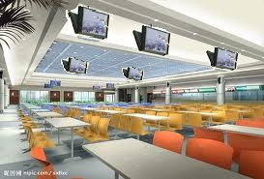
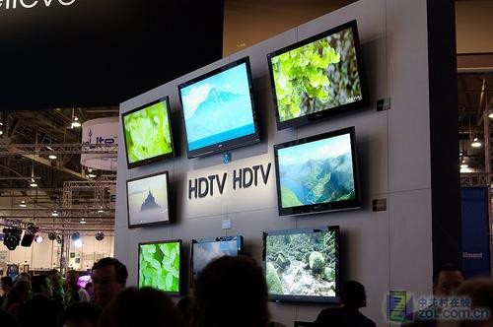
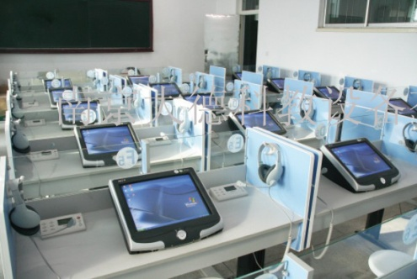
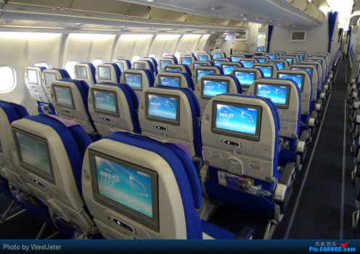
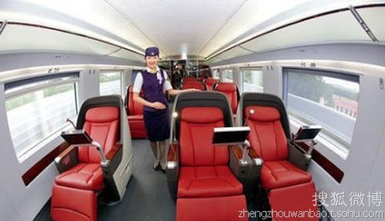
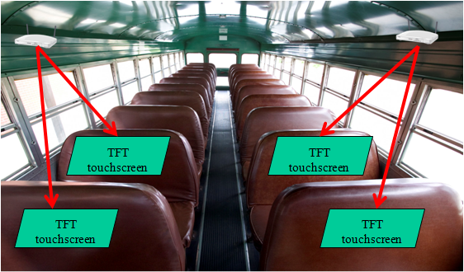
Usage Model 5: Video/Mass-Data Distribution/Video on Demand System
APs are located in ceilings and seats.
Users interact with AP through touch screens in front of them or wireless controllers.
Video streaming, VOD, video gaming, audio, downloading courseware in classroom, etc.
HD-Video distribution in dining-hall, exhibition etc.; in-Flight/Train/Ship/Bus entertainment.[6]
Dining-Hall
Exhibition
Classroom
Flight
High-Speed Rail
Bus

Slide 13
Usage Model 6: Mobile Offloading and Multi-Band Operation (MBO)
Pre-Conditions:
Mobile devices are equipped with Cellular interface and Wi-Fi interfaces
Mobile devices are equipped with multiple Wi-Fi bands (2.4Ghz,5Ghz and 60Ghz)
Application:
Mobile device is capable of off-load the video traffic from cellular interface to the high throughput 60Ghz interface. In tri-band scenario, offloading can also occur with traffic being switched to higher throughput 60Ghz band for band efficiency.
The data transfers at ~20 Gbps, with some low mobility (5km/h etc) Handoff disconnection <100ms, PER<10E-2.
Environment:
Devices are operating in both outdoor and indoor environment with some potential LOS obstruction objects or interference from other sources. Transmissions are mostly LOS. Distance between far corners of the room are <100m
Traffic Conditions:
Potential interference from environmental factors and obstruction of the LOS.
The devices might be stationary or might be used with low-mobility during usage.
Use Case:
User is using his smart phone to join a video conference over the cellular interface
He walks into an Mobile Hotspot which has the 11ay interface
By auto-detecting the mobile hotspot in proximity, his smart phone automatically initiate the offloading.
Without even noticing the smooth transition, user is able to keep his video conference going without any disruption.
-----
User is using his tablet within office building to retrieve some large documents
His device is equipped with tri-band wifi chips
His device initiates the SFTP connectivity through the 11ac interface
But the device automatically switch to the 11ay at the best range to speed up the file downloading.
When file downloading is finished, 11ay interface is put as idle state.

Slide 14



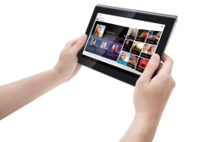
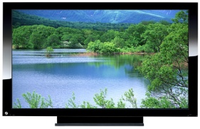
Usage Model 6– Mobile Offloading and MBO
WiFi Offloading
Based on an analysis [7], by the end of 2013 there exist about 1.4-billion smart phones and 420-million tablets used worldwide.
Mobile devices like smart phones and tablets may operate multiple functions (call, internet access, data transfer and/or video streaming etc.) simultaneously, some of which require very high data rate transmission.
WiFi can offload high-speed data through the 60 GHz band and relatively low-speed data through the 2.4/5 GHz bands.
Individual mobile users require good user experience with low mobility and/or a change of gesture.
Cellular
Offloading (60GHz)
Offloading (2.4/5GHz)
Mobile Display
3D, HD
Uncompressed video

Slide 15
Usage Model 7: Mobile Fronthauling
Pre-Conditions:
RRHs (Remote Radio Heads) are located around Base Band Unit (BBU) which is connected to mobile core network.
Application:
Generally BBU and RRHs are connected by optical fibers. However, especially in rural areas or in disaster areas, optical fibers are unavailable. In such areas, cellular areas can be easily expanded by using 11ay links.
The data transfers at ~20 Gbps. High reliability and availability (99.99%).
Environment:
Devices are operating in outdoor environment with LOS. Distance is <200m.
Traffic Conditions:
RRHs and BBU are static.
Number of RRHs may be increased due to traffic load increasing.
QoS support is necessary for cellular traffic to carry real-time traffic such as voice and video.
Use Case:
Mobile operators deploy BBU/RRHs with 11ay I/Fs to expand 5G/4G coverages, especially in an area without optical fiber.
Mobile phone users can access to mobile core NW by RRH with 11ay I/Fs.

Slide 16


Usage Model 7: Mobile Fronthauling
Requirements
- Provides full rate ~20 Gbps ,
less than 200m LOS @60GHz band
- QoS
- 99.99% of availability
Similar use-case discussed in [8]
RRH
BBU
RRH
RRH
EPC
[1]

Slide 17
Usage Model 8: Wireless Backhauling with Single Hop
Pre-Conditions:
A number of 11ay APs forms a P2P/P2MP wireless outdoor backhaul connectivity
Application:
The Wireless Backhaul could be used for small cell backhauling deployment in lieu of expensive fiber networks to access networks, inter buildings or so.
The data transfers at ~20 Gbps with link aggregation, High reliability and availability (99.99%)
High requirements for QoS/QoE [9]
Environment:
Devices are operating in outdoor environment with LOS. Distance is <1000m
Traffic Conditions:
-Potential interference from environmental factors and obstruction of the LOS, beam un-alignment.
Use Case:
Alice fire up her laptop at the bus stop to download some UHD movie while waiting
The bus stop mounted the 11ay AP and connected wirelessly to another 11ay Portal AP mounted on the outside curb light-pole.

Slide 18



Usage Model 8: Wireless Backhaul with Single hop
Requirements
- Provides full rate >20 Gbps , less than 1000m LOS @60Ghz band
- Low latency < 35ms
- P2P or P2MP
- Highly secure
- QoS/QoE
- Self Backhauling
- 99.99% of availability
- Complies with FCC Part 15 regulations
Backhaul @60GHz
11ay AP
11ay AP
N-LOS Access
LOS Access
BUS STOP

Slide 19
Usage Model 9: Wireless Backhauling with Multi-hop
Pre-Conditions:
A number of 11ay APs forms a P2P/P2MP wireless out door backhaul connectivity. The topology of the network could allow the connectivity through multiple hops
Application:
The Wireless Backhaul could be used for small cell backhauling deployment in lieu of expensive fiber networks to inter-connect offices, data centers and many other IT applications.
The data transfers at ~2 Gbps with per link.
The maximum number of hops should not exceed 5
High reliability and availability(99.99%)
Environment:
Devices are operating in outdoor environment with LOS on each link. Distance between each link <150m
Traffic Conditions:
-Potential interference from environmental factors and obstruction of the LOS, beam misalignment.
Use Case:
Alice fire up her laptop at the bus stop to download the latest UHD movie while waiting
The bus stop mounted the 11ay AP and connected wirelessly to another 11ay Portal AP mounted on the outside curb light-pole.

Slide 20
Usage Model 9: Wireless Backhaul with Multi-hop
Requirements
- Provides full rate 2Gbps , at less than 150m LOS in @60Ghz band
- # of hops AP <5
- P2P/P2MP
- Low latency < 35ms
- Highly secure
- QoS/QoE
- Self Backhauling
- 99.99% of availability
- Complies with FCC Part 15 regulations
Backhaul @60GHz
Backhaul @60GHz
Backhaul @60GHz
11ay AP
11ay AP
11ay AP
11ay AP
N-LOS Access
N-LOS Access
BUS STOP
BUS STOP
POP

Slide 21
Summary of Key metrics
UC # | Indoor (I)/ Outdoor (O) | bne | Throughput | Topology | Latency | Security | Availability | Applications and Characteristics
 |  | LOS/ NLOS
1 | I | <10cm | ~10Gbps | P2P | <100ms |  |  | -Static,D2D, -Streaming/Downloading
2 | I | <5m | >28Gbps | P2P | <5ms |  |  | -Umcompressed 8K UHD Streaming
3 | I | <5m | ~20Gbps | P2P | <100ms |  |  | -Low Mobility, D2D -3D UHD streaming
4 | I | <10m | ~20Gbps | P2P/P2MP | <100ms | C/I | 99.99% | -Indoor Backhaul with multi-hop*
5 | I | <100m | >20Gbps | P2P/P2MP | <100ms | C/I |  | -Multicast -Streaming/Downloading - Dense Hotspot
6 | I/O | <100m | >20Gbps | P2P/P2MP | <100ms | C/I | 99.99% | -Multi-band -Multi-RAT operation Hotspot
7 | O | <200m | ~20Gbps | P2P/P2MP |  | C/I | 99.99% | -Fronthauling
8 | O | <1km | ~20Gbps | P2P/P2MP | <35ms | C/I | 99.99% | -Small Cell Backhauling with single hop
9 | O | <150m | ~2Gbps | P2P/P2MP | <5ms | C/I | 99.99% | -Small Cell Backhauling with multi-hop*
*: Multi-hop will build up on the scope of the DMG Relay defined in IEEE 802.11ad

Slide 22
References
[1] http://www.forbes.com/fdc/welcome_mjx.shtml.
[2] http://www.wpi.edu/Pubs/ETD/Available/etd-050112-072212/unrestricted/Fitzpatrick.pdf
Table 1: Serve Moto Speeds Obtained from output Link speeds
[3] The PER is based on requirements of 11ad, sub-clause 21.3.3.8
[4] The average CISCO Catalyst switch over time is between 35msec to 280msec,
http://www.cisco.com/c/en/us/products/collateral/switches/catalyst-6500-series-switches/prod_white_paper0900aecd801c5cd7.html
[5] IEC 60297 mechanical structures for electronic equipment with 19’’ cabinet plus some spacing
[6] https://mentor.ieee.org/802.11/dcn/14/11-14-0606-00-0wng-next-generation-802-11ad.pptx
[7] http://www.businessinsider.com/smartphone-and-tablet-penetration-2013-10
[8] 15-14-0304-11-003d-applications-requirement-document-ard.docx
[9] 3GPP TR 36.932 V12.1.0 (2013-03): Scenarios and requirements for small cell enhancements for E-UTRA and E-UTRAN
[10]http://cbnl.com/sites/all/files/userfiles/files/Examining%20small%20cell%20backhaul%20requirements%20webinar%2015%20Feb%202012.pdf
22

Slide 23
References
[11] 11-14-1185-00-11ay-11ay-usage-scenarios
[12] 11-14-1166-01-11ay-11ay-use-cases
[13] 11-14-1160-00-11ay-ultra-short-range-usr-communications-usage-models-for-11ay
[14] 11-14-1249-01-11ay-backhaul-support-in-ng-60
[15] 11-14-1151-05-11ay-11ay-proposed-par
[16] 11-14-1152-06-11ay-11ay-proposed-csd
[17] 11-15-0345-00-8K-UHD-Wireless-Transfer-Usage-Model-for-11ay

Slide 24
Straw Poll
Do you agree that the use cases described in document 11-15/328r4 represent a sufficient set of use cases for the 11ay SG and future TG?
Yes:
No:
Need to know more:

