Slide 1
OBSS Preamble Error Probability
Date: 2015-05-11
Authors:
Notes:
DL and UL

Slide 2
Background
The OBSS preamble detection probability impacts much on the overall network behavior.
[1, 2] showed that errors on OBSS preambles were very high around even 90% in both 11ax SS1 and SS2 [3] via MAC Simulator.
In this presentation, we provide our initial results about the OBSS preamble error probability via Integrated Simulator where we find that the error probability is related closely to the simulation configuration.

Slide 3
Simulation Scenario
20MHz channel at 5G
1*1 antenna: 20dBm AP Tx power, 15dBm (-2dBi) STA Tx power
Standard 11ax SS1 – Residential
5 floor, 20 rooms per floor, 10 STAs per room
Reuse 3 randomly
Standard 11ax SS3 – Indoor
19 BSSs, 30 STAs per BSS
Standard 11ax SS4 – Outdoor
19 BSSs, 50 STAs per BSS

Slide 4
Simulation Parameters
PHY parameters
Preamble model | [4, 5]
CCA-ED | -62dBm/20MHz (measured after large-scale fading)
Rx sensitivity/CCA-SD | -82dBm/20MHz (a packet with lower rx power is dropped)
Link Adaption | SINR feedback
Channel estimation | ideal
PHY abstraction | RBIR, BCC
MAC parameters
Access protocol | [EDCA, AC_BE with default parameters] [CWmin = 15, CWmax = 1023, AIFSn=3 ]
Queue length | A single queue for each traffic link is set inside AP/STA sized of 2000 packets
Traffic type | UDP CBR with rate 10^8bps
MPDU size | 1540 Bytes (1472 Data + 28 IP header + 40 MAC header)
Aggregation | [A-MPDU / max aggregation size / BA window size, No A-MSDU, with immediate BA], Max aggregation: 64 or 2 MPDUs with 4-byte MPDU delimiter
Max number of retries | 10
Beacon | Disabled
RTS/CTS | ON or OFF

Slide 5
Preamble Model
Signal Detect
Preamble Error Detect
Preamble
PPDU
The receiver will be locked by the first-arrived packet with signal strength above -82dBm, and later-arrived packets are considered as interference[4,5].
The receiver should be in IDLE status to detect an incoming preamble
Preamble decoding modeled as a sub-frame decoding
The packet length is calculated based on the assumption of 3-byte/4us (MCS0)
Box0 PHY abstraction of SINR-to-PER is used [6]
Preamble error% = 1-Total successfully decoded OBSS preambles/Total attempted decodes of OBSS preambles [2]

Slide 6
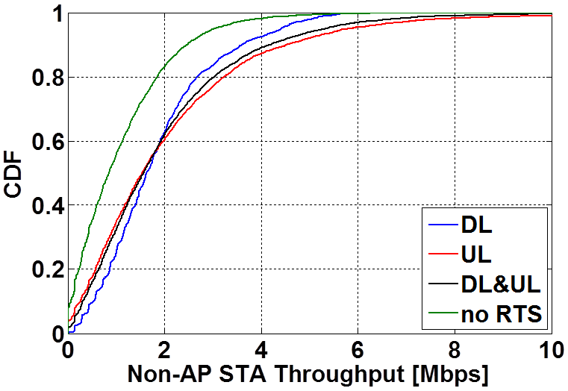
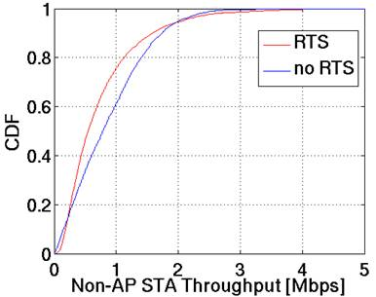
SS1 Error Probability
SS1 | 64MPDU |  |  |  | 2MPDU
 | RTS On |  |  | RTS Off | RTS On | RTS Off
 | DL Only | UL Only | DL & UL | DL & UL | DL & UL
Error % | 38.30% | 55.89% | 57.52% | 87.33% | 22.24% | 81.96%
64MPDU
2MPDU

Slide 7
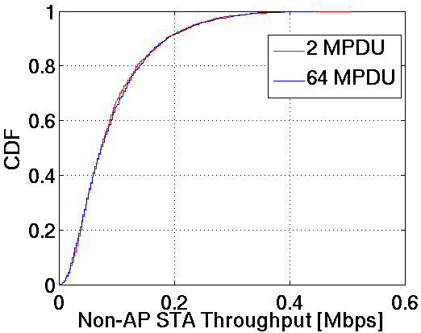
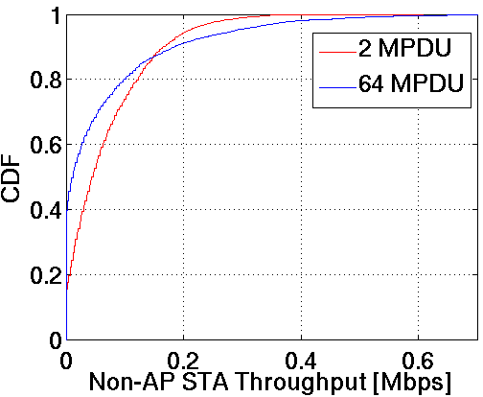
SS3 & SS4 Error Probability
Case | DL & UL
 | RTS On
 | SS3 |  | SS4
 | 64MPDU | 2MPDU | 64MPDU | 2MPDU
Error % | 27.69% | 27.56% | 16.21% | 13.36%
SS3
SS4

Slide 8
Observation
Without RTS/CTS, the preamble error increases significantly.
DL preamble could be more reliably detected than UL preamble.
Aggregation level of MPDU also impacts the preamble detection.
With RTS and short AMPDU, the preamble error in SS1 is low around 25%.
With RTS, the preamble error does not depend much on AMPDU length in SS3 and SS4 and is low under 30% in SS3 and around 15% in SS4.

Slide 9
Summary
We checked OBSS preamble error probability via our integrated SLS and we see that
The error probability is not as much high as shown in [1,2]
Error probability varies with different simulation cases
Further observation will be get via more evaluation
Further and thorough evaluation of this problem is required.

Slide 10
References
[1] 11-14/1420r1 The Impact of Preamble Error on MAC System Performance
[2] 11-15/0367r0 OBSS Preamble Detection
[3] 11-14/0980r10 Simulation Scenarios
[4] 11-14/1523r5 Offline Discussion Minutes of SLS Calibration
[5] 11-14/0571r8 Evaluation Methodology
[6] 11-14/1176r1 PHY abstraction tables for 11ax system level simulation

