Slide 1
Channel Sensing in UL-OFDMA
Date: 2015-03-09
Authors:
Name | Affiliations | Address | Phone | email
Reza Hedayat Young Hoon Kwon Yongho Seok Vida Ferdowsi | NEWRACOM | 9008 Research Drive, Irvine, CA 92618 |  | reza.hedayat at newracom.com younghoon.kwon at newracom.com yongho.seok at newracom.com vida.ferdowsi at newracom.com
Reza Hedayat, NEWRACOM

Slide 2
Summary
TGax SFD considers UL MU transmissions such as UL OFDMA and UL MU MIMO, which is expected to offer good medium utilization
Compared to existing SU and DL MU MIMO, UL OFDMA are unique due to multiple STAs participating in forming a single PPDU
This contribution focuses on channel sensing in presence of UL OFDMA frames

Slide 3
SU vs UL MU Transmission
CSMA/CA is an important aspect in 802.11 operation, where all clients sense the medium and verify if the medium is busy/idle based on which they decide to access to access the medium
In SU transmission and DL MU transmission, since the frame is sent by a single node, it is straightforward how the neighboring nodes interpret the state of the medium
However, multiple clients participate in forming UL OFDMA PPDUs, hence the assessment of the status of the medium becomes tricky
The goal is that unintended neighboring STAs have accurate channel sensing regarding the ongoing PPDU on the entire BW

Slide 4
Channel sensing in presence of UL OFDMA frames
802.11 offers several channel sensing mechanisms such as carrier sensing (CS), energy detect (ED), and virtual carrier sensing
However despite above mechanisms, operation of UL OFDMA might get affected by unintended BSS clients, or OBSS clients that start assessing the medium in the middle of the UL OFDMA PPDU
Depending on the sub-band assignment of the UL OFDMA PPDU, there could be ambiguity in channel sensing in each the neighborhood of each of the clients participating in the UL OFDMA frame
The problem mostly comes from the fact that 802.11 clients assess availability of the medium based on 20MHz portions, while UL OFDMA assignments could be narrower and varying across the BSS coverage

Slide 5
Channel sensing in presence of UL OFDMA frames
Channel sensing
In the case of SU transmission, all the nodes in the coverage area of the transmitter would have proper assessment of the medium status even if they start assessing the medium in the middle of the frame
However, in the case of UL OFDMA channel sensing gets tricky
A STA that participate in forming an UL OFDMA PPDU transmits no energy on some sub-bands, hence its coverage area differs across bandwidth
A STA within the coverage of a transmitting UL OFDMA STA assesses the 20MHz sub-band S that the STA occupies is busy; the rest might be assessed as idle
If S is the primary channel, then the clients in the neighborhood of other UL OFDMA STAs might assess the medium is available despite an ongoing UL MU OFDMA frame
If S is a non-primary channel then OBSS STAs (whose primary channel is different than S) might assess the medium is available even though there is an ongoing UL MU OFDMA frame

Slide 6
Partially-Hidden Nodes
Channel sensing in presence of UL OFDMA causes nodes within the coverage to be partially-hidden
For instance, in the case of an 80MHz UL OFDMA PPDU with four participating STAs where each STA is assigned one of the 20MHz sub-channels, only the cross-coverage of the four STAs would sense the medium properly
In other words, some sub-bands of the UL OFDMA PPDU appear hidden to some of the STAs outside of the cross-coverage of the four UL OFDMA STA
STA1’s Sub-band
STA1’s Sub-band
STA2’s Sub-band
STA2’s Sub-band
AP
STA2
STA1
STA1’s Sub-band
STA2’s Sub-band

Slide 7
Partially-Hidden Nodes
Partially-hidden nodes are not the same as hidden nodes. Hidden nodes are out of the coverage of one node, but partially-hidden nodes are out of the coverage of part of the bandwidth of au UL OFDMA frame that a node transmits (due to sub-band assignment)
Next slide shows some analysis of the probability of partially-hidden nodes when an UL OFDMA PPDU is formed by N=2, 3, 4, or 5 STAs
STA2
STA2
STA3
STA1
AP
AP
STA1
STA3
STA4

Slide 8
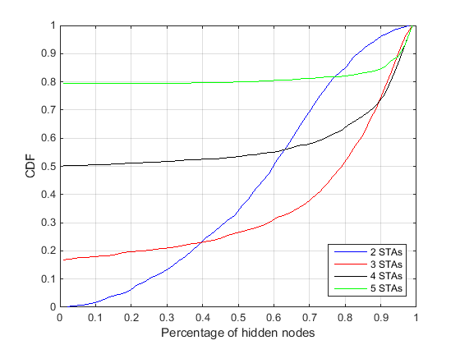
Probability of Presence of Partially-Hidden Nodes
Below analysis shows that for larger number of STAs participating in an UL OFDMA PPDU the chance that unintended clients appear as partially-hidden is large and increases with number of STAs in an UP OFDMA PPDU
Analysis assumptions:
Transmit power =15dBm
IEEE propagation loss model with exponent 2 up to 5m breakpoint, and exponent 3 thereafter is modeled
Mean value for shadowing fading of lognormal (0dB,5dB) is used
Percentage of partially-hidden nodes

Slide 9
Conclusion
CSMA/CA is an important aspect of 802.11 operation that needs to be observed in presence of UL OFDMA frames
UL MU transmissions require additional considerations so that the unintended nodes accurately sense the status of the medium across the whole bandwidth (or at least across the primary channel) in presence of UL MU PPDUs

Slide 10
Straw Poll
Do you agree to add the following to 11ax SFD:
“TGax shall provide mechanisms to allow physical channel sensing (ED, CS) across the bandwidth and throughout the duration of an UL OFDMA.”

