Slide 1
Empirical Measurements of Channel Degradation Under Load
Date: 2015-03-09
Authors:

Slide 2
Abstract
We previously reported open air multi-client throughput data for 50x1SS, 50x2SS and 50x3SS STAs (14/1513r0)
This contribution presents results for 100x1SS, 100x2SS and 100x3SS STAs in VHT20 and HT40 channels
We are reporting significant throughput degradation beyond 25 simultaneously contending STAs
The idea of “contention premium” is introduced and defined
The underlying mechanism is analyzed via pcaps. It affects both HT and VHT from different radio and client OS vendors.
We conclude that with current MAC, spectral efficiency is inversely proportional to active STAs in BSS. Simulators need to be updated.
MAC efficiency improvements may yield another path to achieving PAR requirement of 4X throughput increase
There are important implications for LAA fairness

Slide 3
Testbed Configuration
Clients:
Smartphone, 11ac, 1SS, 100 stations
Laptop, 11ac, 2SS, 100 stations
Laptop, 11ac, 3SS, 100 stations
Controller & AP:
7220-US controller running 6.4.2.3-HDMS public code.
Aruba AP225 (11ac 3SS)
LAN:
Jumbo frames enabled. [BE] queue. Full buffer traffic.
Test Automation:
IxChariot 8.1EA. Separate, dedicated machines for console and wired endpoint.
RF configuration:
Channels - 100E (VHT80), 100+ (VHT40), 100 (VHT20).
Exclusive use of 5490 - 5570MHz / swept daily.
essid "HDTest-5"
a-basic-rates 24
a-tx-rates 18 24 36 48 54
a-beacon-rate 24
max-tx-a-msdu-count-be 3

Slide 4
VHT20 - 1SS, 2SS & 3SS (Aggregate - Mbps)
TCP Up, VHT20, AP Radio Vendor A
Significant drop >25 STAs
1SS Phone Up
1SS Phone Bidirect
2SS Laptop Up
2SS Laptop Bidirect
3SS Laptop Up
3SS Laptop Bidirect

Slide 5
VHT20 - 1SS, 2SS & 3SS (Per STA - Mbps)
TCP Up, VHT20, AP Radio Vendor A
30 Mbps
Per-STA drop steady across STA range
1SS Phone Up
1SS Phone Bidirect
2SS Laptop Up
2SS Laptop Bidirect
3SS Laptop Up
3SS Laptop Bidirect

Slide 6
MIMO Works! (Aggregate, normalized to %3SS STA)
TCP Up, VHT20, AP Radio Vendor A
Normalized to
3SS = 1
2SS is about 66% across the range
1SS Phone Up
1SS Phone Bidirect
2SS Laptop Up
2SS Laptop Bidirect
3SS Laptop Up
3SS Laptop Bidirect
1SS is about 33% across the range

Slide 7
Contention Premium (Normalized to %1 STA)
TCP Up, VHT20, AP Radio Vendor A
5% - 10% contention premium
1SS Phone Up
1SS Phone Bidirect
2SS Laptop Up
2SS Laptop Bidirect
3SS Laptop Up
3SS Laptop Bidirect
10% - 30%
30% - 50%
50% -
60%
“Contention premium” is the delta between aggregate goodput
for 1 STA as compared with a larger number of STAs.

Slide 8
Effect Continues Past 100 STAs & Affects UDP
UDP & TCP, VHT80, AP Radio Vendor A
50% 1SS Phone +
50% 2SS Laptop
VHT80!
TCP Down
UDP Down
TCP Up
UDP Up

Slide 9
Retries Are Normal (<10%) and Steady
2SS Laptop, TCP Up, VHT20, AP Radio Vendor A
2SS Laptop, TCP Down, HT40, AP Radio Vendor B
Same behavior with 802.11n AP, different channel width, different direction, different radio manufacturer
Retries are well under 10% of frames
They do not grow

Slide 10
Rate Adaptation Is Normal
TCP Up, VHT20, AP Radio Vendor A
Rate adaptation on data frames
NDPs @ 18Mbps
Acks @ 12Mbps

Slide 11
Control Frame Growth Is Key Factor
Change silicon, PHY, channel width, direction
2SS Laptop, TCP Up, VHT20, AP Radio Vendor A
2SS Laptop, TCP Down, HT40, AP Radio Vendor B
Data frames drop by 34%
PS NDP frames increase 5X
Control frames increase 3X
Control frames increase 2.6X

Slide 12
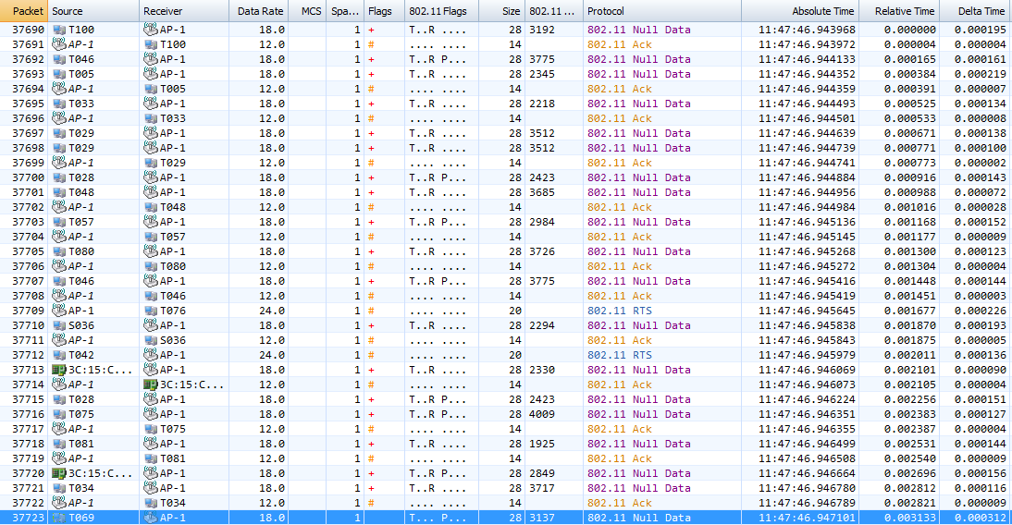
Elevated Power Save Activity (3ms, 16 PS events)
16 STAs attempt PS state in 3.1 ms;
13 succeed

Slide 13
Average Frame Size Decreases With Load
2SS Laptop, TCP Up, VHT20, Radio Vendor A
TCP Data
TCP Ack
Control Frames

Slide 14
Control Frame Growth Explained
ACKs are for NDPs. Combined total grows from 6.4K → 34.2K
2SS Laptop, TCP Up, VHT20, AP Radio Vendor A
TXOPs increase by 300% over the range
Ack
Preceded by SIFS (16usec)
BA
Preceded by full arbitration (43usec AIFS + EDCA CW)
CTS
RTS
NDP

Slide 15
Same Result Seen With HT on 11n Hardware
2SS Laptop, TCP Down, HT40, AP Radio Vendor B
TXOPs increase from 12.2K to 31.4K
PS NDP frames increase 5.6X

Slide 16
Average Burst Size Is Decreasing
2SS Laptop, TCP Up, VHT20, AP Radio Vendor A
2SS Laptop, TCP Down, HT40, AP Radio Vendor B
Drops from 45.9 to 115.12
Drops from 47.0 to 11.2

Slide 17
Contention Premium Summary
Principal mechanism behind the contention premium is MAC layer overhead growing with STA count.
Decreased A-MPDU packing efficiency
More TXOPs required to move a given amount of payload
Airtime efficiency of each TXOP decreases
Power save NDP/Ack growth due to elevated TXOP activity level
Amount of time channel spends in arbitration increases
Channel is working harder and harder to move less data
It is an emergent property of 802.11 system implementations
We hypothesize that the combination of OS, network stack and radio driver implementations on both sides of link leads to this result

Slide 18
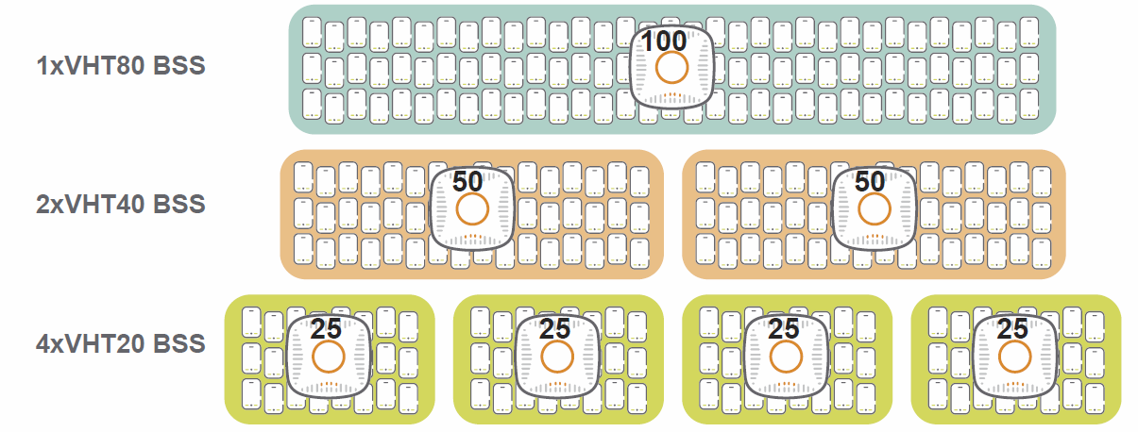
Practical Effects – STAs Per Channel
Contention premium penalty implies that narrower bandwidths (more collision domains) will yield more goodput than wider bandwidths.
Hypothesis was tested and found to be correct.
Each test uses the exact same 80-MHz bandwidth
Each test uses the exact same number of STAs
Both VHT40 BSS will victimize each other with ACI
All four VHT20 BSS will victimize each other

Slide 19
80 vs. 40 vs 20 Result (1SS STAs)
2SS Laptop, TCP Up, VHT, Radio Vendor A
C.P. for 25 STAs per channel is just 5-10%
Contention premium for 100 STAs/channel is 50-60%
C.P. for 50 STAs per channel is 10-30%

Slide 20
Analysis
11ac MAC spectral efficiency is inversely proportional to the number of STAs contending for the medium
Wide channels are inherently less efficient for a given number of STAs, even with full buffer traffic. It is better to spread over more collision domains.
This significantly dilutes a key supposed benefit of 802.11ac
The expected benefits of A-MPDU are greatly diminished in high density, high duty-cycle conditions
Full buffer traffic likely overstates channel efficiency as it is not principal traffic type [2] [3] [4]
Our results are best case because some level of aggregation is still occurring. This may not be true of routine end user traffic types.

Slide 21
Implications
Recovering capacity lost due to the contention premium effect is another route to 4X area throughput increase!
Existing TGax Box3 simulators pushing full buffer traffic are incomplete
Small STA counts are less impaired than large STA counts
PS transition rate is important to channel availability and should be modeled as proportional to offered load
Current 802.11 MAC makes vital assumptions about STA & AP operation and scalability that may not be true (9.13)
LAA fairness mechanism based on channel sensing will become less and less fair as STA count increases

Slide 22
Questions
What is an acceptable contention premium value at high STA counts in a well-ordered channel?
20% seems like a good target @ 100 STAs versus 60%
If aggregate client stack latency is materially diluting 802.11 spectral efficiency, is it even possible to tweak the the existing MAC to mitigate?
If large bursts of larger frames are not significant in many deployed networks due to structural issues, should a new HE-MAC be optimized for that instead?

Slide 23
Next Steps
Continue investigation
Explain average A-MPDU packing decrease
Evaluate smaller frame sizes & less aggressive arrival distributions
Assessing optimal resource block width
Methodology & data for optimal channel bandwidth for typical frame size distributions.
Develop validated traffic models for SS use cases – enterprise, residential, LPV/stadia, outdoor
Must factor frame size distribution and burst size distribution
Also by network usage mode – general browsing, cloud sync, social media update, video streaming, VDI, etc.

Slide 24
References
[1] 14/1513r0 – “Empirical open-air VHT client scaling results for use in validating MAC simulators”, C Lukaszewski, L Liang (Aruba Networks) Nov, 2014
[2] 15/0343r0 - “In Situ Frame Size Measurements”, C Lukaszewski, L Liang (Aruba Networks) Mar, 2015
[3] “Anatomy of WiFi Access Traffic of Smartphones and Implications for Energy Saving Techniques”, International Journal of Energy, Information and Communication (IJEIC), 3(1):1-16. February, 2012.
[4] 14/1144r1, “Simplified Traffic Model Based On Aggregated Network Statistics”, W Carney, K Agardh et al (Sony, Ericsson), Sep 2013

