Slide 1
802.11 March 2015 Closing Reports
Date: 2015-03-13
Authors:

Slide 2
Abstract
This document is a digest of the closing reports of all 802.11 sub-groups for presentation at the March 2015 closing plenary meeting. Attendance information and liaison reports are also included.

Slide 3
Attendance

Slide 4
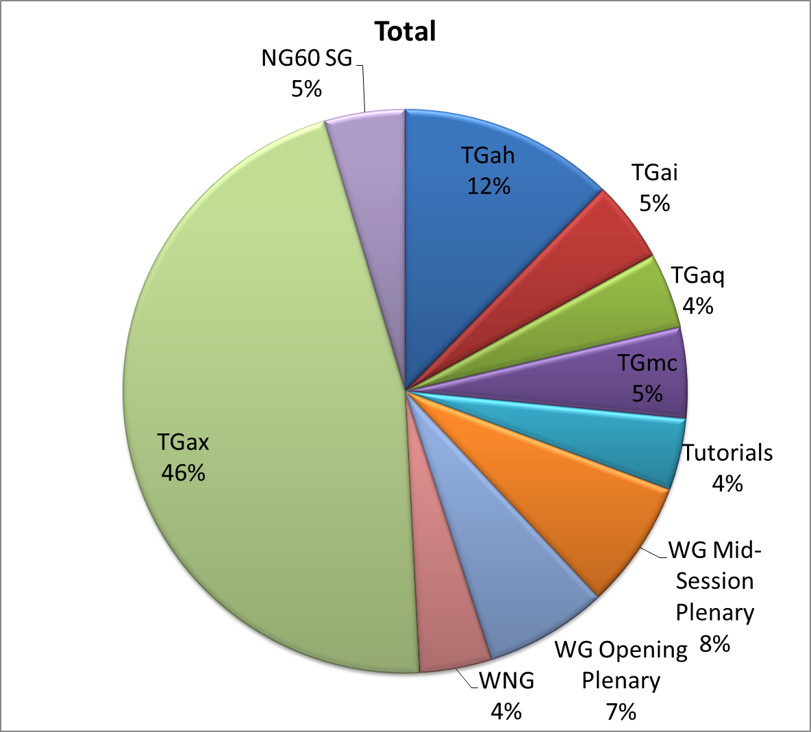
Attendance Total

Slide 5
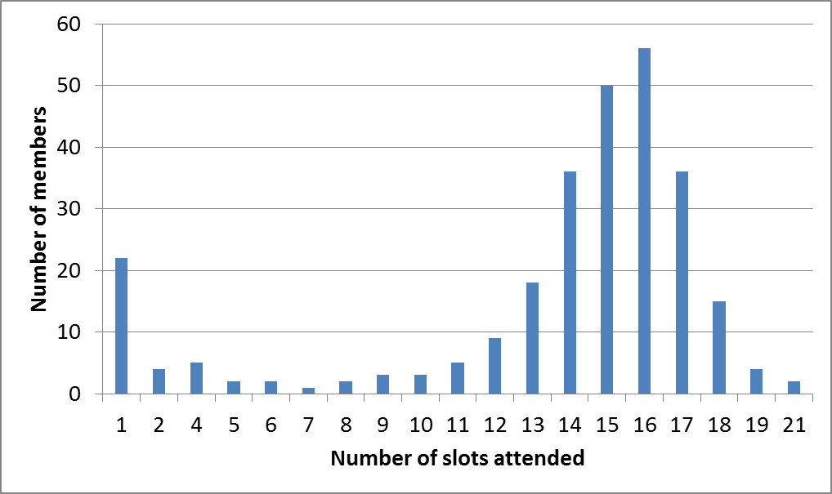
Attendance Histogram (Thu)

Slide 6
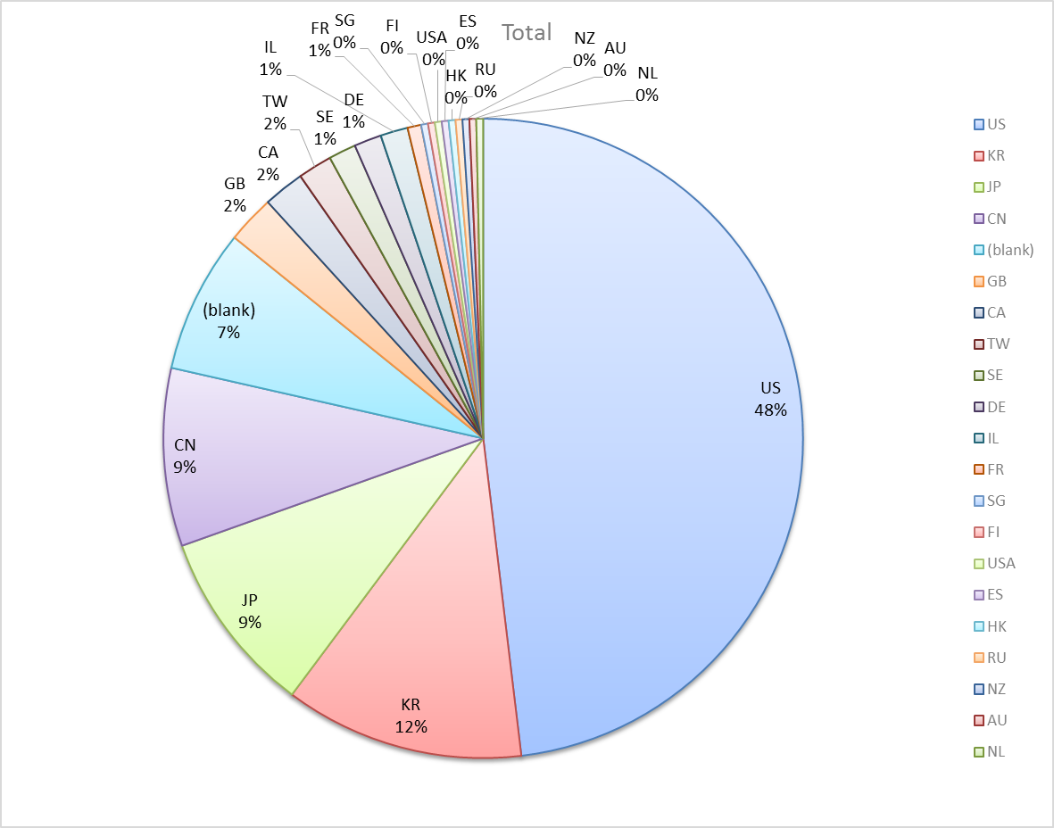
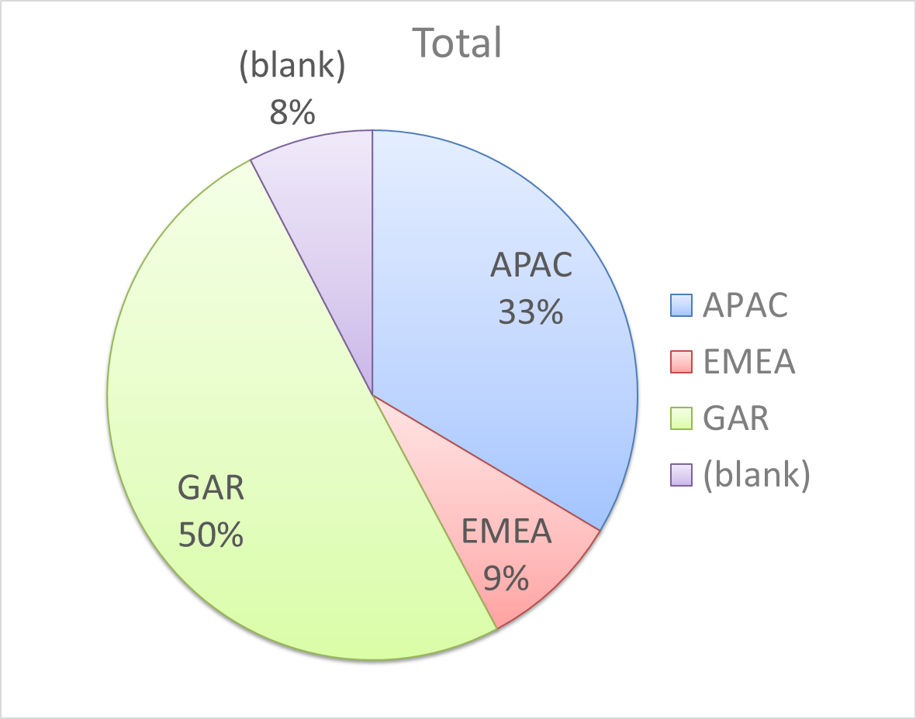
Attendance by Country

Slide 7
Type of Groups
Type of Group | Description
WG | Working Group
SC | Standing Committee
TG | Task Group
SG | Study Group

Slide 8
Groups
Type | Group | Description | Chair
WG | WG11 | The IEEE 802.11 Working Group | Adrian Stephens
SC | PUB | Publicity | Stephen McCann
SC | WNG | Wireless Next Generation | Clint Chaplin
SC | ARC | Architecture | Mark Hamilton
SC | JTC1 | ISO/IEC/JTC1/SC6 shadow committee | Andrew Myles
SC | PAR | Project Authorization Request | Jon Rosdahl
SC | REG | Regulatory | Richard Kennedy
TG | MC | Maintenance (Revision C) | Dorothy Stanley
TG | AH | Operation in 900 MHz bands | Yongho Seok
TG | AI | Fast Initial Link Setup | Hiroshi Mano
TG | AJ | China Millimeter Wave (CMMW) | Xiaoming Peng
TG | AK | General Link Setup | Donald Eastlake 3rd
TG | AQ | Pre-association Discovery | Stephen McCann
TG | AX | High Efficiency Wireless LAN (HEW) | Osama Aboul-Magd
SG | NG60 | Next Generation 60 GHz | Edward Au
SG | NGP | Next Generation Positioning | Jonathan Segev

Slide 9
802.11 WG Editor’s Meeting (Mar ‘15)
Date: 2015-03-07
Authors:
from slide 1/6 of 11-15-0341 by Peter Ecclesine (Cisco Systems)
Notes:
July 2007

Slide 10
Volunteer Editor Contacts
TGmc – Adrian Stephens – adrian.p.stephens@intel.com, Edward Au – edwardau@marvell.com, Emily Qi – emily.h.qi@intel.com
TGah – Yongho Seok yongho.seok@gmail.com, Alfred Asterjadhi – aasterja@qti.qualcomm.com
TGai – Lee Armstrong – LRA@tiac.net, Ping FANG Ping.FANG@huawei.com
TGaj – Jiamin CHEN – jiamin.chen@mail01.huawei.com
TGak – Donald Eastlake – d3e3e3@gmail.com, Norm Finn – nfinn@cisco.com
TGaq – Dan Gal – ddrgal@gmail.com
  TGax – Robert Stacey – robert.stacey@intel.com
Editors Emeritus:
  TGaa – Alex Ashley – alex.ashley@hotmail.co.uk
  TGac – Robert Stacey – robert.stacey@intel.com
  TGad – Carlos Cordeiro – carlos.cordeiro@intel.com
  TGae – Henry Ptasinski – henry@LOGOUT.COM
  TGaf – Peter Ecclesine – pecclesi@cisco.com
from slide 2/6 of 11-15-0341 by Peter Ecclesine (Cisco Systems)
Notes:
July 2007

Slide 11
802.11 Style Guide
See 11-09-1034-10-0000-wg11-style-guide.doc
  We updated 802.11 WG Style Guide based on 2012 IEEE Standards Style Manual and consistency changes in final publication of the 802.11 standard
Editor’s responsibility includes checking the 2014 IEEE Standards Style Manual when creating or updating drafts. https://development.standards.ieee.org/myproject/Public/mytools/draft/styleman.pdf
Submissions with draft text should conform to both the WG11 Style Guide and IEEE Standards Style Manual
Note that the Style Guide evolves with our practice
from slide 3/6 of 11-15-0341 by Peter Ecclesine (Cisco Systems)

Slide 12
Editor Amendment Ordering
Data as of Mar 2015
See http://grouper.ieee.org/groups/802/11/Reports/802.11_Timelines.htm
In Nov 2014, Editors changed the running order and will revisit in November 2015, maintaining this order in the interim
Amendment Number | Task Group | Projected REVCOM Date
802.11REVmc | TGmc - 3640 | Mar 2016
802.11-2016 Amendment 1 | TGai - 129 | Mar 2016
802.11-2016 Amendment 2 | TGah - 581 | Mar 2016
802.11-2016 Amendment 3 | TGaq - 15 | Sept 2016
802.11-2016 Amendment 4 | TGak - 48 | Jan 2017
802.11-2016 Amendment 5 | TGaj - 109 | Jun 2016***
802.11-2016 Amendment 6 | TGax | Mar 2019
Amendment numbering is editorial! No need to make ballot comments on these dynamic numbers!
from slide 4/6 of 11-15-0341 by Peter Ecclesine (Cisco Systems)
Notes:
July 2007

Slide 13
Draft Development Snapshot
TG | Published or Draft Baseline Documents |  |  |  |  |  |  |  | Source | MDR | Style Guide | Editor | Snapshot Date
 | Published | mc | ai | ah | aq | ak | aj | ax
mc | N | 4.0 |  |  |  |  |  |  | Frame 12.0 | Yes | 2012 | Adrian Stephens Edward Au, Emily Qi | 9-Mar
ai | N | 4.0 | 4.1 |  |  |  |  |  | Frame 12.0 | No | 2012 | Lee Armstrong Ping FANG | 9-Mar
ah | N | 3.0 |  | 4.0 |  |  |  |  | Frame 11.0 | No | 2012 | Yongho Seok Alfred Asterjadhi | 8-Mar
aq | N |  |  |  | 1.0 |  |  |  | Word | No | 2012 | Dan Gal | 8-Mar
ak | N | 4.0 |  |  |  | 0.07 |  |  | Word | No | 2012 | Donald Eastlake Norm Finn | 7-Mar
aj | N |  |  |  |  |  | 0.5 |  | Frame 10.0 | No | 2012 | Jiamin Chen | 9-Mar
ax | Y |  |  |  |  |  |  |  |  | No | 2012 | Robert Stacey | 9-Mar
Most current doc shaded green.
Changes from last report shown in red.
from slide 5/6 of 11-15-0341 by Peter Ecclesine (Cisco Systems)
Notes:
July 2009
July 2007
Peter Ecclesine (Cisco Systems)
Page 13

Slide 14
MIB style, Visio and Frame practices
I’m going to suggest going forward we use a single style with appropriately set tabs, and use leading Tabs to distinguish the syntax and description parts. (Adrian Stephens Feb 9, 2010)
Figure in an anchored frame within a table, and use a table caption as a figure caption
Keep embedded figures using visio as long as possible
  Near the end of sponsor ballot, turn these all into .wmf (windows meta file) format files (you can do this from visio using “save as”). Keep separate files for the .vsd source and the .wmf file that is linked to from frame. There is likelihood we should use .emf
Frame templates for 11aa, 11ac, 11af
Text version of MIB is available (2012, ae2012, aa2012, ad2012, acD5.0, afD5.0. mcD3.0)
from slide 6/6 of 11-15-0341 by Peter Ecclesine (Cisco Systems)

Slide 15
ARC Closing Report
Date: 2015-03-12
Authors:
from slide 1/5 of 11-15-0469 by Mark Hamilton, Spectralink

Slide 16
Abstract
This document is the closing report for ARC SC,
March 2015, Berlin meeting
from slide 2/5 of 11-15-0469 by Mark Hamilton, Spectralink

Slide 17
Work Completed
MIB Design Pattern work item
  Considered first draft pattern guidelines document
  Agreed to add some more examples, and some editorial changes
  Still need to find names more distinct than “Enabled” and “Activated”
  With the above done (especially the naming?) ready to circulate for comments
  Will start to scrub existing usage for any missing patterns next time
IETF/802 coordination update
  No news
Joint meeting with TGak, and 802.1
  Discussed how to model a DS implemented with 802.1Q bridges, in combination with 11ak bridging APs running GLK links.
from slide 3/5 of 11-15-0469 by Mark Hamilton, Spectralink

Slide 18
Teleconference(s)
None
from slide 4/5 of 11-15-0469 by Mark Hamilton, Spectralink

Slide 19
May 2015 Plans
Two standalone meeting slots planned:
  Design Pattern for MIB attribute use
  802.11 Architecture topics: DSAF, DS_SAP, Figure 5-1 et seq
  DS/AP/Portal architecture discussions
One joint session with TGak
  11ak architecture discussions
from slide 5/5 of 11-15-0469 by Mark Hamilton, Spectralink

Slide 20
PAR Review SC – Closing Report – March 2015
Date: 2015-03-13
Authors:
from slide 1/6 of 11-15-0230 by Jon Rosdahl, CSR

Slide 21
Snapshot
Review of Proposed PAR documents:
  802c- Amendment: Local Media Access Control (MAC) Addressing, PAR and CSD
  802.1Qci- Amendment, Per-Stream Filtering and Policing, PAR and CSD
  802.1Qcj- Amendment, Automatic Attachment to Provider Backbone Bridging (PBB) services, PAR and CSD
  802.3bq- Amendment, PAR Modification Request and CSD
  802.3bz- Amendment, 2.5 Gb/s and 5 Gb/s, PAR and CSD
  802.11ay- Amendment: Enhancements for Ultra High Throughput in and around the 60 GHz Band, PAR and CSD
  802.15.3e- Amendment for High-rate close proximity point-to-point communications , PAR and CSD
  Privacy Recommendation EC Study Group - Privacy Considerations for IEEE 802 Technologies, PAR and CSD
  802.24 IoT New TG request
Meeting times: Monday PM2, Tuesday AM2, Thursday AM2
from slide 2/6 of 11-15-0230 by Jon Rosdahl, CSR

Slide 22
PAR SC – March 2015
Chair: Jon Rosdahl
Monday Agenda:
  Welcome
  Determine order of review
  Review PARs/CSD posted for review this week.
  Recess
Tuesday Agenda:
  Complete review of PARs/CSD and post comments to 802 WGs
  Recess
Thursday Agenda:
  Review Response to Comments
  Prepare Report for 802.11 WG closing plenary
  Adjourn
from slide 3/6 of 11-15-0230 by Jon Rosdahl, CSR

Slide 23
Output
802.11 has posted comments for the PARs under consideration for the 802 March 15 Plenary in the doc:11-15/229r1: https://mentor.ieee.org/802.11/dcn/15/11-15-0229-01-0PAR-802-11-par-review-meeting-slides-and-minutes-march-2015.pptx
Comments were provided for the following WGs:
  802.1: 802c, 802.1Qci
  802.15.3e
  Privacy Recommendation EC Study Group:
  802.24 IoT New Task Group Request
  No comments were submitted for: 802.1Qci, 802.3bq 802.3bz
Response to Comments and report to 802.11 WG in the doc: 11-15/229r3: https://mentor.ieee.org/802.11/dcn/15/11-15-0229-03-0PAR-802-11-par-review-meeting-slides-and-minutes-march-2015.pptx
from slide 4/6 of 11-15-0230 by Jon Rosdahl, CSR

Slide 24
Minutes for PAR Review SC – March 2015
Monday PM2:
  Welcome – called to order at 4pm by Jon Rosdahl
  Determine order of review -
  Review PARs/CSD posted for review this week.
  Recess at 6pm
Tuesday AM1:
  Called to order at 10:30am
  Completed review of PARs/CSD and post comments to 802 WGs
  Recess – 12:30pm
Thursday AM2:
  Meeting did not come to order as there was only the Chair attending.
  Review Response to Comments was conducted by Chair
  A Report was prepared for 802.11 WG closing plenary
  Adjourn - as no more work to be done for the week.12:30pm
from slide 5/6 of 11-15-0230 by Jon Rosdahl, CSR

Slide 25
References
Comments sent out:
https://mentor.ieee.org/802.11/dcn/15/11-15-0229-01-0PAR-802-11-par-review-meeting-slides-and-minutes-march-2015.pptx
Comment Feedback and final report:
https://mentor.ieee.org/802.11/dcn/15/11-15-0229-03-0PAR-802-11-par-review-meeting-slides-and-minutes-march-2015.pptx
from slide 6/6 of 11-15-0230 by Jon Rosdahl, CSR

Slide 26
IEEE 802.11/15 Regulatory SC
Berlin Closing Report
Date: 2015-03-13
Authors:
from slide 1/6 of 11-15-0292 by Rich Kennedy, MediaTek

Slide 27
Abstract
This presentation is the closing report for the March 2015 IEEE 802.11/15 Regulatory Standing Committee meeting in Berlin.
from slide 2/6 of 11-15-0292 by Rich Kennedy, MediaTek

Slide 28
Agenda
Agenda in document 11-15/238r1
Complete the work of the DSRC Coexistence Tiger Team
The regulatory summaries
  Challenge of LAA-LTE in 5 GHz
  5 GHz expansion bands status – US, EU, ITU and CITEL
  Globalstar in 2.4 GHz band update
  New challenges?
Actions required
  Review NGMN whitepaper and any necessary interaction with that group
  The New EC Radio Equipment Directive – Planning for June 2016
  Continue pressure on 3GPP for sharing in 5 GHz
Adjourn
from slide 3/6 of 11-15-0292 by Rich Kennedy, MediaTek

Slide 29
Accomplishments
Tuesday AM2
  Said goodbye to the DSRC Coexistence Tiger Team
  Reviewed the document to be presented at the WG for approval of the report
Wednesday AM2 Mid-week Plenary
  Discussed the reasons for sending the report to the FCC
  Working group approved sending the report to the RR-TAG
Thursday AM1 (abbreviated)
  Abbreviated meeting to enable Chair to attend the RR-TAG review
  Discussed next steps with the NGMN whitepaper
  Regulatory updates
Thursday AM1.5 802.18 meeting
  Edited the report per discussion (now document 18-15/0016r0)
  Approved sending the amended report to the EC
from slide 4/6 of 11-15-0292 by Rich Kennedy, MediaTek

Slide 30
Teleconferences
Bi-weekly on Thursdays, 12:30 to 13:30 ET
from slide 5/6 of 11-15-0292 by Rich Kennedy, MediaTek

Slide 31
Thank You
  Special thanks to Jim Lansford for piloting the Tiger Team for 20 months
  Thanks to Tevfik Yucek and Peter Ecclesine for developing the two proposals
  Thanks to all who participated in the discussions and creation of the report
from slide 6/6 of 11-15-0292 by Rich Kennedy, MediaTek

Slide 32
Closing Report
Date: 2015-03-12
Authors:
from slide 1/3 of 11-15-0468 by Jim Lansford (CSR)

Slide 33
Abstract
Closing report for WNG SC for March 2015, Berlin, Germany
from slide 2/3 of 11-15-0468 by Jim Lansford (CSR)

Slide 34
Presentations at March 2015 meeting
  Over-the-air testing of 802.11 equipped devices – Robert Rehammar (Bluetest AB)
    - https://mentor.ieee.org/802.11/dcn/15/11-15-0243-00-0wng-over-the-air-testing-of-802-11-equipped-devices.pptx
Minutes
  https://mentor.ieee.org/802.11/dcn/15/11-15-0408-00-0wng-march-2015-wng-meeting-minutes-berlin.doc
Plans for May 2015
  One 2 hour session
from slide 3/3 of 11-15-0468 by Jim Lansford (CSR)

Slide 35
IEEE 802 JTC1 SC closing report
(Mar 2015)
Date: 2015-3-13
Authors:
from slide 1/7 of 11-15-0473 by Andrew Myles, Cisco

Slide 36
Abstract
Closing report for IEEE 802 JTC1 SC
for March 2015 in Berlin
from slide 2/7 of 11-15-0473 by Andrew Myles, Cisco

Slide 37
The SC did not have a great deal of work this week and only one session was required
Discussed liaison of drafts
  802.11ah/ai/mc from 802.11 WG
Reviewed status of PSDO pipeline
  802.22, 802.1AEbw, 802.1AEbn passed
Noted status of PSDO agreement revision
  Positive collaboration process
Clarified IEEE Style Guide with staff
  It has precedence over ISO Style Guide
Prepared for next SC6 meeting in Belgium in May
  Very little on agenda so far – may need teleconference
  Passed HoD empowerment motion
from slide 3/7 of 11-15-0473 by Andrew Myles, Cisco

Slide 38
IEEE 802 has pushed ten standards completely through the PSDO ratification process …
March 2015
IEEE 802 standard | 60 day pre-ballot | 5 month FDIS ballot
802.11 | Passed (2012) | Passed in 2012
802.1X | Passed (2013) | Passed (21 Oct 2013)
802.1AE | Passed (2013) | Passed (21 Oct 2013)
802.1AB | Passed (May 2013) | Passed (18 Dec 2013)
802.1AR | Passed (May 2013) | Passed (18 Dec 2013)
802.1AS | Passed (May 2013) | Passed (18 Dec 2013)
802.3 | Passed (2013) | Passed (16 Feb 2014)
802.11aa | Passed (Feb 2013) | Passed (28 Jan 2014)
802.11ad | Passed (Feb 2013) | Passed (28 Jan 2014)
from slide 4/7 of 11-15-0473 by Andrew Myles, Cisco

Slide 39
… and has nine standards in the pipeline for ratification under the PSDO
March 2015
IEEE 802 standard | 60 day pre-ballot | 5 month FDIS ballot
802.11ac | Passed (Sep 2014) | Closes 11 July 2015
802.11af | Passed (Sep 2014) | Closes 11 July 2015
802.1AEbw | Passed (Jan 2014) | Passed 1 Feb 2015
802.1AEbn | Passed (Jan 2014) | Passed 1 Feb 2015
802.1Xbx | Closes 19 March 2015 | -
802.1Q-Rev | Closes 13 March 2015 | -
802 | Passed (Oct 2014) | Waiting for start
802.3.1 | Passed (Oct 2014) | Closes 19 June 2015
802.22 | Passed (May 2014) | Passed (Feb 2015)
from slide 5/7 of 11-15-0473 by Andrew Myles, Cisco

Slide 40
A number of standards are about to go into the pipeline
802.22a
802.22b
802.1AX-2014
802.1BA-2011
802.1BR-2012 f
from slide 6/7 of 11-15-0473 by Andrew Myles, Cisco

Slide 41
The SC will focus in Vancouver on SC6 meeting prep
Process any comments on IEEE submissions to SC6 under PSDO process
  802.1Xbx, 802.1Q-Rev
Prepare for SC6 meeting in Belgium in May
  Review agenda
  Review submissions
from slide 7/7 of 11-15-0473 by Andrew Myles, Cisco

Slide 42
IEEE 802.11mc Closing Report for
March 2015
Date: 2015-03-11
Authors:
from slide 1/7 of 11-15-0448 by Dorothy Stanley, Aruba Networks

Slide 43
Abstract
This document contains the TGmc closing report for March 2015.
from slide 2/7 of 11-15-0448 by Dorothy Stanley, Aruba Networks

Slide 44
Status
Completed processing comments received in LB 206 – Third recirculation (46 comments)
Agenda, includes motions
  https://mentor.ieee.org/802.11/dcn/15/11-15-0221-05-000m-tgmc-agenda-march-2015.pptx
Comment resolution spreadsheet
  https://mentor.ieee.org/802.11/dcn/13/11-13-0233-56-000m-revmc-wg-ballot-comments.xls
Report to EC for conditional approval to go to Sponsor Ballot
  https://mentor.ieee.org/802.11/dcn/15/11-15-0287-05-000m-p802-11revmc-report-to-ec-on-conditional-approval-to-go-to-sponsor-ballot.pptx
from slide 3/7 of 11-15-0448 by Dorothy Stanley, Aruba Networks

Slide 45
TGmc Plan of Record - modified
20 July 2012 – 12 Sept 2012 – Call for Comment/Input
29-30 Aug 2012 – NesCom, SASB PAR Approval
Sept 2012 – Begin to process CC input, 11aa, 11ae integration
Dec 2012 – March/May 2013 – 11ad integration
Jan 2013 – First WG Letter ballot - without 11ad – on D1.0
Sept 2013 – Letter ballot on D2.0
Dec 2013 – May 2014 – 11ac, 11af integration – D3.0 in May 2014
July 2014 – Mandatory Draft Review
Jan 2015 – D4.0 Recirculation, goal to follow with D4.0 unchanged
Form Sponsor Pool: Open through Feb 20th good for 6 months (end of July 2015)
EC conditional SB approval March 2015
Considering ad-hoc comment resolution meeting July 2015
Nov 2015/Jan 2016 – WG/EC Final Approval
March 2016 – RevCom/SASB Approval
from slide 4/7 of 11-15-0448 by Dorothy Stanley, Aruba Networks
Notes:
doc.: IEEE 802.11-10/0503r4
May 2010
Michael Montemurro, Research in Motion
Page 45

Slide 46
Teleconferences and next steps
Conference Calls 10am Eastern (2 hours)
  March 30
May 2015
  Begin initial Sponsor Ballot comment resolution as Comment Resolution Committee
from slide 5/7 of 11-15-0448 by Dorothy Stanley, Aruba Networks

Slide 47
Motion for WGLB on P802.11mc D4.0 (Unchanged)
Having approved comment resolutions for all of the comments received from LB206 on P802.11mc D4.0
Approve a 15 day Working Group Recirculation Ballot asking the question “Should P802.11mc D4.0 be forwarded to Sponsor Ballot?”
Moved: Edward Au
Seconded: Mike Montemurro
Result: 12-0-1 Motion Passes
Approved by WG on Wednesday
from slide 6/7 of 11-15-0448 by Dorothy Stanley, Aruba Networks

Slide 48
Motion for EC Approval on P802.11mc D4.0
Approve document 11-15-0287r4 as the report to the IEEE 802 Executive Committee on the requirements for conditional approval to forward Draft P802.11-REVmc/D4.0 to sponsor ballot, granting the chair editorial license and
Request the IEEE 802 Executive Committee to conditionally approve forwarding Draft P802.11-REVmc/D4.0 to sponsor ballot.
Moved: Jon Rosdahl
Seconded: Mark Hamilton
Result: 14-0-3 Motion Passes
from slide 7/7 of 11-15-0448 by Dorothy Stanley, Aruba Networks

Slide 49
IEEE 802.11ah Closing Report for
March 2015
Date: 2015-03-12
Authors:
from slide 1/7 of 11-15-0460 by Yongho Seok (NEWRACOM)

Slide 50
Abstract
March 2015
This presentation is the closing report for the Berlin meeting of the IEEE 802.11 TGah.
from slide 2/7 of 11-15-0460 by Yongho Seok (NEWRACOM)

Slide 51
Activity in TGah
Letter Ballot 207 for Draft 4.0 closed February 14th
  214 comments received
TGah has completed all comment resolution of the Letter Ballot 207 for Draft 4.0
  15/261 LB207 Comment Spreadsheet
TGah has approved the TGah MDR Report (11-15/247r3)
Instructed the editor to generate Draft 5.0
from slide 3/7 of 11-15-0460 by Yongho Seok (NEWRACOM)

Slide 52
Going forward
Start third Recirculation WG Letter Ballot and address comments in May
from slide 4/7 of 11-15-0460 by Yongho Seok (NEWRACOM)

Slide 53
Teleconference
April 14, 8PM ET for 2 hour
April 21, 8PM ET for 2 hour
April 28, 8PM ET for 2 hour
May 5, 8PM ET for 2 hour
from slide 5/7 of 11-15-0460 by Yongho Seok (NEWRACOM)

Slide 54
TGah Timeline – No Change
Internal Task Group Ballot : May 2013
Initial Letter Ballot : September 2013
Initial Recirculation Letter Ballot : September 2014
Initial Sponsor Ballot : July 2015
Initial Recirculation Sponsor Ballot : November 2015
EC Approval : January 2016
Revcom Approval : March 2016
from slide 6/7 of 11-15-0460 by Yongho Seok (NEWRACOM)

Slide 55
Motion 5
Having approved comment resolutions for all of the comments received from LB207 on P802.11ah D4.0
Instruct the TGah editor to prepare P802.11ah D5.0 from incorporating these resolutions and changes approved by TGah at this session and
Approve a 15 day Working Group Recirculation Ballot asking the question “Should P802.11ah D5.0 be forwarded to Sponsor Ballot?”
Moved: Menzo Wentink
Seconded: Chittabrata Ghosh
Result: Motion Passed (Yes 10 No 0 Abstain 1)
from slide 7/7 of 11-15-0460 by Yongho Seok (NEWRACOM)

Slide 56
IEEE 802.11TGai
Closing Report
March 2015
Date: 2015-3-12
Authors:
Name | Company | Address | Phone | email
Hiroshi MANO | Koden Techno Info K.K. | Fuji Blg 28 2F, 2-7-26 Kita-Aoyama, Minato-ku, Tokyo, 107-0061, Japan | +81-3-6890-0594 | mano@koden-ti.com hiroshi@manosan.org
from slide 1/9 of 11-15-0472 by Hiroshi Mano (KDTI)

Slide 57
Abstract
This presentation is the closing report for the Berlin meeting of the IEEE 802.11 TGai.
from slide 2/9 of 11-15-0472 by Hiroshi Mano (KDTI)

Slide 58
IEEE 802.11 FILS TGai – March 2015 Berlin
Goals for the Meeting:
  Approve minutes of past meeting and teleconference
  Comment resolution of WG Recirc LB209
  Approve to forward the draft to WG Recirc LB
  Approve Timeline
  Approve Teleconference schedule
  Approve Plan for May
from slide 3/9 of 11-15-0472 by Hiroshi Mano (KDTI)

Slide 59
Accomplishments TGai 1/2
11 regular slots
Approved TGai Meeting Minutes for the IEEE 802.11 Atlanta meeting:
  January 2015 Atlanta Session Minutes 11-15/0246r1
Approved TGai teleconference meeting minutes of Atlanta to Berlin meeting.
  January-March Teleconferences Minutes 11-15/0390r0
from slide 4/9 of 11-15-0472 by Hiroshi Mano (KDTI)

Slide 60
Accomplishments TGai 2/2
Received 491 comments byWG LB209
  Resolved 471 comments
  17 open comments
Approved the TGai MDR Report
  11-15/0248r1
Approved Plan for May
Approved Time line
Approved Teleconference schedule
from slide 5/9 of 11-15-0472 by Hiroshi Mano (KDTI)

Slide 61
Plan for May
Goals for the Meeting:
  Approve minutes of past meeting and teleconference
  Comment resolution of WG Recirc LB
  Approve Timeline
  Approve Teleconference schedule
  Approve Plan for July
from slide 6/9 of 11-15-0472 by Hiroshi Mano (KDTI)

Slide 62
Time line of TGai (No change)
  PAR Approved, Modified, or Extended 2010-12-08
  WG Letter Ballots Initial / Recirc Mar14/Sep14/Jan15/Mar15
  MEC Done Nov14
  Form Sponsor Ballot Pool / Reform Jan15
  IEEE-SA Sponsor Ballots Initial / Recirc Jul15/ Sep 15
  Final 802.11 WG Approval Nov 15
  final or Conditional 802 EC Approval Nov 15
  RevCom & Standards Board Final or
  Continuous Process Approval Mar 16
  ANSI Approved N/A
Approved by unanimous consent
from slide 7/9 of 11-15-0472 by Hiroshi Mano (KDTI)

Slide 63
Teleconference Schedule
March 2015
Motion:
  Approve the following schedule of weekly teleconferences between Mar 24th to May 19th.
  Tuesdays 10:00 ET
  Duration 1.0Hour
  Using WEB-EX that will be provided by Task Group Chair
from slide 8/9 of 11-15-0472 by Hiroshi Mano (KDTI)

Slide 64
Reference
Motions (11-13-1186r23)
  https://mentor.ieee.org/802.11/dcn/13/11-13-1186-23-00ai-tgai-motion-deck.pptx
TGai LB209 comments for Draft 4.0 (11-15/0281r14)
  https://mentor.ieee.org/802.11/dcn/15/11-15-0281-14-00ai-tbai-lb209-comments-on-draft-d4-0.xlsx
from slide 9/9 of 11-15-0472 by Hiroshi Mano (KDTI)

Slide 65
IEEE 802.11aj March 2015 Closing Report
Date: 2015-03-12
Author:
from slide 1/5 of 11-15-0455 by Haiming Wang (SEU)

Slide 66
Abstract
This document is the closing report for TGaj for the March 2015 session.
from slide 2/5 of 11-15-0455 by Haiming Wang (SEU)

Slide 67
Work Completed
6 submissions were covered during the meeting covering areas related to:
  Comment Resolution for 11aj (60 GHz)
  New Technique Proposals for 11aj (45GHz)
from slide 3/5 of 11-15-0455 by Haiming Wang (SEU)

Slide 68
May 2015 Goals
Complete proposal and text proposal for 45 GHz
Comment resolution for CC20
from slide 4/5 of 11-15-0455 by Haiming Wang (SEU)

Slide 69
Conference Call Times
  April 28, 2015, 9pm (ET)
    Beijing Time: April 29, 2015, 9am
from slide 5/5 of 11-15-0455 by Haiming Wang (SEU)

Slide 70
TGak March Closing Report
Date: 2015-03-12
Authors:
from slide 1/6 of 11-15-0471 by Donald Eastlake, Huawei Technologies

Slide 71
Abstract
Closing Report of IEEE 802.11 Task Group AK at the IEEE 802.11 Meeting, March 2015, held in Berlin, Germany.
from slide 2/6 of 11-15-0471 by Donald Eastlake, Huawei Technologies

Slide 72
TGak Closing Report
Accomplishments
  Received and discussed the submissions listed on the next page. Resolved all remaining comments.
  Motion passed in TGak to direct the Editor to produce D1.0 go to Letter Ballot.
  Met jointly with 802.1Qbz and ARC SC Thursday AM1.
  An annotated agenda is in 11-15/0237r11.
from slide 3/6 of 11-15-0471 by Donald Eastlake, Huawei Technologies

Slide 73
TGak Closing Report
Submissions
  11-15/116, “Assorted 11ak Improvements” Donald Eastlake (Huawei)
  11-15/283, “An adaptation of GCR for GLK links” Ganesh Venkatesan (Intel)
  11-15/150, “GCR using SYNRA for GLK” Ganesh Venkatesan (Intel)
  11-15/415, “Clause 5 proposed changes” Mark Hamilton (SpectraLink)
  11-15/0454r0, “Some more DS architecture concepts” Mark Hamilton (SpectraLink)
  11-15/462r1, “Clause 5 Changes for EPD” Mark Hamilton
from slide 4/6 of 11-15-0471 by Donald Eastlake, Huawei Technologies

Slide 74
TGak Closing Report
Motion:
Having approved changes to P802.11ak_D0.07, as specified in 11-15/237r9,
Instruct the Editor to prepare a P802.11ak_D1.0 incorporating the changes, and
Approve a 30 day Working Group Technical Letter Ballot asking the question “Should P802.11ak_D1.0 be forwarded to Sponsor Ballot?”
  Mover: Mark Hamilton Seconder: Richard Roy
  Yes: 5 No: 0 Abstain: 0
from slide 5/6 of 11-15-0471 by Donald Eastlake, Huawei Technologies

Slide 75
TGak Closing Report
Teleconferences
  Decided to hold 1 hour teleconferences, to be joint with 802.1Qbz, on Monday, April 6th, April 27th, and May 4th , all at 11am Eastern US time.
May 2015 Plans
  Resolve comments from Letter Ballot or, if the WG does not approve LB, improve the draft.
  Joint meeting with 802.11 ARC.
from slide 6/6 of 11-15-0471 by Donald Eastlake, Huawei Technologies

Slide 76
TGaq Closing Report
Date: 2015-03-13
Authors:
from slide 1/3 of 11-15-0456 by Stephen McCann, BlackBerry

Slide 77
Abstract
Closing report for TGaq (Pre-Association Discovery) for March 2015, Berlin, Germany.
from slide 2/3 of 11-15-0456 by Stephen McCann, BlackBerry

Slide 78
Letter Ballot 208
  Failed with 73% approval
  702 comments
  Resolved 74 technical and assigned 152 to the editor
  Motions in 11-15-0417r1
Timeline
  Re-circulation Letter ballot date brought forward to July 2015, but sponsor ballot date has slipped to January 2016.
5 Teleconferences
Plans for May 2015
  Letter ballot comment resolution
from slide 3/3 of 11-15-0456 by Stephen McCann, BlackBerry

Slide 79
TGax March 2015 Closing Report
Date: 2015-03-12
Authors:
from slide 1/6 of 11-15-0465 by Osama Aboul-Magd (Huawei Technologies)

Slide 80
Abstract
This document is the closing report for the TGax for the March 2015 session.
from slide 2/6 of 11-15-0465 by Osama Aboul-Magd (Huawei Technologies)

Slide 81
Work Completed – TG Documents
Passed a number of motions affecting the TG specification Framework
  PHY motions related to LTF design and SIG-B
  MAC motions related to MU BA and UL MU Procedure
  MU motions related to ACK multiplexing.
  Etc.
Approved new revisions of Simulation Scenarios and Evaluation Methodology TG documents.
  https://mentor.ieee.org/802.11/dcn/14/11-14-0571-08-00ax-evaluation-methodology.docx
  https://mentor.ieee.org/802.11/dcn/14/11-14-0980-09-00ax-simulation-scenarios.docx
Other TG documents
  https://mentor.ieee.org/802.11/dcn/14/11-14-0882-04-00ax-tgax-channel-model-document.docx
  https://mentor.ieee.org/802.11/dcn/14/11-14-1009-02-00ax-proposed-802-11ax-functional-requirements.doc
from slide 3/6 of 11-15-0465 by Osama Aboul-Magd (Huawei Technologies)

Slide 82
Work Completed – Technical Presentations
Technical submissions.
A list of the submissions is available in the agenda document available at:
  https://mentor.ieee.org/802.11/dcn/15/11-15-0235-08-00ax-tgax-march-2015-meeting-agenda.ppt
from slide 4/6 of 11-15-0465 by Osama Aboul-Magd (Huawei Technologies)

Slide 83
May 2015 Goals
Continue to advance the TG documents based on submissions.
  Expectation is more submissions affecting the TG specification framework document will be considered.
Technical Presentations
from slide 5/6 of 11-15-0465 by Osama Aboul-Magd (Huawei Technologies)

Slide 84
Conference Call Times
Thursday April 9 10:00 – 12:00 ET
Thursday April 30 20:00 – 22:00 ET
from slide 6/6 of 11-15-0465 by Osama Aboul-Magd (Huawei Technologies)

Slide 85
NG60 SG March 2015 Closing Report
Date: 2015-03-12
Authors:
from slide 1/5 of 11-15-0452 by Edward Au (Marvell Semiconductor)

Slide 86
Abstract
This document is the closing report for NG60 SG for the March 2015 session.
from slide 2/5 of 11-15-0452 by Edward Au (Marvell Semiconductor)

Slide 87
Work Completed
14 submissions were covered during the meeting covering areas related to:
  Usage models
  Channel modeling
  Technologies
  Revised PAR and CSD proposals
Reviewed the Study Group timeline.
Resolved comments on PAR and CSD
Approved motions on updated PAR and CSD, and SG extension.
from slide 3/5 of 11-15-0452 by Edward Au (Marvell Semiconductor)

Slide 88
May 2015 Goals
Subject to approval on PAR by EC and NesCom, continue with discussion and presentations that are relevant to the Study Group topics
from slide 4/5 of 11-15-0452 by Edward Au (Marvell Semiconductor)

Slide 89
Conference Call Times
March 19, 2015 (Thursday), 10am ET – 11am ET
from slide 5/5 of 11-15-0452 by Edward Au (Marvell Semiconductor)

Slide 90
NGP SG March 2015 Closing Report
Date: 2015-03-12
Authors:
from slide 1/6 of 11-15-0463 by Jonathan Segev, Intel Corporation

Slide 91
Abstract
This document is the closing report for NGP SG for the Berlin meeting March 2015.
from slide 2/6 of 11-15-0463 by Jonathan Segev, Intel Corporation

Slide 92
Work Completed
PAR document review and approval as work draft document.
1st review of CSD document and approval as work draft document.
Review of use case document template and approval as basis for use case document work draft.
Approval of previously presented SG timelines.
Agenda: See 11-15/242
from slide 3/6 of 11-15-0463 by Jonathan Segev, Intel Corporation

Slide 93
Goals for May meeting
SG and WG approval of PAR and CSD final version and FWD to circulation amongst other WGs for July.
Entertain submissions towards CSD and PAR completion (use cases, usages, performance analysis etc.).
from slide 4/6 of 11-15-0463 by Jonathan Segev, Intel Corporation

Slide 94
Conference Call Times
Apr. 15th 10:00 – 11:00 EST
from slide 5/6 of 11-15-0463 by Jonathan Segev, Intel Corporation

Slide 95
Study Group Extension Motion
Motion
Request the IEEE 802 LMSC to extend the 802.11 Next Generation Positioning (NGP) Study Group.
Moved: Jonathan Segev
2nd:
Y: N: A:
from slide 6/6 of 11-15-0463 by Jonathan Segev, Intel Corporation

Slide 96
RR-TAG (802.18) to 802.11 Liaison Report
Date: 2015-03-12
Authors:
from slide 1/3 of 11-15-0295 by Rich Kennedy, MediaTek

Slide 97
Abstract
This document summarizes the activities of the IEEE 802.18 Radio Regulatory Technical Advisory Group (RR-TAG) during the IEEE 802 March 2015 Wireless Interim Meeting in Berlin.
from slide 2/3 of 11-15-0295 by Rich Kennedy, MediaTek

Slide 98
RR-TAG Actions Taken
Reviewed, edited and approved document 18-15/16r0 as the IEEE 802 DSRC Coexistence Tiger Team Report
from slide 3/3 of 11-15-0295 by Rich Kennedy, MediaTek

Slide 99
802.24 Vertical Applications
Technical Advisory Group
Smart Grid Task Group
Liaison Report
Date: 2015-01-16
Author:
from slide 1/4 of 11-15-0457 by Tim Godfrey, EPRI

Slide 100
802.24 Structure
802.24 Vertical Applications TAG
802.24.1 Smart Grid TG
802.24.2 IoT TG
802.24 was originally the Smart Grid Technical Advisory Group
  Internal / external coordination in matters related application of IEEE 802 standards for Smart Grid
  802.24 meets at Plenaries and Wireless Interims
Scope expansion to “Vertical Applications TAG”
  IoT Application Development Group – on ExCom agenda for approval tomorrow
  Current plan is for IoT TG to meet at plenaries
from slide 2/4 of 11-15-0457 by Tim Godfrey, EPRI

Slide 101
March 2015 Activities
24.1 Smart Grid TG: Continued development of companion presentation for the 802 Smart Grid white paper.
  Updated draft presentation is 24-14-0035-04
24.1 Smart Grid TG: Discussed and approved new white paper development on Sub 1GHz wireless
  Scope Statement is 24-15-0004-00
  Outline in 24-15-0009-00
  Participation from 802.11ah is requested
TAG: Chair Election
  James Gilb has stepped down as TAG Chair, and Tim Godfrey was elected as the new TAG Chair, effective with ExCom confirmation
from slide 3/4 of 11-15-0457 by Tim Godfrey, EPRI

Slide 102
Moved: IEEE 802.11 working group supports the formation of
the IEEE 802.24.2 IoT Task Group with the scope contained
in document 24-15-0003-01-0000-iot-scope-form.docx *
Moved: Tim Godfrey
Seconded:
Vote: Y: N: A:
*https://mentor.ieee.org/802.24/documents
from slide 4/4 of 11-15-0457 by Tim Godfrey, EPRI

Slide 103
IEEE 802.1 OmniRAN TG
Status Report to IEEE 802 WGs
2015-03-12
from slide 1/4 of omniran-15-20 by Max Riegel, Nokia-DE

Slide 104
IEEE 802.1 OmniRAN TG Resources
OmniRAN TG maintains a Wiki page on mentor to reflect its status and achievements
  https://mentor.ieee.org/omniran/bp/StartPage
  Also showing meeting announcements and conference call dial-in information
OmniRAN filespace on mentor is used for contributions and meeting documents
  https://mentor.ieee.org/omniran/documents
FYI: OmniRAN P802.1 PAR
  https://development.standards.ieee.org/get-file/P802.1CF.pdf?t=81644900003
from slide 2/4 of omniran-15-20 by Max Riegel, Nokia-DE

Slide 105
OmniRAN TG Achievements
Meeting in Berlin, Germany on March 9th-12th
  Progressing on P802.1CF based on contributions:
    Network reference model
      Revision proposal of normative text and R9 reference point discussions
      Progress, but some new open issues requiring further thoughts
    Functional decomposition and design
      Review of revision of Access Network set-up
    SDN Abstraction
      Initial text proposal for SDN chapter
    Informative annex on mapping of P802.1CF to real networks
  What can be done in P802.1CF on privacy
      Presentation on privacy engineered access network (also to PRIV ECSG)
  Update on SDN
    Update on latest developments in ONF by Charlie Perkins
    SDN practice of China Mobile showing good fit of P802.1CF
  Review of project plan
    On track to plan (LB Mar 2016, SB Mar 2017)
from slide 3/4 of omniran-15-20 by Max Riegel, Nokia-DE

Slide 106
Looking forward to next session in
Pittsburgh, May 20-21, 2015
Envisioned topics:
  Editor session for compiling first draft of P802.1CF specification
Conference calls:
  April 16th, 10:00 AM ET
  May 8th, 10:00 AM ET
  June 30th, 10:00 AM ET
  Dial-in details on OmniRAN TG Wiki page on mentor
  https://mentor.ieee.org/omniran/bp/StartPage
from slide 4/4 of omniran-15-20 by Max Riegel

Slide 107
IEEE 802 EC Privacy Recommendation SG
Closing Report
802 Plenary Meeting
March 9-13, 2015
Juan Carlos Zuniga, InterDigital Labs
(EC SG Chair)
from slide 1/9 of privecsg-15 by Juan Carlos Zuniga, Interdigital

Slide 108
March 2015 F2F Meeting
Venue
  Estrel Hotel and Conference Center,
  Berlin, Germany
2 Sessions – ECC 4 meeting room, Conference Center, 2nd level
  Tuesday, March 10th, 19:30 – 21:30 (EVE)
  Thursday, March 12th, 08:00 – 10:00 (AM1)
from slide 2/9 of privecsg-15 by Juan Carlos Zuniga, Interdigital

Slide 109
IEEE 802 Privacy Recommendation PAR/CSD
PAR/CSD pre-circulated with 802 EC
  PAR/CSD Presentation
  https://mentor.ieee.org/privecsg/dcn/15/privecsg-15-0004-02-0000-privacy-recommendation-par-csd-proposal.pptx
  PAR Text
  https://mentor.ieee.org/privecsg/dcn/15/privecsg-15-0006-00-ecsg-privacy-recommendation-par-proposal.pdf
from slide 3/9 of privecsg-15 by Juan Carlos Zuniga, Interdigital

Slide 110
IEEE 802 Privacy Recommendation PAR/CSD
Received comments
  https://mentor.ieee.org/privecsg/dcn/15/privecsg-15-0010-00-ecsg-par-csd-comments-received.pptx
Response to PAR CSD comments
  https://mentor.ieee.org/privecsg/dcn/15/privecsg-15-0013-01-0000-response-to-par-csd-comments.pptx
from slide 4/9 of privecsg-15 by Juan Carlos Zuniga, Interdigital

Slide 111
IEEE Privacy EC SG Closing Report
PAR submission
  Withdrawn from 802 EC closing agenda – some comments require further consideration by the group
  Planning to refine text, especially with respect to intended audience for the recommended practices document
  Will continue discussions on mailing list
Study Group extension
  Planning to request extension for one more cycle
from slide 5/9 of privecsg-15 by Juan Carlos Zuniga, Interdigital

Slide 112
Technical Presentations
Max Riegel (Nokia Networks)
  Initial thoughts about privacy aspects on P802.1CF specification
  https://mentor.ieee.org/omniran/dcn/15/omniran-15-0015-00-CF00-privacy-engineered-access-network.pptx
Antonio de la Oliva (UC3M)
  MAC address randomization experiment being run on IEEE 802 network during Berlin plenary meeting:
  https://mentor.ieee.org/privecsg/dcn/15/privecsg-15-0007-01-0000-wifi-privacy-experiement-at-802-berlin-plenary.pptx
from slide 6/9 of privecsg-15 by Juan Carlos Zuniga, Interdigital

Slide 113
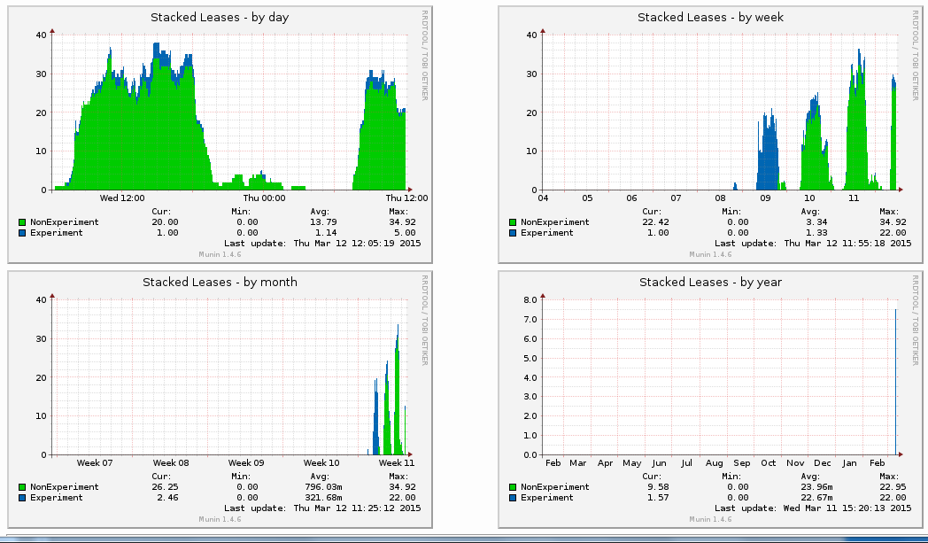
MAC Randomization Trial
MAC address randomization experiment run on IEEE 802 wireless network during Berlin plenary meeting
[Strong support from Verilan and Warren Kumari (Google)]
More info available at the trial Wiki page: http://goo.gl/eFUM9h
from slide 7/9 of privecsg-15 by Juan Carlos Zuniga, Interdigital

Slide 114
Proposed Next Steps
Refine PAR/CSD on recommended privacy practices for IEEE 802 protocols
Continue call for proposals to discuss technical topics
  Threat Model for Privacy at Link Layer
  Privacy Issues at Link Layer
  Proposals regarding functionalities in IEEE 802 protocols to improve Privacy
  Proposals regarding measuring levels of Privacy on Internet protocols
  Implications of MAC address changes
  Other…
from slide 8/9 of privecsg-15 by Juan Carlos Zuniga, Interdigital

Slide 115
Future Plans
Upcoming meetings (if SG is renewed)
  Teleconferences
    15 April 2015, (10:00 AM ET)
    3 June 2015, (10:00 AM ET)
      PAR/CSD submission
    1 July 2015, (10:00 AM ET)
  13-17 July, 2015, IEEE 802 Plenary meeting in Waikoloa, HI, USA
from slide 9/9 of privecsg-15 by Juan Carlos Zuniga, Interdigital

Slide 116
802.19 liaison report
13 March 2015
Authors:
Name | Company | Phone | email
Andrew Myles | Cisco | +61 2 84461010 +61 418 656587 | amyles@cisco.com
from slide 1/3 of 11-15-0475 by Andrew Myles, Cisco

Slide 117
802.19 approved two liaisons from IEEE 802 to 3GPP
Liaison 1: clarification to 3GPP related to “no LBT”
  Asks for clarification on the intent of specifying a “no LBT” option as part of evaluation of LAA solutions
  Link to liaison:19-15-0026-02
from slide 1/3 of 11-15-0475 by Andrew Myles, Cisco

Slide 118
802.19 approved two liaisons from IEEE 802 to 3GPP
Liaison 2: recommendation to 3GPP in relation to LAA
  Makes a series of recommendations to 3GPP in relation to LAA activities, at least partially based on lessons from LTE-U Forum material
    Recommends more realistic usage scenarios
    Requests that LAA and 802.11 have equal access to medium
    Requests that LAA access mechanisms be non proprietary
    Requests that LAA access mechanisms dynamically respond to changing conditions
    Requests 3GPP consider fairness definitions
    Suggests 3GPP look for reasonable scenarios that are unfair
    Suggests 3GPP facilitate activities to gather views of all stakeholders
  Link to liaison: 19-15-0024-04 (supporting presentation: 19-15-0025-00)
from slide 1/3 of 11-15-0475 by Andrew Myles, Cisco

Slide 119
802c Liaison Report
Date: 2015-03-10
Authors:
from slide 1/7 of 11-15-0426 by Dan Harkins, Aruba Networks

Slide 120
Abstract
A liaison report for the 802c SC
from slide 2/7 of 11-15-0426 by Dan Harkins, Aruba Networks

Slide 121
Status
An PAR for 802c was circulated and discussed back in November 2014
  Comments received from 802.11 regarding “rules” on using the local address space and its plans to “allocate a portion of the address space”.
  The PAR was not approved.
SC met in January 2015 and generated a new PAR
To address concerns expressed by comments on old PAR, some finessing was in order:
  The group wants to amend a standard, namely IEEE 802, and therefore cannot be a standalone recommended practice, it has to be a standard. But a standard can recommend practices.
  There will be guidelines for imposing structure on the local MAC address space.
from slide 3/7 of 11-15-0426 by Dan Harkins, Aruba Networks

Slide 122
Changes of Interest in New PAR
Old Scope: “The amendment will provide recommendations and rules for using the local address space. This will allocate a portion of the address space for protocols using an IEEE Registration Authority assigned Company ID. Another portion of the local address space will be allocated for assignment by local administrators.”
New Scope: “The amendment will provide an optional local address space structure to allow multiple administrations to coexist. This structure will designate a range of addresses for protocols using a Company ID assigned by the IEEE Registration Authority. Another range of local addresses will be designated for assignment by local administrators. The amendment will recommend a range of local addresses for use by IEEE 802 protocols.”
from slide 4/7 of 11-15-0426 by Dan Harkins, Aruba Networks

Slide 123
Changes of Interest in New PAR
Intellectual Property, 6.1.b: Is the Sponsor aware of possible registration activity related to this project?: Yes
If yes please explain:
Old: “This will allocate a portion of the address space for protocols using an IEEE Registration Authority assigned Company ID.”
New: “This will designate a portion of the address structure for protocols using an IEEE Registration Authority assigned Company ID and one or more blocks of CID space to be agreed with the IEEE Registration Authority.”
from slide 5/7 of 11-15-0426 by Dan Harkins, Aruba Networks

Slide 124
What Now?
802.11WG PAR Committee generated some new comments– 11-15/0229r1
  Some are stylistic
  Some ask for clarification
  None are show-stopping
Comments also received from (at least) 802.3
Group will meet Wed PM1 (ECC4– join us!) to work on comments
Work on another PAR to develop a protocol that uses the structured local MAC address space will start after this PAR is approved
from slide 6/7 of 11-15-0426 by Dan Harkins, Aruba Networks

Slide 125
References
802c PAR and CSD
11-15/229r1
from slide 7/7 of 11-15-0426 by Dan Harkins, Aruba Networks

Slide 126
IEEE 802.11-IETF Liaison Report
Date: 2015-03-11
Authors:
from slide 1/16 of 11-15-0337 by Dorothy Stanley, Aruba Networks

Slide 127
Abstract
This presentation contains the IEEE 802.11 – IETF liaison report for March 2015.
from slide 2/16 of 11-15-0337 by Dorothy Stanley, Aruba Networks

Slide 128
IETF- IEEE 802 Liaison Activity
Joint meetings, agenda and presentations
  http://www.iab.org/activities/joint-activities/iab-ieee-coordination/
  2015-01-21 teleconference held; Next teleconference June 2015
  No new 802.11 work items
  For information: https://tools.ietf.org/html/draft-baccelli-manet-multihop-communication-04 “This document describes characteristics of communication between interfaces in a multi-hop ad hoc wireless network, that protocol engineers and system analysts should be aware of when designing solutions for ad hoc networks at the IP layer”
RFC 7241, “The IEEE 802/IETF Relationship” has been published (RFC4441 update)
  https://datatracker.ietf.org/doc/rfc7241/
IEEE 802 Liaisons list is available
  http://ieee-sa.centraldesktop.com/802liaisondb/FrontPage
802 EC “IETF/IAB/IESG” 802 EC Standing Committee
  Formed March 2014, Pat Thaler as chair
from slide 3/16 of 11-15-0337 by Dorothy Stanley, Aruba Networks

Slide 129
IETF Meetings
Meetings:
  March 22-27, 2015 – Dallas
  July 19-24, 2015 – Prague
  November 1-6, 2015 – Yokahama
  April 3-8, 2016 – Buenos Aires
http://www.ietf.org
  Newcomer training: https://www.ietf.org/edu/process-oriented-tutorials.html#newcomers
  Tutorials (process and technical); Wireless Tutorial (Donald Eastlake) : https://www.ietf.org/edu/tutorials.html
from slide 4/16 of 11-15-0337 by Dorothy Stanley, Aruba Networks

Slide 130
Protocol to Access White Space database (paws) WG
Received request for IEEE 802.11 review of paws protocol draft document: https://datatracker.ietf.org/doc/draft-ietf-paws-protocol/
  Held IEEE 802.11 Call for Comments
  No comments received
Paws Charter and problem statement documents:
  Charter, see https://datatracker.ietf.org/wg/paws/charter/
  Problem Statement, see https://datatracker.ietf.org/doc/draft-patil-paws-problem-stmt/
  Use Cases and requirements, published as RFC 6953: https://datatracker.ietf.org/doc/rfc6953/
Update [March 2015]
  PAWS protocol document http://datatracker.ietf.org/doc/draft-ietf-paws-protocol/ sent for publication
from slide 5/16 of 11-15-0337 by Dorothy Stanley, Aruba Networks

Slide 131
RADEXT WG
See http://datatracker.ietf.org/wg/radext/
RADIUS Extensions
  The RADIUS Extensions Working Group will focus on extensions to the
  RADIUS protocol required to define extensions to the standard attribute space as well as to address cryptographic algorithm agility and use over new transports.
  In addition, RADEXT will work on RADIUS Design Guidelines and define new attributes for particular applications of authentication, authorization and
  accounting such as NAS management and local area network (LAN) usage.
Updates [March 2015]
  New: Larger Packets for RADIUS over TCP, see http://datatracker.ietf.org/doc/draft-ietf-radext-bigger-packets/
  New version, submitted to IESG for publication: NAI-based Dynamic Peer Discovery for RADIUS/TLS and RADIUS/DTLS, see http://datatracker.ietf.org/doc/draft-ietf-radext-dynamic-discovery/
  New version of RADIUS fragmentation draft, submitted to IESG for publication, see http://datatracker.ietf.org/doc/draft-ietf-radext-radius-fragmentation/
  New version of RADIUS extensions for IP Port Configuration and Reporting, see http://datatracker.ietf.org/doc/draft-ietf-radext-ip-port-radius-ext/
from slide 6/16 of 11-15-0337 by Dorothy Stanley, Aruba Networks

Slide 132
Emergency Context Resolution with Internet Technologies (ECRIT)
Working Group website: http://www.ietf.org/dyn/wg/charter/ecrit-charter.html
Emergency Services
  Framework for Emergency Calling using Internet Multimedia, see http://datatracker.ietf.org/doc/rfc6443/
  Describing boundaries for Civic Addresses, see http://tools.ietf.org/id/draft-thomson-ecrit-civic-boundary-02.txt
Updates [March 2015]
  Updated and submitted to IESG for publication: Additional Data Related to an Emergency Call, see http://datatracker.ietf.org/doc/draft-ietf-ecrit-additional-data/
  New: individual submission on Indoor Location Mechanisms for Emergency Services , see http://datatracker.ietf.org/doc/draft-marshall-ecrit-indoor-location/
from slide 7/16 of 11-15-0337 by Dorothy Stanley, Aruba Networks

Slide 133
Home Networking (homenet) WG
See https://datatracker.ietf.org/wg/homenet/
This working group focuses on the evolving networking technology
within and among relatively small "residential home" networks
  The task of the group is to produce an architecture document that outlines how to construct home networks involving multiple routers and subnets.
  This document is expected to apply the IPv6 addressing architecture, prefix delegation, global and ULA addresses, source address selection rules and other existing components of the IPv6
  architecture, as appropriate.
  Home Networking Architecture for IPv6, Published as IPv6 Home Networking Architecture Principle: http://datatracker.ietf.org/doc/rfc7368/
Updates [March 2015] Documents of interest:
  Updated: Home Networking Control Protocol: http://datatracker.ietf.org/doc/draft-ietf-homenet-hncp/
  Updated: Internet draft on Prefix and Address Assignment in a Home Network: http://datatracker.ietf.org/doc/draft-pfister-homenet-prefix-assignment/
  Updated: Distributed Node Consensus Protocol, see http://datatracker.ietf.org/doc/draft-ietf-homenet-dncp/
from slide 8/16 of 11-15-0337 by Dorothy Stanley, Aruba Networks

Slide 134
Operations Area Working Group
http://datatracker.ietf.org/wg/opsawg/
  Area WG processes submissions related to Operations Area WGs that have closed
  Control and Provisioning of Wireless Access Points (CAPWAP) Working Group closed in 2009
Responded to requests from OPSAWG chairs for IEEE 802.11 review
  “Alternate Tunnel Encapsulation for Data Frames in CAPWAP” http://www.ietf.org/id/draft-zhang-opsawg-capwap-cds-02.txt , see Slide 5 in https://mentor.ieee.org/802.11/dcn/14/11-14-0368-01-0000-march-2014-liaison-to-ietf-report.pptx
  “IEEE 802.11 MAC Profile for CAPWAP” https://datatracker.ietf.org/doc/draft-ietf-opsawg-capwap-hybridmac/ , see https://mentor.ieee.org/802.11/dcn/14/11-14-0684-01-0000-capwap-hybridmac-liaison-response.docx
  “CAPWAP extension for 802.11n and Power/channel Autoconfiguration” http://datatracker.ietf.org/doc/draft-ietf-opsawg-capwap-extension/ , see https://mentor.ieee.org/802.11/dcn/14/11-14-0913-01-0000-liaison-response-opsawg-capwap-extension.docx
Updates [March 2015] Operations Area Working Group work group items
  Sent to IESG for publication: http://datatracker.ietf.org/doc/draft-ietf-opsawg-capwap-hybridmac
  (r4): http://datatracker.ietf.org/doc/draft-ietf-opsawg-capwap-alt-tunnel/
  (r5): http://datatracker.ietf.org/doc/draft-ietf-opsawg-capwap-extension/
  New individual submission: CAPWAP Control and Data Channel Separation for Multi-provider Scenario, see http://datatracker.ietf.org/doc/draft-you-opsawg-capwap-separation-for-mp/
from slide 9/16 of 11-15-0337 by Dorothy Stanley, Aruba Networks

Slide 135
Active Queue Management (AQM)
Active Queue Management and Packet Scheduling Working Group website: http://datatracker.ietf.org/wg/aqm/charter/
IETF Recommendations Regarding Active Queue Management to update https://datatracker.ietf.org/doc/rfc2309/
Updates [March 2015]
  Submitted to IESG for Publication: IETF Recommendations Regarding Active Queue Management, see http://datatracker.ietf.org/doc/draft-ietf-aqm-recommendation/
  Updated: AQM Characterization Guidelines, see http://datatracker.ietf.org/doc/draft-ietf-aqm-eval-guidelines/
  The Benefits and Pitfalls of using Explicit Congestion Notification (ECN), see http://datatracker.ietf.org/doc/draft-ietf-aqm-ecn-benefits/
  On Queuing, Marking, and Dropping, see http://datatracker.ietf.org/doc/draft-ietf-aqm-fq-implementation/
  Controlled Delay Active Queue Management, see http://datatracker.ietf.org/doc/draft-ietf-aqm-codel/
from slide 10/16 of 11-15-0337 by Dorothy Stanley, Aruba Networks

Slide 136
Transport Layer Security (TLS)
Transport Layer Security Working Group website: http://datatracker.ietf.org/wg/tls/charter/
Work underway on a new version of TLS (used in EAP methods): Transport Layer Security Protocol Version 1.3
Updates [March 2015]
  Updated: Negotiated Finite Field Diffie-Hellman Ephemeral Parameters for TLS, see http://datatracker.ietf.org/doc/draft-ietf-tls-negotiated-ff-dhe/
  Updated: TLS Fallback Signaling Cipher Suite Value (SCSV) for Preventing Protocol Downgrade Attacks, see http://datatracker.ietf.org/doc/draft-ietf-tls-downgrade-scsv/
  Updated: Deprecating Secure Sockets Layer Version 3.0, see http://datatracker.ietf.org/doc/draft-ietf-tls-sslv3-diediedie/
  TLS version 1.3 http://datatracker.ietf.org/doc/draft-ietf-tls-tls13/
from slide 11/16 of 11-15-0337 by Dorothy Stanley, Aruba Networks

Slide 137
Extensions for Scalable DNS Service Discovery (dnssd)
Working Group website: http://datatracker.ietf.org/wg/dnssd/charter/
Charter: Develop scalable DNS-SD/mDNS Extension requirements and standard solutions to address problematic use of mDNS and DNS-SD in networks today
  mDNS discovery of services on other links is not possible
  Multicast transmissions over wireless are very expensive
  Addressed with different ad hoc technologies
Of interest to: Homenet, Zero configuration, Enterprise-grade vendors of 802.11 infrastructure, Multi-link mesh networking
Updates [March 2015]
  Updated version of Requirements document submitted to IESG for publication: http://datatracker.ietf.org/doc/draft-ietf-dnssd-requirements/
  New document: On Interoperation of Labels Between mDNS and DNS, http://datatracker.ietf.org/doc/draft-ietf-dnssd-mdns-dns-interop/
  Multicast DNS (mDNS) Threat Model and Security Consideration, see http://datatracker.ietf.org/doc/draft-rafiee-dnssd-mdns-threatmodel/
from slide 12/16 of 11-15-0337 by Dorothy Stanley, Aruba Networks

Slide 138
Of Interest to Smart Grid
6LOWPAN
  Working Group website: http://datatracker.ietf.org/wg/6lowpan/charter/
  Focus: IPv6 over Low Power PAN: Adaption of IPv6 protocol to operate on constrained nodes and link layers
ROLL
  Working Group website: http://datatracker.ietf.org/wg/roll/
  Focus: Routing over Low Power and Lossy Networks
CORE
  (Constrained RESTful Environments) Working Group website: http://datatracker.ietf.org/wg/core/
  Focus: framework for resource-oriented applications intended to run on constrained IP networks.
from slide 13/16 of 11-15-0337 by Dorothy Stanley, Aruba Networks

Slide 139
Of Interest: Network-Based Mobility Extensions (NETEXT)
NETEXT: http://datatracker.ietf.org/wg/netext/charter/
Submitted to IESG for publication: Mapping PMIPv6 QoS Procedures with WLAN QoS Procedures, see http://datatracker.ietf.org/doc/draft-ietf-netext-pmip-qos-wifi/
Abstract: This document provides guidelines for achieving end to end Quality- of-Service (QoS) in a Proxy Mobile IPv6 (PMIPv6) domain where the access network is based on IEEE 802.11. RFC 7222 describes QoS negotiation between a Mobility Access Gateway (MAG) and Local Mobility Anchor (LMA) in a PMIPv6 mobility domain. The negotiated QoS parameters can be used for QoS policing and marking of packets to enforce QoS differentiation on the path between the MAG and LMA. IEEE 802.11, Wi-Fi Multimedia - Admission Control (WMM-AC) describes methods for QoS negotiation between a Wi-Fi Station (MN in PMIPv6 terminology) and an Access Point. This document provides a mapping between the above two sets of QoS procedures and the associated QoS parameters. This document is intended to be used as a companion document to RFC 7222 to enable implementation of end to end QoS.
from slide 14/16 of 11-15-0337 by Dorothy Stanley, Aruba Networks

Slide 140
Potential Liaison: Protocol Independent Multicast (PIM) Re-charter
PIM: http://datatracker.ietf.org/wg/pim/charter/
  Group being re-chartered
  One contributor’s comment:
    IP Multicast over 802.11 is inefficient and unreliable. I would like to see at least one of the multicast working groups in the IETF have a chartered item to work with the IEEE coordinating a solution to this mess. Or at least a coordinated effort to state our dis-satisfaction with the current mess and make a formal request to provide high bandwidth, efficient multicast over 802.11 without sending unicast copies to each group member. After all, it is a radio and it is being broadcast???”
from slide 15/16 of 11-15-0337 by Dorothy Stanley, Aruba Networks

Slide 141
References
RFC 4017 - IEEE 802.11 Requirements on EAP Methods
Jan 2012 report (PAWS, Homenet details), https://mentor.ieee.org/802.11/dcn/12/11-12-0122-01-0000-january-2012-liaison-to-ietf.ppt
from slide 16/16 of 11-15-0337 by Dorothy Stanley, Aruba Networks

