Slide 1
Indoor Wall Propagation Loss Measurements
Date: 2015-01-14
Authors:

Slide 2
Abstract
It has been observed that the current Simulation Scenarios significantly understate propagation loss across walls. [1]
SS#1 assumes 5dB per wall
SS#2 assumes 7dB per wall
SS#4a references SS#1 (Outside in penetration)
This contribution presents field RF measurements from site surveys using professional grade software tools
Recommend uniform loss value of 9 dB / wall in SS #1 and #2

Slide 3
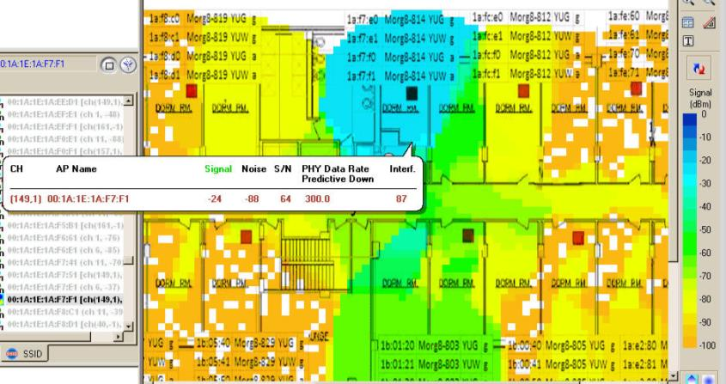
Framed vs. Concrete/Block Construction
Stud and
Wallboard
Construction
(~10dB/wall)
Concrete Wall
Construction
(25-30dB/wall)

Slide 4
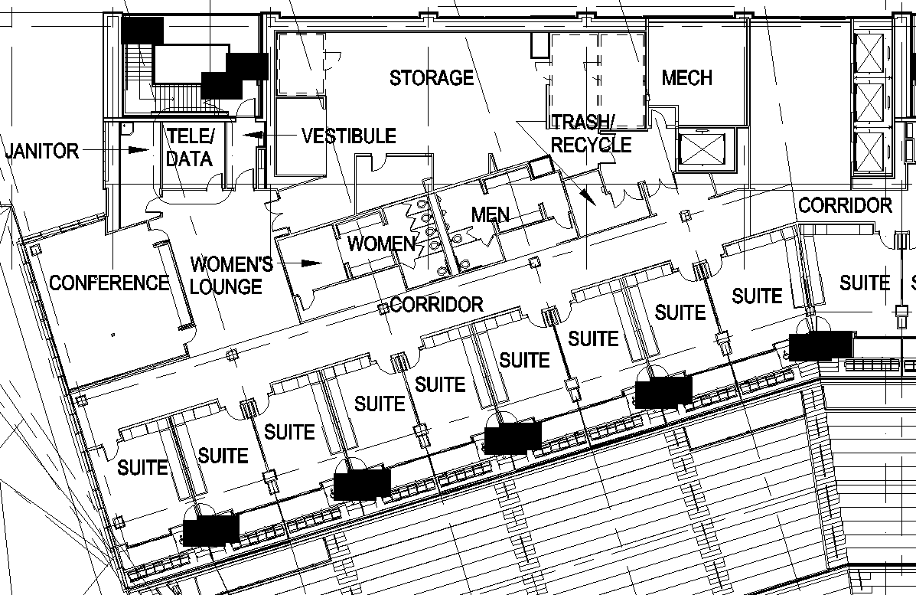
70,000 Seat Stadium Skyboxes
Aluminum stud + wallboard (3.3m /11ft wide)

Slide 5
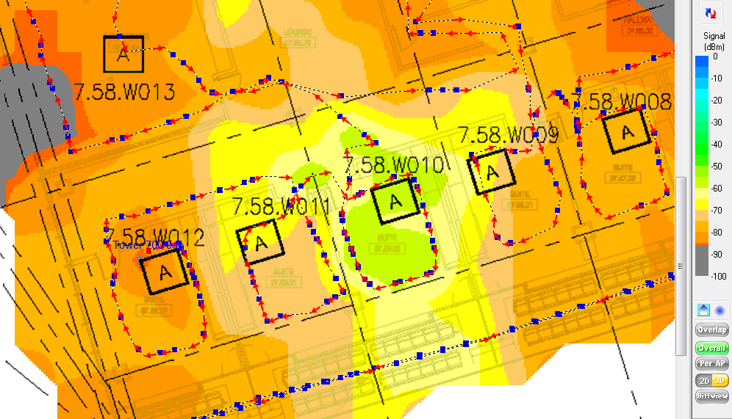
70,000 Seat Stadium Skyboxes (5GHz)
Aluminum stud + wallboard (3.3m /11ft wide)
-57dBm
-66dBm
-58dBm
-67dBm
-62dBm
-69dBm
-70dBm
-60dBm

Slide 6
Jan 2015 Hyatt Regency Ballroom (5 GHz)
Retracting partition wall
AP in front of room
47:e0:cc
Ch 165
-56dBm
-67dBm
-70dBm
-77dBm

Slide 7
Jan 2015 Hyatt Regency Ballroom (5 GHz)

Slide 8
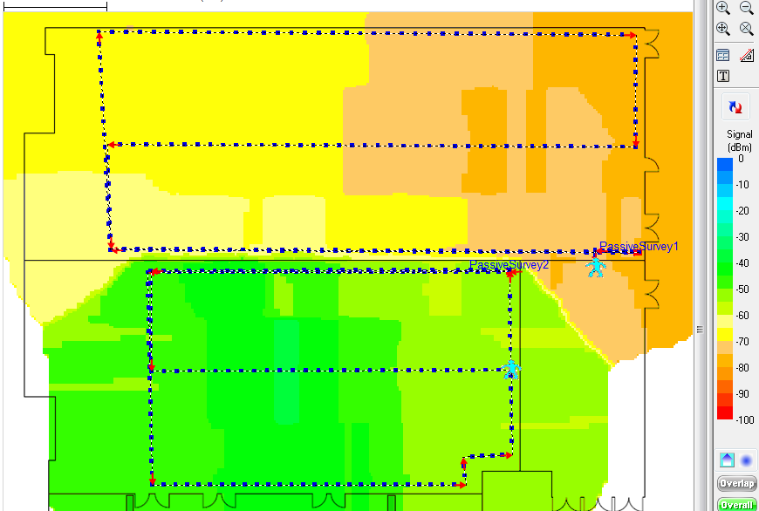
Jan 2015 Hyatt Regency Ballroom (5 GHz)
Retracting partition wall
-62dBm
-69dBm
AP in next room
4f:df:ac
Ch 36
-50dBm
-56dBm

Slide 9
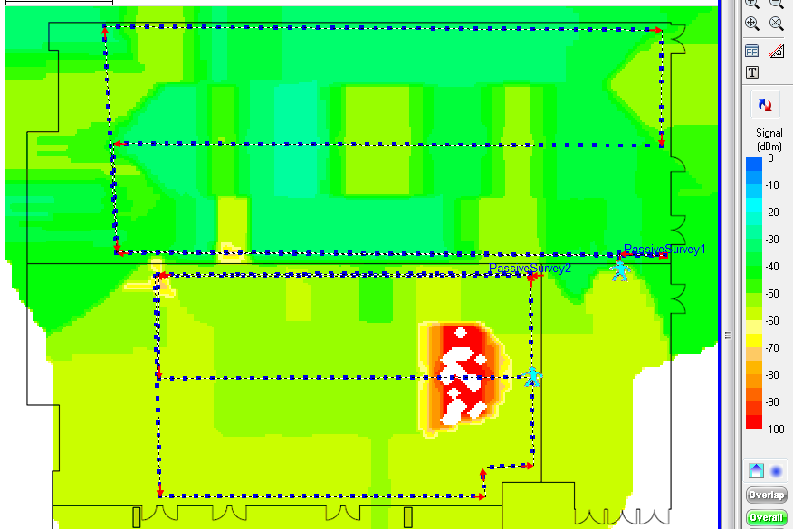
Jan 2015 Hyatt Regency Ballroom (2.4 GHz)
Retracting partition wall
AP in front of room
ce:41:58
Ch 1
-35dBm
-42dBm
-51dBm
-52dBm

Slide 10
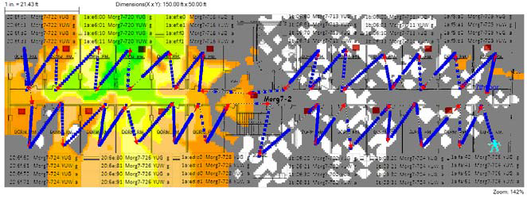
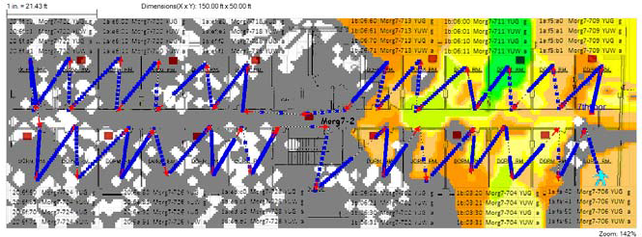
Private NY Area University Dorm
Concrete block walls – each dorm room is 3.1m /10ft wide

Slide 11
Recommendation
Based on data presented, 9 dB is a more conservative value for soundproofed interior walls separating tenants.
This assumes wood-frame or aluminum-frame construction with wallboard and standard insulating materials.
Concrete block, plaster-over-brick, and poured concrete walls have significantly higher values (at least 25dB)
There is no structural reason to use a different value for residential & enterprise scenario. Insulated bearing walls will have similar loss. If anything, residential case will have slightly higher average loss than enterprise.
Exterior walls in SS#4a should be modeled using a higher value than 9 dB

Slide 12
Straw Poll
Do you agree that the penetration loss values in both SS#1 and SS#2 should be increased to 9 dB?
Yes/No/Abstain

Slide 13
References
14/1590r0 - Zhao, et al, “Multi-wall penetration loss model for HEW system level simulation” – Jan 2014

