Slide 1
Payload Symbol Size for 11ax
Date: 2015-01-12
Authors:

Slide 2
Authors (continued)

Slide 3
Authors (continued)

Slide 4
Authors (continued)

Slide 5
Authors (continued)

Slide 6
Authors (continued)

Slide 7
Authors (continued)

Slide 8
Outline
The issue of symbol size for 11ax payloads has been discussed previously
  Eg: [1] investigated the impact of CFO estimation on symbols with larger FFT sizes (256 and 512 FFT)
We have investigated several symbol durations for the payload and propose a new symbol duration
We also follow up with a proposal for the choices of CP
Provide simulations with real processing that show
  Significant goodput gains over current choice of (64 FFT, 0.8 us CP)
  Robust performance in outdoor UL OFDMA

Slide 9
Proposal on payload symbol size & CP size
We propose to replace the current symbol duration (3.2 us) with longer symbols of duration 12.8 us in the payload to meet the following 11ax requirements
  Robustness in outdoor channels: both point to point and point-to-multipoint (UL MU/UL OFDMA)
  Greater tolerance to timing jitter across users in UL MU/OFDMA
  Efficient indoor operation by reducing CP overhead
We also propose the three following natural CP sizes for the proposed longer payload symbols
  0.8 us: similar to 11ac long GI, in particular serving high efficiency in indoor settings
  1.6 us: percentwise 11ac short GI, in particular serving high efficiency in outdoor channels and indoor UL MU/OFDMA
  3.2 us: percentwise 11ac long GI, in particular providing robustness in the challenging case of outdoor UL MU/OFDMA

Slide 10
Channel models & implications
Outdoor channels
  UMi-LoS, UMi-NLoS, UMa-NLoS
NLoS channels have large delay spreads with significant probability
Intersymbol interference leads to high error floors
0.8 us CP leads to error floors
Need longer CPs

Slide 11
Spectral efficiency
Assume a fixed transmission bandwidth and choose an MCS
R = code rate, bps = bits/sample (in the frequency domain. Eg. 256 QAM, bps = 8)
N_{fft} = symbol FFT size, N_{data} = #data tones/symbol, N_{cp} = #CP samples
Spectral Efficiency $=\left(1 −PER\right) × \frac{1}{1+ \frac{N_{cp}}{N_{fft}}}$ $× \frac{N_{data }}{ N_{fft}}$ $× \left(R× bps\right)$
Depends only on MCS
Increases as N_{cp} increases
As PER decreases for ISI channels
Decreases as N_{cp} increases
Unless we increase N_{fft}
Tone utilization
For a given N_{cp} (dictated by channel length), increase N_{fft} for smaller overheads and greater spectral efficiency

Slide 12
Simulation setup
11ax
Preamble
Payload
L-STF
L-LTF
L-SIG
11ax-LTF
Packet structure
  Payload
    1000 bytes
    FFT sizes: 64, 128, 256 FFT
    Data tones as defined for corresponding FFT sizes in 11ac
    CP sizes: 0.8 us, 1.6 us
  11ax-LTF: 1 symbol, same (FFT size, GI) as payload
  11ax-Preamble: 3 symbols, 64 FFT (precise structure undecided now, but # guided by 11ac)
  How is the preamble relevant?
    Pilots used for phase tracking, reduce CFO estimation error
20MHz bandwidth, SISO, BCC
Real processing
  Channel estimation, timing, frequency offset estimation, phase tracking, phase noise: all real

Slide 13
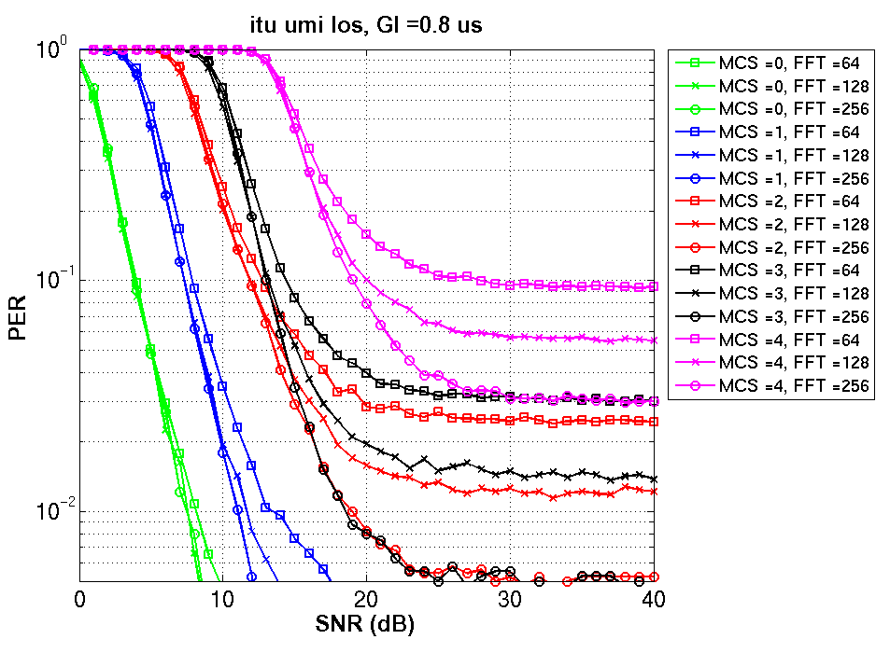
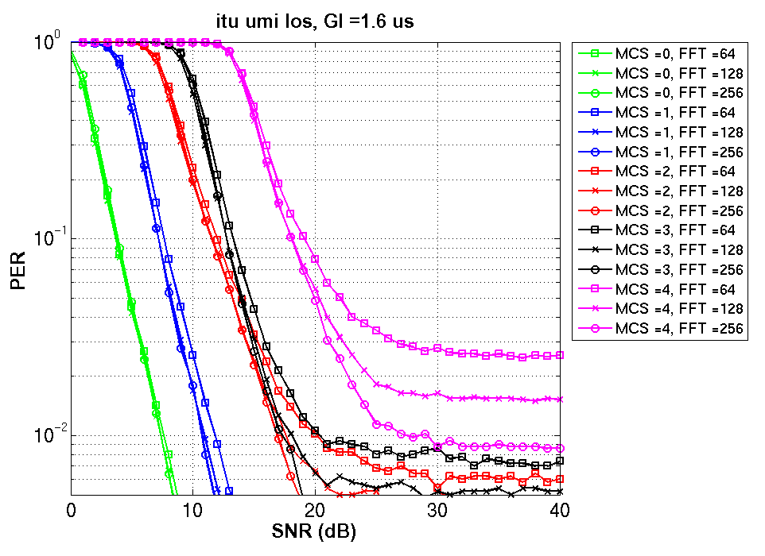
UMi-LoS: PER for MCS 0-4
PERs with 1.6 us GI (right figure) smaller than PERs with 0.8 us GI (left figure)
Even for a given GI, increasing FFT size reduces PER (ICI corrupted samples is a smaller fraction of the total number of samples)

Slide 14
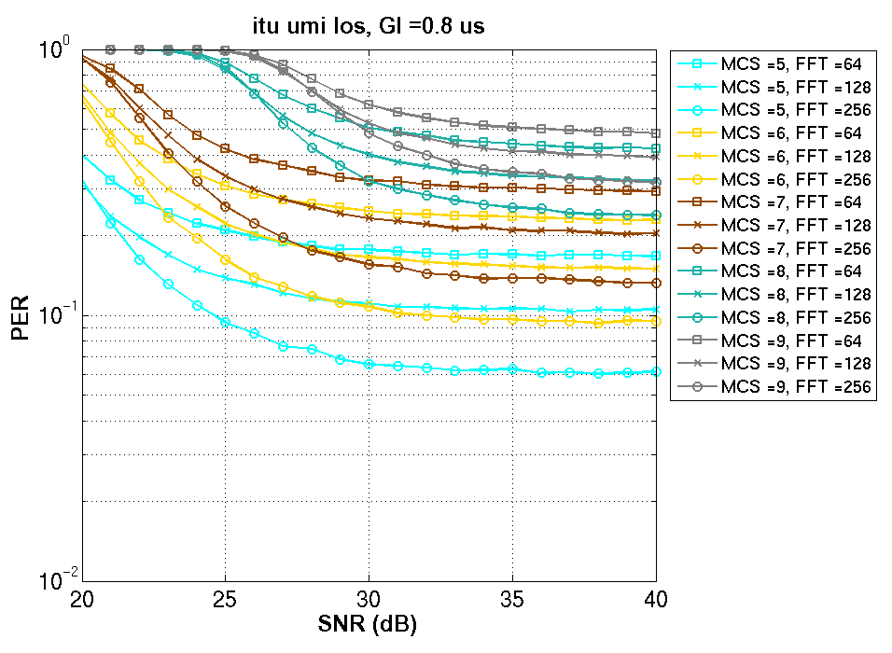
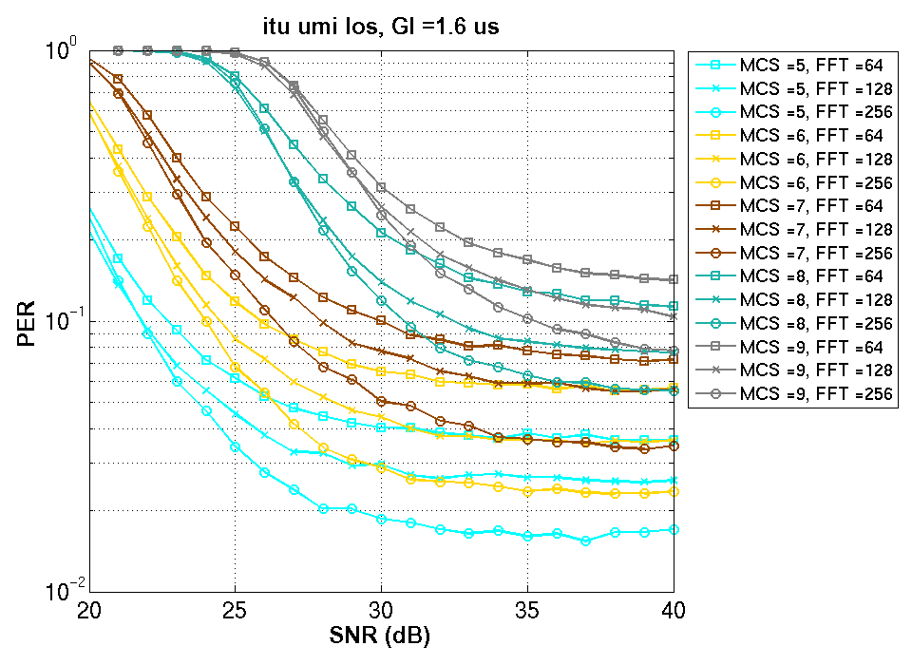
UMi-LoS: PER for MCS 5-9
PERs with 1.6 us GI (right figure) smaller than PERs with 0.8 us GI (left figure)
Even for a given GI, increasing FFT size reduces PER (ICI corrupted samples is a smaller fraction of the total number of samples)

Slide 15
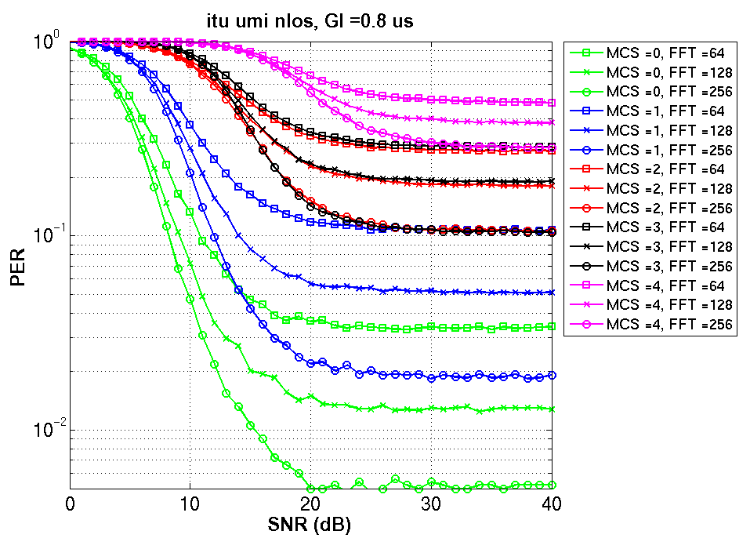
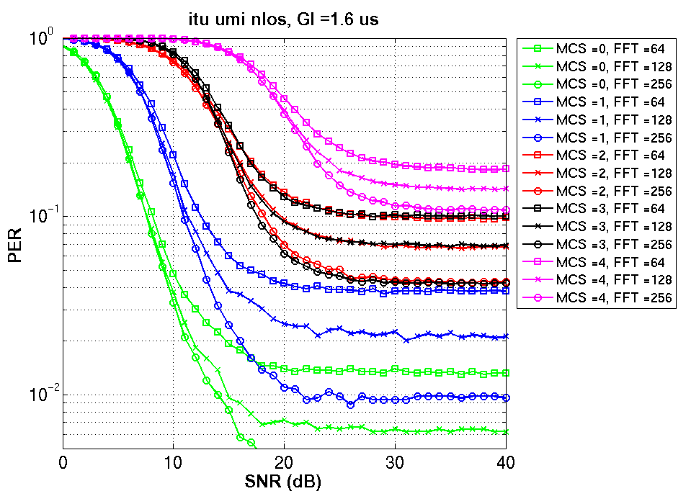
UMi-NLoS: PER for MCS 0-4
PERs with 1.6 us GI (right figure) smaller than PERs with 0.8 us GI (left figure)
Even for a given GI, increasing FFT size reduces PER (ICI corrupted samples is a smaller fraction of the total number of samples)

Slide 16
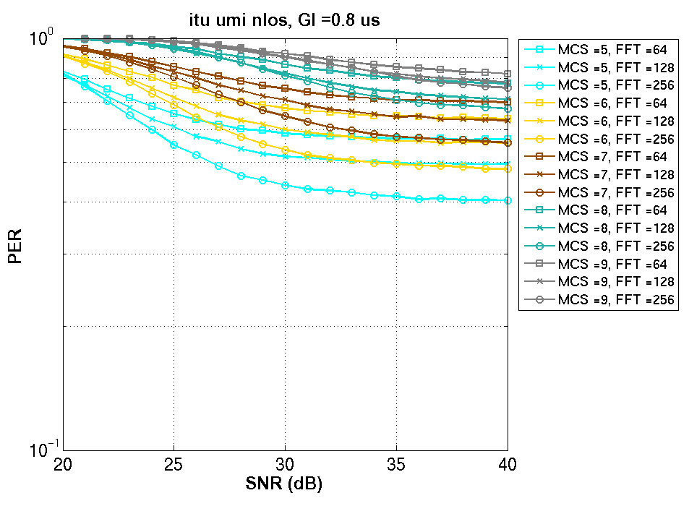
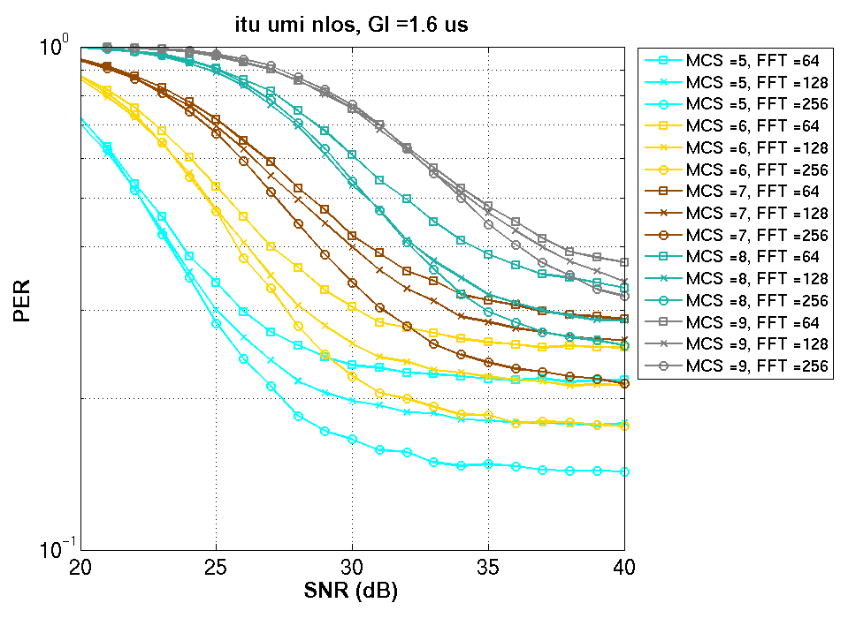
UMi-NLoS: PER for MCS 5-9
PERs with 1.6 us GI (right figure) smaller than PERs with 0.8 us GI (left figure)
Even for a given GI, increasing FFT size reduces PER (ICI corrupted samples is a smaller fraction of the total number of samples)

Slide 17
Goodput metric used for comparison
Goodput = max spectral efficiency obtained by picking the best MCS (for each SNR)
Spectral Efficiency $= \frac{N_{data }}{ N_{fft}}× \frac{1}{1+ \frac{N_{cp}}{N_{fft}}} × \max_{MCS}{[\left(1 −PER\right) × \left(R× bps\right)]}$
For a given CP size N_{cp}, choose largest possible N_{fft}
  CP overhead decreases, tone utilization also improves
For a given FFT size N_{fft} , there is a tradeoff in choosing N_{cp}
  Small N_{cp} : small overhead, but PER may be large
  Large N_{cp} : PER is small, but overhead large
  Choose the sweet spot for N_{cp}

Slide 18
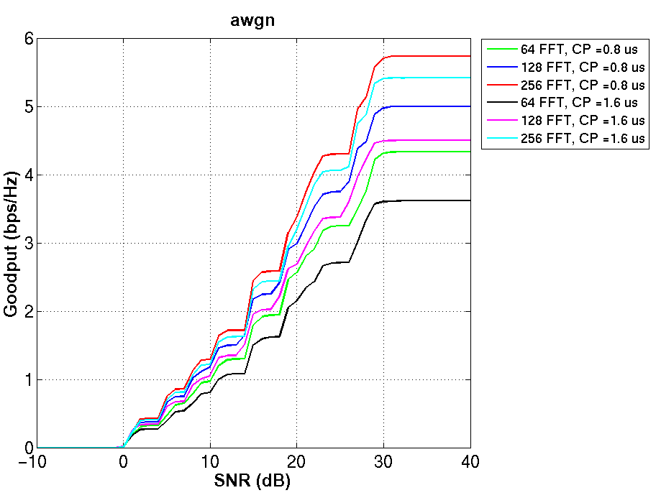
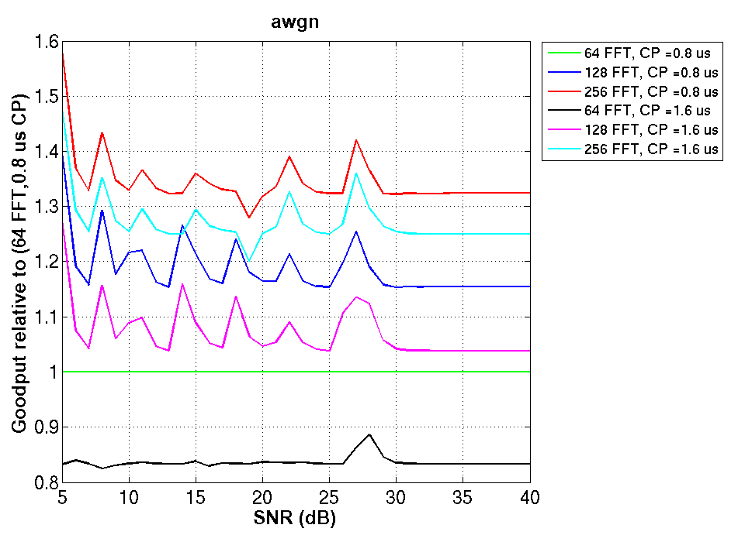
Goodput: AWGN
Absolute Goodput
Goodput relative to (64 FFT, 0.8 us CP)
For best results, pick as large an FFT as possible and then pick the smallest CP
  Increasing CP has no PER benefit in AWGN, increasing FFT reduces overhead
Using (256 FFT, 0.8 us CP) gives 1.32x goodput of (64 FFT, 0.8 us CP)

Slide 19
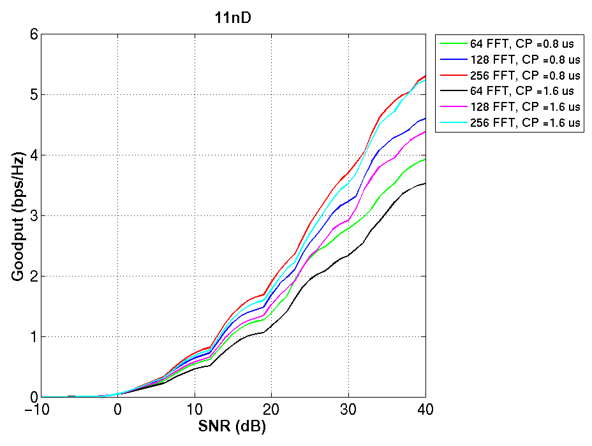
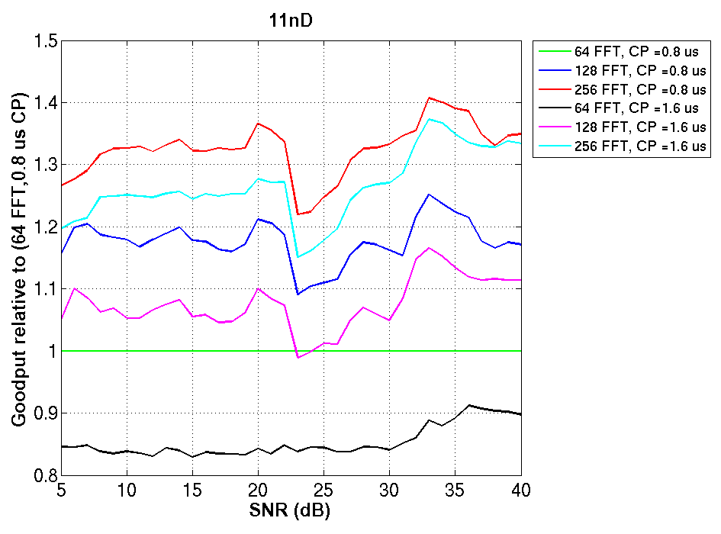
Goodput: 11nD
Absolute Goodput
Goodput relative to (64 FFT, 0.8 us CP)
Using (256 FFT, 0.8 us CP) gives ~1.3x goodput of (64 FFT, 0.8 us CP)
Since channels have small delay spreads, 0.8 us CP has 6-7% better throughput than 1.6 us CP (256 FFT, around 15-20 dB)

Slide 20
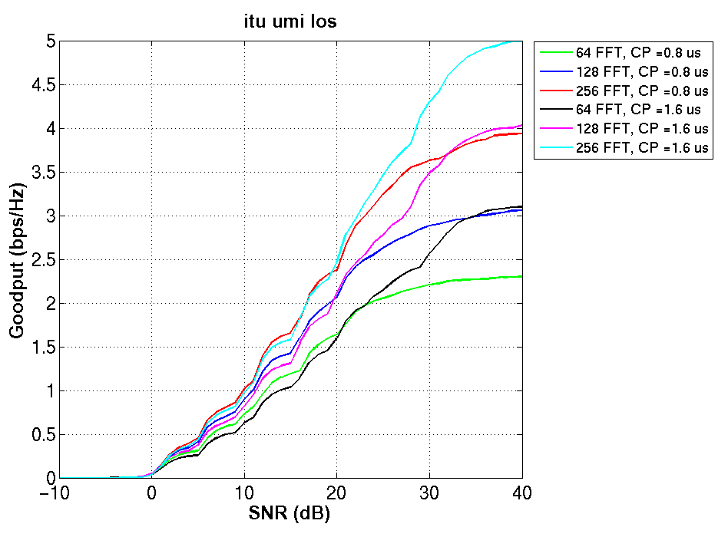
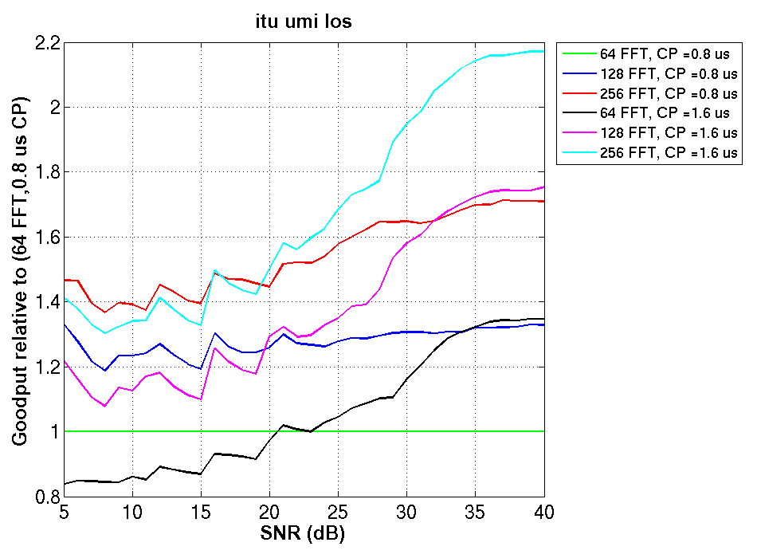
Goodput: UMi-LoS
Absolute Goodput
Goodput relative to (64 FFT, 0.8 us CP)
At high SNR
  Best to use large FFT with longer CP (256 FFT, 1.6 us CP)
  (256 FFT, 1.6 us CP) gives nearly 2.2x goodput of (64 FFT, 0.8 us CP)
At small SNR
  Thermal noise dominates ISI: increasing CP doesn’t give substantial PER gains
  Stick to smaller CPs, but use larger FFTs: (256 FFT, 0.8 us CP) works best

Slide 21
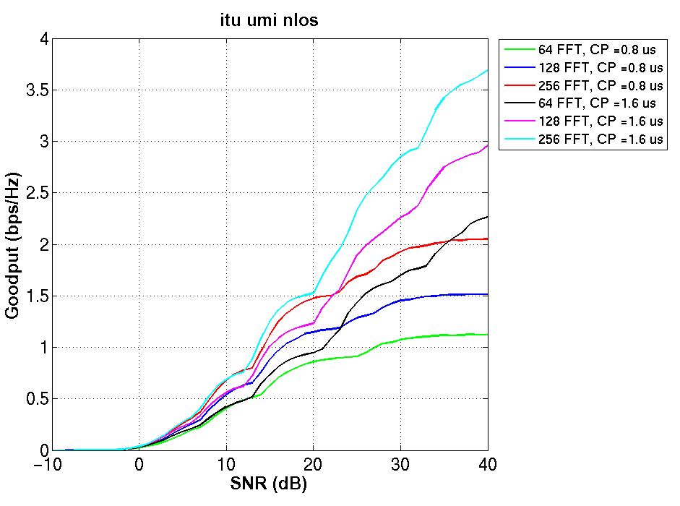
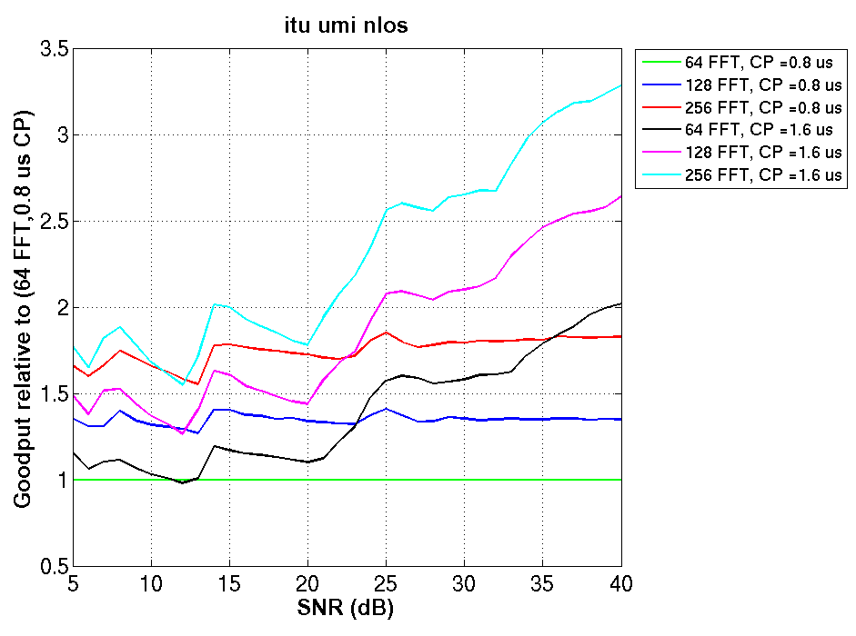
Goodput: UMi-NLoS
Absolute Goodput
Goodput relative to (64 FFT, 0.8 us CP)
Large delay spreads leads to high ISI
  Best to use large FFT with longer CP (256 FFT, 1.6 us)
  (256 FFT, 1.6 us CP) gives ~2.5x goodput of (64 FFT, 0.8 us CP) at 25 dB SNR

Slide 22
Challenge of UL-OFDMA
Timing jitter across users on the UL effectively increases channel delay spread. What is the impact on performance?
  Impact of intended user delay on himself
  Impact of delay of interfering users on intended user
Sources of timing jitter
  Different round trip delay
  Different timing acquisition points due to different channel delay spreads and noise
  Net timing jitter ~1.3 us (details in Appendix)

Slide 23
Simulation setup
UL OFDMA with 4 users
Each user has one antenna, AP has 4 Rx antenna
20MHz, 256 FFT
  Each user is allocated a contiguous block of 56 tone.
  There is one guard tone between two adjacent blocks.
  User allocations are fixed, and the second user (middle one) is the desired user (PER/Goodput are calculated for this user)
GI values considered: 1.6us, 3.2us
ITU UMi NLOS channel
1000 bytes packets
Real channel estimation from one LTF

Slide 24
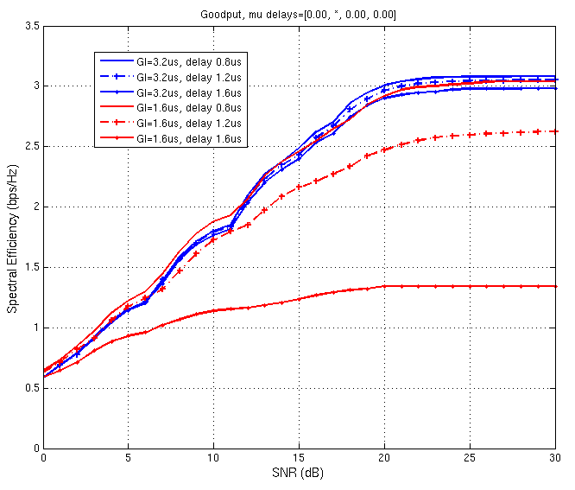
Results
Interfering users have no jitter
For intended user delay of 1.2 us
Goodput with 3.2 us GI = 1.16x Goodput with 1.6 us GI

Slide 25
Discussion
Summary
  256 FFT consistently outperforms current symbol choice of (64 FFT, 0.8 us CP)
  Goodput gains range from 1.3x-2.5x depending on channel
  Use 0.8 us CP with 256 FFT for high efficiency in indoor channels
  Use 1.6 us CP with 256 FFT for greater robustness to long outdoor channels and indoor UL OFDMA/MU
  Use 3.2 us CP with 256 FFT for robust performance in outdoor UL OFDMA/MU
Why not even higher FFT sizes, say 512 FFT over 20 MHz?
  Implementation complexities increase with increasing FFT sizes and bandwidths
  Tones are more narrowly spaced , CFO correction needs to be very precise: challenging task [1]
  Incremental gain over 256 FFT (3-6% depending on CP size) too small for increased complexity
  256 FFT size in 20 MHz seems to be the sweet spot between performance and implementation complexities

Slide 26
Proposal
We propose that 11ax shall have one longer payload symbol size of duration 12.8 us based on a 256 FFT in 20 MHz
  And correspondingly 512 FFT in 40 MHz, 1024 FFT in 80 MHz/80+80 MHz and 2048 FFT in 160 MHz
We also propose to use the following CP sizes: 0.8 us, 1.6 us and 3.2 us

Slide 27
References
[1] 11-14-0801-00-00ax-envisioning-11ax-phy-structure-part-ii

Slide 28
Straw Poll #1
Do you support that 11ax payload symbols use symbol size based on a 256 FFT in 20 MHz?
  And correspondingly 512 FFT in 40 MHz, 1024 FFT in 80 MHz/80+80 MHz and 2048 FFT in 160 MHz
Yes
No
Abstain

Slide 29
Straw Poll #2
Do you support the following CP choices for the proposed payload symbols: 0.8 us, 1.6 us and 3.2 us?
Yes
No
Abstain

Slide 30
Appendix

Slide 31
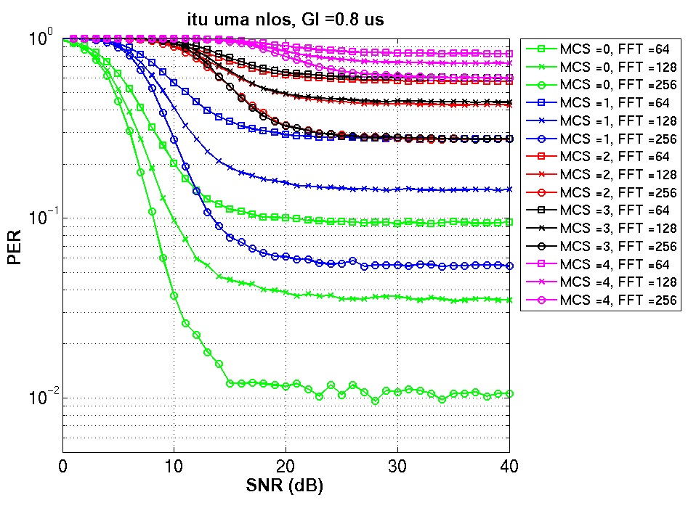
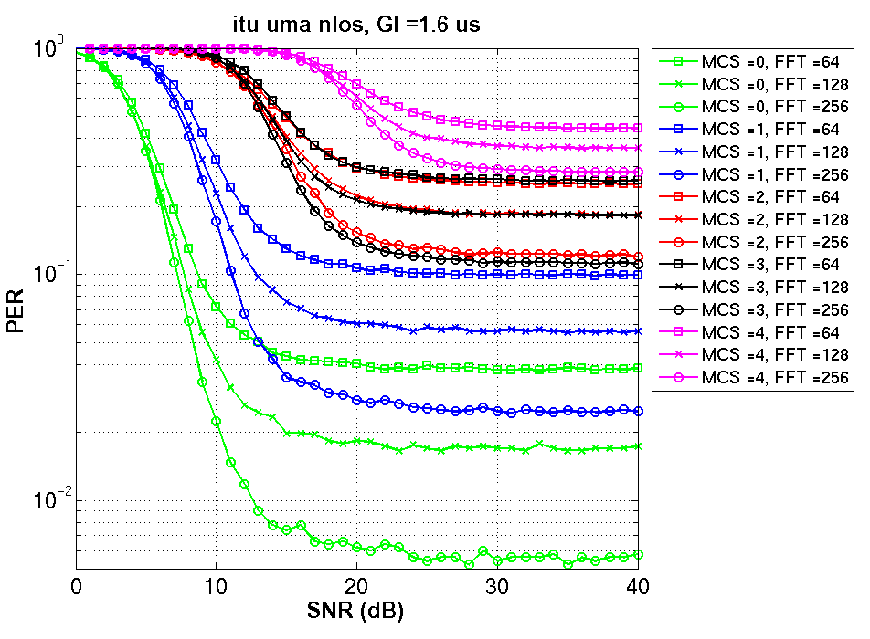
UMa-NLoS: PER for MCS 0-4

Slide 32
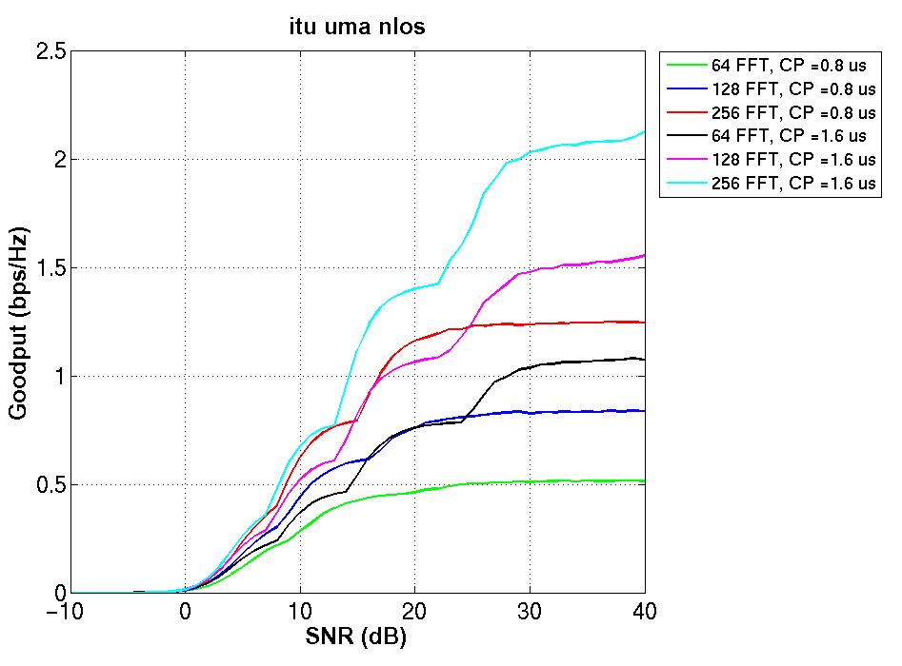
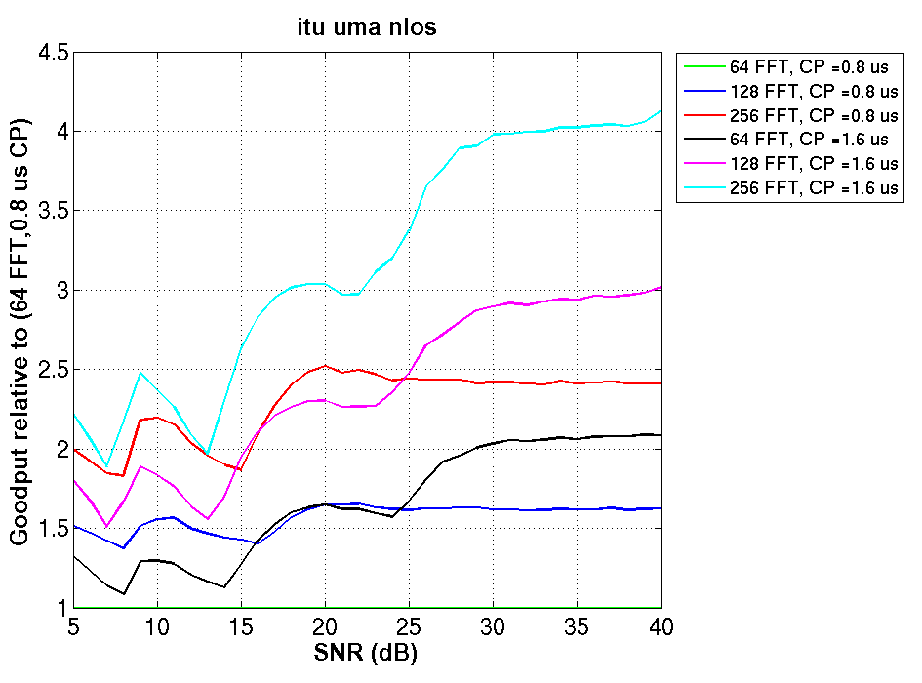
Goodput: UMa-NLoS
Absolute Goodput
Goodput relative to (64 FFT, 0.8 us CP)

Slide 33
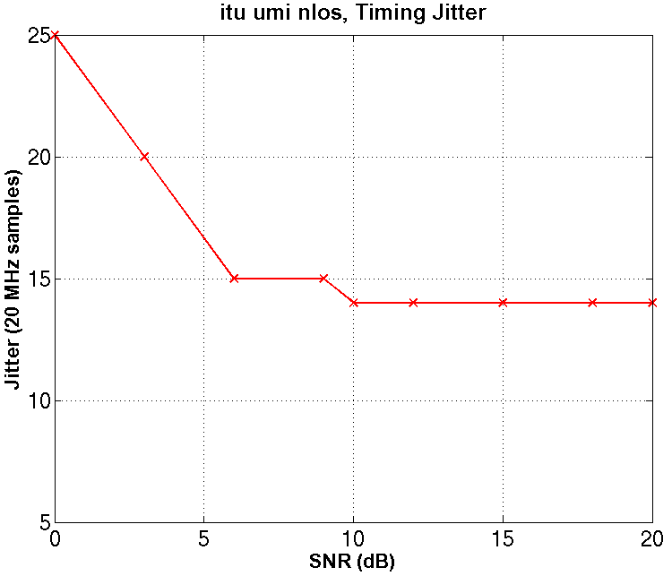
Sources of timing jitter
Different round trip delays can contribute 0.6 us (~ 200 m)
Timing acquisition on DL can contribute 0.7 us jitter in UMi-NLoS channels. For example, at 10 dB in figure below, 14 samples @ 20 MHz = 0.7 us
AP has 4 antennas, STA has 1 antenna
Timing acquired from L-LTF

