Slide 1
Box5 Results of 11ac SS6
Date: 2015-01-12
Authors:

Slide 2
Abstract
The simplified 1-BSS case of 11ac SS6 has been well calibrated by four companies [1].
This presentation further shows our complete 3-BSS case of 11ac SS6.

Slide 3
Calibration Scenario - 11ac Scenario 6 [2]
Fixed Location and Association
STA1 | (5,-9.5)
STA2 | (3.5,7.5)
STA4 | (-4.5,0.5)
STA5 | (-1.5,6)
STA7 | (-9,-5)
STA8 | (-8.5,8.5)
STA10 | (-3,0.5)
STA11 | (-0.5,8)
STA13 | (-4,-4)
STA14 | (7.5,-1)
STA16 | (8,-6)
STA17 | (0,-7.5)
STA19 | (-2.5,-4.5)
STA20 | (0.5,-2)
STA22 | (0,-4.5)
STA23 | (-1.5,7)
STA25 | (3.5,-5)
STA26 | (9,9.5)
STA28 | (-8,-5.5)
STA29 | (1.5,3.5)
AP A | (0,0)
AP B | (40,20)
AP C | (-40,-20)
STA3 | (7.5+xb, ‑9.5+yb)
STA9 | (7+xb, -7.5+yb)
STA15 | (3+xb, -0.5+yb)
STA21 | (-6.5+xb, -3+yb)
STA27 | (‑6+xb, 2.5+yb)
STA6 | (-5.5+xc,4.5+yc)
STA12 | (7+xc,7+yc)
STA18 | (10+xc,0.5+yc)
STA24 | (3+xc,2.5+yc)
STA30 | (9.5+xc,3.5+yc)

Slide 4
PHY Parameters
PHY parameters
BW | All BSSs at 5GHz [80 MHz, no dynamic bandwidth]
Channel model | TGac D NLOS per link
Shadow fading | iid log-normal shadowing (5 dB standard deviation) per link
Data Preamble Type | [5GHz, 11ac], duration is considered.
STA TX Power | 15 dBm per antenna
AP TX Power | 20 dBm per antenna
AP number of TX/RX antennas | 1/1
STA number of TX /RX antennas | 1/1
AP antenna gain | 0 dBi
STA antenna gain | -2 dBi
Noise Figure | 7dB
CCA threshold | -70dBm/80MHz (measured after large-scale fading)
Rx sensitivity | -82dBm/80MHz (a packet with lower rx power is dropped)
Link Adaption | Fixed MCS =7
Channel estimation | ideal
PHY abstraction | RBIR, BCC [3, 4]
Channel correlation | Same as defined in the used channel model

Slide 5
MAC Parameters
MAC parameters
Access protocol | [EDCA, AC_BE with default parameters] [CWmin = 15, CWmax = 1023, AIFSn=3 ]
Queue length | A single queue for each traffic link is set inside AP/STA sized of 2000 packets
Traffic type | UDP CBR with rate 10^8bps
MPDU size | 1540 Bytes (1472 Data + 28 IP header + 40 MAC header)
Aggregation | [A-MPDU / max aggregation size / BA window size, No A-MSDU, with immediate BA], Max aggregation: 64 MPDUs with 4-byte MPDU delimiter
Max number of retries | 10
Beacon | Disabled
RTS/CTS | OFF
Traffic direction | DL Only, UL only and mixed DL&UL
Throughput metric | Histogram of per non-AP STA throughput (received bits/overall simulation time)
[
*Please refer to [5] for more info about how to model these parameters.

Slide 6
Traffic Flow Model
DL/UL traffic assigned for each STA [2]
STA | DL | UL | STA | DL | UL
STA1 | y | y | STA23 | n | y
STA2 | y | y | STA25 | y | y
STA4 | y | y | STA26 | y | y
STA5 | y | y | STA28 | y | y
STA7 | y | y | STA29 | y | y
STA8 | y | y | STA3 | y | y
STA10 | y | n | STA9 | y | n
STA11 | y | n | STA15 | y | n
STA13 | y | n | STA21 | n | y
STA14 | y | n | STA27 | y | y
STA16 | y | n | STA6 | y | y
STA17 | y | n | STA12 | y | n
STA19 | y | n | STA18 | y | n
STA20 | y | n | STA24 | n | y
STA22 | n | y | STA30 | y | y
“y” means having DL/UL traffic flow; “no” means not having DL/UL traffic flow

Slide 7
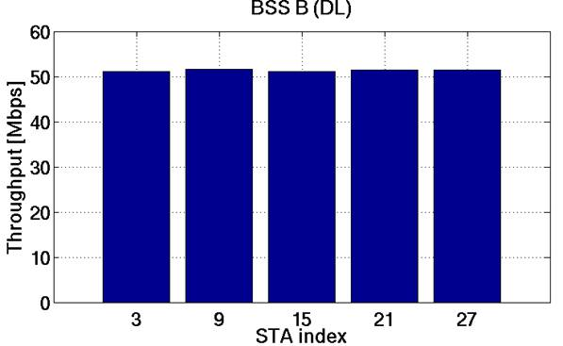
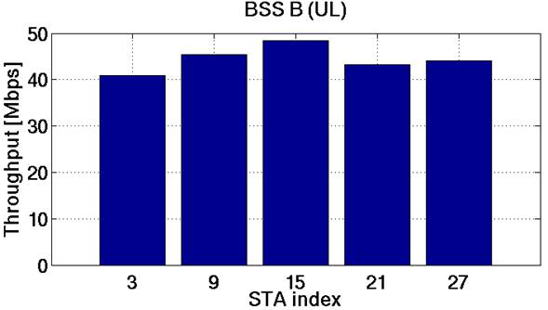
One BSS Test (1/2)
Upright corner BSS B (STAs 3, 9 ,15, 21, 27)
DL only, UL only and mixed DL&UL (STA rate in Mbps)
The same traffic is attached to each STA
DL thrpt = 256.48 Mbps
UL thrpt = 222.01 Mbps

Slide 8
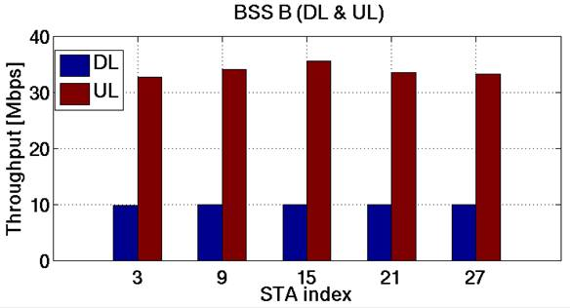
One BSS Test (2/2)
DL thrpt = 49.37 Mbps
UL thrpt = 168.99 Mbps
Total thrpt = 218.36 Mbps
DL still has uniform rate distribution among STAs
UL still has similar trend as that in UL-only case
Similar observation was made in [6]

Slide 9
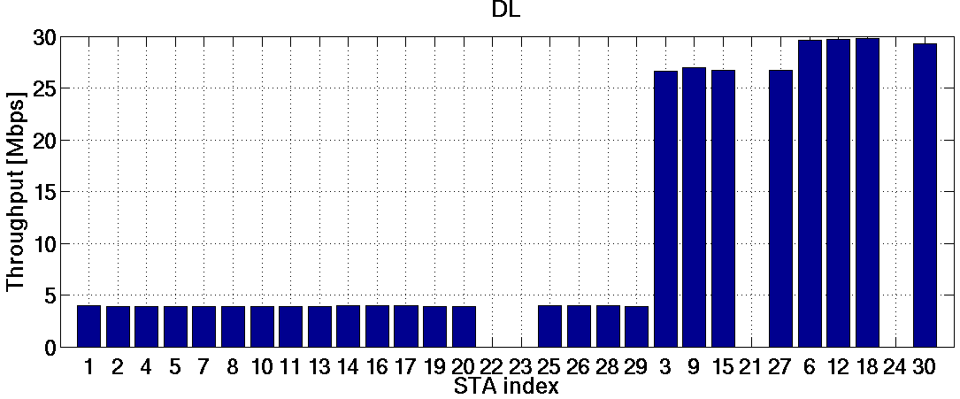
3-BSS Test (1/2)
BSSA thrpt = 70.60 Mbps
BSSB thrpt = 107.10 Mbps
BSSC thrpt = 118.40 Mbps
TOTAL = 296.10 Mbps
Each BSS has uniform STA rate
BSS B and BSS C have similar throughput higher than BSS A has
AP A can hear both AP B and AP C in the most of time
AP B and AP C cannot always hear each other
If 3 APs could always hear each other, each AP should have equal access probability and each BSS should have similar DL throughput

Slide 10
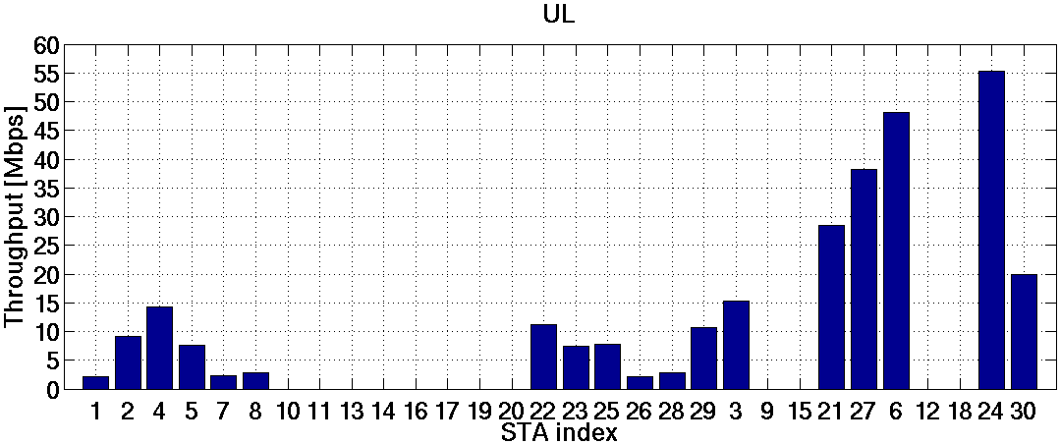
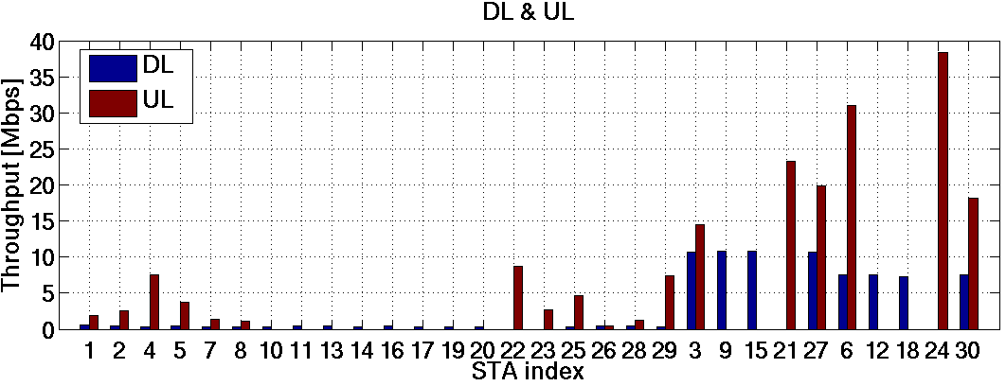
3-BSS Test (2/2)
BSSA thrpt = 80.45 Mbps
BSSB thrpt = 81.96 Mbps
BSSC thrpt = 123.21 Mbps
TOTAL = 285.62 Mbps
DL：
BSSA thrpt = 7.19 Mbps
BSSB thrpt = 42.96 Mbps
BSSC thrpt = 29.91 Mbps
DL TOTAL = 80.06 Mbps
UL：
BSSA thrpt = 43.48 Mbps
BSSB thrpt = 57.57 Mbps
BSSC thrpt = 87.50 Mbps
UL TOTAL = 188.55 Mbps
DL & UL thrpt = 268.61 Mbps
Previous observations of uniform DL rate and distance-related UL rate still hold true.
But it is hard to justify whether the throughput ratio among BSSs is correct or not.
More analysis and comparison are required by companies.

Slide 11
Summary
Four companies have been already able to provide aligned Box5 results of the simplified 1-BSS case of 11ac SS6.
However, for the 3-BSS case different results were observed by those companies.
We showed our 3-BSS results for comparison and we hope more companies could prepare their results so that we can have more sources for calibration.

Slide 12
Reference
[1] 11-15/0051r0 Box5 Calibration Results
[2] 11-09/0451r16 TGac Functional Requirements and Evaluation Methodology
[3] 11-14/0571r6 Evaluation Methodology
[4] 11-14/1176r0 PHY Abstraction Tables for 11ax System Level Simulation
[5] 11-14/1523r3 Offline Discussion Minutes of SLS Calibration
[6] 11-14/1392r2 Simulation Results for Box5 Calibration

