Slide 1
EPD for IEEE 802.11 5.9GHz Operations
Nov 2014
Date: 2014-11-5
Date: 2014-11-5
Authors:

Slide 2
Abstract
Nov 2014
Background
Rationale for switching from LLC Protocol Discrimination (LPD) to EtherType Protocol Discrimination (EPD) in the IEEE 802.11 5.9 GHz bands
Current status of implementations and support

Slide 3
Background
Nov 2014
Slide 3
From their inception, 802.2 (LLC) and 802.3 (L/T aka Ethernet) have been and continue to be incompatible layer-2 (LLC-sublayer) protocols.
Somewhere between 1999 and 2007, IEEE 802.11 specifically designated LLC (as defined in 802.2) as the Logical Link Control sublayer protocol to be used in all 802.11 STAs.
Ethernet now dominates the LAN market (FDDI and Token Ring are disappearing)
Notes:
doc.: IEEE 802.11-yy/0339r0
Month Year
John Doe, Some Company
Page 3

Slide 4
Background
Nov 2014
Slide 4
IEEE 802.2 was withdrawn in 2011 and is no longer supported by IEEE (ISO maintains a “stabilized” version in ISO/IEC 8802-2:1998)
IEEE 802-2014 Overview and Architecture explicitly discourages the use of 802.2 LLC in the future.
  “New IEEE 802 standards shall support protocol discrimination in the LLC sublayer using EPD.”
Notes:
doc.: IEEE 802.11-yy/0339r0
Month Year
John Doe, Some Company
Page 4

Slide 5
Background
Nov 2014
Slide 5
The use of EtherTypes instead of DSAP/SSAP addresses as network layer protocol identifiers means LLC SNAP/RFC1042 has to be used (cf. IEEE 802.11)
As a consequence, six (6) octets of fixed content (and therefore useless) are transmitted in every over-the-air stream.
Notes:
doc.: IEEE 802.11-yy/0339r0
Month Year
John Doe, Some Company
Page 5

Slide 6
Background
Nov 2014
LLC-sublayer 802.2 (LPD) header format (LLC SNAP RFC1042)
Length/Type encoding (EPD) header format
Length < 1503 (0x05DF)
Ethertype > 1535 (0x05FF)
Slide 6
Notes:
doc.: IEEE 802.11-yy/0339r0
Month Year
John Doe, Some Company
Page 6

Slide 7
Background
Nov 2014
IEEE 802.11 TGp created the amendment to IEEE 802.11 for operations in the 5.850-5.925 GHz frequency bands currently allocated by the FCC to Intelligent Transport Systems (ITS) operations
Operations in these bands are “outside the context of a BSS” (dot11OCBActivated is true in 5.9 GHz bands in the US and Europe (see IEEE Std 802.11 Annex E))
Slide 7
Notes:
doc.: IEEE 802.11-yy/0339r0
Month Year
John Doe, Some Company
Page 7

Slide 8
Rationale
Nov 2014
There are currently no commercial deployments of IEEE 802.11 5.9 GHz units/systems (only prototype units in trials); hence the 5.9 GHz MAC/PHY can be considered to be “new”.
Therefore, EPD should be used because it is:
  more efficient (6 bytes saved in every data frame)
  “compatible” with 802.3 ethernet LANs and 802.1Q bridges
  compatible with GLK (EPD) operation (when standardization is complete)
  IEEE 802-2014 mandates it!
Slide 8
Notes:
doc.: IEEE 802.11-yy/0339r0
Month Year
John Doe, Some Company
Page 8

Slide 9
Rationale
Nov 2014
There are ongoing discussions on and investigations into possible sharing of some part of the ITS 5.9 GHz frequency bands (cf. UNII-4 in FCC NPRM 13-22)
Changing from LPD to EPD for ITS communications in the ITS bands would neither impact nor be impacted by possible sharing with other IEEE 802.11 devices should such sharing eventually be allowed
The ONLY change is to the contents of the LLC sublayer Protocol Data Unit (LPDU … aka MSDU)
Slide 9
Notes:
doc.: IEEE 802.11-yy/0339r0
Month Year
John Doe, Some Company
Page 9

Slide 10
Current Implementations
Nov 2014
4 vendors of 5.9 GHz (11p) radio units have made and successfully tested the change (< 2 man-hours of effort)
  Q-Free
  Commsignia
  Savari Networks
  Arada Systems
Slide 10
Notes:
doc.: IEEE 802.11-yy/0339r0
Month Year
John Doe, Some Company
Page 10

Slide 11
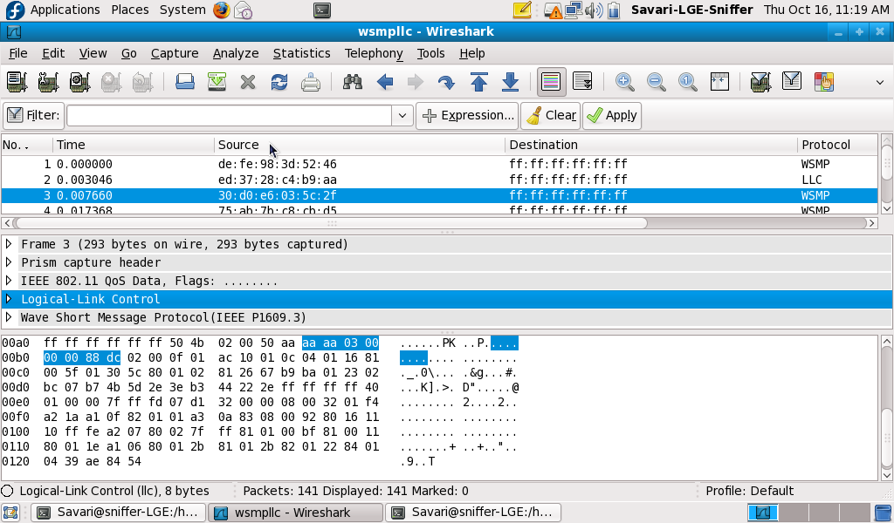
Current Implementations - LPD (before)
Nov 2014
Slide 11
Notes:
doc.: IEEE 802.11-yy/0339r0
Month Year
John Doe, Some Company
Page 11

Slide 12
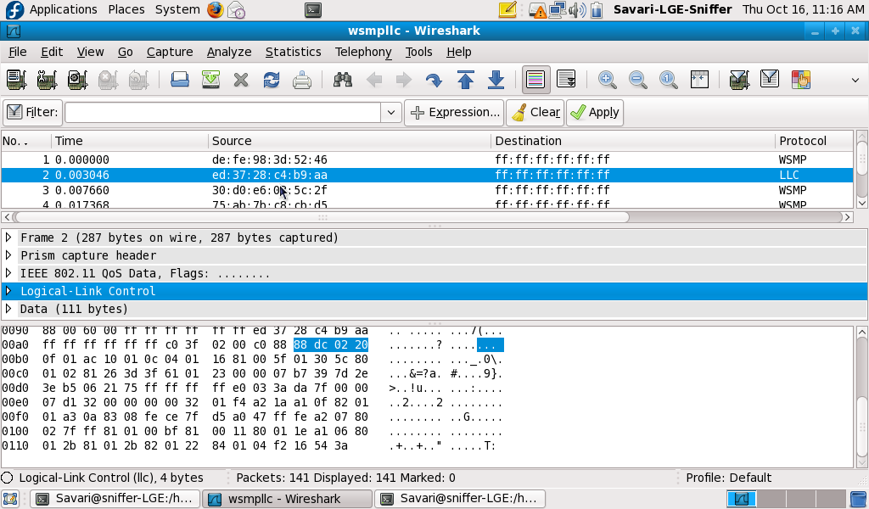
Current Implementations - EPD (after)
Nov 2014
Slide 12
Notes:
doc.: IEEE 802.11-yy/0339r0
Month Year
John Doe, Some Company
Page 12

Slide 13
Current Support
Nov 2014
Several other vendors have indicated support for the change
In October 2014, TC 204 passed the following resolution:
“Resolution 1072:
ISO/TC 204 resolves to support a change from LPD
to EPD in the 802.11 specifications for 5.9 GHz frequency bands.
APPROVED”
Slide 13
Notes:
doc.: IEEE 802.11-yy/0339r0
Month Year
John Doe, Some Company
Page 13

Slide 14
Straw Poll
Nov 2014
Do you support a change from LPD to EPD for ITS communications in the IEEE 802.11 5.9GHz (“11p”) frequency bands?
  YES:
  NO:
  NEED MORE INFORMATION:
  ABSTAIN:
Slide 14
Notes:
doc.: IEEE 802.11-yy/0339r0
Month Year
John Doe, Some Company
Page 14

