Slide 1
802.11ax Power Save Discussion
Date: 2014-11-03
Authors:

Slide 2
Abstract
The submission discusses on the power save requirements in 802.11ax use scenarios. The traditional power save mechanisms and the microsleep (PSMP, Partial AID) mechanisms are shortly introduced.
The submission provides simulation results for the power save calibration scenario.

Slide 3
Characteristics of HEW Use Cases
802.11ax simulation scenarios have very high traffic load in dense deployment
The networks are large, multiple APs and very high traffic load
Traditional power save mechanism are designed for lower traffic load and tailored for random access
Power save mechanisms may hang, i.e. the power saving STAs may need to operate in Awake state for a long time, when traffic is delivered to other STAs
No DL delivery before a UL trigger

Slide 4
HEW Requirements for Power Save
.11ax needs to enable efficient channel access
High throughput shortens PHY operating times
Exhaustive competition in channel access easily results to overhead
Power save must be available all times also during high throughput data transmission
Only the current transmitter(s) and receiver(s) need to be Awake
The main requirement for 802.11ax is to offer 4x average throughput per STA (of 802.11ac) while maintaining or improving the power efficiency per station

Slide 5
Power Save Mechanisms Using Power Save Mode
The previous submissions for power save calibration[1] discussed on the following power save mechanisms:
Power Save Mode transitions (PSM) STA controls its operation in active and power save mode
Power save mechanisms within power save mode:
U-APSD; STA trigger service periods, data delivery during service period and AP terminates the service period
PS-POLL; STA sends a single PS-POLL frame, AP transmits a single PPDU to the STA
PS-Poll creates overhead due to PS-Poll frame (100us per PS-poll + ACK) and only a single PPDU transmission per received PS-Poll

Slide 6
Example of PSM Operation
Non-AP STA has full control on its power save mode.
AP is aware STA is out of PM mode, and no longer buffers traffic for this STA
More Data field is always 0 in active mode – The STA does not know if AP has buffered traffic for it.
AP buffers this frame since this STA is in power save mode
DATA
PM=0
PM=1
ACK
A-MPDU
MPDU
ACK
BA
ACK
PM=0
PM=1
AP starts CCA
STA return to Doze, and AP resumes buffering traffic for this STA
A non-AP STA may select when it sends a frame to transition to active mode.
A Non-AP STA may select when it sends a frame to transition to power save mode. The duration of the operation in active mode should be minimized for good power save.

Slide 7
Example of PSP Operation
AP buffers this frame since this STA is in power save mode
DATA
AP starts EDCA for downlink one PPDU
AP
ACK
MPDU
STA
PS-Poll
ACK
STA starts CCA for PS-Poll
STA return to Doze, and AP resumes buffering traffic for this STA
PS-Poll (20 octets) 48us + SIFS 16 us+ ACK (14 octets) 44us are overhead ~100 us.
TXOP obtaining takes time and resources.
Just a single PPDU delivery after a PS-Poll is not suitable for high throughput DL delivery.

Slide 8
Example of U-APSD Operation
AP buffers this frame since this STA is in power save mode
DATA
STA return to Doze, and AP resumes buffering traffic for this STA
EOSP=0
EOSP=1
ACK
A-MPDU
A-MPDU
MPDU
BA
BA
STA starts CCA for trigger frame, i.e. QoS (Null) frame
Service Period
If an AP does not have buffered traffic, unnecessary service period is triggered. Every SP needs to be terminated with acked frame exchange which creates overhead.
The service period should be possible to terminate with a UL or DL + ACK frame exchange, similarly as mesh peer service periods in 802.11s.

Slide 9
Microsleep – Avoiding Operation during Transmissions to other STAs
Microsleep enables a STA to know that it will not receive or transmit within a period
The STA may operate in Doze state during the period
Microsleep works in active and power save mode
Microsleep was introduced in 802.11n
802.11n introduced Power Save Multi Poll (PSMP) to enable an AP to schedule UL and DL transmissions within a TXOP
802.11ac continued the evolution with Partial AID; the PLCP header indicates the transmitter and receiver(s) and enables other STAs to go to Doze state
802.11ax has not (yet) defined its solution
UL & DL MU-MIMO have likely some microsleep solution

Slide 10
Scheduling – Mastering the Contention Level
802.11ax use cases have huge traffic load
Means on mastering the contention level improves the overall performance
Clear indications when a STA is expected to operate simplify the power save operation and enable STA to go to long term (deep) sleep
Restricted Access Window (RAW) could reduce contention and improve the channel access efficiency
HCCA and TXOP continuation may be used to inititate or continue TXOPs without large contention
UL & DL MU-MIMO transmissions may create the highest capacity for data transmission

Slide 11
Power save calibration simulations

Slide 12
Power Save Calibration
The power save calibration ensures the correct implementation of the power save mechanisms
The simulation case should be simple and easy to understand
Simulator is not the same as practise and real devices
The PS mechanisms need to be implemented similarly to produce the same results
Eliminate vendor specific implementations from calibration scenario. Minimize the calibrated operations for timely progress
Focus on time distribution of the PHY modes

Slide 13
Power save scenarios
The proposal was to define 2 scanerios for power save calibration:
Scenario 1:
120 bytes with CWmin=7 15 (assuming 24 kbps codec, once every 40 ms) for both AP and STA
This application should be used for all power save modes testing
Scenario 2:
1500 bytes with CWmin=15 downlink every 200 ms
This application model is targetted for PSM and PS-POLL testing
This traffic model is not similar to applications in HEW → This is similar to ”stand-by operation”

Slide 14
Simulated Power Save Calibration Scenario
Simulations are done with U-APSD and with ”normal” active mode
Only a single application was used
The traffic was (=24kbps throughput) and no packets were dropped
U-APSD:
The non-AP STA transmits trigger frame (UL VoIP packet) and the AP transmits SP termination frame (DL VoIP packet)
Next SP is triggered with next UL VoIP packet

Slide 15
Power Save Calibration scenario
The AP Beaconing was not tested in the calibration scenario
Recommendation is to transmit 80 octet Beacons, but not to force the STA to receive the beacons
Proposal:
The details of the beacon frame reception should not be required in calibration scenario

Slide 16
Simulation Results
The PHY modes distribution is shown in the following slides
Slide 8 contains results for non-AP STA
Slide 9 contains results for AP STA
Some collisions (0.05% of time) did happen in active mode

Slide 17
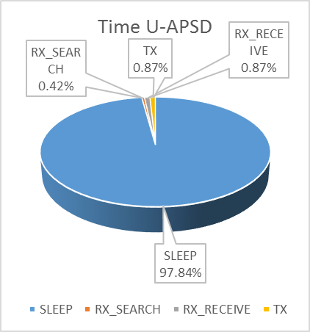
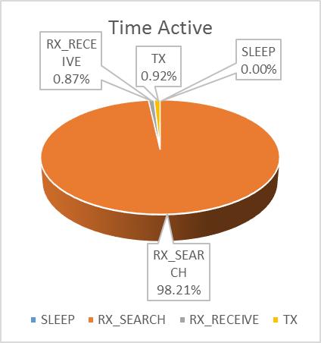
Distribution of Non-AP STA PHY Operation Modes

Slide 18
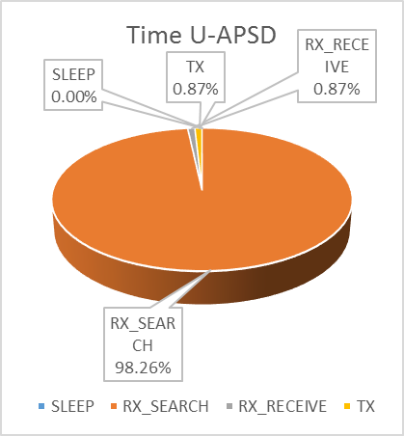
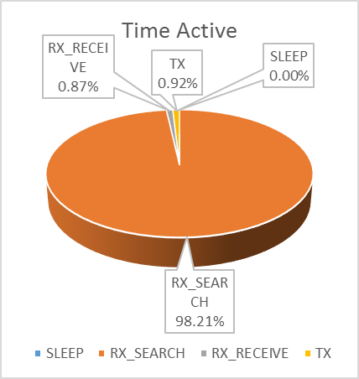
Distribution of AP PHY Operation Modes

Slide 19
Summary
The existing power save mechanisms should be reused and further improved for better performance
Scheduling enhancements should be considered so that power save operation can be simplified and STA can go to long term (deep) sleep
Microsleep will be important in dense deployments

