Slide 1
Clear Channel Assessment for OFDMA PHY
Authors:
Date: 2014-11-01

Slide 2
Outline
Challenges on CCA in Single User PHY
Challenges on CCA in OFDMA PHY

Slide 3
Challenges on CCA in Single User PHY
Single user PHY
Single carrier transmission
Multicarrier transmission but a single use occupying all sub-carriers
CDMA multiuser communication to achieve high data rate at low error rate degenerates to FDMA with different spreading codes
Energy/Power detection is not reliable under spectrum sharing among heterogeneous systems

Slide 4
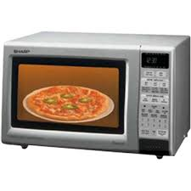
Unreliable Energy Sensing
CCA is clear but
transmission actually
can not be successful!
Receiver
Strong interference
to reception
Transmitter
Little interference
Receiver
Strong interference
to disable CCA
Transmission can
be actually successful!
Transmitter

Slide 5
Clear Channel Assessment
RSSI pin out from RF to baseband processor (no need for single chip)
To indicate sensed energy/power inside the band
Easy and quick to get but NOT reliable
Whether CCA can be clear must depend on the carrier locking and/or timing locking, or even estimated error rate
That is, the entire packet has been decoded.

Slide 6
Network Topology Not Equivalent to Sensing Topology
Hidden terminal problem
Sensing topology is different from network topology
Transmitter senses the existence of transmission is NOT reliable
Receiver may observe in a different way from transmitter
Access
Point
Station A
Communication
Link
Station D
Station B
Station C
Sensing Link

Slide 7
OFDMA PHY
OFDMA is a multiuser PHY
Carrier locking does not imply that transmissions are not allowed.
As shown in the figure, purple radio blocks being used suggests that energy detection is on and carrier locking is on, but the transmission can still use yellow, or green radio blocks.
No. of OFDM Symbols
No. of Sub-Carriers

Slide 8
What Was Random Access?
Random access consists of carrier sensing and collision resolution
Therefore, it is a concept associated with physical channel(s)
IEEE 802.11 is actually FDMA
Both carrier sensing and collision resolution can be treated as the tree structure
OFDMA further divides a physical channel into logic channels (i.e. groups of radio blocks)

Slide 9
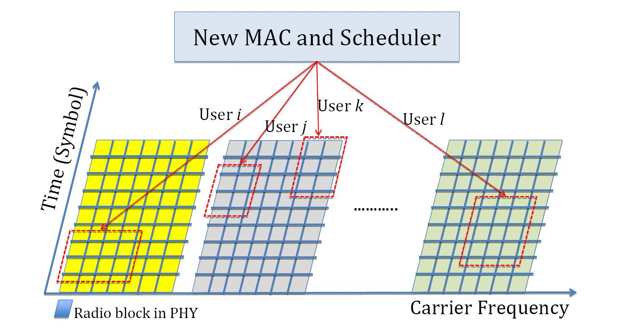
Challenges on CCA in OFDMA PHY
Major Challenge: Sensing busy but may have radio blocks (logic channels) available
Can sensing bring in availability of radio blocks? NO!
As shown in the figure, if user j is utilizing some RBs at the grey carrier frequency, user k is possible to utilize other portion of RBs at the same grey carrier frequency, though the CCA is negative to prohibit using this carrier frequency as CSMA/CA operation.

Slide 10
Summary
CCA and CSMA/CA might face new challenges if OFDMA PHY is adopted. Reliable CCA to deploy CSMA/CA in WLANs is still an open problem.

