Slide 1
IEEE 802.11TGai
Closing Report
Date: 2014-9-18
Authors:
Name | Company | Address | Phone | email
Hiroshi MANO | Koden Techno Info K.K. | Fuji Blg 28 2F, 2-7-26 Kita-Aoyama, Minato-ku, Tokyo, 107-0061, Japan | +81-3-6890-0594 | mano@koden-ti.com hiroshi@manosan.org

Slide 2
Abstract
This presentation is the closing report for the Athens meeting of the IEEE 802.11 TGai.

Slide 3
IEEE 802.11 FILS TGai –
Sep 2014 Athens meeting
Goals for the Meeting:
  Approve minutes of past meeting and teleconference
  Comment resolution of WG
  Approve to forward the draft to WG Recirc LB
  Approve Timeline
  Approve Teleconference schedule
  Approve Plan for Nov

Slide 4
Accomplishments TGai 1/2
7 regular slots + 1Joint meeting with TGaq
Approve TGai Meeting Minutes for the IEEE 802.11 SanDiego meeting:
  11-14/0900r0 July 2014 San Diego Session Minutes
Approve TGai teleconference meeting minutes of San Diego to Athens meeting.
    11-14/1053r1 TGai Teleconference Minutes on Aug 19th
    11-14/1080r2 July-September Teleconference Minutes

Slide 5
Accomplishments TGai 2/2
TGaq joint meeting
Compete all of 1186 comments resolution of WG LB201
  By 19 technical motions
Approve to forward the draftD3.0 to WG Recirc LB
Approved Plan for Nov
Approved Time line
Approved Teleconference schedule

Slide 6
Motion to goto the recirc WG LB
Having approved comment resolutions for all of the comments received during Working Group Letter Ballot 201 on TGai D2.0 as contained in document 11-14/0565r24,
  Instruct the editor to incorporate the resolutions with the D2.0 and create D3.0.
  Approve a 15 day Working Group Recirculation Ballot asking the question “Should TGai D3.0 be forwarded to Sponsor Ballot?”.
Moved: Ping Fang
Seconded: Lee Armstrong
Result (11/0/0)

Slide 7
Plan for Nov
Goals for the Meeting:
  Approve minutes of past meeting and teleconference
  Joint meeting with TGaq
  Comment resolution of WG Recirc LB
  Approve Timeline
  Approve Teleconference schedule
  Approve Plan for Jan

Slide 8
Time line of TGai (no changes)
  PAR Approved, Modified, or Extended 2010-12-08
  WG Letter Ballots Initial / Recirc Mar14/Sep14/Jan15
  MEC Done Nov14
  Form Sponsor Ballot Pool / Reform Mar15
  IEEE-SA Sponsor Ballots Initial / Recirc Jul15/ Sep 15
  Final 802.11 WG Approval Nov 15
  final or Conditional 802 EC Approval Nov 15
  RevCom & Standards Board Final or
  Continuous Process Approval Mar 16
  ANSI Approved N/A

Slide 9
Teleconference Schedule
Motion:
  Approve the following schedule of weekly teleconferences on Sep30th , Oct 21st, Oct 28th and Nov 11th.
  Tuesdays 10:00 ET
  Duration 1.0Hour
  Using WEB-EX that will be provided by Task Group Chair
Approved by unanimous consent

Slide 10
Reference
Motions
  14-1186r9 TGai-Motion-deck
TGai LB201 comments for Draft 2.0
  14-0565r24 TGai LB201 comments for Draft 2.0

Slide 11
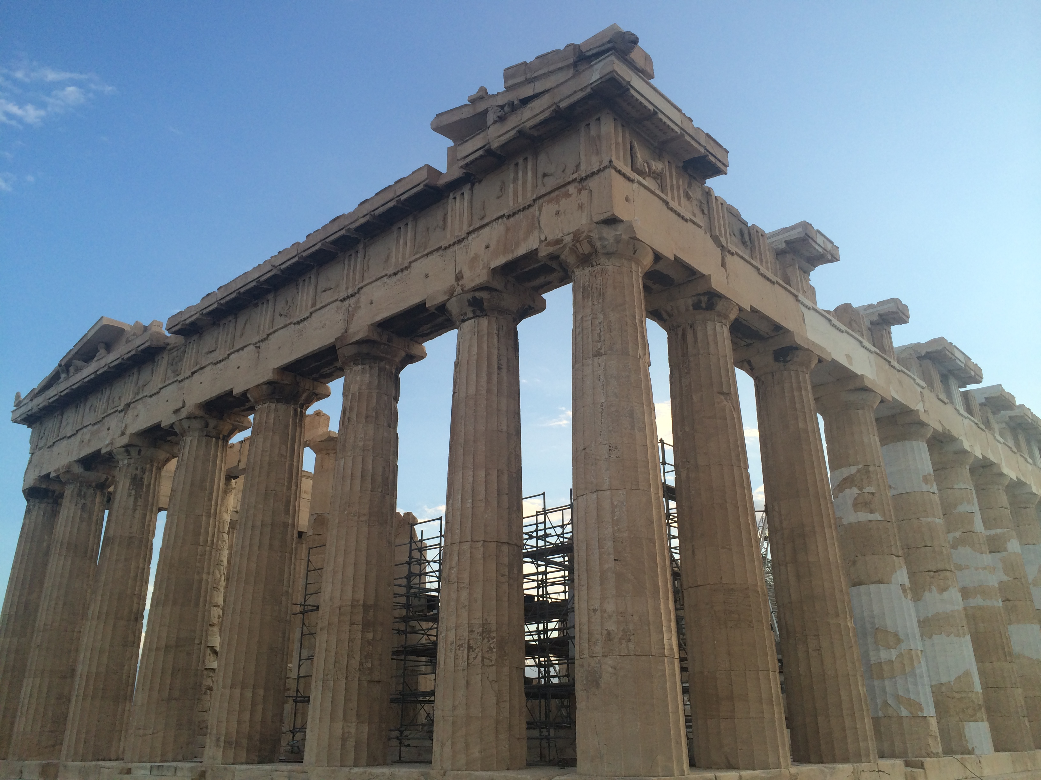
Συχαριστο

