Slide 1
Discussion about Box5 Calibration
Date: 2014-09-15
Authors:

Slide 2
Abstract
This presentation proposes the detailed Box-5 calibration parameters of both PHY layer and MAC layer and also shows initial results in Enterprise OBSS networks.
We suggest using 11ac scenario 6 as an easy-to-start scenario to calibrate Box-5.

Slide 3
Recap of the Calibration Boxes
As illustrated in the calibration flow chart below [1], we can start to directly calibrate Box-5 by integrating PHY abstraction and basic MAC features after Box-0, Box-1 and Box-2 are calibrated firstly.
Box-3 MAC calibration could be done independently and in parallel [2].

Slide 4
Current Calibration Progress
During and after the July meeting, 7 companies kept updating their calibration results of both Box-1 long-term SINR and Box-2 multipath SINR for all the 11ax four scenarios and test cases [3] and so far most results have been aligned well [4].
Also in the July meeting, Box-0 PHY abstraction was well calibrated for both BCC and LDPC coding schemes [1, 5].
Now Box-5 calibration can be done based on the calibrated Box-0, Box-1 and Box-2. So here in the rest slides,
firstly more detailed PHY and MAC parameters of Box-5 [6] are provided;
then 11ac scenario 6 [7] is used as the baseline to simplify and facilitate the calibration at the start.
After that we can easily turn to calibrate much more complicated 11ax scenarios.

Slide 5
Box-5 PHY Details
PHY parameters
BW | All BSSs at 5GHz [80 MHz, no dynamic bandwidth]
Channel model | TGac D NLOS per link
Shadow fading | iid log-normal shadowing (5 dB standard deviation) per link
Data Preamble Type | [5GHz, 11ac], always decoded correctly after successful reception, duration is considered.
STA TX Power | 15 dBm per antenna
AP TX Power | 20 dBm per antenna
AP number of TX/RX antennas | 1/1
STA number of TX /RX antennas | 1/1
AP antenna gain | 0 dBi
STA antenna gain | -2 dBi
Noise Figure | 7dB
CCA threshold | -70dBm (measured across the entire bandwidth after large-scale fading)
Rx sensitivity | -82dBm (a packet with lower rx power is dropped)
Link Adaption | Fixed MCS =7
Channel estimation | ideal
PHY abstraction | RBIR, BCC [1, 5]
Channel correlation | Independent or time-correlated channel per packet

Slide 6
Box-5 MAC Details
MAC parameters
Access protocol | [EDCA, AC_BE with default parameters] [CWmin = 15, CWmax = 1023]
Queue length | A single queue is set inside AP/STA sized of 2000 packets
Traffic type | UDP CBR with rate 10^8bps (may not enough to model full buffer)
MPDU size | 1540 Bytes (1472 Data + 28 IP header + 40 MAC header)
Aggregation | [A-MPDU / max aggregation size / BA window size, No A-MSDU, with immediate BA], Max aggregation: 64 MPDUs with 4-byte MPDU delimiter (no pad)
Max number of retries | 10
Beacon | Disabled
RTS/CTS | Simple ON/OFF independent of packet length
Traffic direction | UL Only, DL only, Mixed DL & UL
Throughput metric | CDF or Histogram of per non-AP STA throughput (received bits/overall simulation time)
[

Slide 7
11ac Scenario 6 – OBSS Enterprise [7]
Fixed Location and Association
STA1 | (5,-9.5)
STA2 | (3.5,7.5)
STA4 | (-4.5,0.5)
STA5 | (-1.5,6)
STA7 | (-9,-5)
STA8 | (-8.5,8.5)
STA10 | (-3,0.5)
STA11 | (-0.5,8)
STA13 | (-4,-4)
STA14 | (7.5,-1)
STA16 | (8,-6)
STA17 | (0,-7.5)
STA19 | (-2.5,-4.5)
STA20 | (0.5,-2)
STA22 | (0,-4.5)
STA23 | (-1.5,7)
STA25 | (3.5,-5)
STA26 | (9,9.5)
STA28 | (-8,-5.5)
STA29 | (1.5,3.5)
AP A | (0,0)
AP B | (40,20)
AP C | (-40,-20)
STA3 | (7.5+xb, ‑9.5+yb)
STA9 | (7+xb, -7.5+yb)
STA15 | (3+xb, -0.5+yb)
STA21 | (-6.5+xb, -3+yb)
STA27 | (‑6+xb, 2.5+yb)
STA6 | (-5.5+xc,4.5+yc)
STA12 | (7+xc,7+yc)
STA18 | (10+xc,0.5+yc)
STA24 | (3+xc,2.5+yc)
STA30 | (9.5+xc,3.5+yc)

Slide 8
Traffic Flow Model
DL/UL traffic assigned for each STA [7]
STA | DL | UL | STA | DL | UL
STA1 | y | y | STA23 | n | y
STA2 | y | y | STA25 | y | y
STA4 | y | y | STA26 | y | y
STA5 | y | y | STA28 | y | y
STA7 | y | y | STA29 | y | y
STA8 | y | y | STA3 | y | y
STA10 | y | n | STA9 | y | n
STA11 | y | n | STA15 | y | n
STA13 | y | n | STA21 | n | y
STA14 | y | n | STA27 | y | y
STA16 | y | n | STA6 | y | y
STA17 | y | n | STA12 | y | n
STA19 | y | n | STA18 | y | n
STA20 | y | n | STA24 | n | y
STA22 | n | y | STA30 | y | y
“y” means having DL/UL traffic flow; “no” means not having DL/UL traffic flow

Slide 9
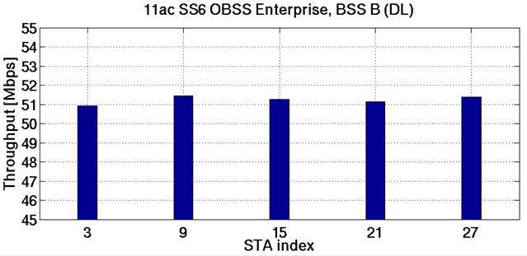
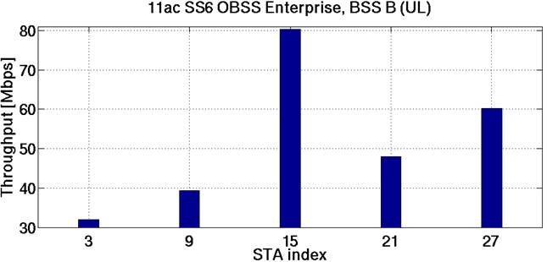
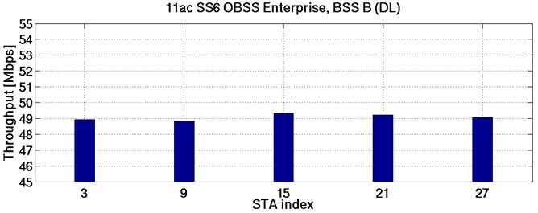
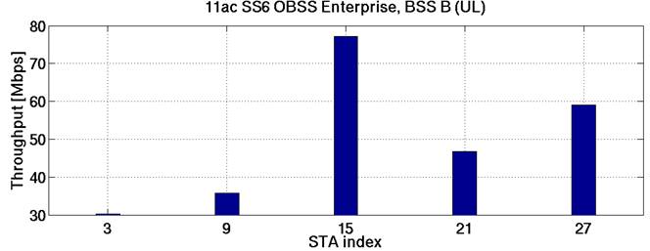
One BSS Test
Upright corner BSS B (STAs 3, 9 ,15, 21, 27)
DL only & UL only
The same traffic is attached to each STA
RTS/CTS OFF
Total Thrpt = 256.16 Mbps
Total Thrpt = 259.76 Mbps
RTS/CTS OFF
RTS/CTS ON
Total Thrpt = 245.37 Mbps
Total Thrpt = 248.92 Mbps
RTS/CTS ON

Slide 10
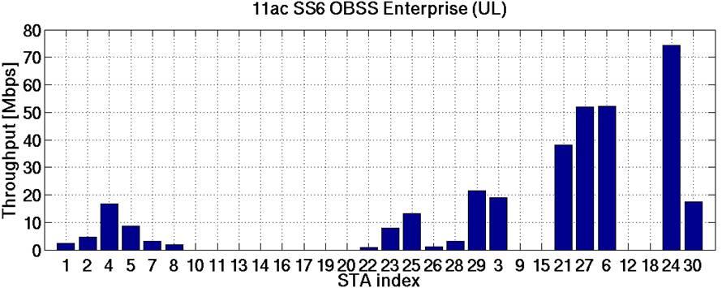
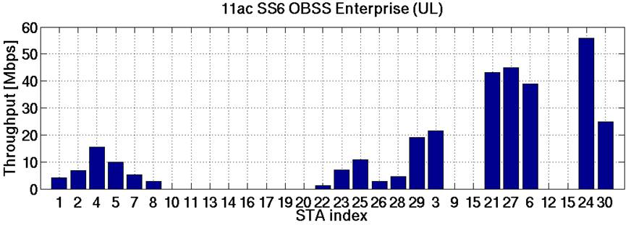
UL Only STA Throughput
RTS/CTS OFF
BSS C
Total Thrpt BSS A = 85.34 Mbps
Total Thrpt BSS B = 109.17 Mbps
Total Thrpt BSS C = 144.12 Mbps
BSS B
BSS A
RTS/CTS ON
BSS C
BSS B
Total Thrpt BSS A = 90.05 Mbps
Total Thrpt BSS B = 109.67 Mbps
Total Thrpt BSS C = 119.48 Mbps
BSS A

Slide 11
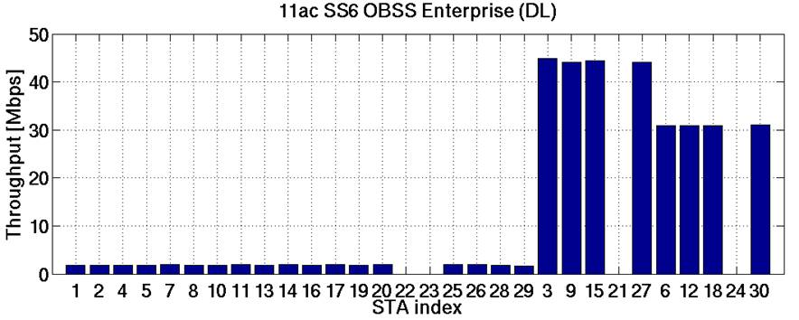
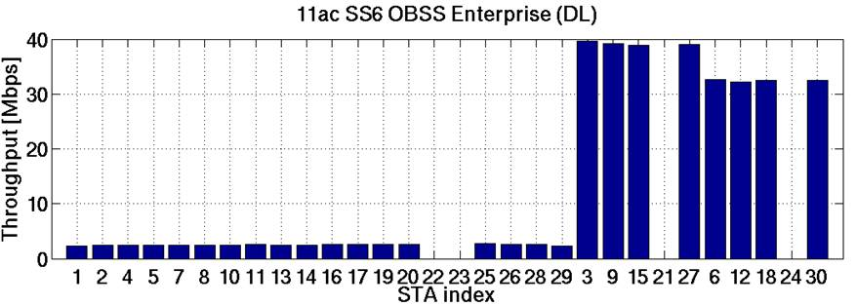
DL Only STA Throughput
RTS/CTS OFF
BSS C
Total Thrpt BSS A = 33.29 Mbps
Total Thrpt BSS B = 177.61 Mbps
Total Thrpt BSS C = 123.52 Mbps
BSS A
BSS B
RTS/CTS ON
BSS C
Total Thrpt BSS A = 45.35 Mbps
Total Thrpt BSS B = 156.80 Mbps
Total Thrpt BSS C = 129.69 Mbps
BSS A
BSS B
Notes:
PackPer no R1110

Slide 12
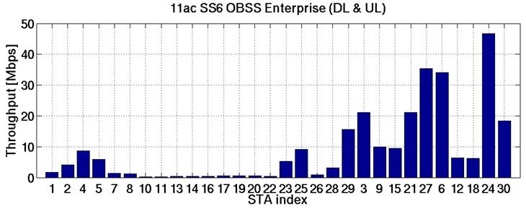
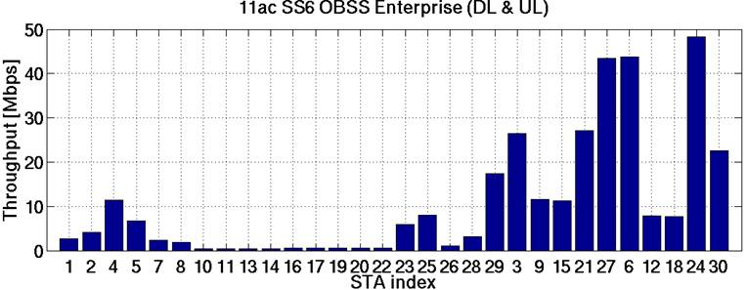
Aggregated (DL & UL) STA Throughput
BSS C
RTS/CTS OFF
BSS B
Total Thrpt BSS A = 61.01 Mbps
Total Thrpt BSS B = 96.94 Mbps
Total Thrpt BSS C = 111.67 Mbps
BSS A
BSS C
RTS/CTS ON
Total Thrpt BSS A = 68.85 Mbps
Total Thrpt BSS B = 119.73 Mbps
Total Thrpt BSS C = 130.34 Mbps
BSS B
BSS A

Slide 13
Observations on the Results
The area throughput of 3 OBSSs is just improved by about 30% compared to that of 1 BSS case.
Uplink area throughput is slightly larger than downlink area throughput.
RTS/CTS slightly degrades the area throughput in UL only and DL only cases but improves both the area and BSS throughputs in the mixed UL/DL case.
BSS B and BSS C are relatively independent from each other due to far distance.
BSS A in the middle is interfered by both BSS B and BSS C.
Uplink STA throughput within each BSS depends on the relative distances to both the serving AP and also the neighboring APs.
Downlink STA throughput within each BSS is almost irrelevant to the distance towards the serving AP.

Slide 14
Summary
The calibration progress from Box-1, Box-2 and Box-0 towards Box-5 was shortly reviewed.
The suggested PHY and MAC details were proposed for Box-5 calibration.
We suggest using 11ac scenario 6 as an easy-to-start scenario to calibrate Box-5.

Slide 15
Reference
[1] 11-14/0571r3 Evaluation Methodology
[2] 11-14/1192r0 MAC calibration results
[3] 11-14/0980r2 Simulation Scenarios
[4] 11-14/0800r17 Box 1 and Box 2 Calibration Results
[5] 11-14/1176r0 PHY Abstraction Tables for 11ax System Level Simulation
[6] 11-14/0871r1 Further Calibration Results towards Integrated System Level Simulation
[7] 11-09/0451r16 TGac Functional Requirements and Evaluation Methodology

Slide 16
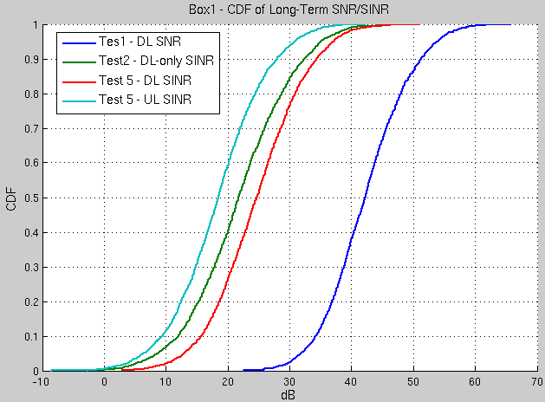
Appendix 1 – 11ac Scenario 6 Box-1 Result

