Slide 1
Further Calibration Results towards Integrated System Level Simulation
Date: 2014-07-15

Slide 2
Abstract
This presentation shows the updated results of each calibration box based on the latest offline-agreed parameters to promote the calibration progress.
This presentation also shows the system throughput under different CCA levels evaluated by both PHY SS and Integrated SS.

Slide 3
Background
Box-by-box evaluation methodology and procedures have been agreed in [1] for various simulation scenarios [2].
Six companies finished the Box1 calibration for [2.4GHz, 20MHz] case [3] and the initial results towards integrated SS was provided in [4].
After the May meeting, simulation parameters in [2] were keeping updated offline and the agreed modifications is proposed in [5] where [5GHz, 80MHz] is used for calibration.
Based on [5], four companies have provided their Box-1 and Box-2 results of all the scenarios where the results of Scenario 1 & 3 are aligned in [6].
In the following, we provide our results of Scenario 1 - Residential for Box-1 and Box-2 as well as subsequent Box-4 and Box-5 under varying CCA threshold to stress again the signification of integrated SS.

Slide 4
Box 1: Long Term SINR/SNR Calibration
Three Test results are provided below
Test 1: interference free DL SNR
Test 2: DL only SINR
Test 5: DL and UL SINR (all nodes active)

Slide 5
Box 2: Instantaneous SINR Calibration
Three Test results are provided below
Test 1: Interference free DL SNR;
Test 2: DL only SINR;
Test 3: CCA-only mechanism with assumption of all nodes having the same channel access probability, which can be reused in the PHY SS (i.e., Box 4)
1 Tx and 1 Rx is assumed

Slide 6
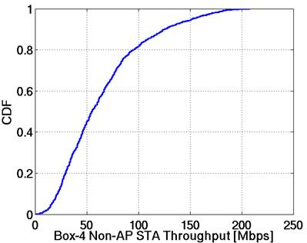
Box 4: PHY SS Calibration
CDF of per non-AP STA throughput of PHY SS
Same CCA mechanism as in Box 2 Test 3
RBIR based PHY abstraction
Ideal link adaption
MMSE receiver
Full buffer
Mean: 65.05Mbps
5%: 15.97Mbps

Slide 7
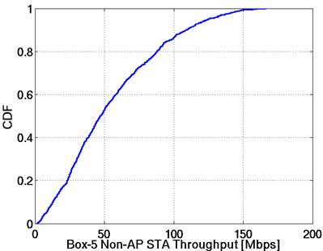
Box 5: Integrated SS Calibration
CDF of per non-AP STA throughput of PHY SS
Besides features defined in PHY SS, the following ones are also activated
EDCA
CCA
RTS/CTS
A-MPDU
Mean: 55.08Mbps
5%: 7.91Mbps

Slide 8
PHY SS and Integrated SS Comparison with Different CCA Thresholds
CCA threshold varies from -82dBm to -30dBm
Mean and 5% non-AP STA throughput (Mbps)
mean
5%
PHY SS and Integrated SS achieve different gains with varying CCA threshold
PHY SS and Integrated SS achieve different peaks
In larger CCA regions, throughput decreases much quickly in Integrated SS

Slide 9
Summary
The calibration results of Scenario 1 – Residential were presented for all Boxes based on latest scenario parameters.
We also provided results of Box-4 and Box-5 with suggested MAC and PHY features for varying CCA threshold.
The comparison of the STA throughput between PHY SS and Integrated SS under different CCA thresholds shows the need and role of integrated SS on system performance evaluation.

Slide 10
References
[1] 11-14/0571r2 11ax Evaluation Methodology
[2] 11-14/0621r4 TGax Simulation Scenarios
[3] 11-14/0336r0 Calibration of Long-Term SINR for System Simulator
[4] 11-14/0612r0 Calibration procedures towards integrated system level simulation
[5] 11-14/0799r2 Modifications to simulation scenarios and calibration process
[6] 11-14/0800r0 Box1 and Box2 calibration results

Slide 11
Appendix-1 Basic Parameters for Calibration
Parameter |  | Value
 |  | Residential | Enterprise | Indoor | Outdoor
Central Frequency |  | 5.0 GHz
Bandwidth |  | 80 MHz
Channel Assignment |  | Random assignment of 3 non overlapping channels | chan = mod(BSS_index,4). That is, in each office, (ch1, ch2, ch3, ch4) and identical for each office. Ignore adjacent channel interference. | Frequency reuse 3 | Frequency reuse 1
Transmission Power per antenna | AP / STA | 20dBm/15dBm
Antenna Configuration | Antenna gain # of AP/STA antenna | AP: 0dBi; STA: -2dBi; 1*1
Penetration Loss | Wall / Floor | 5dB / 18.3dB | 7 dB / N.A. | N.A. / N.A. | 100% outdoor
Noise Figure | AP / STA | 7 dB / 7 dB
Channel Model | PL multipath | TGn Model B TGn Model D | TGn Model D TGn Model D | TGn Model D TGn Model D | ITU UMi ITU UMi
Antenna Height | AP STA | 1.5m 1.5m | 3m 1m | 3m 1.5m | 10m 1.5m
STA Number |  | 2 per apartment | 2 per cubicle | 30 per BSS | 50 per BSS
AP-STA min distance (2D) |  | N.A. | N.A. | N.A. | 10m
Association |  | 100% STA associated to the AP in the same apartment | 100% STA associate with the strongest AP in the same office | 100% of STAs associate with the strongest AP | 100% of STAs associate with the strongest AP

