Slide 1
MAC calibration results
Date: 2014-07
Authors:

Slide 2
Summary
Contribution [1][2] define the simulation scenarios and evaluation method for MAC system calibration
This contribution provides preliminary results on MAC calibration
Test 1: MAC overhead test
Test 2: Deferral test
For test 4, we found the test case violates the basic 802.11ac MAC behavior, therefore we propose to modify the test case to fulfill the calibration purpose

Slide 3
Test 1a: MAC overhead w/out RTS/CTS -Simulation Parameter-
AP1
STA 1
AP1
Assumptions:
PER is 0
Parameters:
MSDU length:[0:500:2000Bytes]
RTS/CTS OFF
MCS = [0,8] ( to clarify, run a sweep over MSDU length once for MCS 0, and once for MCS 8.

Slide 4
Test 1a: MAC overhead w/out RTS/CTS -Check Points-
AP1
s 0.012128065 _1_ MAC --- 1 cbr 3016 [54 0 1 0] Check point1 (CP1)
r 0.015896097 _0_ MAC --- 1 cbr 1472 [0 0 1 0] Check point2 (CP2)
r 0.015896097 _0_ MAC --- 2 cbr 1472 [0 0 1 0 Check point2 (CP2)
s 0.015912097 _0_ MAC --- 0 ACK 32 [0 1 0 0] Check point3 (CP3)
r 0.015980129 _1_ MAC --- 0 ACK 32 [0 1 0 0] Check point4 (CP4)
s 0.016122129 _1_ MAC --- 3 cbr 3016 [54 0 1 0] Check point5 (CP5)
 | Simulation Log | Standard definition | Matching?
Frame duration | Tcp2-Tcp1= 3768 us | ceil((FrameLength*8)/rate/OFDMsymbolduration) * OFDMsymbolduration + PHY Header
SIFS | Tcp3-Tcp2=16 us | 16 us
ACK duration | Tcp4-Tcp3=68 us | ceil((ACKFrameLength*8)/rate/OFDMsymbolduration) * OFDMsymbolduration + PHY Header
Defer & backoff duration | Tcp5-Tcp4=142 us | DIFS(34 us)+backoff (CWmin) =34us+12*9us

Slide 5
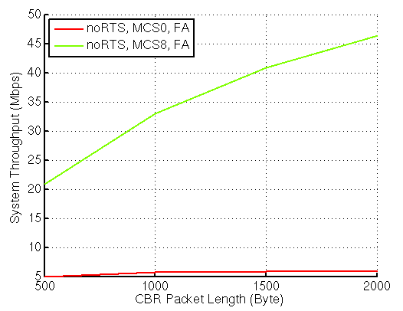
Test 1a: MAC overhead w/out RTS/CTS -Throughput Performance-
AP1

Slide 6
Test 1b: MAC overhead w RTS/CTS -Simulation Parameter-
AP1
STA 1
AP1
Assumptions:
PER is 0
Parameters:
MSDU length:[0:500:2000Bytes]
RTS/CTS ON
MCS = [0,8] ( to clarify, run a sweep over MSDU length once for MCS 0, and once for MCS 8.

Slide 7
Test 1b: MAC overhead w RTS/CTS -Check Points-
AP1
s 0.012229123 _1_ MAC --- 0 RTS 20 [f58 0 1 0] Check point1 (CP1)
r 0.012281154 _0_ MAC --- 0 RTS 20 [f58 0 1 0] Check point2 (CP2)
s 0.012297154 _0_ MAC --- 0 CTS 14 [f1c 1 0 0] Check point3 (CP3)
r 0.012341185 _1_ MAC --- 0 CTS 14 [f1c 1 0 0] Check point4 (CP4)
s 0.012357185 _1_ MAC --- 1 cbr 3016 [0 0 1 0] Check point5 (CP5)
r 0.016125216 _0_ MAC --- 1 cbr 1472 [0 0 1 0] Check point6 (CP6)
r 0.016125216 _0_ MAC --- 2 cbr 1472 [0 0 1 0] Check point6 (CP6)
 | Simulation Log | Standard definition | Matching?
RTS duration | Tcp2-Tcp1=52 us | ceil((RTSFrameLength*8)/rate/OFDMsymbolduration) * OFDMsymbolduration + PHY Header
CTS duration | Tcp4-Tcp3=44 us | ceil((CTSFrameLength*8)/rate/OFDMsymbolduration) * OFDMsymbolduration + PHY Header
Frame duration | Tcp6-Tcp5= 3768 us | ceil((FrameLength*8)/rate/OFDMsymbolduration) * OFDMsymbolduration + PHY Header

Slide 8
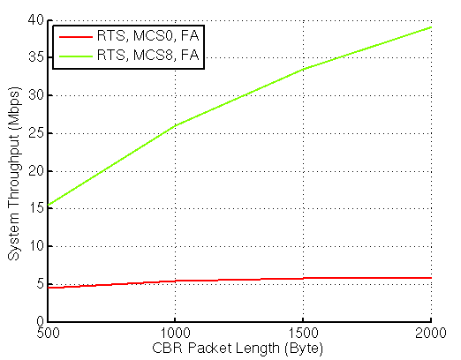
Test 1b: MAC overhead w RTS/CTS -Throughput Performance-
AP1

Slide 9
Test 2a: Deferral Test 1 -Simulation Parameters-
AP1
AP1
AP 2
STA 2
STA 1
(AP1 and STA2 are essentially co-located)
Assumptions:
devices are within energy detect range of each other.
When AP1 and AP2 start to transmit on the same slot, both packets are lost (PER= 100%). Otherwise packets get through 100%. PER=0 %
Parameters:
MSDU length:[0:500:2000Bytes]
RTS/CTS [ OFF, ON]
MCS = [0, 8]

Slide 10
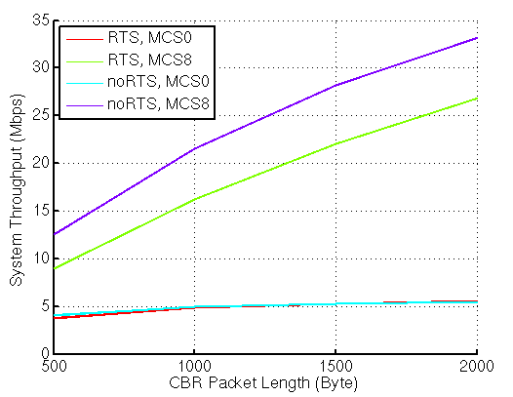
Test 2a: Deferral Test 1 -Throughput Performance-
AP1

Slide 11
Test 2b: Deferral Test 2 -Simulation Parameters-
AP1
STA 2
AP 2
AP1
STA 1
Assumptions:
AP1 and AP2 can not hear each other. ( ever)
If MPDUs from AP1 and AP2 overlap, they both fail with 100% probability
If an MPDU from AP1/AP2 is interference free, it succeeds with 100% probability.
Parameters:
MSDU length:[0:500:2000Bytes]
RTS/CTS [ OFF, ON]
MCS = [0, 8]

Slide 12
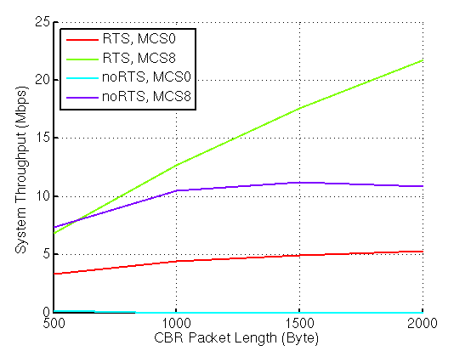
Test 2b: Deferral Test 2 -Throughput Performance-
AP1

Slide 13
Test 4: NAV deferral
AP1
AP1
AP 2
STA 2
STA 1
(AP1 and STA2 are essentially co-located)
Source from [1]
Assumptions:
All devices are within energy detect range of each other.
When AP1 and AP2 start to transmit on the same slot, both packets are lost (PER= 100%). Otherwise packets get through 100%. PER=0 %
APs send single MPDU, but sets NAV to txop= 4 ms
APs should defer due to NAV setting..
According to 802.11ac, STA doesn't stop transmitting frame in an allocated TXOP, sending one single frame and leaving the rest of TXOP open doesn’t look like a reasonable assumption
Propose to change the single MPDU to MPDUs

Slide 14
Reference
[1] 11-14-0621-04-00ax-simulation-scenarios
[2] 11-14-0571-02-00ax-evaluation-methodology

Slide 15
Annex

Slide 16
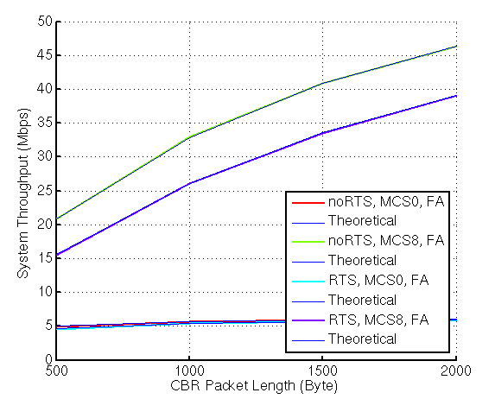
Test1a + Test1b
Simulation results and theoretical calculation matches

