Slide 1
Channel Generation of 802.11aj (45GHz) Based on Channel Measurement
Date: May 21, 2014
Presenter: Haiming WANG
Authors/contributors:
Name | Company | Address | Phone | Email
Haiming WANG | SEU/CWPAN | 2 Sipailou, Nanjing 210096, China | +86-25-5209 1653-301(ext.) | hmwang@seu.edu.cn
Wei HONG |  |  | +86-25-5209 1650 | weihong@seu.edu.cn
Jin ZHU |  |  |  | jinzhu@emfield.org
Shiwen HE |  |  | +86-25-5209 1653-3121(ext.) | hesw01@seu.edu.cn
Nianzu ZHANG |  |  | +86-25-5209 1653-320 (ext.) | nzzhang@seu.edu.cn
Guangqi YANG |  |  | +86-25-5209 1653-211(ext.) | gq.yang@seu.edu.cn

Slide 2
Abstract
This presentation gives process of channel realization generation of 45 GHz band.

Slide 3
Outline
Review of generation of the channel impulse response of 11ad
Realization process
Modeling of parameters
Statistical measurement at 45 GHz band
Measurement process
Modeling
Improvement of Matlab script based on statistical model
Difference of models and parameters
Future work

Slide 4
CIR Generation of 802.11ad
Fig 1. Process of channel realization generation

Slide 5
CIR Generation of 802.11ad
General structure of channel model:
where:
h is a generated channel impulse response.
t, ϕ_{tx}, θ_{tx}, ϕ_{rx}, θ_{rx} are time and azimuth and elevation angles at the transmitter and receiver, respectively.
A^{(i)} and C^{(i)} are the gain and the channel impulse response for i-th cluster respectively.
δ( )- is the Dirac delta function.
T^{(i)}, Φ_{tx}^{(i)}, Θ_{tx}^{(i)}, Φ_{rx}^{(i)}, Θ_{rx}^{(i)} are time-angular coordinates of i-th cluster.
α^{(i,k)} is the amplitude of the k-th ray of i-th cluster
τ^{(i,k)}, ϕ_{tx}^{(i,k)}, θ_{tx}^{(i,k)}, ϕ_{rx}^{(i,k)}, θ_{rx}^{(i,k)} are relative time-angular coordinates of k-th ray of i-th cluster.

Slide 6
CIR Generation of 802.11ad
Cluster grouping
LOS path;
Four first order (reflected) clusters from four walls;
One first order cluster from ceiling;
Four second order clusters from the walls and ceiling;
Eight second order clusters corresponding to reflections from two walls.
Fig 2. 3D model of conference room used for ray tracing

Slide 7
CIR Generation of 802.11ad
Clusters blockage probabilities of STA-STA scenario
cfg.cr.Psta_1st_c = 0.9;
Probability that the cluster is present for the 1st order reflections from ceiling
cfg.cr.Psta_1st_w = 0.6;
Probability that the cluster is present for the 1st order reflections from walls
cfg.cr.Psta_2nd_wc = 0.7;
Probability that the cluster is present for the 2nd order wall-ceiling (ceiling-wall) reflections
cfg.cr.Psta_2nd_w = 0.2;
Probability that the cluster is present for the 2nd order reflections from walls

Slide 8
CIR Generation of 802.11ad
LOS path
Cls.los_el=ap_el_los(N);
tx_az = 0;
tx_el = cls.los_el;
rx_az = 0;
rx_el = -cls.los_el;
Function y = ap_el_los(size)
Y = -76 + 45.*rand(1,size);

Slide 9
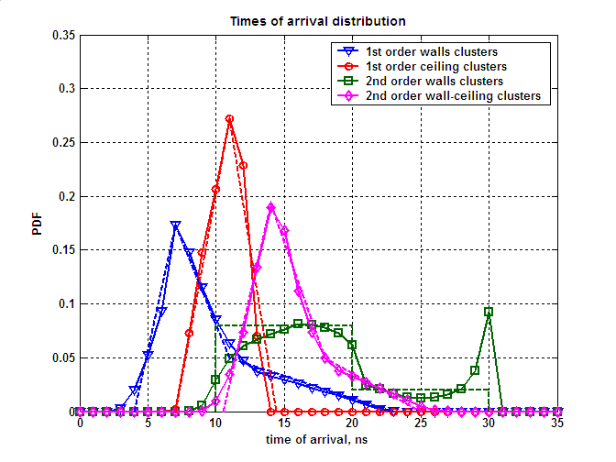
CIR Generation of 802.11ad
Time of Arrival (Inter-cluster)
Piecewise modeling of first order reflections from walls (green line)
Piecewise modeling of second order reflections from walls (blue line)
Fig 3. TOA empirical distributions from ray tracing

Slide 10
CIR Generation of 802.11ad
Reflection-loss (Inter-cluster)
Without polarization:
1st order: normal distribution with
2nd order: normal distribution with
With polarization:
Polarization matrix is introduced with coupling coefficients
R(1,1)=ref_coef(0,1);
R(2,2)=ref_coef(0,1);
R(1,2)=0.1.*(2.*randn(1,1)>0-1);
R(2,1)=0.1.*(2.*randn(1,1)>0-1);

Slide 11
CIR Generation of 802.11ad
Reflection-loss (Inter-cluster)
Fig 4. Distribution of reflection losses

Slide 12
CIR Generation of 802.11ad
Angular characteristics (Inter-cluster)
Angular parameters of the four clusters are dependent upon each other.
Fig 5. Joint distribution of azimuth angles
Fig 6. Joint modeling of azimuth angles

Slide 13
CIR Generation of 802.11ad
Ray modeling (Intra-cluster)
The number of pre-cursor rays N_{b} and post-cursor rays N_{f} was derived from measurements;
The average amplitudes A_{f} and A_{b} of the pre-cursor and post-cursor rays decay exponentially with decay times γ_{f} = 1.3 ns and γ_{b}= 1.3 ns , respectively;
Pre-cursor rays are modeled as two Poisson processes with arrival rates λ_{f} = 0.2 ns⁻¹ and λ_{b} = 1.3 ns⁻¹ , respectively.
Amplitude of pre-cursor rays and post-cursor rays was both modeled by Rayleigh distribution.
Fig 7. Time domain model of the cluster

Slide 14
CIR Generation of 802.11ad
Amplitude modeling (Intra-cluster)
The average amplitudes A_{f} and A_{b} of the pre-cursor and post-cursor rays decay with decay times γ _{f} = 1.3 ns and γ _{f} = 1.3 ns , respectively.
Fig 8. Experimental PDP of the cluster

Slide 15
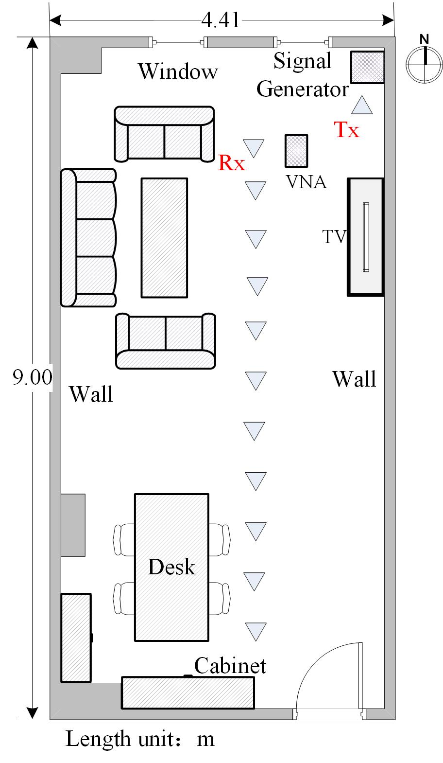
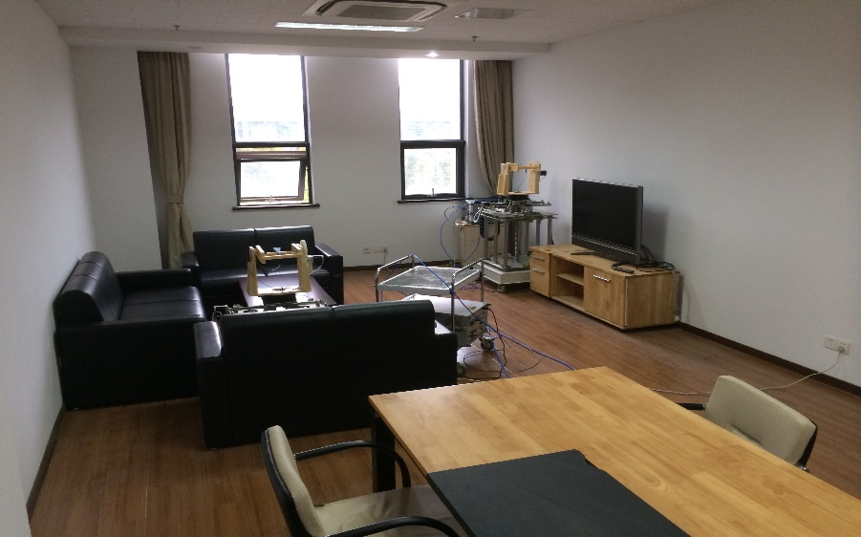
Measurement Scenario
Fig 9. Scene and layout of living room environment

Slide 16
CIR Generation for TG11aj (45GHz)
11ad CIR gen. routine
MIMO Corr. Mtx
11aj (45GHz) CIR
New Parameters

Slide 17
Parameters of Q-band Channel Measurement
Parameter | Value
Frequency band | 45 GHz (center 44.955 GHz)
Method | Signal Generator and VNA Sweep Frequency
Subcarrier Spacing | 2.578125 MHz
Bandwidth | 660 MHz
Sweep Frequency Points | 256
Sweep Frequency Duration | 80 ms (adjustable)
Tx Power | 10 dBm
Cable Length | 2 m at both ends
Antenna | Horn antenna / Open ended waveguide antenna
Measurement Scenario | Conference room (Cubicle room, Living room)

Slide 18
Channel Measurement Technique
Frequency domain measurement
Complex response is recorded in the frequency domain;
Channel impulse response is obtained from channel frequency response using 256 point IFFT transformation with hanning window to suppress sidelobe leakage.
Scanning measurement in the angular domain
Both transmit and receive antennas are rotated each 10 degree using horn antennas;
36×36 sub-channels are derived with detailed angular information;
Clustering is campaigned in the joint angular and temporal domain.

Slide 19
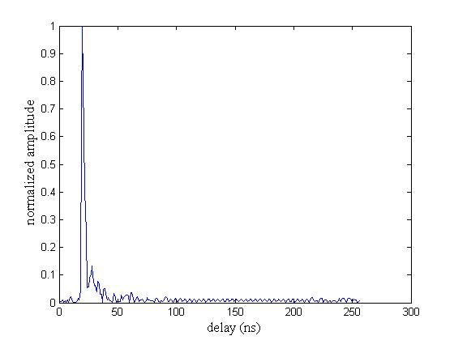
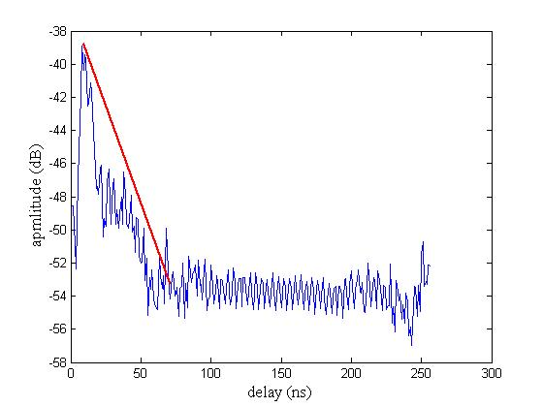
Channel Impulse Response
A ray is obvious in the left figure with corresponding propagation delay;
Cluster decay rate and arrival rate are obtained from the right figure which combines all the sub-channel impulse responses;
Clusters received after 100 ns are under the noise.
Fig 10. Sub-channel impulse response
Fig 11. Combined channel impulse response

Slide 20
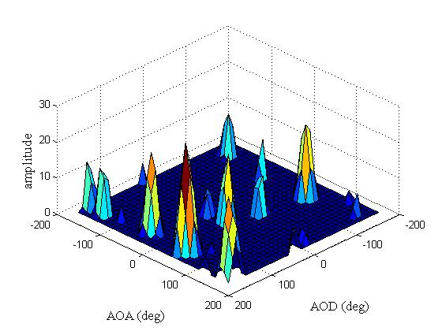
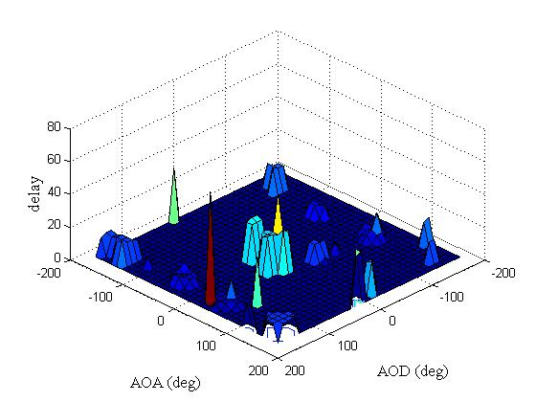
Clustering in the angular domain
Averaging is performed for received power in the frequency domain in each sub-channel to carry out clustering in the angular domain;
Powers that are 30dB below the max received power are ignored to calculate number of rays that can be recognized by the receiver;
Time of each sub-channel is derived from the CIR .
Fig 12. Clustering in the angular domain
Fig 13. Corresponding delay distribution

Slide 21
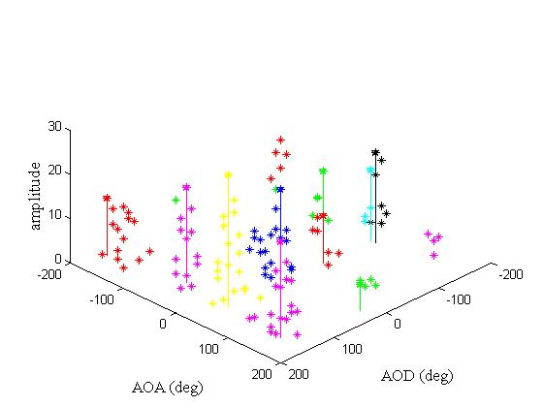
Clustering in the angular domain
A clustering algorithm is used to classify all the rays to several clusters, and the best number of clusters is derived from a number range. Each color represents one cluster and the strongest ray component is signed.
Number of clusters is uniformly distributed from 10 to 20;
Fig 14. Clustering

Slide 22
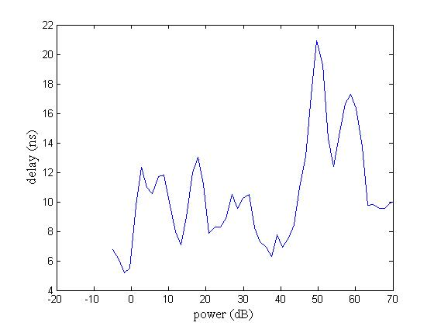
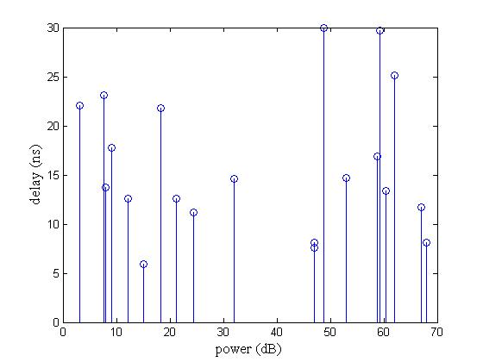
Inter-cluster parameters
Fig 15. CIR from IFFT of living room
Fig 16. Clusters derived in angular domain
Clusters that within 30 dB of the peak power are considered to be recognizable, and the power and the corresponding delay of received cluster are recorded and illustrated in the right picture which agree well with the CIR.

Slide 23
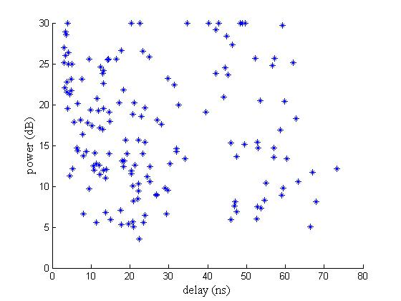
Inter-cluster parameters
Clusters extracted from 10 measured locations are summarized and shown in the left picture. All clusters obeys a uniformly distribution with delay ranging from 0 ns to 70 ns and power ranging from 5 dB to peak power 30 dB.
Fig 17. Distribution of cluster power in time domain

Slide 24
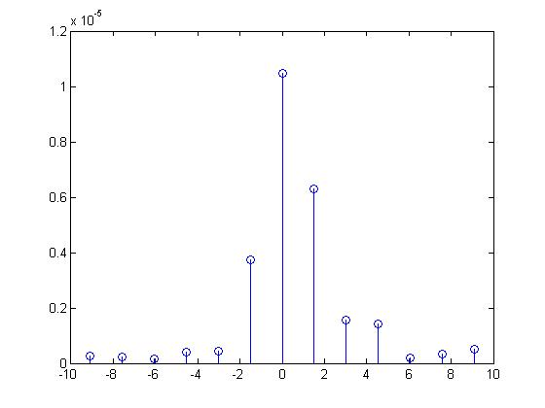
Clustering in the angular domain
This figure presents exponentially decaying distribution of rays in one cluster which is extracted from the combination of CIR of all rays in the strongest cluster, and the main ray delay is set to be 0 ns as the reference delay.
Fig 18. Power-delay distribution of rays

Slide 25
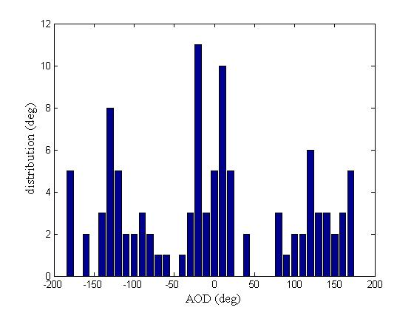
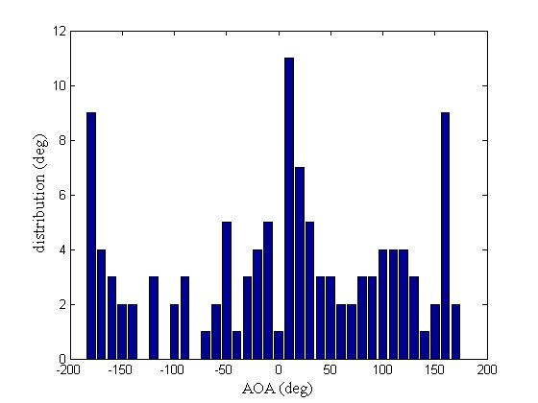
Clustering in the angular domain
Fig 19. Distribution of azimuth AOD
Fig 20. Distribution of azimuth AOA

Slide 26
Future Work
Clustering will be improved to better classifying rays in the angular domain;
Inter-cluster and intra-cluster parameters will be statically computed to describe the 45 GHz channel more accurately.
We will put the new parameter list and some examples of channel generation of 11aj (45GHz) in our website in June 2014, and the hyperlink will be sent to the email reflector.
More information of channel generation for 11aj (45 GHz) in conference room will be provided in this July session.

