Slide 1
Large-Scale Characteristics of 45 GHz Based on Channel Measurement
Date: March 19, 2014
Presenter: Haiming WANG
Authors/contributors:
Name | Company | Address | Phone | Email
Haiming WANG | SEU/CWPAN | 2 Sipailou, Nanjing 210096, China | +86-25-5209 1653-301(ext.) | hmwang@seu.edu.cn
Jin ZHU |  |  |  | jinzhu@emfield.org
Wei HONG |  |  | +86-25-5209 1650 | weihong@seu.edu.cn
Nianzu ZHANG |  |  | +86-25-5209 1653-320(ext.) | nzzhang@seu.edu.cn
Shiwen HE |  |  | +86-25-5209 1653-3121(ext.) | hesw01@seu.edu.cn

Slide 2
Abstract
This presentation gives large-scale characteristics of 45 GHz band based on channel measurement.

Slide 3
Outline
Channel Measurement Scheme
  Transmission Scenarios
  Channel measurement setup
Large-Scale Characteristics at 45 GHz band
  Path-loss Fading
  Shadow Fading

Slide 4
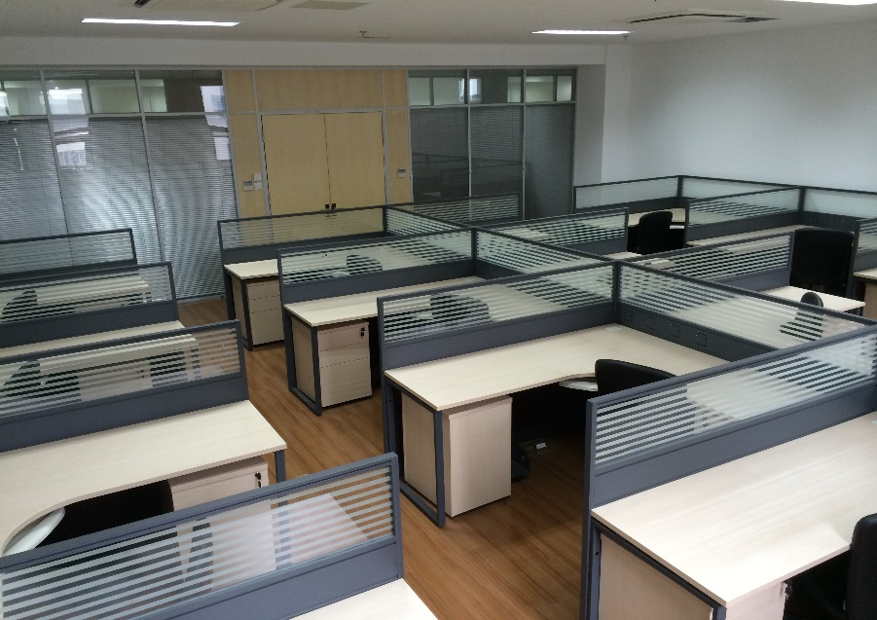
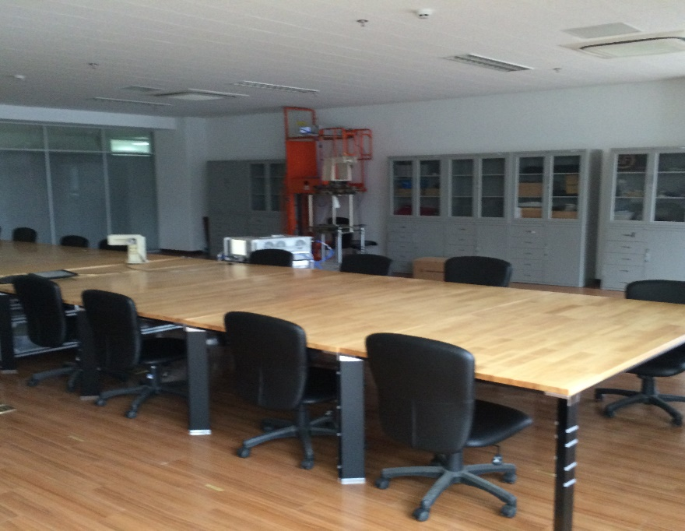
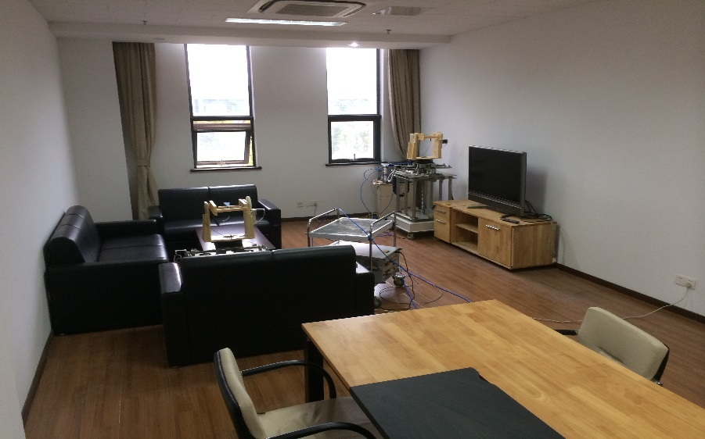
Transmission Scenarios
Conference room
Cubicle room
Living room

Slide 5
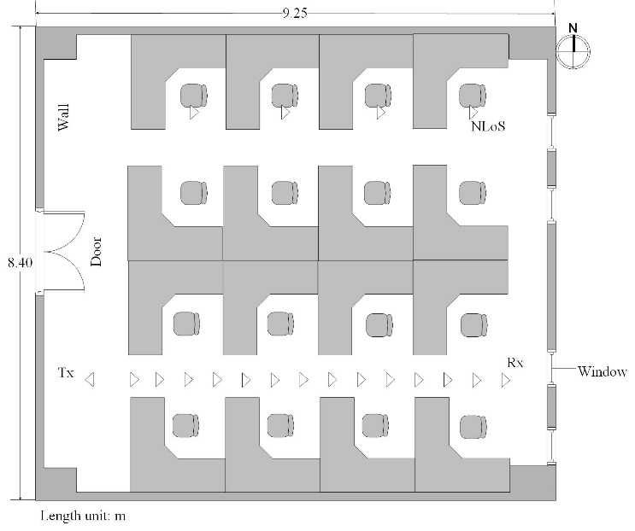
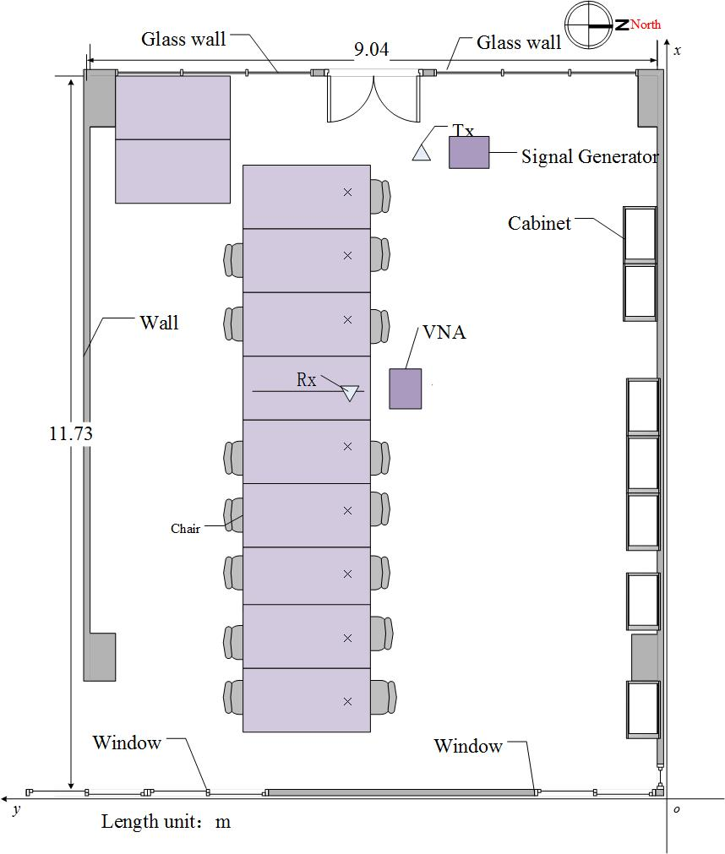
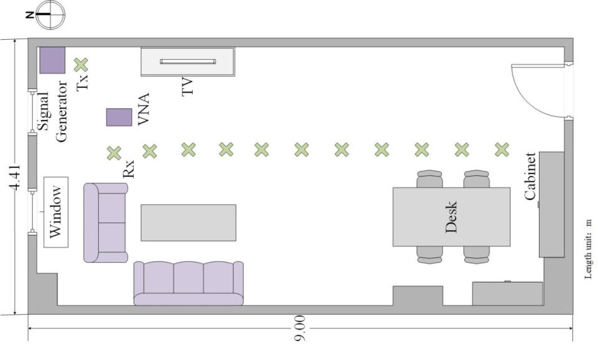
Layout
Cubicle Room
Conference Room
Living Room

Slide 6
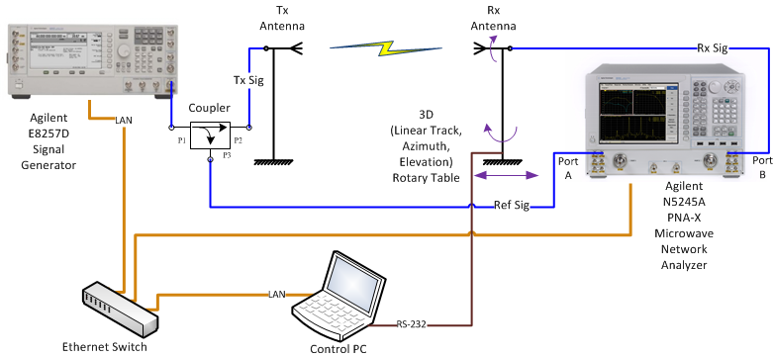
Channel Measurement Setup
A PC is used to not only control the rotary table with an RS-232 port but also control the signal generator and vector network analyzer (VNA) with LAN ports.
The signal generator transmits CW signal at each frequency, then Rx power and channel frequency response are obtained by the VNA. The positions of Tx and Rx antennas and measured data are simultaneously recorded.

Slide 7
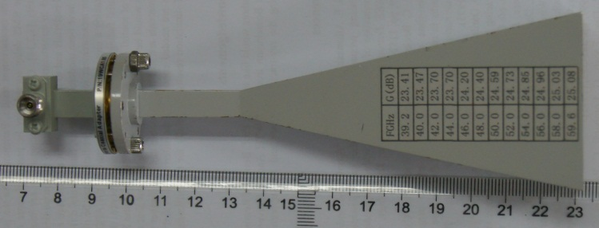
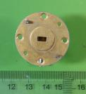
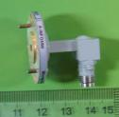
Antennas for Channel Measurement
Type I: Horn antenna with 23.7-dBi gain
H-Plane
E-Plane
Pattern (dB)
Angle (degree)
Type II: Open-ended waveguide (OEW) antenna with 6-dBi gain

Slide 8
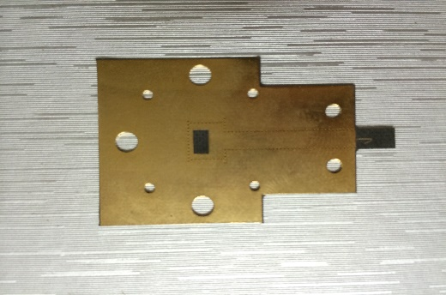
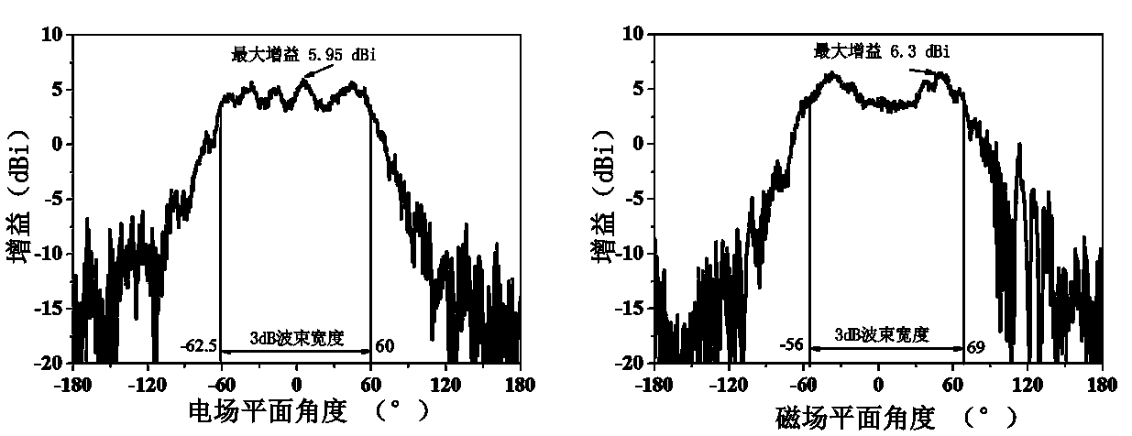
Antennas for Channel Measurement
Type Ⅲ: SIW antenna with 3-dBi gain
Three antennas are linear polarized
Maximum Gain
Maximum Gain
Gain
Gain
Gain
Angle (deg)
Angle (deg)

Slide 9
Scenarios
Three indoor environments: Conference room, Cubicle room, Living room
Two sets of scenarios: AP-STA, STA-STA; LoS, NLoS
Six antenna configurations:
  Tx and Rx: Horn, Co-pol;
  Tx and Rx: Horn, Cross-pol;
  Tx and Rx: OEW, Co-pol;
  Tx and Rx: OEW, Cross-pol;
  Tx and Rx: SIW, Co-pol;
  Tx and Rx: SIW, Cross-Pol

Slide 10
Scenarios
NLoS setup of Conference room and Living room :
  A metal board is placed between TR antennas
  Both antennas are directed to the wall with same incident angle
OLoS setup of Cubicle room:
  Transmit antenna is placed next to the door
  Receive antenna is placed at the sitting position

Slide 11


Path-Loss Model
Two Path-Loss channel models are compared
$$d_{0}$$
where and n denote the reference distance and PL exponent, respectively and is the shadowing fading.
$$X_{σ}$$

Slide 12
Conference Room

Slide 13
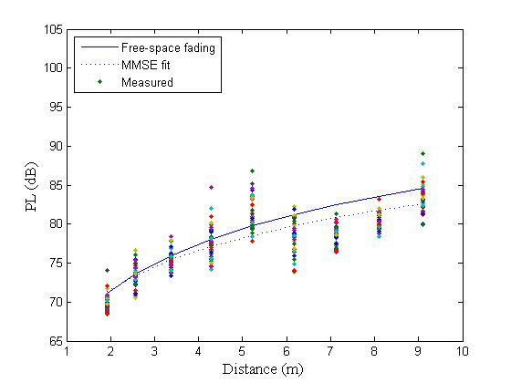
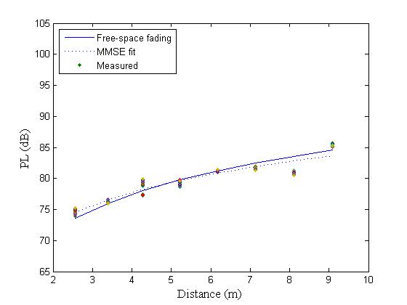
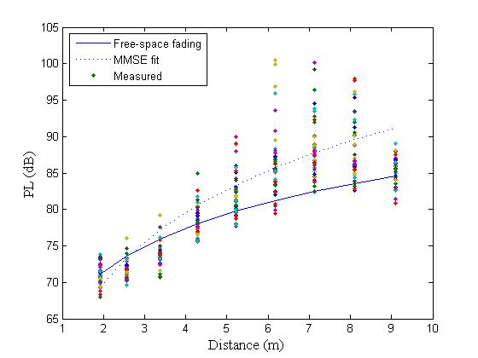
Fitting plot-Conference room-AP
Carrier frequency：44.955GHz
Height of Tx antenna is 1.95 m while height of Rx antenna is 1 m.
TR distance is from 1 m to 9 m with 9 positions.
Forty points are measured with interval 0.5 cm at each position.
(b) Tx and Rx: OEW, Co-Pol
(a) Tx and Rx: Horn, Co-Pol
(c) Tx and Rx: SIW, Co-Pol

Slide 14
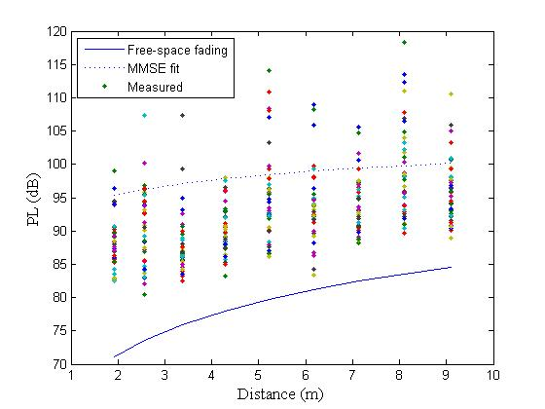
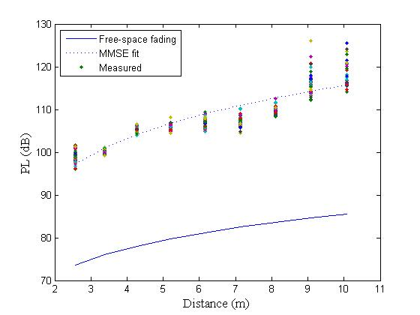
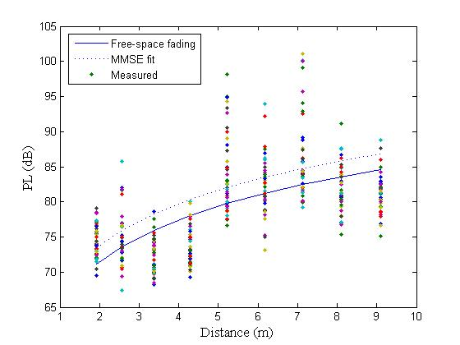
Fitting plot-Conference room-AP
Cross polarization loss can be observed from the illustration.
Cross polarization loss decreases as antenna beam width increases.
Large beam width antenna has larger amplitude fluctuation.
15 dB
25 dB
(b) Tx and Rx: OEW, Cross-Pol
25 dB
3 dB
20 dB
3 dB
(a) Tx and Rx: Horn, Cross-Pol
(c) Tx and Rx: SIW, Cross-Pol

Slide 15
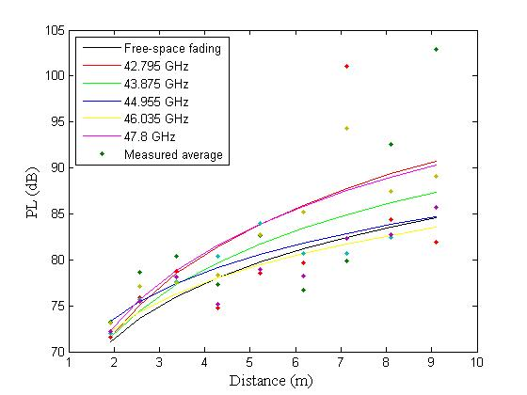
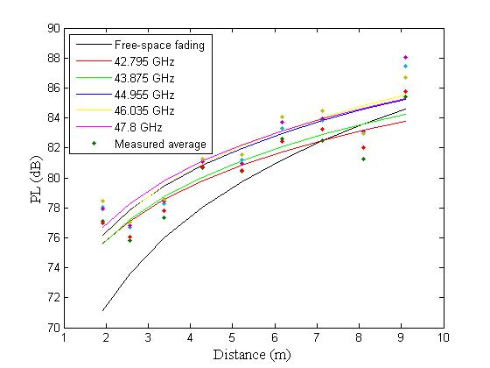
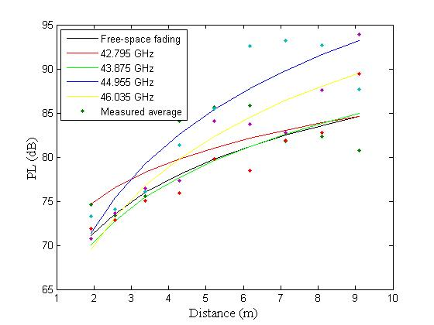
Fitting plot-Conference room-AP
Fitting of Path-loss fading for five different frequencies.
Path-loss increases as frequency increases.
Reflection of the table causes a more obvious multipath effect than other two indoor environments.
(b) Tx and Rx: OEW, Co-Pol
(a) Tx and Rx: Horn, Co-Pol
(c) Tx and Rx: SIW, Co-Pol

Slide 16
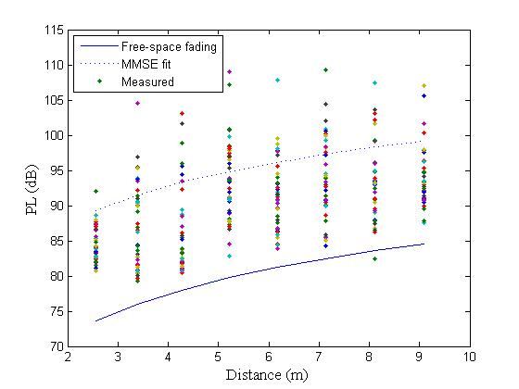
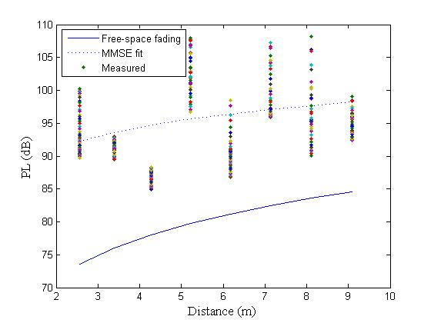
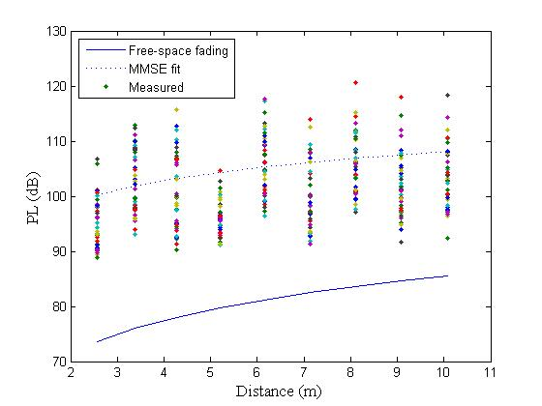
Fitting plot-Conference-NLoS-AP
Reflection causes an additional fading of more than 20 dB due to longer transmitting distance.
The variation of received power in NLoS scenario is much more obvious than LoS scenario.
15 dB
18 dB
(b) Tx and Rx: OEW, Co-Pol
13 dB
20 dB
16 dB
26 dB
(a) Tx and Rx: Horn, Co-Pol
(c) Tx and Rx: SIW, Co-Pol

Slide 17
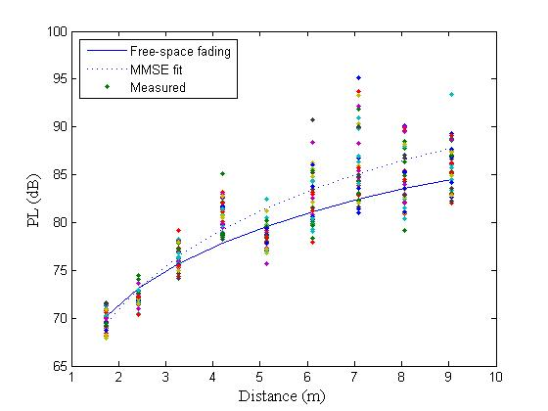
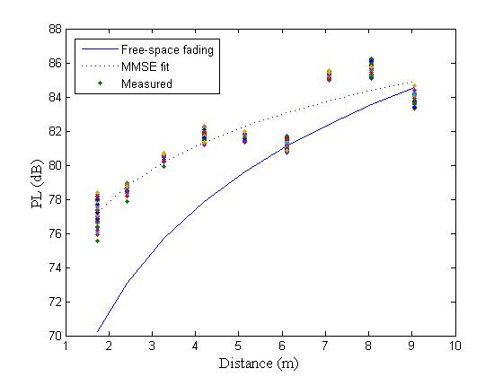
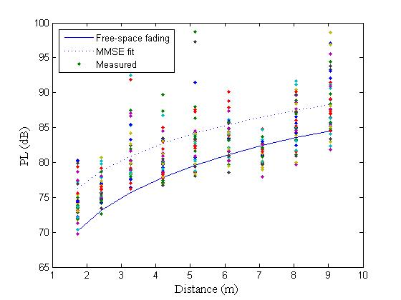
Fitting plot-Conference room-STA
Frequency ：44.955GHz
Heights of Tx antenna is 1.45 m while Rx 1 m.
TR distance is from 1 m to 9 m with 9 positions.
40 points are measured with interval 0.5cm at each position.
(b) Tx and Rx: OEW, Co-Pol
(a) Tx and Rx: Horn, Co-Pol
(c) Tx and Rx: SIW, Co-Pol

Slide 18
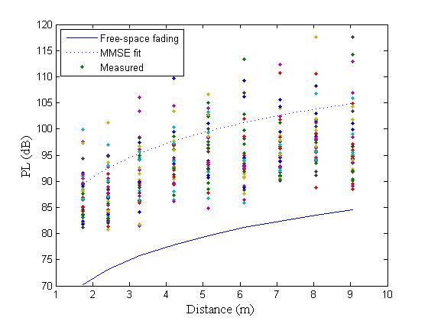
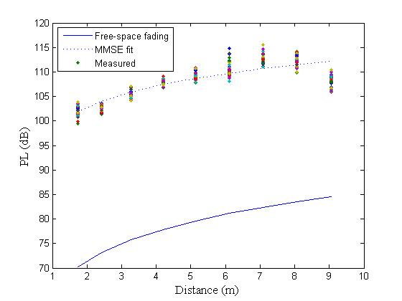
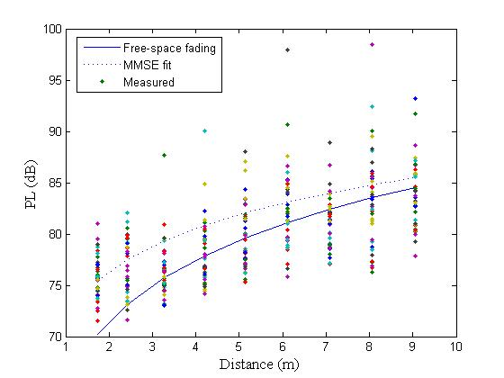
Fitting plot-Conference room-STA
Cross polarization loss can be observed from the illustration.
Cross polarization loss decreases as antennas beam width increases.
Wider beam width antenna has larger fluctuation.
20 dB
19 dB
(b) Tx and Rx: OEW, Cross-Pol
28 dB
1 dB
32 dB
5 dB
(a) Tx and Rx: Horn, Cross-Pol
(c) Tx and Rx: SIW, Cross-Pol

Slide 19
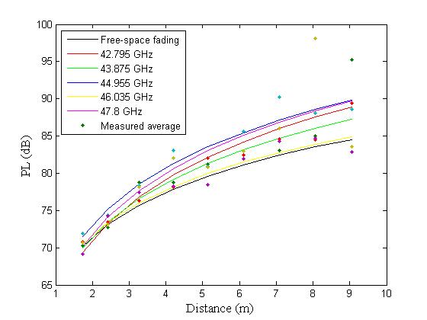
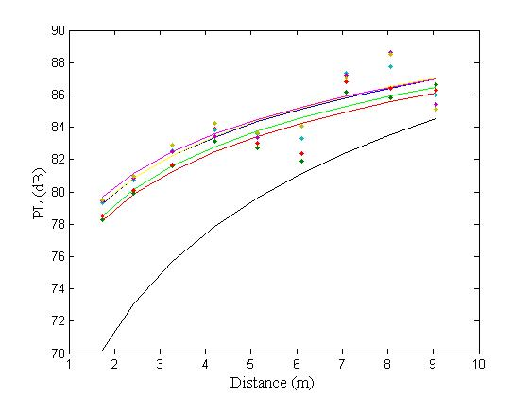
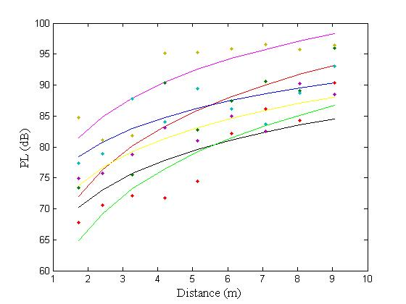
Fitting plot-Conference room-STA
Fitting of Path-loss fading for five different frequencies.
Path-loss increases as frequency increases.
The regularity related to distance caused by multipath effect of table reflection is obvious in narrow beam antenna.
(b) Tx and Rx: OEW, Co-Pol
(a) Tx and Rx: Horn, Co-Pol
(c) Tx and Rx: SIW, Co-Pol

Slide 20
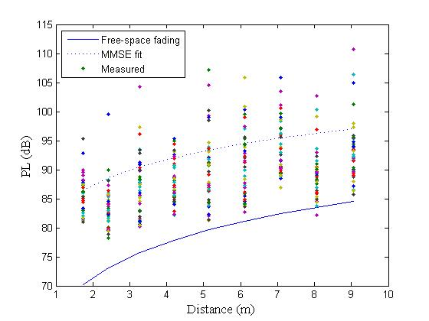
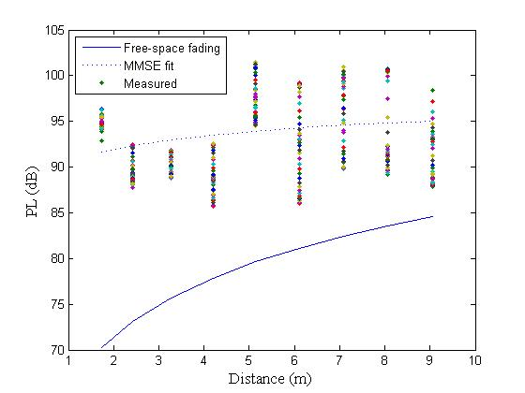
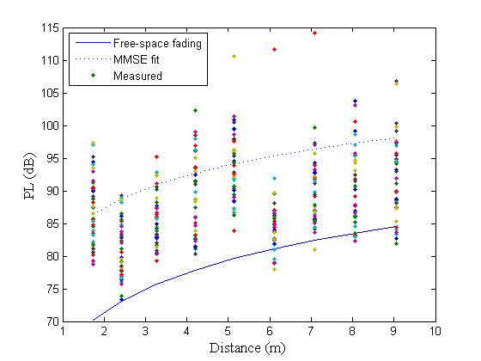
Fitting plot-NLoS-STA
Reflection causes an additional fading due to longer transmitting distance.
Variation of received power in NLoS scenario is much more obvious.
13 dB
15 dB
(b) Tx and Rx: OEW, Co-Pol
11 dB
15 dB
20 dB
17 dB
(a) Tx and Rx: Horn, Co-Pol
(c) Tx and Rx: SIW, Co-Pol

Slide 21
Cubicle Room

Slide 22
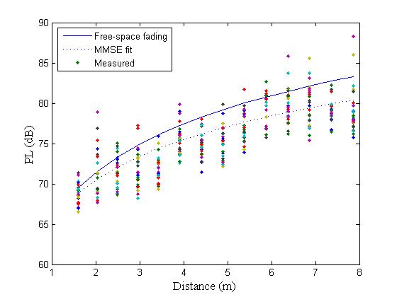
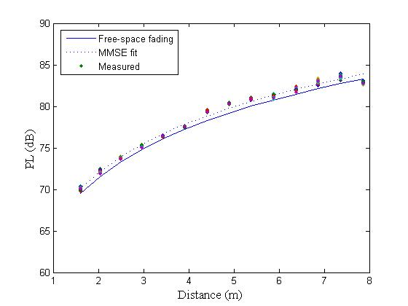
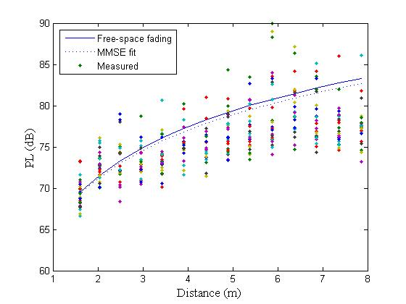
Fitting plot-Cubicle room-AP
Frequency ：44.955GHz
Heights of Tx antenna is 1.95 m while Rx 1 m.
TR distance is from 1 m to 8 m with 14 positions.
5×5 points are measured with interval 1cm at each position.
The fitted line agree well with free space fading model.
(b) Tx and Rx: OEW, Co-Pol
(a) Tx and Rx: Horn, Co-Pol
(c) Tx and Rx: SIW, Co-Pol

Slide 23
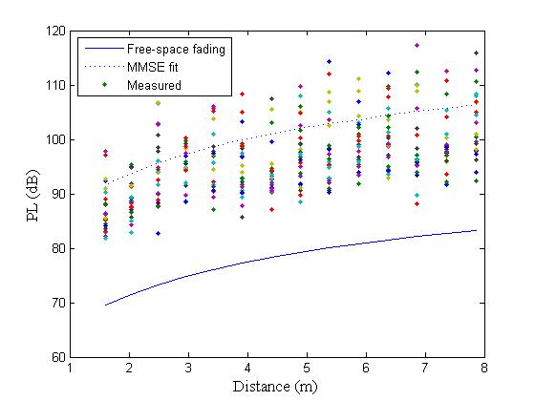
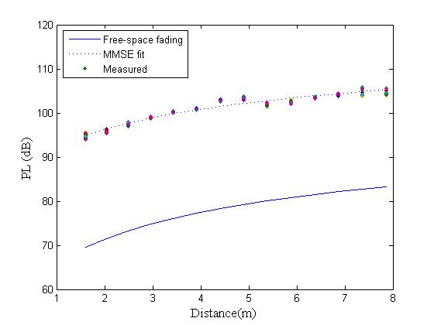
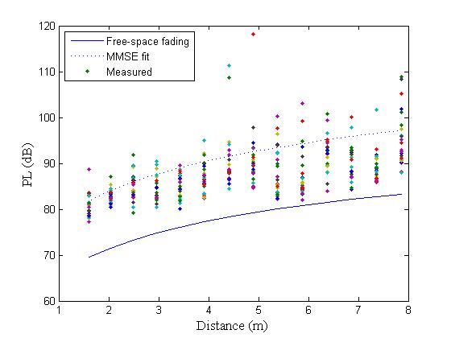
Fitting plot-Cubicle room-AP
Cross polarization loss can be observed from the illustration.
The loss decreases as antennas beam width increases.
Wider beam width antenna has larger fluctuation.
21 dB
21 dB
(b) Tx and Rx: OEW, Cross-Pol
21 dB
12 dB
25 dB
12 dB
(a) Tx and Rx: Horn, Cross-Pol
(c) Tx and Rx: SIW, Cross-Pol

Slide 24
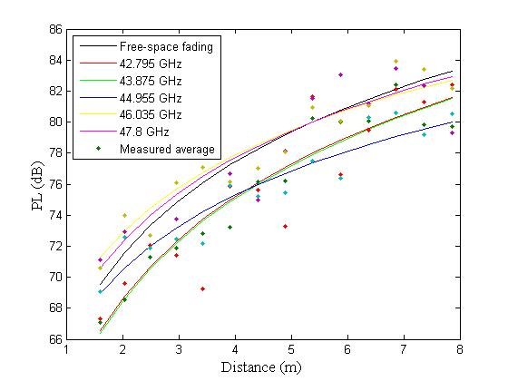
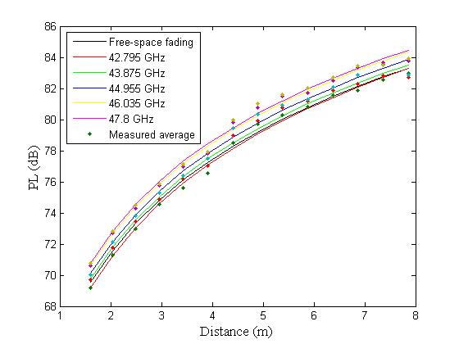
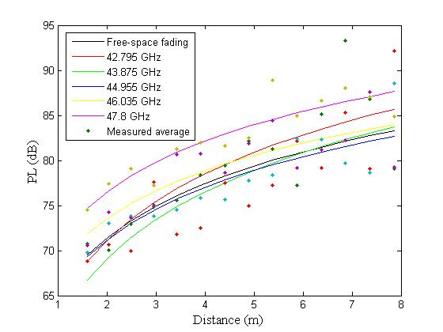
Fitting plot-Cubicle room-AP
Fitting of Path-loss fading for five different frequencies.
Path-loss increases as frequency increases.
Fluctuation appears as wide beam width antennas are used for reflection mainly from the ground.
(b) Tx and Rx: OEW, Co-Pol
(a) Tx and Rx: Horn, Co-Pol
(c) Tx and Rx: SIW, Co-Pol

Slide 25
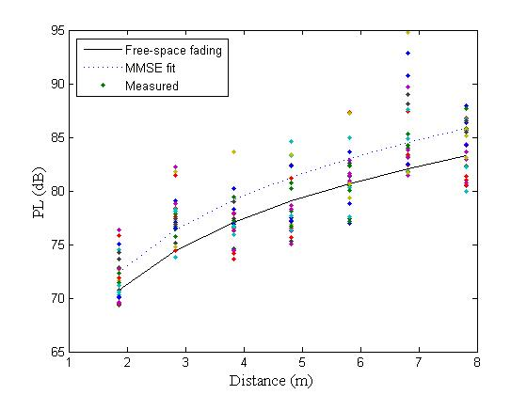
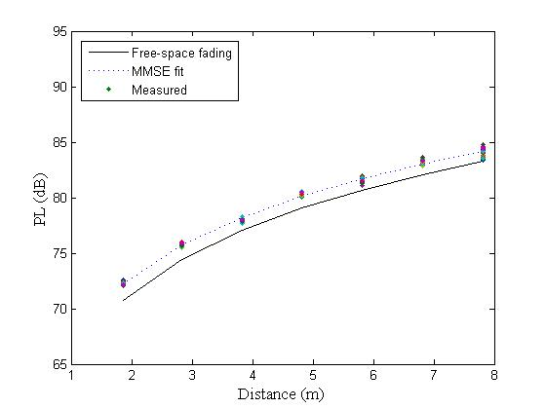
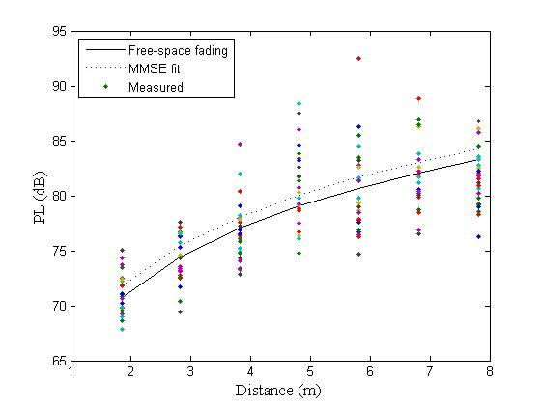
Fitting plot-Cubicle room-STA
Frequency ：44.955GHz
Heights of Tx antenna is 1.45 m while Rx 1 m.
TR distance is from 1 m to 8 m with 14 positions.
5×5 points are measured with interval 1cm at each position.
The fitted line agree well with free space fading model.
(b) Tx and Rx: OEW, Co-Pol
(a) Tx and Rx: Horn, Co-Pol
(c) Tx and Rx: SIW, Co-Pol

Slide 26
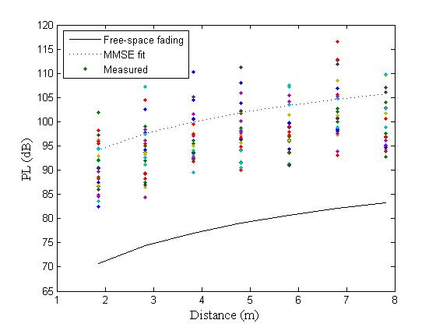
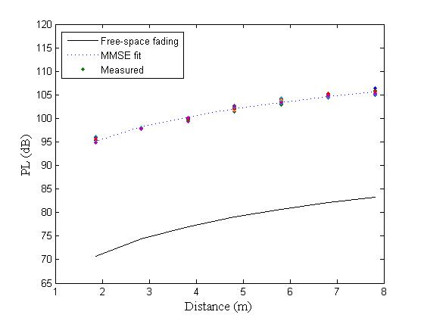

Fitting plot-Cubicle room-STA
Cross polarization loss can be observed from the illustration.
The loss decreases as antennas beam width increases.
Wider beam width antenna has larger fluctuation.
22 dB
23 dB
(b) Tx and Rx: OEW, Cross-Pol
22 dB
23 dB
1 dB
(a) Tx and Rx: Horn, Cross-Pol
(c) Tx and Rx: SIW, Cross-Pol

Slide 27



Fitting plot-Cubicle room-STA
Fitting of Path-loss fading for five different frequencies.
Path-loss increases as frequency increases.
Fluctuation appears as wide beam width antennas are used for reflection mainly from the ground.
(b) Tx and Rx: OEW, Co-Pol
(a) Tx and Rx: Horn, Co-Pol
(c) Tx and Rx: SIW, Co-Pol

Slide 28
Living Room

Slide 29



Fitting plot-Living room-AP
Frequency ：44.955GHz
Heights of Tx antenna is 1.45 m while Rx 1 m.
TR distance is from 2 m to 8 m with 12 positions.
5×5 points are measured with interval 1cm at each position.
The fitted line agree well with free space fading model.
(b) Tx and Rx: OEW, Co-Pol
(a) Tx and Rx: Horn, Co-Pol
(c) Tx and Rx: SIW, Co-Pol

Slide 30



Fitting plot-Living room-AP
Cross polarization loss can be observed from the illustration.
The loss decreases as antennas beam width increases.
Wider beam width antenna has larger fluctuation.
23 dB
21 dB
(b) Tx and Rx: OEW, Cross-Pol
23 dB
23 dB
2 dB
2 dB
(a) Tx and Rx: Horn, Cross-Pol
(c) Tx and Rx: SIW, Cross-Pol

Slide 31



Fitting plot-Living room-AP
Fitting of Path-loss fading for five different frequencies.
Path-loss increases as frequency increases.
Fluctuation appears as wide beam width antennas are used for reflection mainly from the ground.
(b) Tx and Rx: OEW, Co-Pol
(a) Tx and Rx: Horn, Co-Pol
(c) Tx and Rx: SIW, Co-Pol

Slide 32



Fitting plot-Living room-STA
Frequency ：44.955GHz
Heights of Tx antenna is 1.45 m while Rx 1 m.
TR distance is from 2 m to 8 m with 12 positions.
5×5 points are measured with interval 1cm at each position.
(b) Tx and Rx: OEW, Co-Pol
(a) Tx and Rx: Horn, Co-Pol
(c) Tx and Rx: SIW, Co-Pol

Slide 33



Fitting plot-Living room-STA
Cross polarization loss can be observed from the illustration.
The loss decreases as antennas beam width increases.
Wider beam width antenna has larger fluctuation.
19 dB
18 dB
(b) Tx and Rx: OEW, Cross-Pol
28 dB
28 dB
5 dB
(a) Tx and Rx: Horn, Cross-Pol
(c) Tx and Rx: SIW, Cross-Pol

Slide 34



Fitting plot-Living room-STA
Path-loss fitting of five different frequencies.
Path-loss increases as frequency increases.
(b) Tx and Rx: OEW, Co-Pol
(a) Tx and Rx: Horn, Co-Pol
(c) Tx and Rx: SIW, Co-Pol

Slide 35


Shadow Fading Distribution in Cubicle Room
$$\begin{aligned}μ_{\text{1}}\text{=0}，σ_{\text{1}}\text{=0.37} \\ μ_{\text{2}}\text{=}\text{1.3}，σ_{\text{2}}\text{=2.5} \\ μ_{\text{2}}\text{=2.5}，σ_{\text{2}}\text{=3.7}\end{aligned}$$
Horn
OEW
SIW
Three dotted lines represent measurement deviation from fitted values of three antennas
Shadow fading agrees well with the log-normal distribution

Slide 36
Conclusion
The n value increases when the antenna beam width increases
In NLoS scenario, the n value is around zero, indicating a homogeneous distribution of field strength in the room
The measured path loss is close to the theoretical path loss in free space when Tx and Rx both use antennas with co-polarization.
The average additional loss due to cross-polarization is about 24 dB, 22 dB and 2.6 dB for horn, OEW and SIW antennas, respectively.
Standard deviation increased when larger HPBW antenna is configured in the measurement
Standard deviation of reference path-loss constant A_{c} is more stable than PL(d₀)

Slide 37
Future Work
Continue large-scale channel measurement in scenarios of obstruction and movement.
Resume the small-scale channel measurement in all three transmission scenarios.
Finish the channel models based on our channel measurement.

Slide 38
Conference Room Characteristics
Environment | Scenario1 | Scenario2 | Antenna | Pol | Frequency average
 |  |  |  |  | n | PL0 | σ | Ac
Conference_room | LoS | STA-STA | P-P | co | 1.139749 | 73.82214 | 0.35163 | 40.74653
 |  |  |  | cross | 1.511144 | 97.52996 | 0.588878 | 64.45435
 |  |  | O-O | co | 2.630479 | 61.0116 | 0.78206 | 27.93598
 |  |  |  | cross | 1.577574 | 87.18569 | 0.886897 | 54.11007
 |  |  | S-S | co | 2.56263 | 63.11556 | 0.927394 | 30.16818
 |  |  |  | cross | 1.845868 | 67.78648 | 1.139117 | 34.8391
 |  | AP-STA | P-P | co | 1.304055 | 70.27431 | 0.415879 | 37.1987
 |  |  |  | cross | 2.938059 | 88.46472 | 1.023065 | 55.38911
 |  |  | O-O | co | 2.245392 | 63.76319 | 1.396849 | 30.68758
 |  |  |  | cross | 1.972381 | 85.43296 | 1.468228 | 52.35734
 |  |  | S-S | co | 2.476442 | 62.29575 | 0.893249 | 29.34837
 |  |  |  | cross | 2.389663 | 62.17207 | 1.645918 | 29.22468
 | NLoS | STA-STA | P-P | co | 0.309017 | 91.40559 | 1.4048 | 58.45821
 |  |  |  | cross | 0.305875 | 124.8957 | 1.476564 | 91.94828
 |  |  | O-O | co | 1.419084 | 84.64103 | 1.428556 | 51.69365
 |  |  |  | cross | -0.15111 | 104.8941 | 1.242671 | 71.94672
 |  |  | S-S | co | 1.155316 | 86.4047 | 1.474105 | 53.45732
 |  |  |  | cross | 0.089013 | 93.49527 | 0.758909 | 60.54789
 |  | AP-STA | P-P | co | -0.08935 | 97.37172 | 1.278552 | 64.42434
 |  |  |  | cross | -0.03463 | 121.7664 | 1.450245 | 88.819
 |  |  | O-O | co | 0.183341 | 93.58295 | 1.039485 | 60.63557
 |  |  |  | cross | 1.015959 | 95.8668 | 0.6578 | 62.91942
 |  |  | S-S | co | 0.626734 | 89.42338 | 1.039081 | 56.476
 |  |  |  | cross | 0.218608 | 94.19642 | 1.172416 | 61.24904
H-H: horn to horn; O-O: OEW to OEW; S-S: SIW-SIW; co: co-polarization; cross: cross-polarization

Slide 39
Cubicle Room Characteristics
Environment | Scenario1 | Scenario2 | Antenna | Pol | Frequency average
 |  |  |  |  | n | PL0 | σ | Ac
Cubicle_room | LoS | STA-STA | P-P | co | 1.79569 | 68.73988 | 0.0638 | 35.66426
 |  |  |  | cross | 1.606904 | 91.79041 | 0.112075 | 58.71479
 |  |  | O-O | co | 1.987251 | 68.57695 | 0.735821 | 35.50133
 |  |  |  | cross | 1.587652 | 92.96078 | 1.345013 | 59.88516
 |  |  | S-S | co | 2.482227 | 66.32985 | 0.885278 | 33.38247
 |  |  |  | cross | 2.390764 | 67.77112 | 1.42207 | 34.82373
 |  | AP-STA | P-P | co | 2.005008 | 65.94193 | 0.115975 | 32.86631
 |  |  |  | cross | 1.55109 | 91.45427 | 0.205535 | 58.37865
 |  |  | O-O | co | 1.9603 | 64.61183 | 0.7977 | 31.53622
 |  |  |  | cross | 2.326209 | 86.84695 | 1.174327 | 53.77134
 |  |  | S-S | co | 2.155971 | 64.73363 | 1.060874 | 31.78625
 |  |  |  | cross | 1.976314 | 69.33096 | 1.3203 | 36.38358
 | NLoS | STA-STA | P-P | co | 2.095542 | 69.22941 | 0.702625 | 36.1538
 |  |  |  | cross | 0.934477 | 100.3316 | 0.826368 | 67.25597
 |  |  | O-O | co | 1.476295 | 74.5536 | 1.634227 | 41.47799
 |  |  |  | cross | 1.229472 | 94.59532 | 0.621439 | 61.5197
 |  |  | S-S | co | 2.178841 | 74.30523 | 0.952263 | 41.35785
 |  |  |  | cross | 2.167594 | 84.23814 | 0.841976 | 51.29075
 |  | AP-STA | P-P | co | 2.46548 | 63.2624 | 0.326308 | 30.18679
 |  |  |  | cross | 2.632257 | 82.60221 | 0.18978 | 49.52659
 |  |  | O-O | co | 1.935346 | 66.71061 | 0.414967 | 33.63499
 |  |  |  | cross | 2.892114 | 79.22749 | 0.912131 | 46.15187
 |  |  | S-S | co | 1.7684 | 70.30398 | 0.455573 | 37.3566
 |  |  |  | cross | 1.44843 | 85.58861 | 1.366867 | 52.64123
H-H: horn to horn; O-O: OEW to OEW; S-S: SIW-SIW;OLoS: obstructed line of sight

Slide 40
Living Room Characteristics
Environment | Scenario1 | Scenario2 | Antenna | Pol | Frequency average
 |  |  |  |  | n | PL0 | σ | Ac
Living_room | LoS | STA-STA | P-P | co | 2.231738 | 64.62093 | 0.109134 | 31.54532
 |  |  |  | cross | 1.993172 | 92.27755 | 0.12008 | 59.20193
 |  |  | O-O | co | 2.412787 | 62.80727 | 0.513327 | 29.73165
 |  |  |  | cross | 2.115442 | 86.9178 | 1.313205 | 53.84218
 |  |  | S-S | co | 2.544253 | 62.50163 | 2.073575 | 29.55425
 |  |  |  | cross | 2.596201 | 64.2595 | 2.245281 | 31.31212
 |  | AP-STA | P-P | co | 2.075801 | 65.70149 | 0.043349 | 32.62588
 |  |  |  | cross | 2.024144 | 88.83036 | 0.157892 | 55.75475
 |  |  | O-O | co | 2.406526 | 63.84632 | 0.355291 | 30.7707
 |  |  |  | cross | 3.110935 | 81.87936 | 1.955085 | 48.80375
 |  |  | S-S | co | 2.286152 | 65.19459 | 2.053458 | 32.2472
 |  |  |  | cross | 2.516595 | 65.90757 | 2.686096 | 32.96019
 | NLoS | STA-STA | P-P | co | -0.43859 | 99.56027 | 0.546746 | 66.48465
 |  |  |  | cross | -0.46102 | 123.9658 | 0.806784 | 90.89018
 |  |  | O-O | co | 0.657759 | 93.34336 | 1.488326 | 60.26774
 |  |  |  | cross | 0.31636 | 104.366 | 1.410035 | 71.29041
 |  |  | S-S | co | 0.19743 | 94.47523 | 1.29829 | 61.52784
 |  |  |  | cross | -0.28265 | 100.3553 | 1.152425 | 67.40792
 |  | AP-STA | P-P | co | 1.524857 | 84.94494 | 0.286436 | 51.86933
 |  |  |  | cross | 0.097595 | 128.5621 | 0.681437 | 95.48653
 |  |  | O-O | co | 0.387018 | 92.98406 | 1.944789 | 59.90845
 |  |  |  | cross | 0.533777 | 102.8803 | 1.938324 | 69.8047
 |  |  | S-S | co | 0.204226 | 95.09873 | 1.037752 | 62.15135
 |  |  |  | cross | -1.54134 | 107.258 | 1.714575 | 74.31063
H-H: horn to horn; O-O: OEW to OEW; S-S: SIW-SIW

