Slide 1
Large-Scale Characteristics of 45 GHz Based on Channel Measurement
Date: 2014-01-08
Presenter: Haiming WANG
Authors/contributors:
Name | Company | Address | Phone | Email
Haiming WANG | SEU/CWPAN | 2 Sipailou, Nanjing 210096, China | +86-25-5209 1653-301(ext.) | hmwang@seu.edu.cn
Wei HONG |  |  | +86-25-5209 1650 | weihong@seu.edu.cn
Jixin CHEN |  |  | +86-25-5209 1653-403(ext.) | jxchen@seu.edu.cn
Shiwen HE |  |  | +86-25-5209 1653-3121(ext.) | hesw01@seu.edu.cn
Nianzu ZHANG |  |  | +86-25-5209 1653-320 (ext.) | nzzhang@seu.edu.cn
Guangqi YANG |  |  | +86-25-5209 1653-211(ext.) | gq.yang@seu.edu.cn

Slide 2
Abstract
This presentation gives large-scale characteristics of 45 GHz band based on channel measurement.

Slide 3
Outline
Channel Measurement Scheme
  Transmission Scenarios
  Channel measurement setup
Large Characteristics at 45GHz band
  STA-STA
  AP-STA

Slide 4

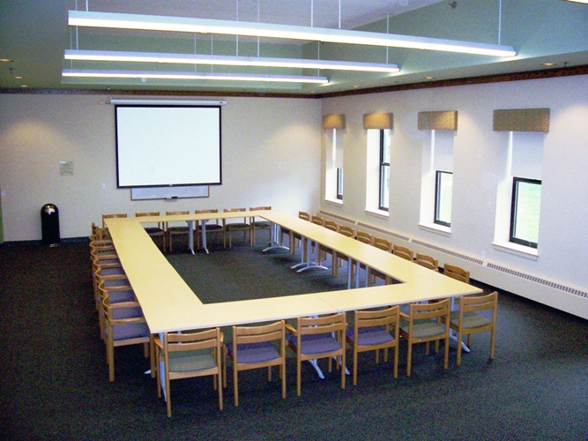

Transmission Scenarios
Conference room
Cubicle room
Living room

Slide 5
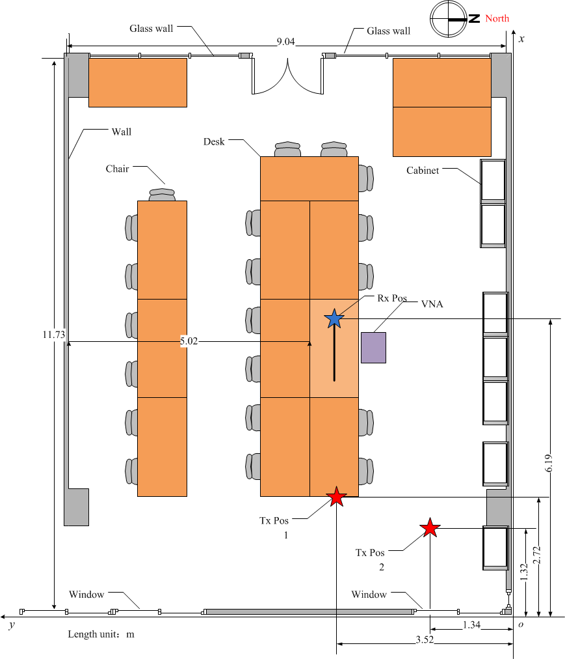
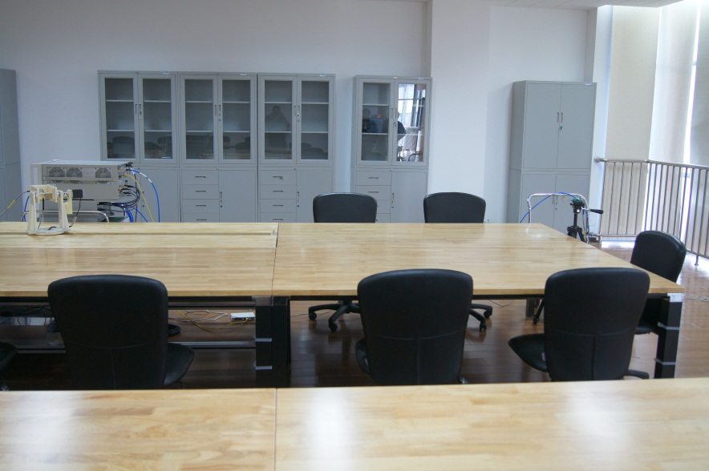
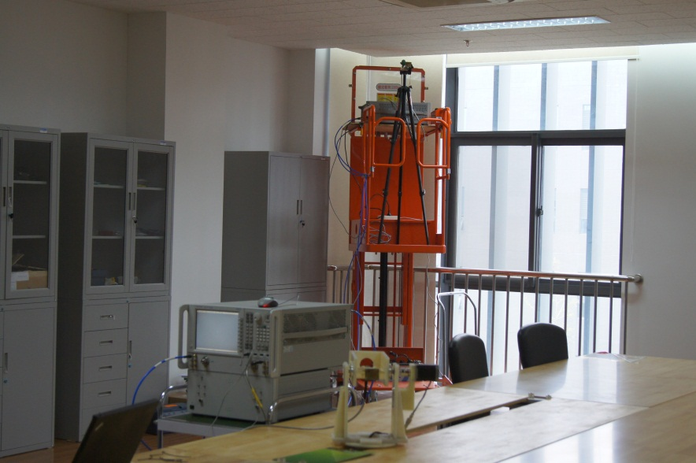
Conference Room

Slide 6
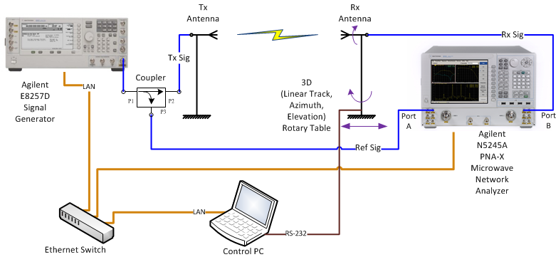
Channel Measurement Setup
A PC is used to not only control the rotary table with an RS-232 port but also control the signal generator and network analyzer with LAN ports.
The signal generator transmits CW signal at each frequency, then Rx power and channel frequency response are obtained by the network analyzer. The positions of Tx and Rx antennas and measured data are simultaneously recorded.

Slide 7
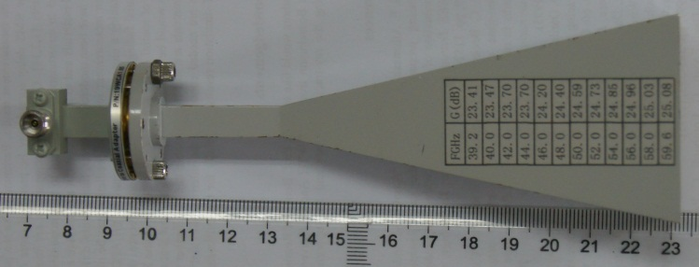
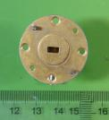
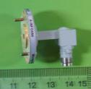
Antennas for Channel Measurement
Type I: Horn antenna with 23.7-dBi gain
H-Plane
E-Plane
Pattern (dB)
Angle (degree)
Type II: Open-ended waveguide (OEW) antenna with 6-dBi gain

Slide 8
Outline
Channel Measurement Scheme
  Transmission Scenarios
  Channel measurement setup
Large Characteristics at 45GHz band
  STA-STA
  AP-STA

Slide 9
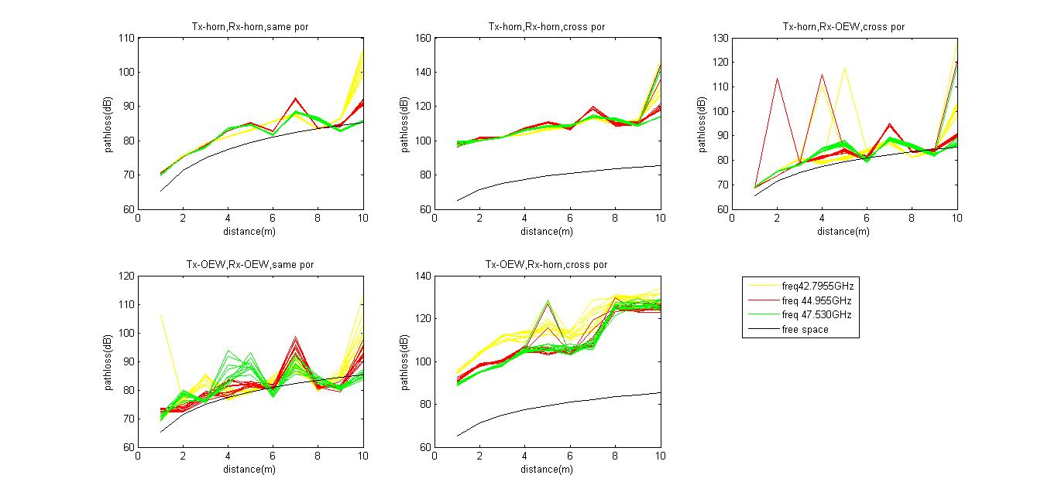
STA-STA
Heights of Tx and Rx antennas are all 1m
TR distance is from 1 m to 10 m.
(a)
(b)
(c)
(d)
(e)
a) Tx and Rx: Horn, Co-Pol; b) Tx and Rx: Horn, Crs-Pol; c) Tx: Horn, Rx: OEW, Co-Pol
d) Tx and Rx: OEW,Co-pol; e) Tx and Rx: Crs-Pol

Slide 10
STA-STA
Freq. (GHz) | Tx and Rx: Horn, Co-Pol |  | Tx and Rx: Horn, Crs-Pol |  | Tx: OEW, Rx: Horn, Co-Pol |  | Tx and Rx: OEW, Co-Pol
 | n | PL₀(dB) | n | PL₀(dB) | n | PL₀(dB) | n | PL₀(dB)
42.795 | 2.2634 | -68.6890 | 2.3638 | -93.0875 | 2.2961 | -85.6179 | 1.7732 | -106.866
43.335 | 2.1378 | -68.7501 | 2.2039 | -93.7773 | 2.2489 | -84.4544 | 1.9448 | -104.352
43.875 | 1.9901 | -69.3433 | 2.2344 | -93.9981 | 2.1707 | -84.8523 | 1.8585 | -103.866
44.415 | 1.8747 | -70.1376 | 2.1358 | -94.2795 | 2.1078 | -85.4511 | 1.8603 | -104.058
44.955 | 1.8695 | -70.4212 | 1.9839 | -95.7345 | 1.9884 | -87.3143 | 1.7193 | -105.838
45.495 | 1.7960 | -70.2936 | 2.0173 | -94.7180 | 1.9462 | -87.4034 | 1.5930 | -106.247
46.035 | 1.7494 | -70.3742 | 1.9399 | -94.8080 | 1.8752 | -87.0325 | 1.6499 | -105.122
46.575 | 1.7047 | -70.4991 | 1.8805 | -94.9216 | 1.9972 | -86.3310 | 1.4921 | -106.436
47.530 | 1.6242 | -71.0165 | 1.8232 | -95.7375 | 1.7887 | -88.0258 | 1.3393 | -108.339
48.070 | 1.5777 | -70.6783 | 1.9137 | -94.6527 | 1.8709 | -87.9001 | 1.6109 | -107.220

Slide 11
STA-STA
Conclusion:
  The n value decreases when the carrier frequency increases
  The n value of cross-polarization is bigger than that of co-polarization.
  The measured path loss is very close to the theoretical path loss in free space when Tx and Rx both use OEW antennas.
  The additional loss due to cross-polarization is about 30 dB.

Slide 12
AP-STA
Tx Position: (10.56m, 3.00m, 2.64m)，under the roof, the antenna direction to the center of the conference room
Rx Position: (1.00m, 3.00m, 1.00m) –(10.00m, 3.00m, 1.00m)
Five antenna configurations:
  Tx and Rx: Horn, Co-Pol;
  Tx and Rx: Horn, Crs-Pol;
  Tx: Horn, Rx: OEW, Co-Pol
  Tx and Rx: OEW, Co-pol;
  Tx and Rx: Crs-Pol

Slide 13
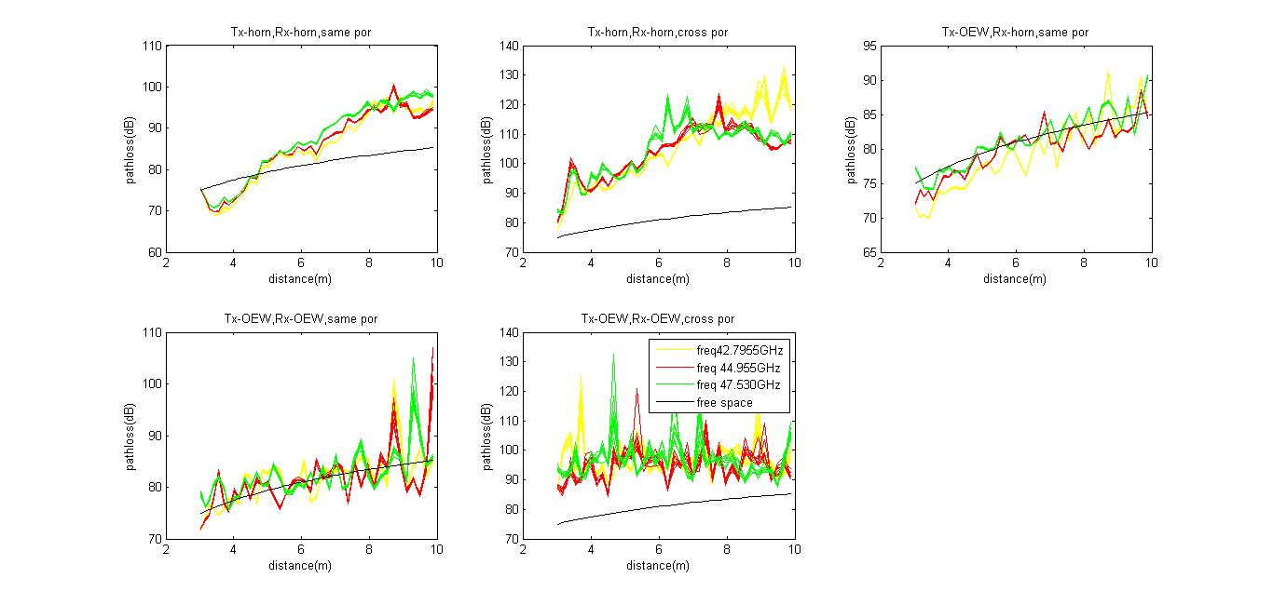
AP-STA
(a)
(b)
(c)
(d)
(e)
Additional path loss occurs due to cross-polarization
The path loss is approximately unchanged when the TR distance increases

Slide 14
AP-STA
Freq (GHz) | Tx and Rx: Horn, Co-Pol |  | Tx and Rx: Horn, Crs-Pol |  | Tx: OEW, Rx: Horn, Co-Pol |  | Tx and Rx: OEW, Co-Pol
 | n | PL₀(dB) | n | PL₀(dB) | n | PL₀(dB) | n | PL₀(dB)
42.795 | 2.6993 | -58.0590 | 6.7915 | -57.5552 | 1.9415 | -66.5720 | 1.6911 | -67.1594
43.335 | 2.5176 | -59.3366 | 4.1582 | -76.4049 | 1.9189 | -66.7769 | 1.6906 | -66.3621
43.875 | 3.0071 | -55.2477 | 5.0154 | -69.0075 | 1.6385 | -67.6855 | 1.5118 | -66.1248
44.415 | 2.8323 | -57.8814 | 4.5279 | -74.8665 | 1.3962 | -71.0565 | 1.5370 | -67.4646
44.955 | 2.5531 | -59.8066 | 3.8905 | -78.8173 | 1.3040 | -71.8943 | 1.4590 | -68.6947
45.495 | 2.4821 | -60.5281 | 4.8252 | -72.7278 | 1.2709 | -72.0765 | 0.8431 | -72.3576
46.035 | 3.1900 | -55.8076 | 3.4456 | -82.9572 | 1.2269 | -72.1731 | 1.0783 | -70.2655
46.575 | 2.8883 | -58.1486 | 4.4268 | -75.1521 | 1.2570 | -72.4974 | 1.1676 | -70.5428
47.530 | 2.9430 | -58.1477 | 4.1062 | -78.0454 | 1.5114 | -71.5868 | 1.4209 | -69.6995
48.070 | 3.0225 | -57.4967 | 4.2967 | -75.1949 | 1.6915 | -70.6470 | 1.9185 | -66.7296

Slide 15
AP-STA
Conclusion:
  The n value of the cross-polarization is bigger than that of co-polarization
  The n value is smaller when wide beamwidth antennas are used
  The path loss is approximately unchanged when both OEW antennas are used in Tx and Rx with cross-polarization.

Slide 16
Future Work
Continue large-scale channel measurement in Cubicle office room and living room.
Resume the small-scale channel measurement in all three transmission scenarios.
Finish the channel models based on our channel measurement.
The complete channel models will be available in IEEE 802 Beijing plenary session in March 2014.

Slide 17
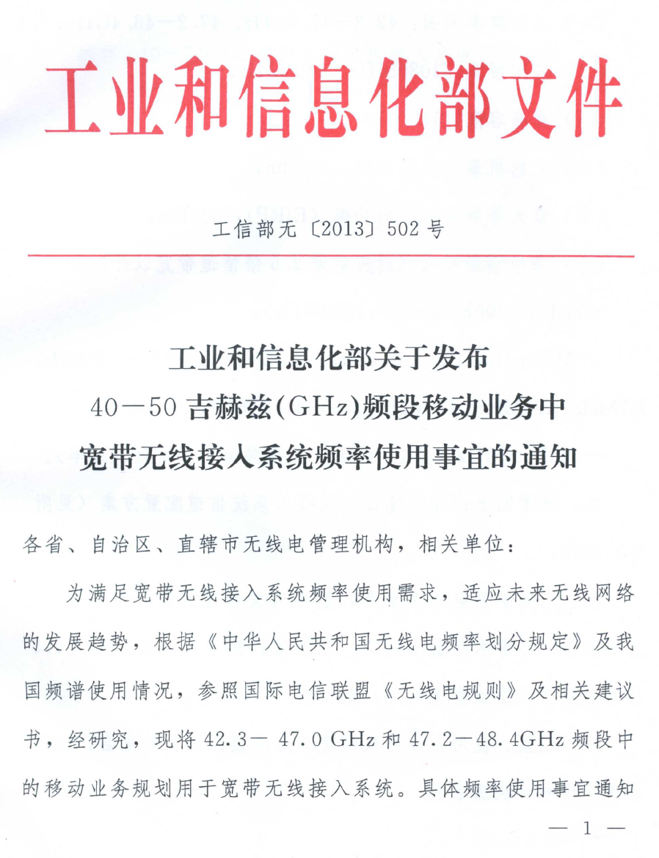
Reference
[1] MIIT, The usage of 40-50 GHz frequency band for mobile services in broadband wireless access systems, n15635784, http://www.miit.gov.cn/ n11293472/n11293832/n12845605/n13916913/15636214.html
Notes:
《40—50吉赫兹频段移动业务中宽带无线接入系统频率使用相关事宜》

