Slide 1
Tx EVM for MCS-10 in 802.11ah
Date: 2013-11-10
Authors:

Slide 4
CID 2004 for 11ah D1.0
Hongyuan Zhang | 336.23 | 24.3.17.4.3 | TBD needs to be filled up | will bring proposal | Counter, propose TxEVM to be -4dB for MCS10, see document 11-xxxx-r0

Slide 5
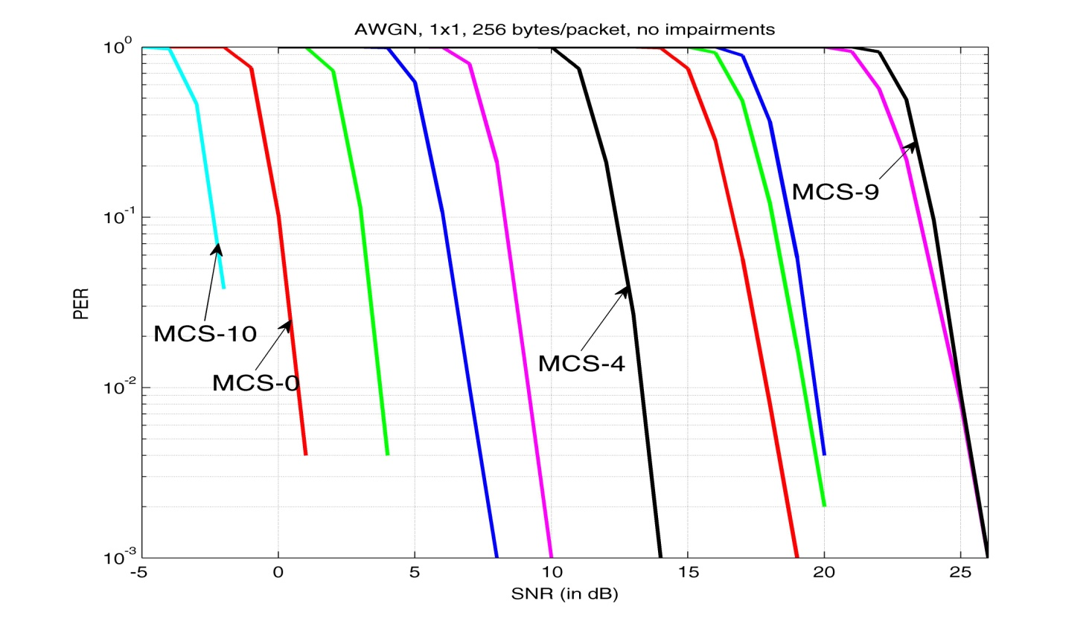
Introduction: Tx EVM
To ensure that the TX signal quality does not significantly limit the overall link performance.
Tx EVM requirement for MCS-10 is currently not specified in [1].
The slopes of PER curves are consistent between different MCS’s.
No fading, 1x1, 1 MHz, 256 bytes/packet, no impairments.

Slide 6
“Criterions” for Setting Tx EVM Requirement
Impact of Tx EVM to PER should be more or less consistent between MCS’s.
“Delta” between Tx EVM requirement and Rx sensitivity requirement should be similar for all MCS’s.
Performance degradation due to Tx constellation error at the EVM requirement point should be relatively small (e.g., <2 dB).
There is no significant incremental performance improvement on PER beyond the Tx EVM requirement point.

Slide 7
Tx EVM Requirement for 11ah
Previously increased ~6 dB for every 4x in QAM order.
Propose -4 dB for BPSK ½ rep2 (MCS-10).
A B A+B
MCS | bits/subcarrier | Tx EVM (in dB) | SNR for 10% PER (in dB) | Difference, “Delta”
BPSK ½ rep2 | 0.25 | -4 | -2.4 | -6.4
BPSK ½ | 0.5 | -5 | 0.0 | -5.0
QPSK ½ | 1 | -10 | 3.0 | -7.0
QPSK ¾ | 1.5 | -13 | 6.0 | -7.0
16QAM ½ | 2 | -16 | 8.3 | -7.7
16QAM ¾ | 3 | -19 | 12.4 | -6.6
64QAM +2/3 | 4 | -22 | 16.7 | -5.3
64QAM ¾ | 4.5 | -25 | 18.1 | -6.9
64QAM +5/6 | 5 | -27 | 18.7 | -8.3
256QAM ¾ | 6 | -30 | 23.5 | -6.5
256QAM+5/6 | 6.7 | -32 | 24.0 | -8.0
6
5.4
6
5.3
Avg.
-6.5
6
5.7
5
5.4

Slide 8
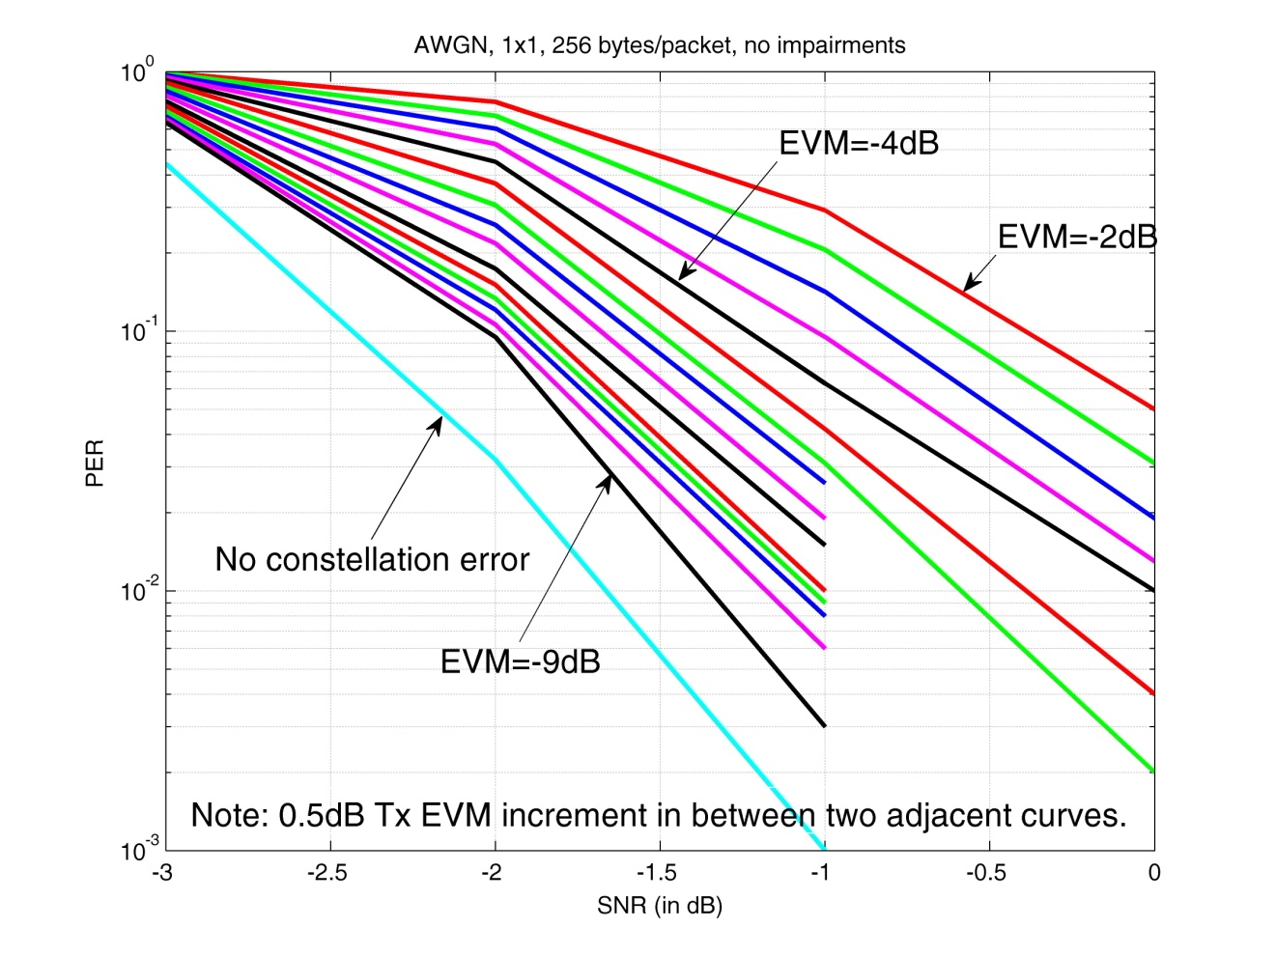
PER v.s. Tx EVM
The loss@EVM=-4 dB w.r.t. no constellation error is about 1.2 dB.
Starting from EVM=-4 dB, the PER performance improvement of each 0.5 dB increment on Tx EVM is marginal (<0.2 dB).

Slide 9
Conclusions
We studied the Tx EVM requirement for MCS-10 in 802.11ah, and suggested to specify it to be -4 dB.

Slide 10
Editorial Instruction
TGah Editor: In Table 24-30 on Page 336, in the second row, please fill up the “TBD” with “-4”.

Slide 11
Straw Poll
Do you support to specify the Tx EVM requirement for MCS-10 in 802.11ah to be -4 dB as the editor’s instruction in Slide 10?
Yes
No
Abstain

Slide 12
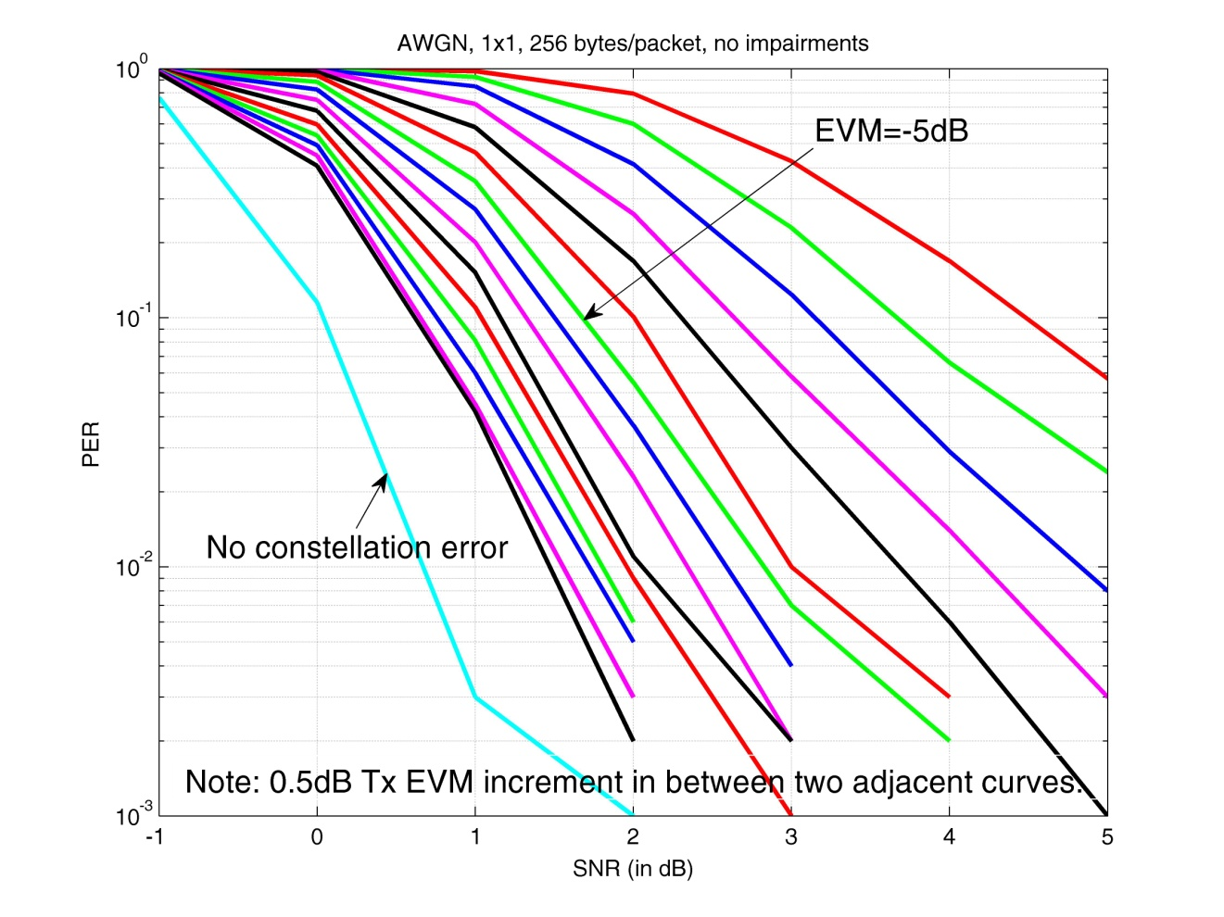
Appendix (1)
MCS-0: the specified requirement is -5 dB.
The loss w.r.t. no constellation error is about 1.6 dB, and the marginal gain beyond EVM=-5 dB is less than 0.2 dB.

Slide 13
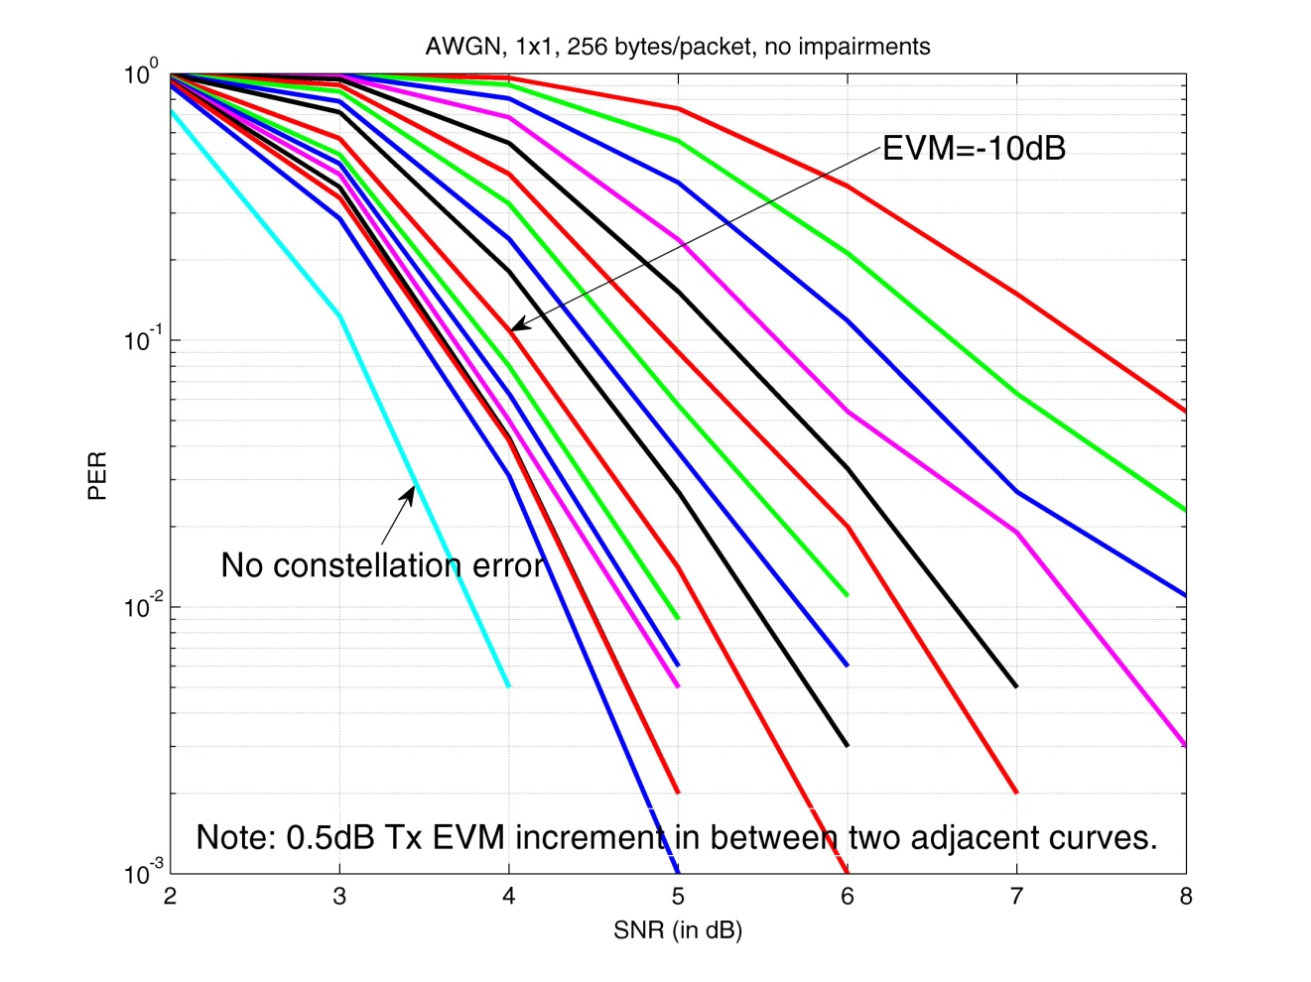
Appendix (2)
MCS-1: the specified requirement is -10 dB.
The loss w.r.t. no constellation error is about 1.0 dB, and the marginal gain beyond EVM=-10dB is less than 0.2 dB.

Slide 14
References
[1] IEEE P802.11ah™/D1.0, October 2013.

