Slide 1
Distributed Timeslot Allocation (DTA) Mechanism for 802.11aj (60GHz)
Date: 2013-11-14
Presenter: Haiming WANG
Authors/contributors:
Name | Company | Address | Phone | Email
Shiwen HE | Southeast University (SEU) | 2 Sipailou, Nanjing 210096, China | +86-25-5209 1653 -3121(ext.) | hesw01@seu.edu.cn
Haiming WANG |  |  | +86-25-5209 1653 -301(ext.) | hmwang@seu.edu.cn
Yongming HUANG |  |  |  | huangym@seu.edu.cn
Wei HONG |  |  | +86-25-5209 1650 | weihong@seu.edu.cn
Bo SUN | ZTE |  |  | sun.bo1@zte.com.cn

Slide 2
Abstract
This presentation describes a New Technique proposal of the Distributed Timeslot Allocation (DTA) Mechanism for IEEE 802.11aj (60 GHz).
Using the proposed DTA mechanism, more than two non-overlapped BSSs can be established with only 2×2.16 GHz channels at 60 GHz band in China.

Slide 3
Outline
Background
Scenario
Proposal
Implementation
Simulation Results

Slide 4
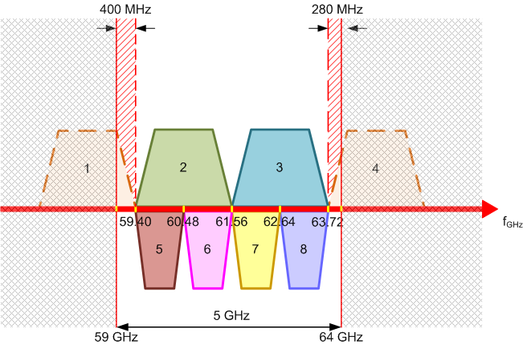
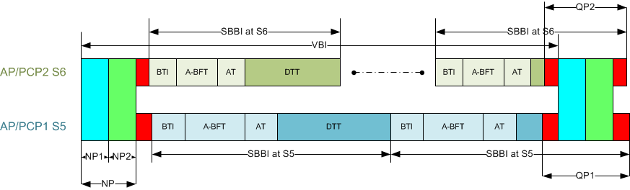
Background
According to channel bandwidth configuration of the 802.11ad standard, there are only two 2.16 GHz channels at 60 GHZ band in China.
In IEEE 802.11aj functional requirements, backward compatibility with 802.11ad in 59-64 GHz frequency band is mandatory.
  It was proposed that two 2.16 GHz channels are partitioned into four 1.08 GHz channels in China, such as channel 5,6,7,8 in the above figure.
  Backward compatibility will be tried to be achieved by sending 2.16 GHz Beacon at NP slots [1].
Notes:
However, in our opinion, the back compatibility can not be met with this kind of arrangement.

Slide 5
Background
A dynamic channel transfer procedure was proposed in [2] to combine two small channels into a big one.
  The above method needs to send two preambles which adapts two protocols.
Using the DTA scheme, at least three BSSs without co-channel interference (CCI) can be built even with only two 2.16 GHz channels available in China. Advantages of this scheme include:
  No 11ad PHY revision needed.
  Strong scalability.
  Strong compatibility.
  DTA scheme can be extended to other 802.11 protocol.
In this NT proposal, the ideas of the DTA are formulated based on 802.11ad standard. In other words, more than 3 non-overlapped channels can be obtained even with 2×2.16GHz channels in Chinese 60 GHz band.

Slide 6
Scenario
PBSS/BSS A and PBSS/BSS C are operating on channel 1 and channel 2, respectively.
PBSS/BSS B wants to build a new BSS.
If PBSS/BSS B chooses an arbitrary 2.16 GHz channel to build a new BSS without any coordination, an OBSS with CCI will occur because only two non-overlapped 2.16 GHz channels exist in China.

Slide 7
DTA Procedure
To mitigate CCI, a DTA mechanism is here proposed to schedule APs to serve their STAs. Specific steps are as follows:
  Step 1：PCP/AP B associates to PCP/AP A (Optional step)
  Step 2：PCP/AP B sends a request frame to ask whether its channel of PCP/AP A can be shared or not.
  Step 3：If yes, then stop; otherwise, continue asking next PBSS/BSS and go to step 2.
  Step 4：If every working PBSS/BSS does not agree to share its channel, then PCP/AP B chooses one of two 2.16 GHz channels to build a PBSS/BSS.

Slide 8
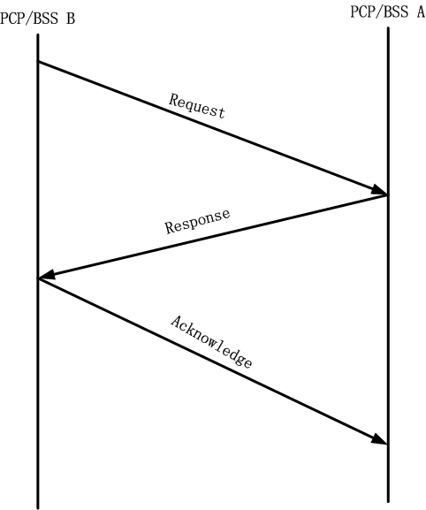
Implementation (1/4)
Building a time division multiplexing BSS
  Pre-PCP/AP B sends a request frame to an existing BSS.
  Requested PCP/AP A replies a time division multiplexing BSS response frame.
  Pre-PCP/AP B sends a time division multiplexing BSS acknowledge frame (Optional).
Notes:
The acknowledgement can be sent in its first BEACON of the new PCP/AP.

Slide 9
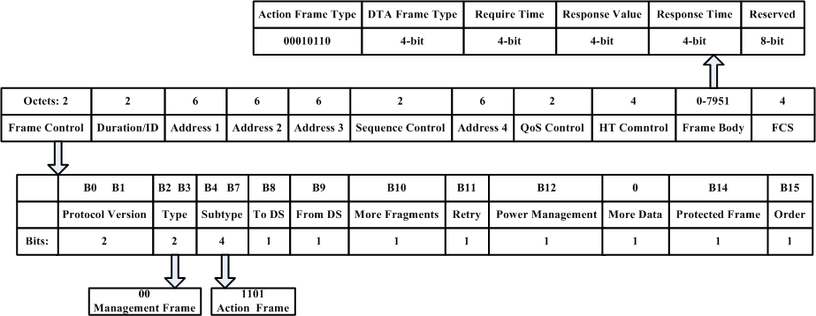
Implementation (2/4)
DTA Request/Response Frame Structure
Request/Response frame

Slide 10
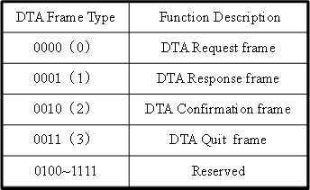
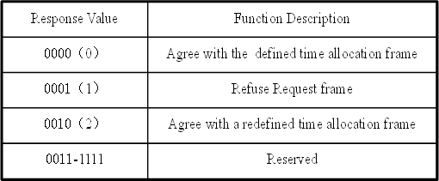
Implementation (3/4)
DTA Frame Type
Request/Response Time Value Field
Req/Resp Time | Description | Req/Resp Time | Description
0000(0) | First 1/8 BI | 1000(8) | Last 1/8 BI
0001(1) | First 1/4 BI | 1001(9) | Last 1/4 BI
0010(2) | First 1/2 BI | 1010(10) | Last 1/2 BI
0011~0111 | Reserved | 1011~1111 | Reserved
DTA Frame Type
Response Values Field

Slide 11
Implementation (4/4)
Building Time Division Multiplexing BSSs
  Assume that PCP/AP A agrees to build two time division multiplexing BSSs
  G denotes a Guard period (Optional), BI represents the common period beacon frame interval for two BSSs, BI A represents the time interval of BSS A, BI B represents the time interval of BSS B.
  BSS A and BSS B need to be synchronous. The synchronization can be done during the pre-association stage, and it can be provided by the 11ad PHY.
  The corresponding timeslot allocation can be noticed by Beacon frame.
Quit：Stop the time division multiplexing mechanism once one of the members quit the time division multiplexing mechanism.
  Active quitting action: One BSS actively sends a quitting request frame to other BSS.
  Passive quitting action: One BSS suddenly quits the time division multiplexing mechanism, then the other can actively stop the time division multiplexing mechanism after loss two or three continuing each other’s beacon frames.
Notes:
G: >70ns (20m); 200 samples of OFDM; Gb128
G can be omitted because no more than one Gb128 in STF is overlapped

Slide 12
Simulations Parameters
Simulation Scenario
  Adjacent BSS APs can intercept each other.
Assumptions
  STAs randomly distribute in the coverage range.
  BSSs have same coverage radius.
  User data saturation.
  Only one data type
Parameters
Parameter | Value
OFDM Symbol | 4 us
RTS | 28 us
CTS | 20 us
DIFS | 35 us
Slot Time | 9 us
Contention Window | CWmin=15,Wmax=1023
BSS Radius | 10 m
Parameter | Value
Overlapping Range (%) | 50, 60,75, 90
Number of STAs in each BSS | 10, 20, 40
Number of Data OFDM Symbols | [10-50], [10-100], [10-200]

Slide 13
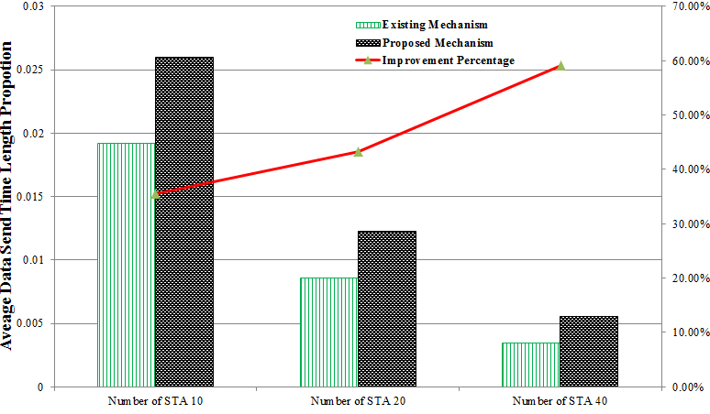
Simulation Results (1/3)
Overlapping 60%, Number of data OFDM symbols is in [10-100]
Numerical results show that the performance gain of the proposed scheme increases with the number of STAs.

Slide 14
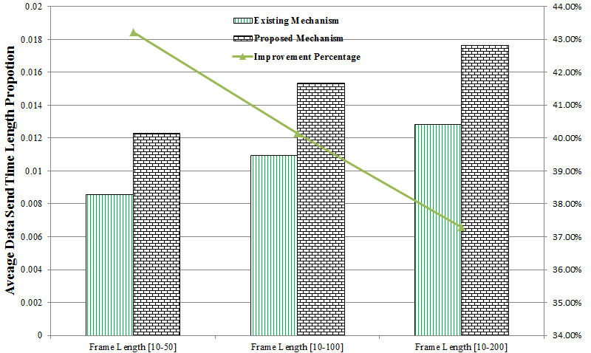
Simulation Results (2/3)
Overlapping 60%, Number of STAs in each BSS is 20
Numerical results show that the performance gain of the proposed scheme decreases with the length of frame.

Slide 15
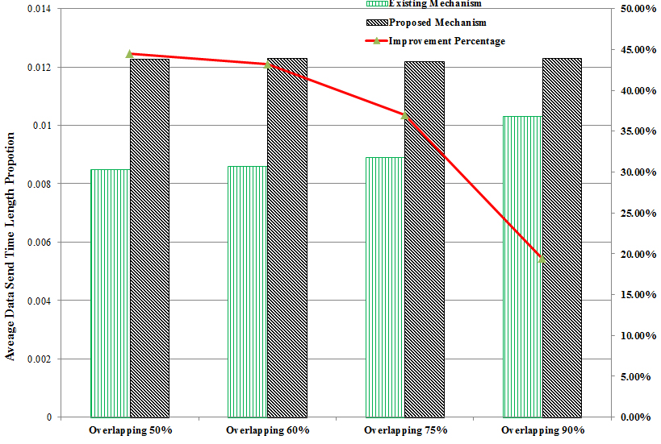
Simulation Results (3/3)
Number of STAs in each BSS is 20, Number of data OFDM symbols is in [10-100].
Numerical results show that the performance gain of the proposed scheme deceases with the expansion of the overlapping range.

Slide 16
Conclusion
A new Distributed Timeslot Allocation (DTA) mechanism is proposed based on the time-division multiplexing (TDM) method.
None of 802.11ad PHY is required to be modified, and a new DTA request/response frame structure is defined according to the existed management frame structure. Backward compatibility with 11ad is also maintained.
Using the DTA, more than two non-overlapped channels can be built even with only 2×2.16 GHz channels available at 60 GHz band in China.
Simulation results show that a considerable gain can be achieved using the DTA compared with the OBSS scenario.

Slide 17
Reference
[1] 11-13-0433-00-00aj-mac-protocol-to-support-dynamic-bandwidth-for-802-11aj-60ghz
[2] 11-13-0440-00-00aj-dynamic-channel-transfer-procedure-for-ieee-802-11aj-60ghz

Slide 18
Thank You!

Slide 19
Straw Poll #1
Do you approve to add the Distributed Timeslot Allocation (DTA) mechanism into the 802.11aj (60GHz) to build more than two non-overlapped channels even with 2×2.16 GHz channels available at 60 GHz frequency band in China?
  Yes:
  No:
  Abstain:

Slide 20
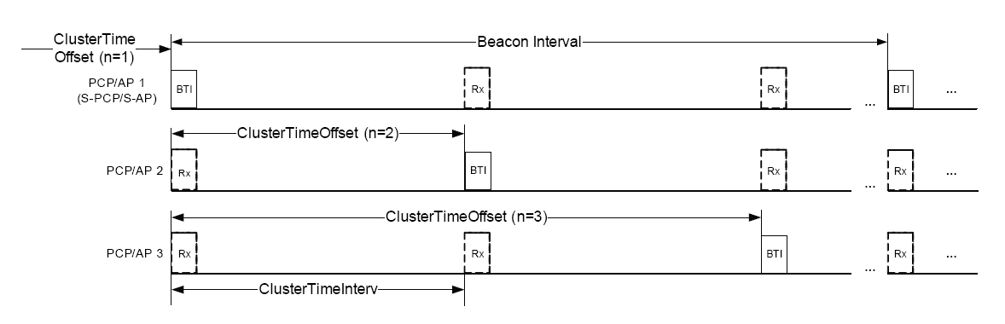
Q & A (1/2)
Question: What are the advantages of the propsoed DTA scheme compared to the clustering mechanism?
Answer: Compared to the clustering mechanism, the DTA scheme has the following advantages:
  Flexible time allocation durations between negotiators;
  Responder has the right to decide that how to divide the time allocation scheme between negotiators, or refuse to build the DTA.
  Interference may still exist between PCPs/APs in the overlapping region of Non-Beacon SP allocated to different PCP/AP clustering.

Slide 21
Q & A (2/2)
Question: A new PCP/AP that builds the DTA mechanism with one the existing DTA PCP/AP whether generates interference to the other user or not?
Answer: The new PCP/AP does not generate interference to the STAs which belong to the existing PCPs/APs that build the DTA mechanism.
Question: How to allocate the timeslot according to the network load?
Answer: The responder can allocate the timeslot according to its network load that in general the responder can estimate its own load based on its running environment.
Question: How to share the non-overlapping BI?
Answer: The shared SP mechanism between the non-overlapping BI can be achieved by sending a request frame with the neighbor PCP/AP information.

