Slide 1
Outdoor Stadium Simulation Details Discussion
Date: 2013-09-17
Authors:

Slide 2
Abstract
This contribution discusses some aspects of the HEW Stadium use case and proposes a physical description and modelling parameters.

Slide 3
Introduction
A outdoor stadium usage model for HEW was proposed in 11-13/0722r1 as well as in 11-13/0657r6. Based on our view of the 802.11 discussions of the importance of this use case – we chose it as the first use case to model.
Therefore in this document we attempt to get HEW agreement to further define this use case so that we can begin to do simulations for this use case.
Critical requirements of the 1a Stadium scenario (11-13/0657r6):
Open area with few obstacles and single/multiple operators’ deployed multiple APs. Most of the transmissions are LOS and the layout of APs are frequently changed.
High density of users and devices (0.5 devices/m²)
Inter-AP distance between 12 and 20 meters

Slide 4
Proposed Use Case Description (1 / 4)
Stadium blocks / AP placements:
12m x 12m block (instead of 10m x 10m from 11-13/0722r1)
Yields an AP-AP spacing of 12-13.4m (instead of 10-12m)
Locates all AP placements on the aisles
AP(m, n)
x = 12 x (m – 1)
y = 12 x (n – 1), for m odd
y = 12 x (n – 1) + 6, for m even
z = 3
m = 1 to 6 and n = 1 to 6 when m is odd, n = 1 to 5 when m is even

Slide 5
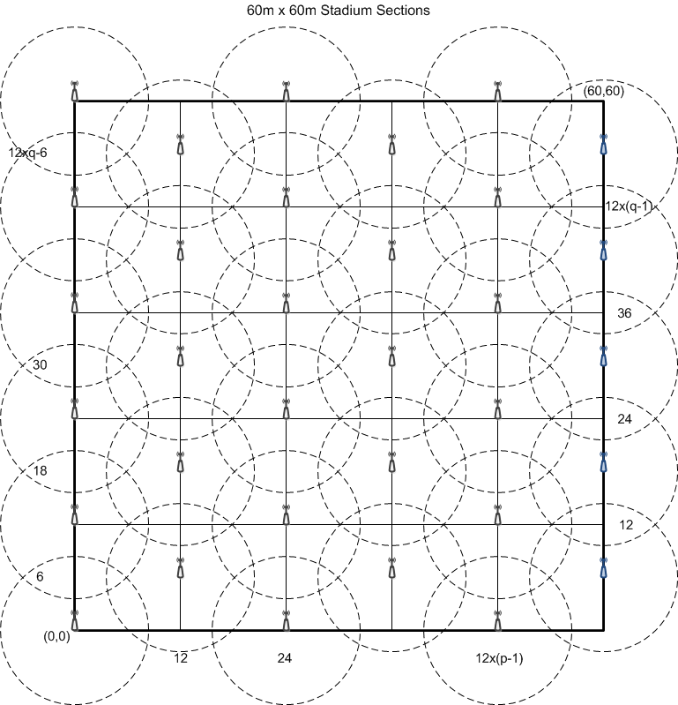
Proposed Use Case Description (2 / 4)

Slide 6
Proposed Use Case Description (3 / 4)
Block seating (72 STA per block, 0.5m row, and 1m and 1.5m block spacing's):
Block seating / STA placements
More realistic row spacing
11 rows of seats, 22 seats per row: 242 seats
0.5 STA/m² (72 STA / 144m²)
~ 30% STA to seat ratio
STA(m, n)
x = 0.5 x (m – 1) + 0.75
y = 1.0 x (n – 1) + 1.0
z = 0.5

Slide 7
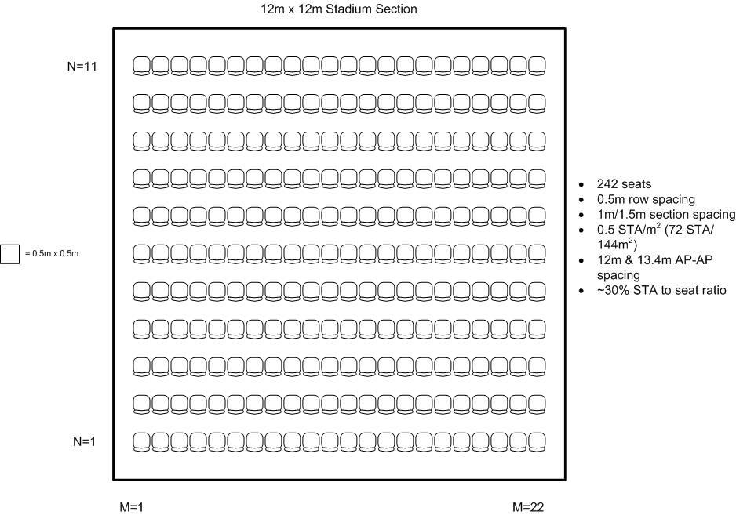
Proposed Use Case Description (4 / 4)

Slide 8
Summary
The proposed HEW outdoor stadium model variants offer better alignment to the 1a Stadium scenario in 11-13/0657r6, and more closely model current stadium configurations.
NOTE: In our view all of the parameters of this model should be agreed so that meaningful system simulations and performance evaluation of HEW techniques can be evaluated.

Slide 9
Model Details in Format of 11-13/1001r2

Slide 10
Model Details in Format of 11-13/1001r2 1 / 5
Topology (A)
Environment description | 1 Outdoor stadium Number of blocks or sections {25} 11 rows of seats, 22 seats per row: 242 seats: {0.5m / 1m / 1.5m seat spacing} Grid layout of blocks {5x5} Block size:{12m x 12m x 0.5m}
APs location | {1 per block, placed alone aisles between blocks at 1 to 3m height}
STAs location | {72 per AP, randomly located at fixed seating locations}
Channel Model | {Outdoor, ITU UMi or Winner II B1}
Penetration Losses | None

Slide 11
Model Details in Format of 11-13/1001r2 2 / 5
PHY parameters
BW: | [up to 80 MHz for 802.11ac, 20/40 MHz for 802.11n, 20/22 MHz for 802.11a/b/g]
MCS: | [BCC up to MCS X]
GI: | [long]
Data Preamble: | [11a/b/g/n/ac]
STA TX power | [19 dBm/Antenna]
AP TX Power | [17 dBm/Antenna]
AP #of TX antennas | {4}
AP #of RX antennas | {4}
STA #of TX antennas | {1,2}

Slide 12
Model Details in Format of 11-13/1001r2 3 / 5
MAC parameters
Access protocol parameters: | [EDCA with default EDCA Parameters set]
Primary channels | [Enterprise: Frequency reuse of N – dependent on GHz band and BW used – maximize non-overlapping BSSs]
Aggregation: | [A-MPDU / max aggregation size / BA window size, No A-MSDU, with immediate BA]
Max # of retries | [10]
RTS/CTS | [off]
Rate adaptation method | [genie, TBD in Evaluation Methodology]
Beacon interval | [100ms, TBD]
Beacon size | [TG dependent]
Probe request interval | [TBD, if active scanning is assumed]
Probe request size | [TBD, if active scanning is assumed]
Probe response size | [TBD, if active scanning is assumed]
Association | [Each STA associated with best AP – no roaming]

Slide 13
Model Details in Format of 11-13/1001r2 4 / 5
Traffic model (Per STA)
# | Source/Sink | Name | Transport Protocol | Average rate [Mbps] | MSDU size [B] | Max. Delay [ms] | Max. PLR | PKT arrival distribution | AC
Downlink
D1 | AP ➔ 10% STA | Office worker: email, web browsing, file transfer | UDP, TCP | 0.1 - 10 | 1500
D2 | AP ⬅➔ 40% STA | Social media user: file transfer | TCP | 10 - 1000 | 1000
D3 | AP ➔ 20% STA | Video viewer: Video streaming | UDP | 0.1 - 4 | 512 | 200 | 10e-4
Uplink
U1 | AP ⬅ 30% STA | Music sharer: file transfer, web browsing | TCP | 0.1 - 10 | 350 - 1500 | 200 | 10e-4
U2 | AP ⬅ 10% STA | Office worker: email, web browsing, file transfer | UDP, TCP | 0.1 - 10 | 300 - 1500

Slide 14
Model Details in Format of 11-13/1001r2 5 / 5
P2P
P1 | STA1/AP
P2 | STA2/AP
P3 | STA3/AP
… | …
PN | STAN/AP
Idle Management
M1 | AP1 | Beacons |  |  | X Bytes |  |  | 1/Xms
M2 | STA2 | Probe Req. |  |  | X Bytes |  |  | 1/Xs
M3 | STA3
… | …
MN | STAN

Slide 15
References
[1] IEEE 802.11-13/0657r6, “Usage models for IEEE 802.11 High Efficiency WLAN study group (HEW SG) – Liaison with WFA,” Laurent Cariou
[2] IEEE 802.11-13/0722r1, “HEW Evaluation Methodology”, Minyong Park
[3] IEEE, 802. 11-13/1000r2, “Simulation Scenarios”, Simone Merlin, et. al.
[4] IEEE 802. 11-13/1001r2, “HEW SG Simulation Scenarios”, Simone Merlin, et. al.

