Slide 1
Understanding Current Situation of Public Wi-Fi Usage
- Possible Requirements for HEW -
Date: 2013-05-12
Authors:

Slide 2
Introduction
Problem Stating
  So many public Wi-Fi spots have been deployed in Japan. However, they have not been used so much as we expected. Why??
Understanding Current Situation
  Throughput measurement and frame monitoring were executed at a train station as an example of current public Wi-Fi usage.
Proposing Possible Requirements
  Possible requirements are proposed from observed results.

Slide 3
Background
KDDI has deployed over 200,000 APs in public areas nationwide. (As of Sep. 2012)
However, the public Wi-Fi service has not been used so much from mobile devices as we expected.
The reasons include customers’ unsatisfaction with its data throughput at some places or sometimes.
→ It makes customers to switch Wi-Fi function off on their Smartphones.

Slide 4
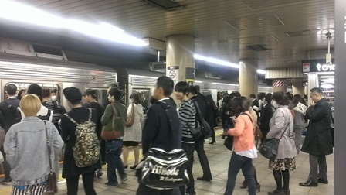
Understanding Current Situation
(Real Example)
Throughput measurement and frame monitoring were executed:
At Shibuya station of Tokyo Metro (under ground)
During 19:00-20:00 on April 15 (MON), 2013

Slide 5
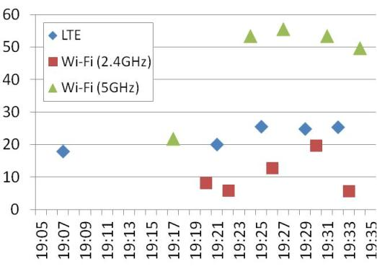
Real Example (1)
Download throughput
Measured by Android 4.1 device.
Throughput (Mbps)
Wi-Fi (2.4GHz) is slower than LTE.
Why is 2.4GHz slower??

Slide 6
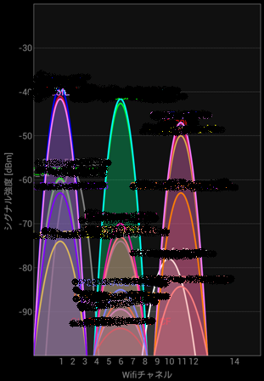
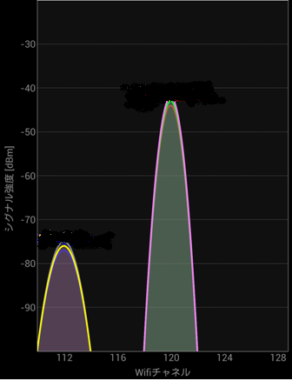
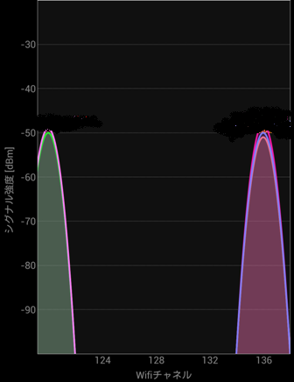
Real Example (2)
Channel usages
CH1
2.4GHz
5GHz lower band
5GHz higher band
CH120
No APs existed.
Frames monitored on CH1 and Ch120 (Slide 7)
By Wifi Analyzer (Android App.)

Slide 7
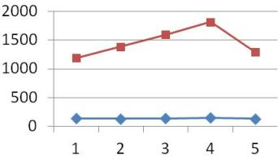
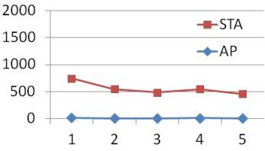
Real Example (2)
Number of APs and STAs
Number of APs and STAs was counted from “Source Addresses” in MAC header of observed frames.
Number of APs was assumed from observed source addresses of Beacon frames.
<CH1>
<CH120>
(min)
(min)
min. | 1 | 2 | 3 | 4 | 5 | Ave.
STA | 1190 | 1387 | 1597 | 1815 | 1293 | 1456
AP | 140 | 134 | 141 | 150 | 137 | 140
min. | 1 | 2 | 3 | 4 | 5 | Ave.
STA | 745 | 579 | 482 | 548 | 458 | 562
AP | 16 | 7 | 7 | 9 | 8 | 9

Slide 8
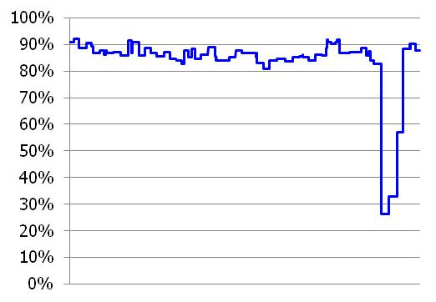
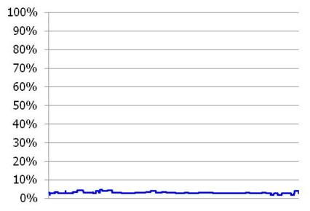
Real Example (3)
Channel Utilization
“Channel Utilization” contained in “BSS Load IE” of Beacon/Probe Response frames with a specific BSSID.
<CH1>
<CH120>
0
5 min
0
5 min

Slide 9
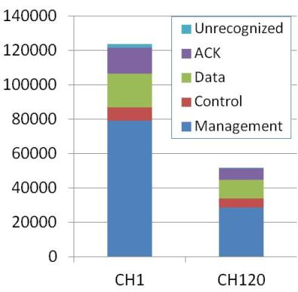
Real Example (4)
Frame type profile
No. of fames per CH
Frame type | CH1 | CH120
Unrecognized | 2143 (2%) | 510 (1%)
ACK | 14996 (12%) | 6720 (13%)
Data | 19790 (16%) | 10754 (21%)
Control | 7522 (6%) | 5178 (10%)
Management | 79144 (64%) | 28587 (55%)
Total | 123595 (100%) | 51749 (100%)
Retry frames | 34.4% | 21.8%
(Frames)
Frame capturing and throughput measurement weren’t executed simultaneously.
During 5 minutes.

Slide 10
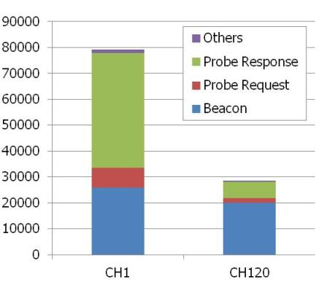
Real Example (4)
Breakdown of Management frames
On CH1, the majority is Probe Response.
<CH1>
Frame type | Qtty. | %
Others | 1,314 | 2%
P. Response | 44,355 | 56%
P. Request | 7,698 | 10%
Beacon | 25,878 | 33%
(Frames)
<CH120>
Frame type | Qtty. | %
Others | 527 | 2%
P. Response | 6,298 | 22%
P. Request | 1,776 | 6%
Beacon | 19,966 | 70%

Slide 11
Observed results
Comparing with 5GHz band, 2.4GHz band has:
  Lower throughput
  More APs/STAs existing on the same channel
  Higher channel utilization
  More Management frames
    11ai will reduce frames for AP discovery and link setup.
  More retry frames

Slide 12
Considerations
In the market, the number of devices supporting 2.4GHz only is still larger than that of devices supporting 5GHz.
  →One of the reasons of lower throughput is large number of devices existing.
  →5GHz band will also be congested in the future as 5GHz supported devices become more popular.
More frame conflicts and losses happen in 2.4GHz band because of channel overlapping with neighboring channels.
  →Even in 5GHz band, existence of hidden terminals may cause frame conflicts and losses.
Some of the solutions for HEW will be derived from solutions for mitigating issues of 2.4GHz band.

Slide 13
Possible requirements for HEW
The following requirements are proposed for HEW:
  Enhanced access control for assuring tolerable bandwidth
  Mitigation method for frame conflicts and losses
→ They might require not only PHY layer improvement but MAC layer improvement.
We hope that the new standard maximize performance and value of Wi-Fi by including requirements.

Slide 14
Backup Slides
Actions for making Wi-Fi use easier and more convenient taken by KDDI are introduced as following slides about:
  APs rolled out with 5GHz channels support
  High Wi-Fi usage at home
  Connection Manager App.
  Connect/Disconnect control
  EAP authentication
  R&D activity

Slide 15




KDDI's approaches for growing wireless data demand
Home AP
Indoor Wi-Fi router at Home for KDDI Smartphone Users.
More than 1.2M installed. (As of Sep. 2012)
- IEEE802.16e-based Mobile WiMAX
- 94% POPS as of Nov. 2012
- Operated by UQ communications
Stimulating Fixed-NW usage
Public Wi-Fi spot
- Public Wi-Fi AP for KDDI Smartphone Users
- CATV & FTTH bundle service
- Smart TV Box Android-based STB
200,000 spots
As of Sep. 2012

Slide 16
Faster and Stabler Wi-Fi
- All LTE Handset Models are equipped with 5GHz Wi-Fi
- 5GHz Wi-Fi APs are rolled out nationwide.
More than 1.2M KDDI Home APs at Home.
More than 0.2M KDDI Wi-Fi Spots in Public Areas.*
(as of Sep. 2012)
 | Bandwidth | Congestion/ Interference | Speed
2.4GHz | Normally 20MHz | Congested depending on locations | High
5GHz | Typically 40MHz | Less Congested | Very High
* Some are not 5GHz compatible.

Slide 17
High Wi-Fi Usage at Home
KDDI Home AP
KDDI Home AP Usage Status
More than 1.2M installed
Among Home AP Users, some 66% of data migrated to Wi-Fi at around 11pm (peak hour in residential area)
This high usage rate was achieved by providing KDDI “Connection Manager App.”
Among Home AP users, some 66% of
data migrated to Wi-Fi at around 11PM
66%
Wi-Fi
KDDI Home AP

Slide 18
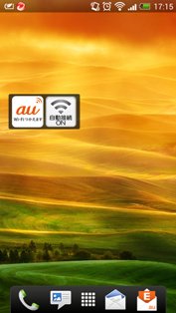
“Connection Manager App.”
KDDI is providing Android App. for Wi-Fi easier start-up.
  Pre-installed
  Easy Home AP setup
- For public Wi-Fi usage:
  No user setup for KDDI’s public Wi-Fi
  No user operation
  Automatic connection control (next Slide)

Slide 19

Connect/Disconnect Control
“Connection Manager App.” controls timing of association and disconnection in order to avoid communication problem at Wi-Fi fringe area.
Cellular BS
Fringe area
OK!!
??
w
AP
w/o
Connect with cellular
weak signal
Keep Wi-Fi,
difficult to communicate
w
: with CM App.
w/o
: without CM App.

Slide 20
EAP Authentication
EAP-AKA + 802.1x have been implemented for user authentication
  For all LTE Android handsets.
  This USIM card based user authentication is completed during link setup. So interruption time of user data communication is very short.
  Previously, HTTP based user authentication was used for CDMA-only handsets. Interruption of user data communications is needed during this process. It requires some seconds to wait for.

Slide 21
R&D Activity
- Link Aggregation
is a function which communicates on Cellular and Wi-Fi link simultaneously. It may make Wi-Fi connectivity problems invisible. Because cellular communication will be maintained at that time period.

