Slide 1
HEW- Metrics, Targets, Simulation Scenarios
Date: 2013-05-13
Authors:

Slide 2
Outline
In [1] we proposed a new study group with focus on WLAN improved efficiency. We reviewed previous gains made since 11a, proposed a new metric of interest and proposed the general scenarios of interest based on previous contributions [2]-[7].
In this contribution we provide more details towards defining a more concrete set of metrics, simulation tools and scenarios of interest.

Slide 3
Recap [1]: Metric of Interest - Driving Area Throughput Higher
Several parameters impact throughput in a given area
As discussed in [1], we propose to focus this group on improving the second and third terms, namely improving BSS efficiency in the presence of high number of STA and high OBSS density
Note however that simply serving only the highest SNR STA can increase the value of this metric but the goal should be to increase this metric given a constraint that cell edge STA performance is also improved.
Hence, the type of channel access (MAC) should be specified along with gains in cell edge (5% of Tput CDF), cell center (50% of Tput CDF) and total aggregate Tput

Slide 4
Simulations Methodology
Typically PHY PER simulations are used to verify point to point performance
In 11ac, MU-MIMO simulations used PHY abstraction to derive point to multi-point aggregate Tput.
11ac also saw few system simulations [8][9] carried out in order to determine system-wise parameters such as CCA levels and the impact of the spectral mask on adjacent channel performance
11n on the other hand side did use more extensively system simulations
We think that similarly to 11n the importance of system simulations should be high in HEW since these are the tools required to examine the impact of various techniques on throughput in the face of intra-BSS and inter-BSS interference.
A note on system simulations: both [8] and [9] used PHY system simulations along with MAC system simulations to determine system-wise performance:
MAC system simulations better capture the protocol aspects but can become prohibitively complex and lengthy if PHY abstraction is used to capture all PHY aspects (a lesson learned from 11n).
PHY system simulations can more accurately capture PHY performance with actual fast fading, MIMO configuration, interference and specific receivers.
Both PHY/MAC system simulations should specify a realistic link adaptation (MCS, MIMO mode etc..)
→ usage of PHY PER point to point simulations should be augmented by PHY/MAC system simulation as needed (depending on the specific technique proposed and scenario)
MAC system simulations should be required to validate final results
In the following slides we provide some examples of PHY/MAC system simulation

Slide 5
Example 1 from [8] – PHY System Simulation
General Description:
N APs and M STA per AP are dropped in an area of size SxS ft (numbers shown in plots)
APs are placed regularly with 5ft std (results with 15ft are similar)
STAs are associated with the closest AP according to path loss (including random shadowing)
One valid transmission per BSS is assumed
BSSs are chosen randomly that meet CCA rules (50% probability to choose an AP as a transmitter)
After all transmitters were chosen, SINR is calculated at each receiver and mapped to MCS
SISO links over one 40MHz channel are assumed with 15dBm transmit power
CCA levels are varied from -90dBm to -50dBm (-90dBm just above noise floor for 40MHz)
Simulation uses 50 drops and 250 TXOP per drop
All plots show average and five percentile per-link throughput (Tput) , average and five percentile sum Tput in TXOP, and the number of concurrent transmissions

Slide 6
Cont.
This example shows the impact of CCA levels of secondary channels on total throughput and cell edge throughput and the interaction between those metrics
The challenge in HEW is to
improve both

Slide 7
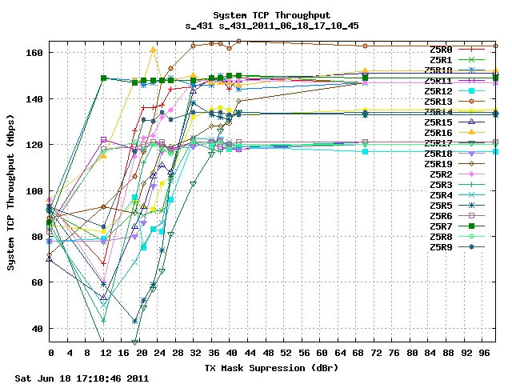
Example 2 from [9] – MAC System Simulation
Impact of mask on adjacent channel performance studied
1 floor, 2 BSS
Semi-rigid AP locations with random variance
2 adjacent channels
Varying TX Mask shoulders
Randomized placements
Randomized up and down pair flows
3:1 ratio DOWN to UP,
randomly assigned
One flow per client
Typical AP separation = 15 m

Slide 8
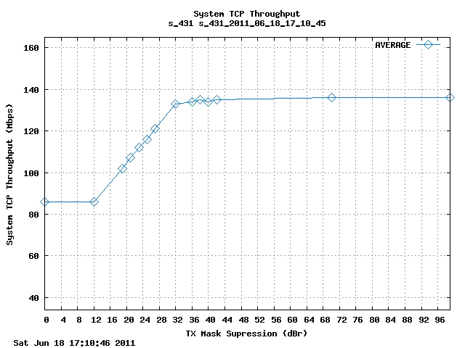
Cont.
System TCP throughput as a function of Tx mask with multiple drops averaged

Slide 9
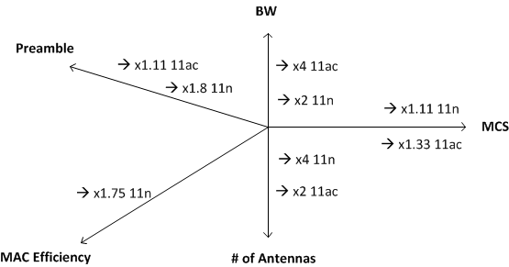
Target Gains
Recall from [1] that a factor of 10 was achieved in both 11ac and 11n using BW and antenna increases.
Similarly we expect a substantial multiplicative increase in HEW using the new metrics as defined in slide 3 and in the scenarios as defined in the following pages.

Slide 10
Simulation Scenarios
Based on [6][7] we propose to define several simulation scenarios each of which focuses on different deployment such that together they cover all use cases
Analyzing [6][7] we see two main use cases leading to 3-4 simulation scenarios
Outdoor Pico deployment – Pico density is not high but can overlap with indoor WiFi (shopping center or neighborhood metro WiFi).
Indoor /Outdoor dense deployments such as in dense urban apartments, stadiums, airports and enterprise environments
This category leads to two subcategories depending on whether the deployment is planned or unplanned
Further details are provided in the following slides for each specific scenario. Some common parameters for all scenarios are:
Antenna configuration – baseline: 2 antenna at AP, 1 at STA . Advanced: 4 antenna at AP 2 at STA. 0dB antenna gain.
SU/MU configurations
Reuse factor – HEW enhancements that enable reuse factor =1 are preferable. Reuse factor =3 or higher values are realistic especially at 5GHz and should be simulated [11].
Full buffer traffic is baseline. FTP model as in 3GPP can be used to test more realistic traffic assumptions and to also test varying levels of interference

Slide 11
Outdoor Pico – Operator Planned Deployment
Hotspot Pico deployments that cover an area (airport terminal, shopping center, park, neighborhood) with typical inter site distance (ISD) 100-200m based on [7] slides 15 and 16
AP location on a regular grid with std (e.g. 20% of ISD)
AP power up to 30dBm (per regulatory limitations in both 2.4GHz and 5GHz). STA power 15dBm (current smartphone Tx power)
Several 10s of users in BSS. Number of AP varies depending on the assumed frequency re-use
All users are assumed outdoors
Channel and path loss models - ITU Urban Micro LOS/NLOS [7] as defined in ITU-R M.2135-1 [10]
ITU channels used for 4G cellular evaluation
This channel is used by LTE in 36.872 (small cell enhancements in R12)
Note: the SCM model used in 11ah is older, applicable up to 5MHz BW and hence not suitable for HEW. ITU Urban Micro (fast fading LOS/NLOS models and path loss) should replace it in the channel model document.
Mobility – the PHY should work at 30kmph
Similar to 36.932 (scenarios and requirement for small cell enhancements)

Slide 12
Dense Deployment
Two variants should be simulated:
Planned deployment:
This scenario is similar to the previous outdoor except that the AP density is much higher with ISD=15-30m based on [7] slide 17
The same system simulation may be used with parameters change
AP location on a regular grid with std (e.g. 20% of ISD)
AP and STA power variable
Several 10s of users in BSS. About 50 AP in 2-3 floors.
Channel model 11nD for indoor deployment
Unplanned deployment
This scenario is designed to emulate high density apartments where AP (or multiple APs) location is random within each apartment. Hence inter AP distance is random which may result in more difficult OBSS scenarios
The rest of the assumptions are as in the planned deployment.

Slide 13
Outdoor plus Indoor
This scenario is a combination of the previous two scenarios and is similar to 11ah in the sense that it is designed to test interference from large cells to/from small cells as is bound to happen in practical WiFi deployments where outdoor coverage encompasses several indoor WiFi AP.
However unlike 11ah, large cells here are not as large (Pico vs. Macro) but are expected to drive high traffic
The set up includes ‘two layers’ of nodes (outdoor and indoor) each dropped with density, channel and path loss as described in the previous two scenarios respectively.
A mix of indoor and outdoor users. Outdoor users associate to outdoor hotspot or indoor WiFi (if close to it). Indoor users associate to indoor WiFi.
X% of users dropped within Y[m] of indoor WiFi, out of which 80% are indoor and 20% outdoor. All those users associate with indoor WiFi
(100-X)% of users dropped randomly throughout the area, assumed to be outdoor and associate with outdoor Pico.
Penetration loss (outdoor to indoor) – 15-20dB @ 2.4, 25-30dB @ 5GHz

Slide 14
Summary
We define three metrics of interest namely cell edge, cell center and aggregate Tput
We propose to include PHY and MAC system simulations as tools to assess the gains of those metrics
We propose a set of simulation scenarios to capture all potential use cases
Through using a combination of techniques, target gain for HEW in all defined scenarios should be substantial and should be verified by MAC system simulations.

Slide 15
References
[1] 11-13-0309-00-0wng-next-gen-wlan
[2] 11-13-0098-00-0wng-802-11-looking-ahead-to-the-future-part-ii
[3] 11-12-1063-00-0wng-requirements-on-wlan-celllular-offload
[4] 11-12-1126-00-0wng-wifi-for-hotspot-deployments-and-cellular-offload
[5] 11-13-0113-00-0wng-applications-and-requirements-for-next-generation-wlan
[6] 11-13-0313-00-0wng-usage-models-for-next-generation-wi-fi
[7] 11-13-0331-05-0wng-high-efficiency-wlan
[8] 11-11-0061-00-00ac-cca_threshold_levels
[9] 11-11-0668-07-00ac-tx-mask-shoulders-vis-a-vis-aci
[10] http://www.itu.int/dms_pub/itu-r/opb/rep/R-REP-M.2135-1-2009-PDF-E.pdf
[11] http://arstechnica.com/information-technology/2013/03/the-49ers-plan-to-build-the-greatest-stadium-wi-fi-network-of-all-time/

