Slide 1
Experimental test report of FILS
Date: 2013-03-18
Authors:

Slide 2
Abstract
The presentation report the result of field experimental trial of a FILS prototype.
The implemented prototype is not equal to the current TGai spec (D0.4).
The purpose of this trial is to confirm the prospected performance of reduced AKM.

Slide 3
Over View of field experimental trial
Field and Date
Kyoto University, 22nd Feb 2013
AP Setup
IEEE802.11g ch13 commercial AP
STA Setup
Android 2.3 tablet device

Slide 4
Implemented Protocol
STA
WPA2
AP
AS
DHCP
STA
FILS
AP
AS
DHCP
Beacon
Beacon
Probe
Probe
Authentication
Association
FILS
EAP
(PEAP/MSCHAPv2)
AS is collocated on AP
WPA2:DHCP server is connected by Ethernet.
FILS: IP address pool is collocated on AP.
EAPOL Key
DHCP

Slide 5
Implementation of FILS Prototype
No any change of scanning mechanism
WPA2 and FIlS Prototype are implemented on the same AP
No any change of hardware
Modified firmware on AP
Modify dhcpd and WPA_supplicant on STA
STA
AP
ANonce
ANonce, SNonce, NAI, MIC
144 octets
ANonce, IPv4 (addr, mask, gateway, DNS), GTK, MIC
147 octets

Slide 6
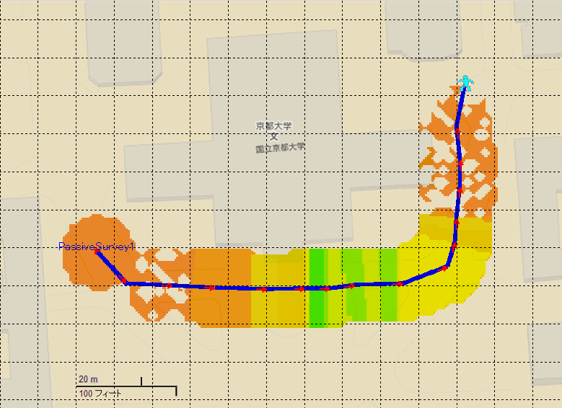
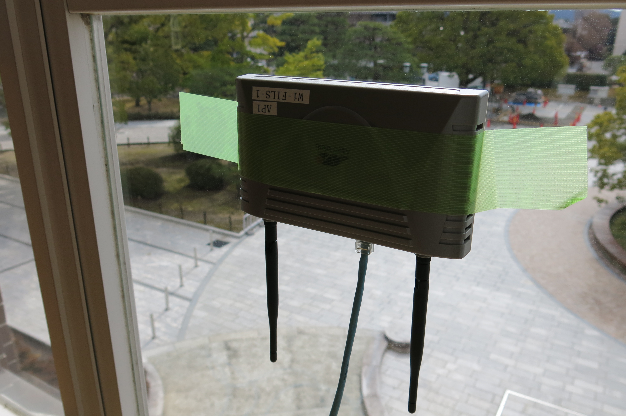
Environment AP1
One AP was installed on window side of 2nd floor.
-90m
+60m
AP
-60m
-30m
0m
+30m

Slide 7
Test Scenario 1
A pair of FILS and WPA2 are entering the service area.
Measured the distance of STA and AP where STA establish link successfully and received http contents.
Measured the time from Association/FILS request to IP address assignment by propriety application.
Established Link Point
FILS
非接続
歩きながら移動
非接続
WPA2
Service Area

Slide 8
Result of test scenario 1 (Distance)
Working Direction
*WPA2 No3 did not establish the link.

Slide 9
Result of test scenario 1 (Time)
*WPA2 No3 did not establish the link.

Slide 10
Result summary of test scenario 1
All FILS STA established link before arriving at in the front of AP.
All WPA2 established link since they passed in the front of AP.
Average link established time between FILS request to IP address assignment is 1.224 Sec.
Average link established time between Association request to IP address assignment is 9.827Sec

Slide 11
Test Scenario 2
20 FILS and 20 WPA2 are entering the service area continuously.
Measured the distance of STA and AP where STA establish link successfully and received http contents.
Measured the time from Association/FILS request to IP address assignment propriety application.
Established Link Point
FILS
非接続
歩きながら移動
非接続
WPA2
Service Area

Slide 12
Result of test scenario 2 (Distance)
Working Direction

Slide 13
Result of test scenario 2 (Time)

Slide 14
Result summary of test scenario 2
90% (18/20) FILS STA established link before arriving at in the front of AP.
85% (17/20) WPA2 established link since they passed in the front of AP.
Average link established time between FILS request to IP address assignment is 0.742Sec.
Average link established time between Association request to IP address assignment is 21.599Sec

Slide 15
Test Scenario 3
41 FILS are entering the service area continuously.
Measured the distance of STA and AP where STA establish link successfully and received http contents.
Measured the time from FILS request to IP address assignment.
Established Link Point
FILS
非接続
歩きながら移動
Service Area

Slide 16
Result of test scenario 3 (Distance)
Working Direction

Slide 17
Result of test scenario 3 (Time)

Slide 18
Result summary of test scenario 3
80% (33/41) FILS STA established link before arriving at in the front of AP.
Average link established time between FILS request to IP address assignment is 0.78Sec.

Slide 19
Scenario 2
Blue bibs : FILS vs White bits:WPA2
The 0 sign marker was located around 30m from AP
1.5m/Sec = 5.5km/h working speed

Slide 20
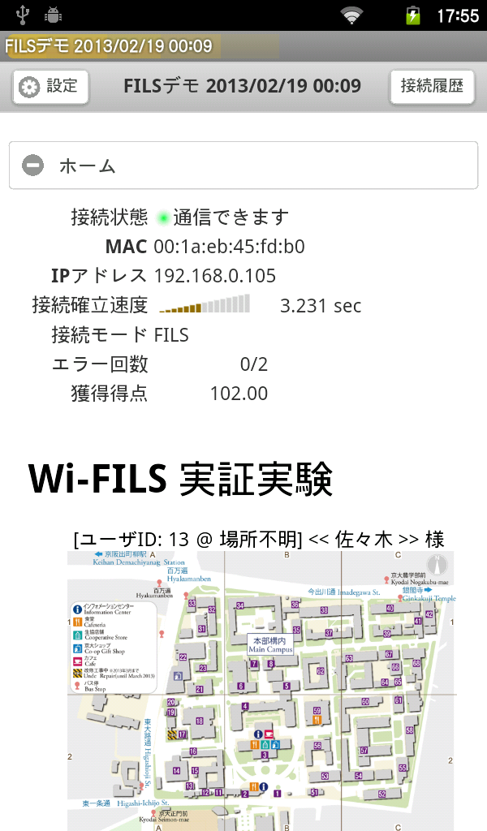
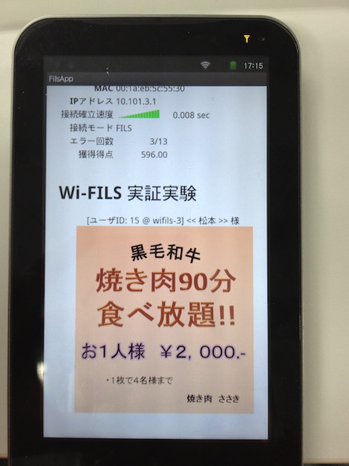
Test Scenario 4
20 FILS and 20 WPA2 are entering the service areas continuously.
STA download contents related to the linked AP automatically.
Measured the number of downloaded content.
STA will download two different contents (109KB Gif image ) if STA connected to two AP in turn definitely.
AP1
A2
Down load content1
Down load content2
FILS
非接続
歩きながら移動
非接続
WPA2

Slide 21
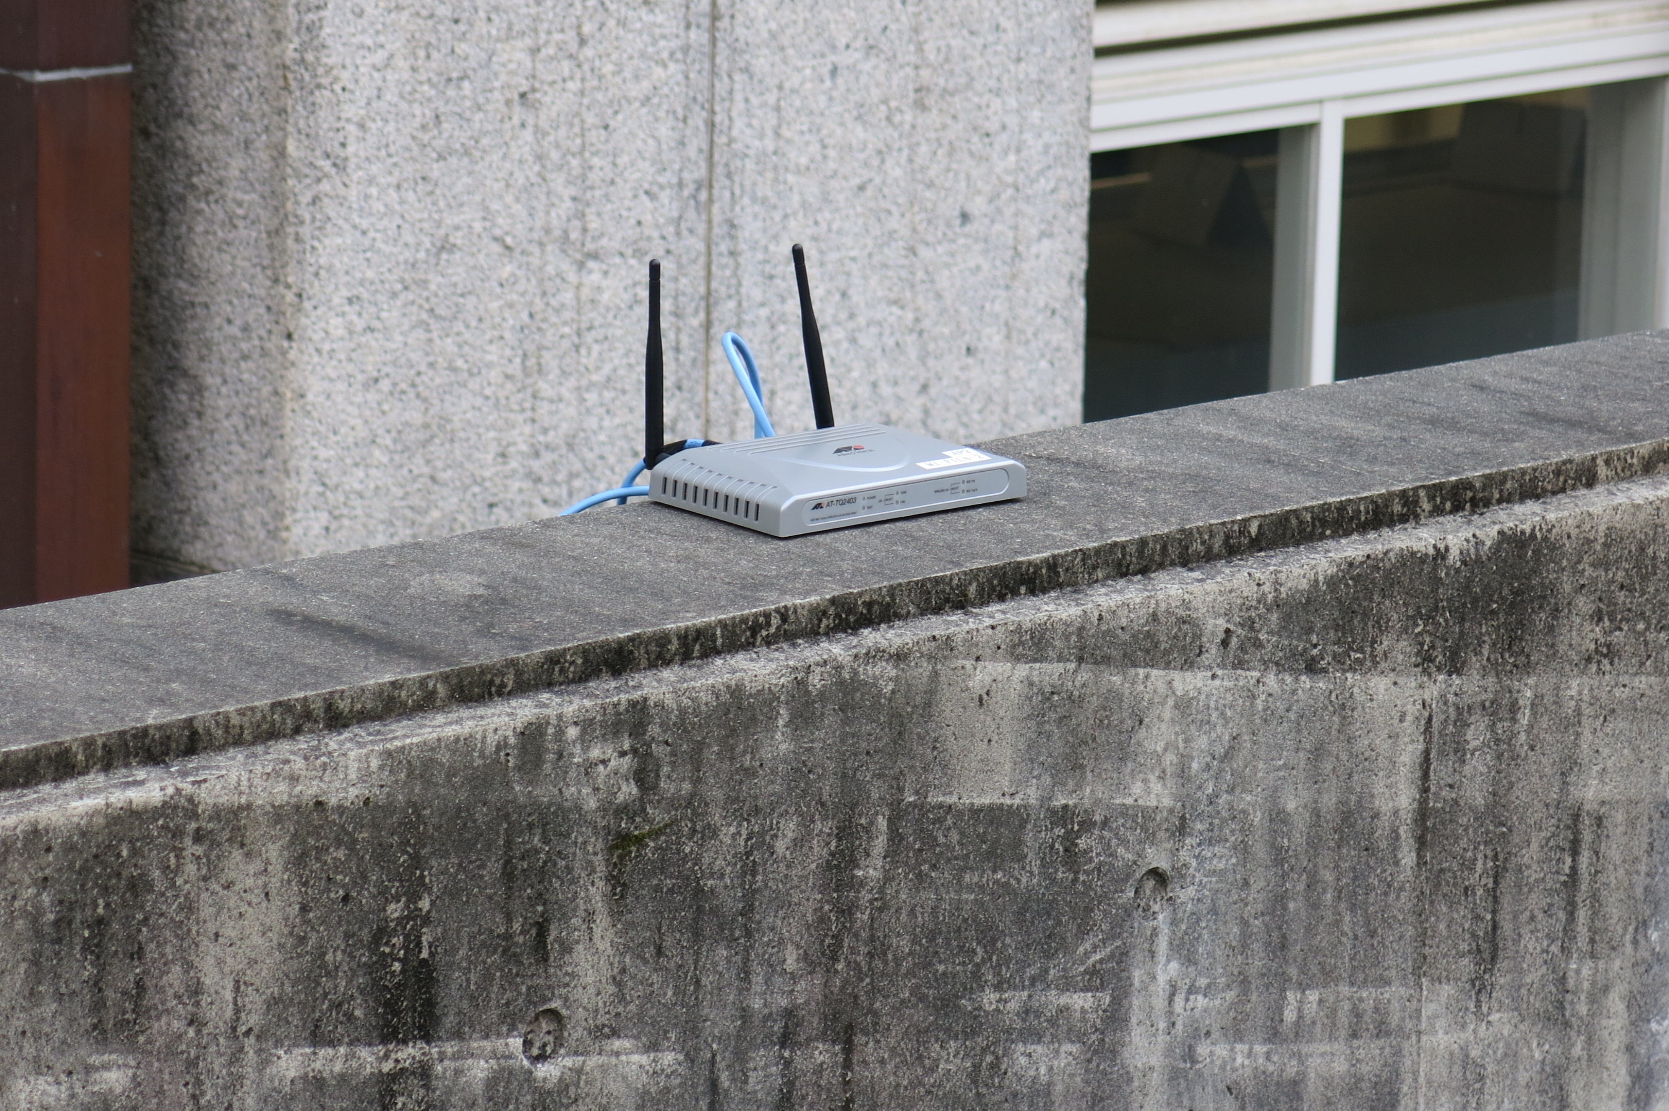
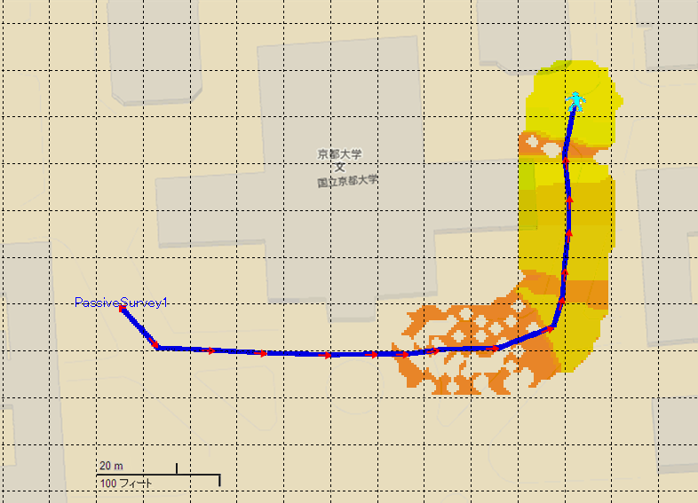
AP2
AP2
Another AP(AP2) was located on the opposite of building.
The coverage of AP1 and AP2 are not over wrapped each other.
-90m
+60m
AP1
-60m
-30m
0m
+30m

Slide 22
Result summary of test scenario 4
95% (19/20) of FILS STAs downloaded two different contents correctly.
1 error caused by application error.
50% (10/20) of WPA STAs could not download any content.

Slide 23
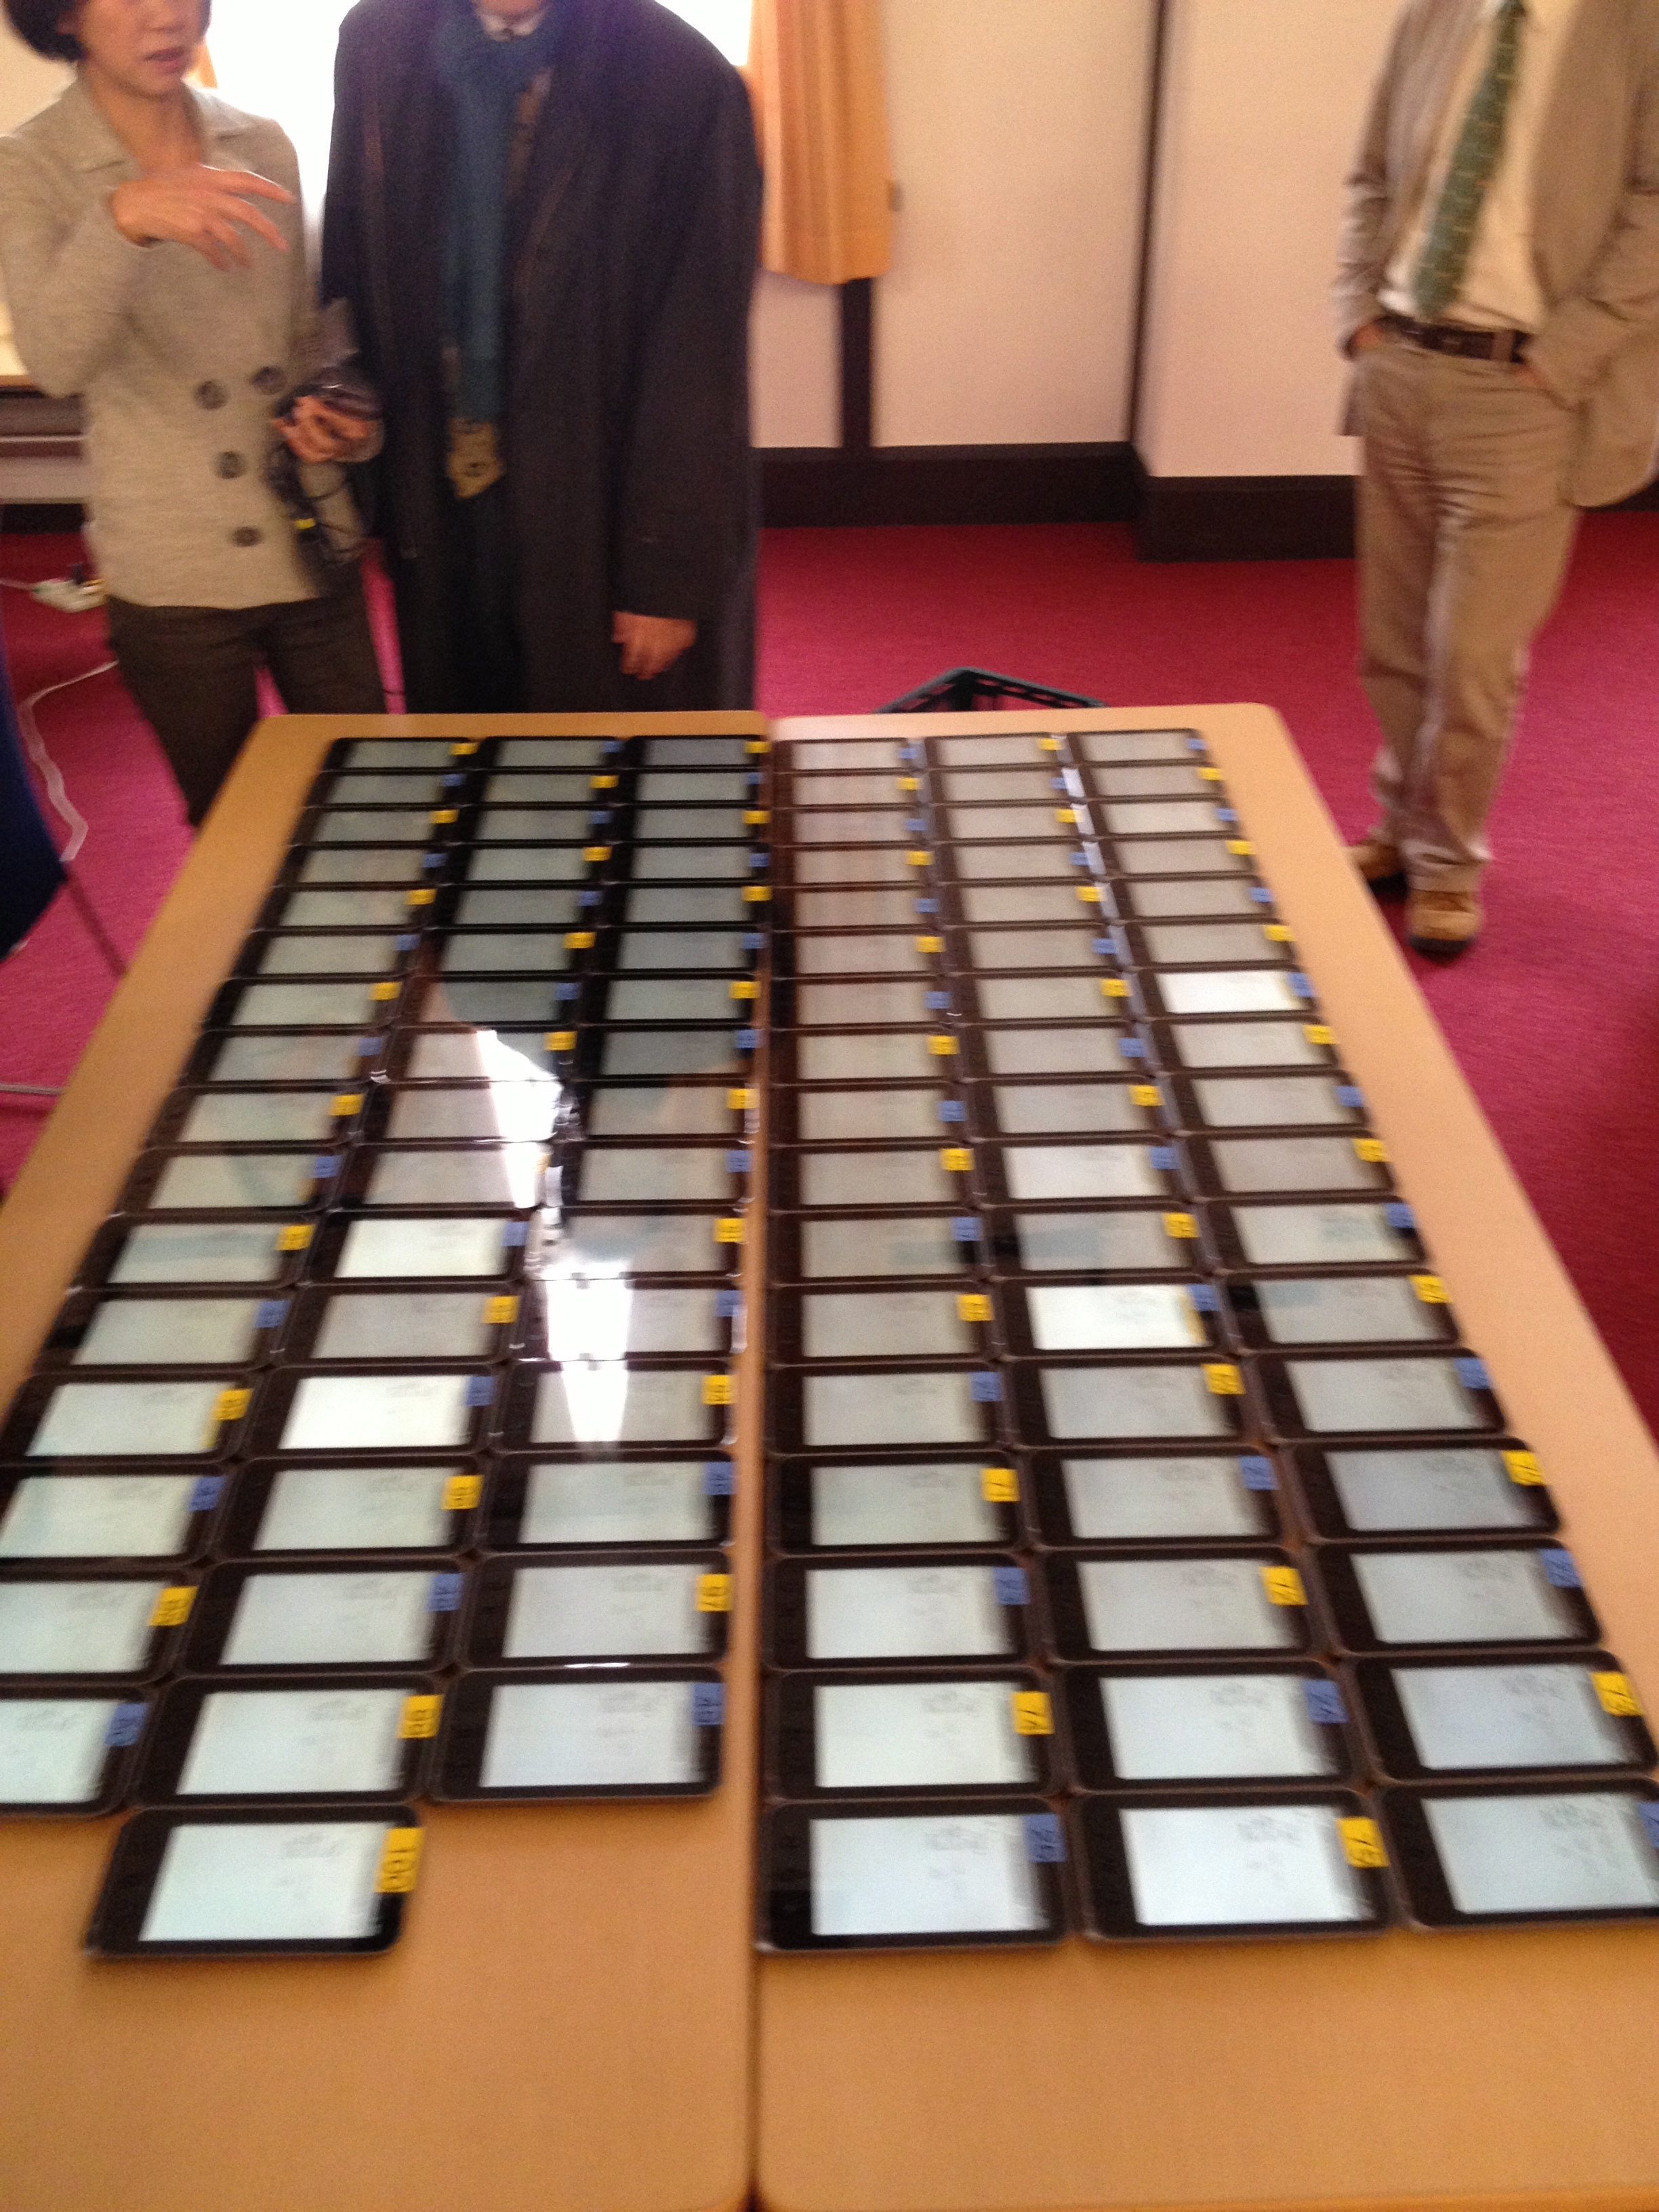
Test scenario 5
50 FILS and 50 WPA2 are setting on table.
One AP was implemented in the same room.
Activate AP.
Measured the time from Association/FILS request to IP address assignment.

Slide 24
Result of test scenario 5
Average of established Link time at FILS 0.685 Sec
Average of established Link time at WPA2 15.880 Sec

Slide 25
Captured data
WPA2
Auth Req ->DHCPACK 5.055 Sec
include 5times retry of dhcp offer
FILS
Assoc Req -> Assoc Resp
0.0011 Sec

Slide 26
Conclusion
FILS STAs completed the association process in significantly less time than WPA STAs.
→ More time within the coverage area of an AP to use for (user) data exchange
The large number of frame exchanges for WPA2 STAs (as compared to FILS STAs) made them vulnerable for fading when entering the AP‘s coverage
If retransmission of a lost frame did not succeed after three attempts, the association process had to restart from the beginning
Further performance increase expected once advanced FILS Discovery schemes are employed

Slide 27
Detail of implementation

Slide 28
Assumption
AP and STA have pre-shared user-ID(NAI)/PSK pair.
In this implementation for demonstration,
GTK is not encrypted.
No PTK update.
Higher Layer Information is not encrypted.

Slide 29
STA State Machine
Scan
Receive Deauth
Run
Receive Deauth
Send Assoc Req
Association
Receive Assoc Resp

Slide 30
Protocol Sequence
STA
AP
Beacon
Scan
(Probe Req/Resp)
Association Req/Resp
Association
CCMP
Run

Slide 31
Functions
In this implementation, FILS supports
Mutual authentication
PTK/GTK setup
IPv4 setup
STA IP address/netmask
Gateway IP address/MAC address
DNS server IP address

Slide 32
Capability sub-IE
1octet
1octet
1octet
Element ID: 1
Length: 1
Capability
bit | capability
0 | Higher Layer Info Encryption (ignored)
1 | IPv4
2 | IPv6
3-7 | reserved (0)

Slide 33
IPv4 config sub-IE
1octet
1octet
Element ID: 41
Length: Variable
IPv4 addr for STA
4octet
netmask
4octet
gateway
4octet
DNS server 1
4octet
DNS server N
4octet

Slide 34
IPv4 MAC sub-IE
1octet
1octet
Element ID: 42
Length: Variable
IPv4 addr 1 (4 octet)
MAC addr 1 (6 octet)
IPv4 addr 2
(IPv4 addr 2)
MAC addr 2

Slide 35
IPv6 config sub-IE
1 octet
1 octet
1 octet
Element ID: 61
Length: Variable
prefix len
IPv6 addr for STA
16 octet
gateway
16 octet
DNS server 1
16 octet
DNS server N
16 octet

Slide 36
IEs & sub-IEs usage
Beacon (Probe resp): in addition to existing IEs,
FILS IE
Capability sub-IE
Timestamp sub-IE
Association Req in addition to existing IEs,
FILS IE
Capability sub-IE
NAI sub-IE
MIC sub-IE
Nonce sub-IE
Timestamp sub-IE
Association Resp in addition to existing IEs,
FILS IE
MIC sub-IE
Timestamp sub-IE
GTK sub-IE
(IPv4 config sub-IE)
(IPv4 MAC sub-IE)
(IPv6 config sub-IE)
(IPv6 MAC sub-IE)

Slide 37
Key Derivation
PSK: configured by user (maybe string)
PMK: SHA256(PSK)
ANonce: SHA256(timestamp_sec|timestamp_usec)
SNonce: SHA256(Nonce)
PTK/KCK, KEK, TK: refer 11.1.6.3 in IEEE802.11-2012

Slide 38
MIC
Fill the MIC field in MIC sub-IE by 0.
MIC: HMAC-MD5(entire FILS IE including EID and length field) with KCK as key.

Slide 39
Behavior
AP
STA
Transmit Beacon/Probe Resp.
Add prevously described IEs
Timestamp sub-IE is filled with the UNIX time of AP clock.
Receive Association Req
Check NAI validity.
Check Timestamp validity.
Check MIC.
All checks are passed, transmit association resp.
Checks failed, transmit deauth.
Transmit Association Req
STA can recognize the AP supports FILS by FILS IE in the beacon or probe response.
Nonce should be randomly generated.
Timestamp sub-IE is filled with UNIX time in last beacon/probe resp.
Calculate PTK.
Fill the MIC as previously described.

Slide 40
Behavior (cont.)
AP
STA
Transmit Association Resp
Timestamp sub-IE is identical with it in association req.
Fill IPv4/6 config/MAC sub-IE.
Calculate PTK.
Fill the MIC.
Receive Association Resp
Check Timestamp.
Check MIC.
Install TK/GTK.
Setup interface according to IPv4/6 config/MAC sub-IE.
Then AP and STA can communicate by CCMP with TK.

