Slide 1
802 5 GHz Tutorial
Date: 2013-03-12
Authors:
Notes:
July 2007

Slide 2
Abstract
This document contains agenda, US/Canada/EU and ITS/DSRC slides for the 5 GHz tutorial

Slide 3
Agenda for 2013-03-18
March 2013 US/CAN regulatory situation, and EU-27 activity
Mika and Stephen/Chris with big picture views, including primary service detection/coordination
Subir, John and Peter with views on registration, frequency coordination, geo-location as applied to the bands we discuss.
John Kenney update on ITS
Q&A
Notes:
July 2007

Slide 4
Current FCC Policy Initiatives
TV Band Auctions (Docket 12-268)
3.5 GHz Commercial Operations (Docket 12-354)
  FCC 3.5 GHz Workshop
  http://www.fcc.gov/events/35-ghz-workshop
    Timemark 134:20-138:40 Three Big Ideas
Next Generation Unlicensed, Revision of Part 15 to Permit Unlicensed National Information Infrastructure Devices in the 5 GHz Band (Docket 13-49)
  Apple 1995 National Information Infrastructure proposal
  http://www.warpspeed.com/lovette1.html

Slide 5
US 5 GHz TAXONOMY
  http://hraunfoss.fcc.gov/edocs_public/attachmatch/FCC-13-22A1.pdf (plain)
  https://mentor.ieee.org/802.18/dcn/13/18-13-0017-01-0000-fcc-5-ghz-unii-rules-revision-nprm.docm (highlights)
U-NII-1 = 5150-5250
U-NII-2A = 5250-5350
U-NII-2B = 5350-5470 NEW
U-NII-2C = 5470-5725
U-NII-3 = 5725-5825 (NEW Proposal to extend to 5850)
U-NII-4 = 5850-5925 (NEW)
Notes:
July 2007

Slide 6
Band plan with new spectrum
Importance of Additional Spectrum
Wide bandwidth channels desired to support high throughput requirements
At the same time, large number non-overlapping channels desired to support high QoS requirements
  To avoid co-channel interference
Current UNII spectrum allows only
  Six 80 MHz channels
  Two 160 MHz channels
Additional unlicensed use of 5.35-5.47 GHz and 5.85-5.925 GHz would allow
  Nine 80 MHz channels
  Four 160 MHz channels
Currently available channels
New channels
IEEE channel #
36
40
44
48
52
56
60
64
68
72
76
80
84
88
92
96
100
104
108
112
116
120
124
128
132
136
140
144
149
153
157
161
165
169
173
177
181
20 MHz
40 MHz
80 MHz
160 MHz
UNII-1
UNII-2
NEW
UNII-2
UNII-3
NEW
5250
MHz
5350
MHz
5470
MHz
5725
MHz
5825
MHz
5925
MHz

Slide 7
Canadian 5 GHz situation
SMSE-012-12 Framework for the Use of Certain Non-broadcasting Applications in the Television Broadcasting Bands Below 698 MHz
  http://www.ic.gc.ca/eic/site/smt-gst.nsf/eng/sf10497.html
To a great degree will align with US Part 15 rules, in addition to preserving existing Remote Rural Broadband Systems RSS-196
  http://www.ic.gc.ca/eic/site/smt-gst.nsf/eng/sf09831.html

Slide 8
EU 5 GHz bands and rules evolved
EN 301 893 v1.5.1 (2008-12) added 40 MHz occupied bandwidths while protecting other services
  Changes to permit 802.11n operation
EN 301 893 v1.6.1 (2011-12) added wider occupied bandwidths while protecting other services
  Changes to permit 802.11ac operation
EN 301 893 v1.7.1 (2012-06) added politeness requirements in technology neutral form
  Listen Before Talk with listening proportional to transmit power, higher power requires more silence than lower power
  EN 300 440, 5.725-5.875 GHz band, ERC 70-03 Short Range Device rules permit transmissions up to 25 mW

Slide 9
EU-27 situation
EC Radio Spectrum Policy Programme and spectrum sharing
  http://blogs.ec.europa.eu/neelie-kroes/spectrum-sharing/
  http://blogs.ec.europa.eu/neelie-kroes/european-council-ict-single-market/
  http://www.digitaltveurope.net/39292/kroes-gets-go-ahead-to-set-out-stall-for-telecoms-single-market/
Study "Impact of traffic offloading and related technological trends on the demand for wireless broadband spectrum“ SMART 2012/0015 awarded
Plum consulting 5 GHz report to EC
https://communities.cisco.com/servlet/JiveServlet/downloadBody/32446-102-2-58832/Plum%20Jan2013%20Future%20proofing%20Wi-Fi.pdf.pdf

Slide 10
Mika Kasslin, Nokia

Slide 11
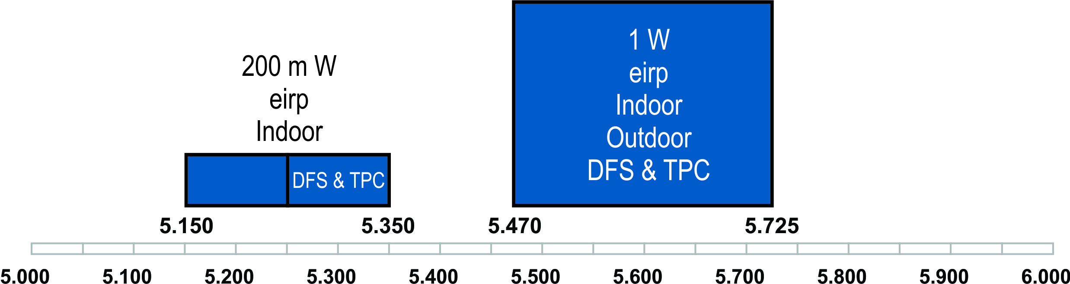
5 GHz in Europe today
Ever since 2005 there has been 455 MHz of spectrum in the 5 GHz for RLAN
  Additionally, 150 MHz of spectrum from 5.725 MHz onwards can be used as per SRD rules
RLANs share this band with others with means of TPC and DFS

Slide 12
Sharing with other primary services
The 5 GHz band is used also by other primary services, such as radars
Two sharing mechanisms are required
  Transmit Power Control (TPC)
  Dynamic Frequency Selection (DFS)
TPC is a mechanism to ensure a mitigation factor of at least 3 dB on the aggregate power from a large number of devices
  Devices are allowed to operate without TPC but for them mean e.i.r.p limits for RF output power and power density are lower

Slide 13
Sharing with DFS
DFS is employed to
  detect interference from radar systems (radar detection) and to avoid co-channel operation with these systems
  provide on aggregate a near-uniform loading of the spectrum
DFS builds upon concept of master and slave mode devices
  Master mode device uses a Radar Interference Detection function and controls the transmissions of RLAN devices operating in slave mode
    A master mode device may rely on another device to implement the Radar Interference Detection function
  Slave mode device transmissions are under control of a master mode device

Slide 14
Different phases of DFS
Channel Availability Check
  A device checks channels for the presence of radar signals in order to identify Available Channels
  This shall be performed during a continuous period in time for at least 60 s
In-Service Monitoring
  Each Operating Channel is monitored for the presence of radar signals
Channel Shutdown
  Once a radar signal has been detected during the In-Service Monitoring on an Operating Channel, the master device and all associated slave devices stop transmissions within 10 s
Non-Occupancy Period
  RLAN device shall not make any transmissions for 30 m on a channel after a radar signal was detected on that channel

Slide 15
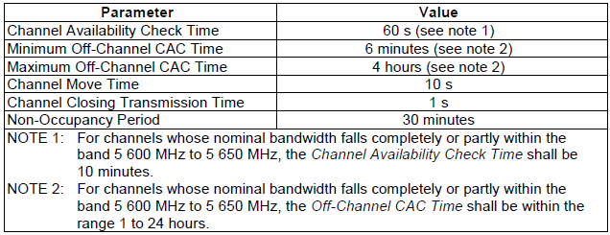

DFS requirement values

Slide 16
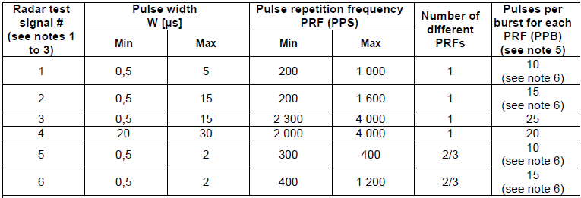
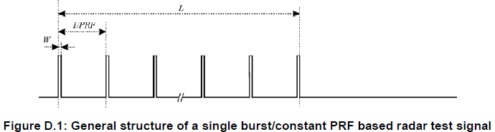
Radar test signals
L = Radar Burst Length

Slide 17
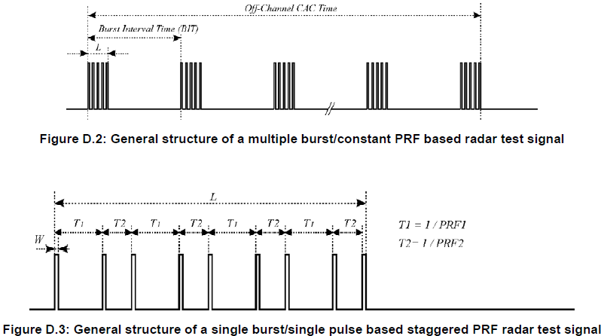
Radar test signals (cont’d)

Slide 18
Dedicated Short Range Communication (DSRC) Tutorial and Implications for Spectrum Sharing
John Kenney
Toyota InfoTechnology Center, USA
March 18, 2013
jkenney@us.toyota-itc.com,
www.us.toyota-itc.com

Slide 19
Contents
Mission
V2V Safety Use Cases
802.11p
5.9 GHz band
Detection challenges
Conclusion

Slide 20
Terminology
ITS = Intelligent Transportation Systems
  See http://www.iteris.com/itsarch/ for National ITS Architecture
DSRC = Dedicated Short Range Communication
WAVE = Wireless Access in Vehicular Environments

Slide 21
Mission
Sometimes called “hard” and “soft” safety, respectively
V2V collision avoidance is
driving deployment
Vehicle communication to/from proximate device
  Vehicle to Vehicle (V2V)
  Vehicle to/from roadside Infrastructure (V2I)
Applications:
  Collision Avoidance
  Road Hazard Safety
  Mobility
  Environment
  Commerce
  Entertainment
  ?

Slide 22
V2V Safety
AAA estimates aggregate cost of accidents $300B in 2011
32,367 traffic fatalities in US – 2011
Accidents have other huge costs:
  Injuries: 387000 in US in 2011
  Property damage
  Lost productivity
  Health care and emergency services
V2V communication can “reduce, mitigate, or prevent 81% of light-vehicle crashes by unimpaired drivers” – US DOT

Slide 23






Joint US DOT – OEM research
CAMP
Vehicle Safety Communications 3
Intelligent Transportation Systems
Vehicle Safety Communication (2003-05)
EEBL (2005-06)
VSC-Applications (2007-2009)
V2V-Interoperability (2010-2014)
V2V-Security Communication (2010-2013)
Safety Pilot Driver Clinics (2010-2012)
Safety Pilot Model Deployment (2011-2013)
Note: my affiliation is Toyota. I do not represent VSC3

Slide 24
How does it work? (high level)
Each vehicle broadcasts its core state information in a “Basic Safety Message” (BSM) nominally 10 times/sec.
BSM is sent 360 degrees using IEEE 802.11p technology (more later)
Receivers build model of each neighbor’s trajectory, assess threat to host vehicle, warn driver or take control if threat becomes acute.
Example application:
Forward Collision Warning (FCW)
Stopped
DSRC communication
If driver of approaching car does not stop, warning issued within car

Slide 25
V2V Safety Use Cases
Emergency Electronic Brake Lights (EEBL)
Traffic
Jam
High deceleration by car approaching jam. Trailing car
Informed via DSRC within 100 msec.

Slide 26


V2V Safety Use Cases
Blind Spot Warning (BSW)
Driver receives warning when showing intent to change lanes
Normal driving – advisory indicator of car in blind spot
Note: Specific timing, format, or decision logic for advisories and warnings will likely vary for each car manufacturer

Slide 27
V2V Safety Use Cases
Do Not Pass Warning (DNPW)
Oncoming
traffic
When showing intent to move to oncoming lane, driver receives warning if not safe to pass.

Slide 28
V2V Safety Use Cases
Intersection Collision Warning (ICA)
Building: Leads to Non-Line Of Sight (NLOS) communication
If intersecting trajectories are indicated, driver is warned.

Slide 29
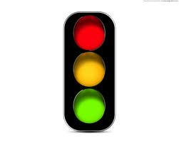
V2I Safety Use Cases
Cooperative Intersection Collision Avoidance System (CICAS)
Two messages sent by signal:
MAP (intersection topology) – changes slowly
Signal Phase and Timing (SPaT) – highly dynamic
Car receives MAP and SPaT. Warning to driver if violation likely. Can avoid collision even if other car not equipped.

Slide 30
Future of DSRC
National Highway Transportation Safety Administration (NHTSA) regulates vehicles in US
NHTSA is evaluating efficacy of DSRC-based collision avoidance systems
NHTSA will announce later in 2013 whether they plan to begin a process to require DSRC devices in new cars
  Will make similar evaluation in 2014 with regard to heavy trucks
Several suppliers of aftermarket devices are also exploring this market

Slide 31
How does it work? (details)
^{DSRC Security (IEEE 1609.2)}
^{Safety Message (SAE J2735)} Min. Perf. Req. (SAE J2945)
^{Non-safety applications}
^{TCP/UDP}
^{DSRC WSMP}
with safety sublayer (IEEE 1609.3)
^{IPv6}
^{DSRC Upper-MAC (IEEE 1609.4)}
^{DSRC PHY+MAC (IEEE 802.11p)}
See: J. Kenney, “DSRC Standards in the United States”, Proc. IEEE, July 2011, Vol. 99, No. 7, pp. 1162-1182

Slide 32
IEEE 802.11p-2010
Incorporated in IEEE 802.11-2012
PHY
  OFDM (Clause 18)
  Class C transmit mask for V2V safety (Table D-5)
  Optional enhanced channel rejection (Table 18-15)
MAC
  Communicating outside the context of a BSS
  (dot11OCBActivated = true) – see e.g. Clause 10-20
  No authentication or association at MAC sublayer
  BSSID field holds wildcard value 0xFFFFFF

Slide 33
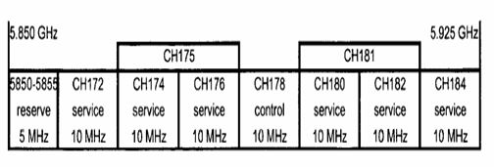
DSRC Spectrum
Ch. 172:
FCC designated “exclusively for vehicle-to-vehicle safety communications for accident avoidance and mitigation, and safety of life and property applications”
Extensive industry research, testing, and field trials of safety applications using Ch. 172
Will host 3 message types:
  Basic Safety Message (V2V)
  MAP Message (I2V)
  Signal Phase and Timing Message (I2V)
Nominal transmit power 20 dBm with 0 dBi antenna

Slide 34
DSRC Spectrum
Ch. 172: Collision Avoidance Safety
Ch. 184:
FCC designated “exclusively for high-power, longer-distance communications to be used for public safety applications involving safety of life and property, including road intersection collision mitigation”
Road authorities and public agencies primarily responsible for usage
Max. power 40 dBm

Slide 35
DSRC Spectrum
Ch. 172: Collision Avoidance Safety
Ch. 184: Public Safety
Ch. 178:
Control Channel
WAVE Service Advertisements are broadcast here, indicating how to access services on other “Service Channels”

Slide 36
DSRC and 802.11ac
Ch. 172: Collision Avoidance Safety
Ch. 184: Public Safety
Ch. 178: Control Channel
20 MHz
20 MHz
20 MHz
20 MHz
From
NTIA
report
40 MHz
40 MHz
80 MHz
160 MHz

Slide 37
Some detection challenges
Master – Client
Asymmetric power, asymmetric channel
Detection levels
Detection latency when RLAN operating
10 MHz channels

Slide 38
Conclusions – DSRC Tutorial
DSRC holds the promise of:
  Saving lives and reducing property loss
  Improving transportation efficiency
  Improving the environment
  Opening a new frontier for innovation
Will be used wherever vehicles go
  EU and Japan also planning implementations
Designed to operate solo
  E.g. adaptive congestion control based on channel load
Sharing presents significant challenges

Slide 39
Backup Slides
http://en.wikipedia.org/wiki/List_of_WLAN_channels
CEPT SE24 on 5725-5875 MHz:
http://www.cept.org/Documents/se-24/5943/M65_26R0_SE24_WI39_way_forward_f-inaldoc
R&TTE Directive 17 October 2012
http://ec.europa.eu/enterprise/sectors/rtte/documents/legislation/review/index_en.htm

Slide 40
Pending Actions

