Slide 1
Ad Hoc Discussions of 802.11ai Scanning during 2012-November Meeting
Date: 2012-11-13
Authors:

Slide 2
Abstract
This document is intended to keep tracking of the ad hoc discussions about 802.11ai scanning during 2012-November San Antonio meeting.

Slide 3
Conformance w/ TGai PAR & 5C
Conformance Question | Response
Does the proposal degrade the security offered by Robust Security Network Association (RSNA) already defined in 802.11? | No
Does the proposal change the MAC SAP interface? | ??
Does the proposal require or introduce a change to the 802.1 architecture? | No
Does the proposal introduce a change in the channel access mechanism? | No
Does the proposal introduce a change in the PHY? | No
Which of the following link set-up phases is addressed by the proposal? (1) AP Discovery (2) Network Discovery (3) Link (re-)establishment / exchange of security related messages (4) Higher layer aspects, e.g. IP address assignment | 1,2

Slide 4
Scanning Ad-hoc Discussion Plan
11ai Scanning Ad Hoc Sessions:
Tue-Eve
Wed-PM1
Topics/Contributions to be discussed:
Text proposal about FD frame:
11-12-1236-01-00ai-tgai-spec-text-proposal-for-fd-frame-definition
Opening Issues about FD frame content design:
11-12-1238-00-00ai-FD-Frame-capability-security-neighbor-info
11-12-1262-00-00ai-fils-frame-content
11-12-1285-00-00ai-802-11ai-fils-discovery-fd-frame-design-discussion
11-12-1270-02-00ai-tgai-spec-text-proposal-for-ap-redirection
11-12-1269-01-00ai-tgai-spec-text-proposal-for-omission-of-probe-request
11-12-1114-02-00ai-tgai-specification-text-for-enhanced-active-scanning-procedure-for-fils
11-12-1271-00-00ai-tgai-spec-text-proposal-for-ap-network-status-information (12/1272 presentation file)
12/1263: active scanning optimization
12/1260 and 12/1261: Rapid Scanning
???

Slide 5
Ad Hoc Discussions – Tuesday Evening
Discussions on Text Proposal for FD Frame Design
12/1236r1: removed the option of designing as FD frame as a new extension frame;
12/1236r2:
modifications based on the ad hoc discussions;
Color-coded the proposed text: “blue” as the “general agreement” text; “red” as the “need-further-discussion” text.
Discussions on FD Frame Content Item design
12/1238, 12/1262, 12/1285
FD Capability Field: see next slide
FD Security Field: deferred until further TGai Security feature development;
FD Neighbor AP’s TBTT info: use Reduced Neighbor Report IE.
Discussions on AP-Redirect-Normative-Text, 12/1270r2
Received lots of comments/suggestions; but still observed objections.

Slide 6
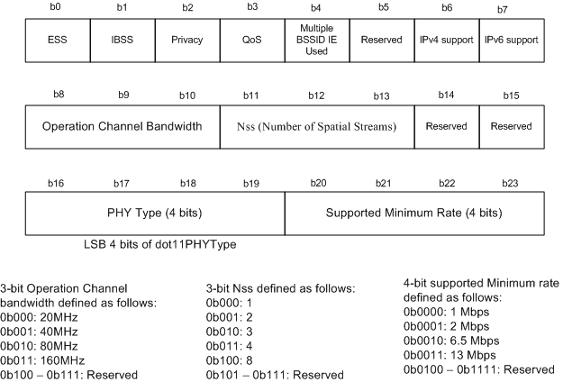
FD Capability Field Proposal – for further discussions

Slide 7
References:
IEEE Std 802.11™-2012
11-12-0151-13-00ai-proposed-specification-framework-for-tgai
11-12-1236-00-00ai-tgai-spec-text-proposal-for-fd-frame-definition
11-12-1238-00-00ai-FD-Frame-capability-security-neighbor-info
11-12-1262-00-00ai-fils-frame-content
11-12-1285-00-00ai-802-11ai-fils-discovery-fd-frame-design-discussion
11-12-1270-02-00ai-tgai-spec-text-proposal-for-ap-redirection
11-12-1269-01-00ai-tgai-spec-text-proposal-for-omission-of-probe-request
11-12-1114-02-00ai-tgai-specification-text-for-enhanced-active-scanning-procedure-for-fils
11-12-1271-00-00ai-tgai-spec-text-proposal-for-ap-network-status-information
11-12-1272-00-00ai-bss-network-status-information-for-a-fast-ap-network-selection

