Slide 1
TSF Timer Freq. Management and Measurement Procedure (TFM²P)
Date: 2012-11-13
Authors:

Slide 2
Abstract
The detailed three procedures of enhanced power saving function which employs the proposed TFM²P (TSF timer Frequency Management & Measurement Procedure) is presented.
TFM²P can be used with existing Power Saving mechanisms to allow STA waking up precisely and sleeping longer, and some sort of access control mechanisms for following operational conditions;
numerous numbers of sensors or meters, with lower traffic at each STA, requiring battery conservation. (use case 1a/c/d/e/f)
access control numerous numbers of sensors or meters using wake-up timing control schemes by TSF timer synchronization, rather than simple ALOHA. (RAW, TWT, PS-mode, etc.)
Notes:
/c

Slide 3
Principle of PS feature
Synchronize peer nodes to TSF
Schedule or Trigger for STA wake-up
Sleep as long as possible for peer nodes to queue
Awake as short as possible to communicate quickly
Accuracy $△$ of TSF sync does set the duty ratio $D$, due to wake-up margin.
$D ≈ \frac{TAwake }{TSleep } + △$ ; for small $D$
c.f. Peer to peer clock frequency accuracy=40ppm,
(1) $D$= (36ms / 15min) + 40 = 40 + 40 ppm
(2) $D$ = (360us / hour) + 40 = 0.1 + 40 ppm or $D$ = (3.6ms / 10 hour) +40 = 0.1 +40 ppm

Slide 4
Wake-up synchronization Simple AP announcement of TSF accuracy (1)
Wake-up Timing margin depends on TSF timer freq. accuracy △;
T_{S}
T_{W}
scheduled wake-up time (ideal case)
(IEEE802.11-2012)
Tolerance
±100ppm
AP
(e.g. TSF master)
± △· (T_{W} –T_{S})
Wake-up margin -△· (T_{W} – T_{S})
T_{W}
notified
≈
STA
(e.g. TSF slave)
actual sleep duration
STA
awake
sleep again
△ includes
accuracy of
both AP & STA
< 11-12/130r0 “Beacon Reception of Long Sleeper” >
AP is supposed to announce TSF accuracy △, (△<100ppm)
STA is able to wake up at (T_{W} –T_{S})(1 - △) +T_{S}
T_{S} : TSF timer value just after last time it was synchronized

Slide 5
Wake-up synchronization Simple AP announcement of TSF accuracy (2)
Awake period of STA may become much longer than actual
Communication.
scheduled wake-up time (ideal case)
T_{W}
AP
(e.g. TSF master)
± △· (T_{W} –T_{S})
actual
communication
T_{W}
notified
Wake-up margin - △· (T_{W} –T_{S})
≈
STA
(e.g. TSF slave)
actual sleep duration
STA
awake
sleep again
T_{W-actual}
actual wake-up point of time
± △·( T_{W} – T_{S})
Communication may happen within green window.
STA have to be awake during entire blue period
while actual communication duration may be a part of awake period.
STA awake

Slide 6
Wake-up sync. using TFM²P AP announcement of TSF timer stability (1)
Wake-up Timer Stability information (±ε) as well as △;
T_{W}
measured AP side
point of time (by STA)
scheduled wake-up time (ideal case)
announced AP
( TSF master)
± △· T_{W}
±ε
△_{measured}
T_{w} notified after TSF frequency measurement
compensated by measured TSF frequency T_{w-compen}
Receiver side
measured STA
(e.g. TSF master)
≈
wake-up margin
-ε
sleep
again
< TFM²P involves two parameters, i.e. △ and ε >
AP advertise △_{worst} and ε
STA to wake up at,
(T_{W-compen} –T_{S})(1 - ε)+T_{S} ≃ (T_{W} –T_{S})(1 + △_{measured} - ε) +T_{S}
STA
awake

Slide 7
Wake-up sync. using TFM²P AP announcement of TSF timer stability (1)
Wake-up Timer Stability information (±ε) as well as △ ;
measured
point of time
scheduled wake-up time (ideal case)
T_{W}
announced AP
( TSF master)
± △· T_{W}
-ε
△_{measured}
actual
communication
T_{w} notified after TSF frequency measurement
compensated by measured TSF frequency T_{w-compen}
Receiver side
measured STA
(e.g. TSF master)
≈
sleep
again
STA
awake
T_{W-actual}
actual point of time
STA to wake up at
(T_{W-compen} –T_{S})(1 - ε)+T_{S} ≃ (T_{W} –T_{S})(1 + △_{measured} - ε)+T_{S}
after once TFM²P has carried out .

Slide 8
Comparison of Wake-up synchronization (1)
Simple Accuracy Announcement and TFM²P (frequency measurement)
scheduled wake-up time T_{w}
actual
communication
AP
(e.g. TSF master)
± △_{advertised} · ( T_{W} –T_{S})
Informed T_{w} is used
with △_{advertised}
wake-up margin
using accuracy information
(△_{advertised} )
awake
STA w/o TFM²P
(e.g. TSF slave)
sleep
wake up
sleep again
Informed T_{w} and ε_{advertised}
is used with
measured frequecy
(Tw - T_{S}) (1- △_{advertised} ) + T_{S}
Less wake-up margin
by TSF freq. offset compensation
and freq. stability information
awake
STA w/t TFM²P
(e.g. TSF slave)
sleep
sleep again
(T_{W} – T_{S})(1 + △_{measured} - ε_{advertised}) + T_{S}

Slide 9
Comparison of Wake-up synchronization (2)
Proposed three procedures of TFM²P for Power Saving
Simple
accuracy
announcement
(broadcast)
Time Stamp
announcement
for TFM²P
(broadcast)
Time Stamp
handshake for
TFM²P
(node by node)
Broadcast
(uni-directional)
Broadcast
(uni-directional)
Unicast handshake
(node by node)
accuracy △_{AP}
AP
AP
AP
Stability ε
Stability ε
B1+B1_{timestamp}
M1+Ack
M6+Ack
accuracy
accuracy
B2+B2_{timestamp}
B2+B2_{timestamp}
B1+B1_{timestamp}
M2+Ack
STA
STA
STA
M5+Ack
STA
STA
M3+Ack
STA
B1+B1_{timestamp}
B2+B2_{timestamp}
M7+Ack
M4+Ack
STA
STA
M8+Ack
STA
Receiving
broadcasted
accuracy information,
then calculate wake-up margin, △_{AP+STA}
Receiving
four broadcasted
time stamp for measuring TSF freq.,
then calculate wake-up margin, △_{measured} , ε
Handshaking
two time measurement
to determine each precise offset and freq.,
then calculate wake-up margin, △_{measured} , ε

Slide 10
Comparison of Wake-up synchronization (3)
Scheme | Broadcast or Handshake | Inaccuracy information | Resulting Wake-up Accuracy | Battery life improvement (ex. estimated) | Update | Required mechanism | PHY/MAC Support
IEEE802.11 2012 (Conventional) | None | Pre-defined by Std. | ±100 ppm +offset | Reference (1.0) | None | TSF synch only | Not required
Timer accuracy notification [11-12/130r0] | Broadcast w/o handshake | by AP announcement | ±20~50 ppm +offset | 1.6 times (1.2~2.0) | Not Required | TSF timer freq. accuracy advertisement | MAC: required
TFM²P | Broadcast (Time-Stamp Announcement) w/o handshake | by direct TSF frequency measurement + AP stability advertisement | ±2~10 ppm +offset | 2.5 times (1.5~4.0) | Conditionally preferred | TSF timer freq. accuracy advertisement + Two time measurements + Calculation & compensation | MAC: required PHY: optional
 | Node by node w/t bi-directional handshake |  | ±1~5 ppm null offset |  | Conditionally Required |  | MAC: required PHY : preferable

Slide 11
Typical mechanism of TFM²P using Broadcast (1)
AP as Clock master broadcasts Time Stamp Announcement with no handshake.
Full beacons with DTIM always carry ToD time stamp for TFM²P.
All ToD time stamps correspond to its N-times previous DTIM beacon.
Each pair of successive ToD time stamps may be used for TSF frequency estimation with corresponding previous pair of ToA time stamps.
N-times DTIM Interval ( N ≥ 1 )
≈
Beacon Interval
≈
DTIM
TIM
TIM
TIM
DTIM
TIM
≈
Beacon Transmissions
( can be short beacon )
Busy medium other transmissions
Full Beacon DTIM
N-times previous ToD time stamp
TFM2P frequency measurement pair
Full Beacon DTIM
N-times previous ToD time stamp

Slide 12
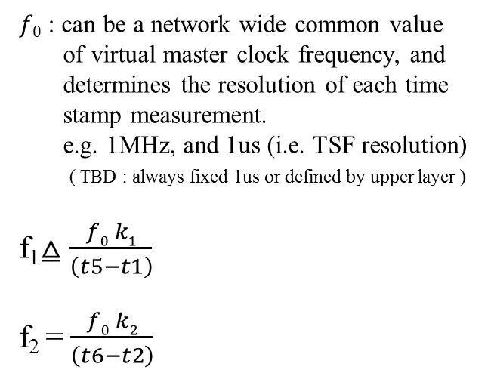
Typical mechanism of TFM²P using Broadcast (2)
AP as Clock master broadcasts Time Stamp Announcement with no handshake.
Sending STA(f₁)
Receiving STA(f₂)
$f0$ : can be a network wide common value
of virtual master clock frequency, and
determines the resolution of each time
stamp measurement.
e.g. 1MHz, and 1us (i.e. TSF resolution) ( TBD : always fixed 1us or defined by upper layer )
f₁⧋ $\frac{f0 k1}{\left(t5−t1\right)}$
f₂ = $\frac{f0 k2}{\left(t6−t2\right)}$
t1=ToD(B1)
B1_{B0-timestamp}
t2=ToA(B1)
t5=ToD(B2)
B2_{B1-timestamp}
t6=ToA(B2)
t1 are known
t9=ToD(B3)
B3_{B2-timestamp}
t10=ToA(B3)
t5 are known
B4_{B3-timestamp}
f₂= f₁ $\left(\frac{1}{1+\frac{\left(t2−t1\right)−(t6−t5)}{k1}} \right)$
Estimation in this figure, t9 and t10 is not used.

Slide 13
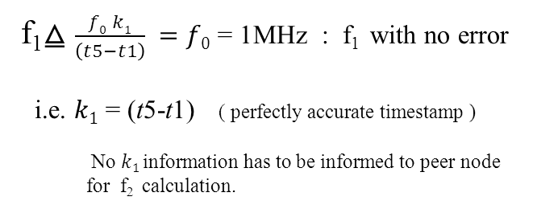
Typical mechanism of TFM²P using Broadcast (3)
f₁ ≈ $f0$ at AP, as master frequency;
f₁⧋ $\frac{f0 k1}{\left(t5−t1\right)} =f0$ = 1MHz : f₁ with no error
i.e. $k1$ = (t5-t1) ( perfectly accurate timestamp )
No $k1$information has to be informed to peer node
for f₂ calculation.
Sending STA(f₁)
Receiving STA(f₂)
t1=ToD(B1)
B1_{B0-timestamp}
t2=ToA(B1)
B2_{B1-timestamp}
f₂= f₁ $\left(\frac{1}{1+\frac{\left(t2−t1\right)−(t6−t5)}{\left(t5−t1\right) }} \right)$
t5=ToD(B2)
t6=ToA(B2)
t1 are known
f₂ = $\frac{f0 k2}{\left(t6−t2\right)}$
therefore :$\frac{k2}{\left(t6−t2\right)}$ = $\frac{\text{f}\text{2}}{f0}$ ⧋1+δ₂
t9=ToD(B3)
B3_{B2-timestamp}
t10=ToA(B3)
t5 are known
B4_{B3-timestamp}
δ₂ (e.g. ppm) should be the calibration factor of f₂ to schedule T_{w} , wake-up time.
Estimation in this figure, t9 and t10 is not used.

Slide 14
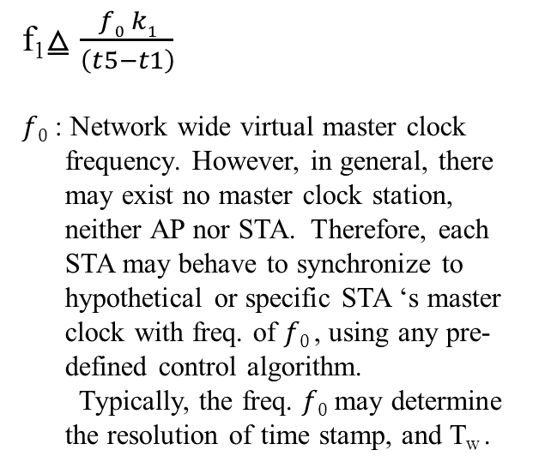
TFM²P mechanism by node-by-node handshake (1)
Handshake can be between AP/MP & STA, STA & STA or MP & MP.
Sending STA(f₁)
Receiving STA(f₂)
f₁⧋ $\frac{f0 k1}{\left(t5−t1\right)}$
$f0$ : Network wide virtual master clock
frequency. However, in general, there
may exist no master clock station,
neither AP nor STA. Therefore, each
STA may behave to synchronize to
hypothetical or specific STA ‘s master
clock with freq. of $f0$, using any pre-
defined control algorithm.
Typically, the freq. $f0$ may determine
the resolution of time stamp, and T_{w} .
t1=ToD(M1)
M1
t2=ToA(M1)
t4=ToA(Ack)
Ack
t3=ToD(M1)
M1_{timestamp}
Ack
t1and t4 are known
t5=ToD(M2)
M2
t6=ToA(M2)
t8=ToA(Ack)
Ack
t7=ToD(M2)
M2_{timestamp}
t5and t8 are known
Ack
offset1 ⧋ [(t2-t1)-(t4-t3)]/2
offset2 ⧋ [(t6-t5)-(t8-t7)]/2

Slide 15
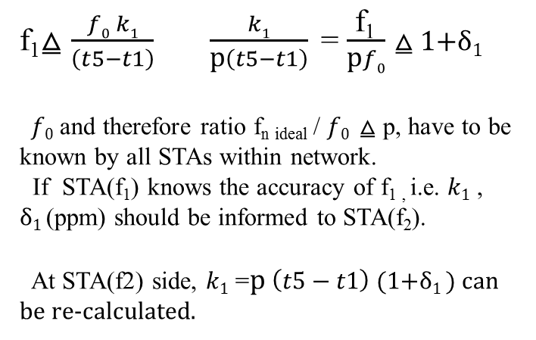
TFM²P mechanism by node-by-node handshake (2)
How all STAs synchronizes each other is out of scope of this standard.
f₁⧋ $\frac{f0 k1}{\left(t5−t1\right)}$ $\frac{k1}{\text{p}\left(t5−t1\right)}$ = $\frac{\text{f}\text{1}}{\text{p}f0}$ ⧋ 1+δ₁
$f0$ and therefore ratio $\text{f}\text{n} \text{ideal}$ / $f0$ ⧋ p, have to be known by all STAs within network.
If STA(f₁) knows the accuracy of f_{1 ,} i.e. $k1$ ,
δ₁ (ppm) should be informed to STA(f₂).
At STA(f2) side, $k1$ =$\text{p} \left(t5−t1\right)$ (1+δ₁ ) can be re-calculated.
Sending STA(f₁)
Receiving STA(f₂)
t1=ToD(M1)
M1
t2=ToA(M1)
t4=ToA(Ack)
Ack
t3=ToD(M1)
M1_{timestamp}
Ack
offset1=[(t2-t1)-(t4-t3)]/2
t5=ToD(M2)
M2
t6=ToA(M2)
t8=ToA(Ack)
Ack
t7=ToD(M2)
f₂= f₁ $\left(\frac{1}{1+\frac{offset1−offset2}{k1}} \right)$
M2_{timestamp}
Ack
offset2=[(t6-t5)-(t8-t7)]/2
f₂⧋ $\frac{f0 k2}{\left(t6−t2\right)}$ $\frac{k2}{\text{p}\left(t6−t2\right)}$ = $\frac{\text{f}\text{2}}{\text{p}f0}$ ⧋ 1+δ₂

Slide 16
TFM²P mechanism by node-by-node handshake (3)
How all STAs should synchronize each other after node-by-node calibration can be achieved, is out of scope of this standard.
However, node-by-node TFM2P is expected to be instrumental because of following reasons,
By utilizing existing 11v timing measurement scheme identical to PTP/IEEE1588, the best time and frequency accuracy of TSF for wake up can be used with the precise timing offset nulling.
This also means that the quick frequency estimation can be possible using shorter time interval of two time measurements.
IBSS, MBSS without AP can still utilize TFM2P for wake up.
To perform such sort of applications, for example, timing sensitive control using DLS, TFM2P works.
Forward looking applications may be facilitated by precise synch..

Slide 17
Procedure (1) : General ( IE in full beacon body )
STA can examine TFM²P availability in Extended Capabilities Element by acquiring full beacon [ bit xx-xx+1 : TBD ]. If AP provides TFM²P, STA are able to select and perform any of TFM²P service available, i.e. simple accuracy announcement, TFM2P time stamp announcement (AP-broadcast), or TFM2P node-by-node handshake.
Even if all STAs can use simple TSF accuracy information only without frequency measurement, AP should still provide accuracy announcement and stability information of corresponding services in TFM2P IE carried by frame body of full beacon including the detailed parameters. It is up to STA’s decision if any frequency measurement is performed or not.
As like existing TSF timer advertisement, STA shall correct its TSF timer offset with AP timer, and this corrected timer value has to be stored as T_{S} , which is the origin of wake up timing calculation.

Slide 18
Procedure (2) : Time Stamp Announcement ( AP-broadcast )
If AP provides TFM2P and a STA selects the timestamp announcement (AP-broadcast) service to calculate its wake up margin, the STA has to obtain AP timer stability information (±ε_{advertised} ) and number of times ( N ) of full beacon carrying DTIM to measure AP TSF timer frequency. Usually, N should be more than 1sec = 1million times of 1us TSF.
Then the STA acquires three consecutive full beacons N-times apart each other and takes ToA information of first two reception by STA PHY itself. Furthermore, STA collects the ToD information corresponding to first two full beacon carried by last two beacons.
Now the STA has two set of ToD-ToA pairs from three full beacon and can estimate the frequency correction coefficient (δ₂ ; ppm). The timing resolution of stamps may be always 1us or defined by higher layer [TBD].
Eventually STA determines the wake up margin from, △_{measured} , ε_{advertised} and STA specific stability ( ε_{STA} ; see “implementation practice”) if required.

Slide 19
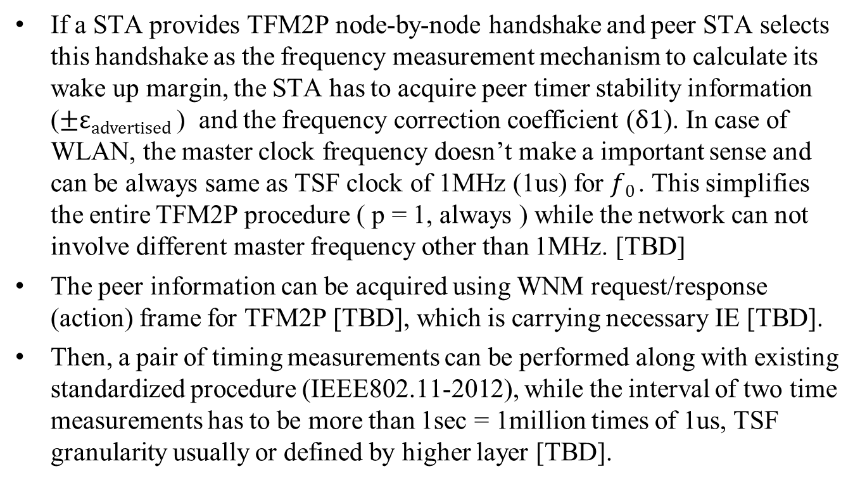
Procedure (3) : Node-by-node handshake ( STA-unicast )
If a STA provides TFM2P node-by-node handshake and peer STA selects this handshake as the frequency measurement mechanism to calculate its wake up margin, the STA has to acquire peer timer stability information (±ε_{advertised} ) and the frequency correction coefficient (δ1). In case of WLAN, the master clock frequency doesn’t make a important sense and can be always same as TSF clock of 1MHz (1us) for $f0$. This simplifies the entire TFM2P procedure ( p = 1, always ) while the network can not involve different master frequency other than 1MHz. [TBD]
The peer information can be acquired using WNM request/response (action) frame for TFM2P [TBD], which is carrying necessary IE [TBD].
Then, a pair of timing measurements can be performed along with existing standardized procedure (IEEE802.11-2012), while the interval of two time measurements has to be more than 1sec = 1million times of 1us, TSF granularity usually or defined by higher layer [TBD].

Slide 20
Procedure (3) : Node-by-node handshake ( STA-unicast )
…. Continued from previous slide.
The data format of timestamp should be same as 802.1AS structure with 1ns resolution.
struct Timestamp
{
UInteger48 seconds;
UInteger32 nanoseconds;
};
Now the STA has two set of ToD-ToA pairs from two times repetition of timing measurement handshake and can estimate the frequency correction coefficient (δ₂ ; ppm), using peer correction coefficient (δ₁ ; ppm).
Eventually STA determines the wake up margin from, △_{measured} , ε_{advertised} , δ₁ and STA specific stability factors ( ε_{STA} ) if required.
( refer to “implementation practice” )

Slide 21
Addition to Extended Capabilities IE [TBD]
Extended capability Element.
Octets : 1 1 n
Element ID = 127
Capability bit = xx - xx+1 [ TBD, e.g. 49-50 ]
Element ID | Length | Capabilities
bit | Information | Notes
xx-xx+1 | TFM2P Service availability | Set to 0, when unavailable. TSF accuracy = ±100ppm Set to 1, when simple accuracy announcement of TSF and TFM2P timestamp announcement (AP-broadcast) are available. (for AP only) Set to 2, when simple accuracy announcement of TSF and/or TFM2P node by node handshake are available. (for AP (and), for STA(and/or)) Set to 3, when all TFM2P timestamp announcement (AP-broadcast), node by node handshake and simple accuracy announcement are available. (for AP only)

Slide 22
New IE for TFM²P (1) [TBD]
Information Element.
Octet : 1 1 1 1 1 1 10
Element ID = xxx [ TBD, e.g. 175 ]
Capability
0 for TFM2P unavailable. Accuracy has to be ±100ppm and stability has to be ±0.
1 for TFM2P simple accuracy announcement of TSF and TFM2P timestamp announcement (AP-broadcast) are available as well. (usually for AP only)
2 for TFM2P simple accuracy announcement of TSF and TFM2P node by node handshake are available as well. (for both AP and STA)
3 for all TFM2P simple accuracy announcement of TSF, timestamp announcement (AP-broadcast) and node-by-node handshake are available. (usually for AP only)
4 for TFM2P simple accuracy announcement of TSF is only available. (usually for STA only)
5 for TFM2P node-by-node handshake is only available. (usually for STA only)
6-255: reserved.
Element ID | Length | TFM2P capability | Accuracy | Stability | N | ToD Time stamp AP-broadcast | reserved
Note, N : number of times of DTIM beacon for the interval
between two time measurements

Slide 23
New IE for TFM²P (2) [TBD]
Information Element.
Octet : 1 1 1 1 1
Accuracy : 2 times integer in ppm (means ±value = 0 to absolute max. ) i.e. resolution of half ppm
Stability : 4 times integer in ppm (means ±value = 0 to absolute max. ) i.e. resolution of quarter ppm
ToD Time stamp announcement in case of AP-broadcast
struct Timestamp
{
UInteger64 microseconds;
UInteger16 nanoseconds;
};
Element ID | Length | TFM2P capability | Accuracy | Stability | ToD Time stamp AP-broadcast | reserved
This is different from 802.1AS structure,
because TSF timer resolution of 1us has to
be maintained.

Slide 24
Implementation practice for TFM²P mechanism
How much wake up margin should set at each STA is out of the scope of Standard. However following implementation practice should work for typical implementation of usual sensor nodes including all of use case 1 applications in general.
Wake up margin at the frequency estimating STA may be the sum of peer stability information and actual latest fluctuation of measurement by itself.
The difference ( i.e. fluctuation ) between latest measured frequency correction coefficient and previous coefficient ( △ δ₂ ) can be summed up with the advertised stability information (±ε_{advertised} ), in addition to the STA’s stability coefficient value.
This estimating STA side stability coefficient value with the fluctuation ( △ δ₂ ) can be always updated and maintained for next δ₂ estimation using TFM2P. ( ε_{STA} )
If the fluctuation (△ δ₂ ) is small, ε_{STA} will be minimum.

Slide 25
Straw poll (1)
Do you support to include the TSF timer frequency measurement function into SFD.
Yes
No
Abstain

Slide 26
Straw poll (2)
Do you support to include proposed TFM2P procedure as the TSF timer frequency measurement function, into SFD.
Yes
No
Abstain

Slide 27
References
[1] 11-12/130r0 “Beacon Reception of Long Sleeper”
[2] IEEE802.11-2012
[3] IEEE1588/PTP
[4] 11-11/0905r5” TGah Functional Requirements and Evaluation Methodology Rev. 5”
[5] PAR and 5C

Slide 28
Appendix : PHY-assist rules for time stamp
Timing Measurement Procedure: IEEE802.11-2012
Standardized mechanism of ToD/ToA time stamp
Proposed Measurement Point for both ToD/ToA
Either end of STF or start of LTF : t_{LTF}
Proposed ToA validation by Sig with no CRC error
Every detection of t_{LTF} is stored (over written) if CRC passed.
By TFM²P Procedure
ToA time stamp of frame destined to the STA itself only be used.

Slide 29
Examples

Slide 30
Frequency Measurement (example 1)
No frequency error
Propagation Delay=0
f₁⧋ $\frac{f0 k1}{\left(t5−t1\right)}$= $\frac{1.000000MHz∗(1048576)}{\left(1235616466−1234567890\right)uSec}$
$=1000000$
Sending
STA(f₁)
Receiving
STA(f₂)
offset1= [(t2-t1)-(t4-t3)]/2
=[(1234578901-1234567890)-(1234667890-1234678901)]/2
= 11011
t1
M1
t2
t4
Ack
t3
M1
offset2=[(t6-t5)-(t8-t7)]/2
=[(1235627477-1235616466)-(1235716466-1235727477)]/2
= 11011
Ack
f₂= f₁ $\left(\frac{1}{1+\frac{offset1−offset2}{k1}} \right)$ = f₁ $\left(\frac{1}{1+\frac{11011−11011}{k1}} \right)$ = f₁
t5
M2
t6
t8
Ack
t7
M2
f₂ = $\frac{f0 k2}{\left(t6−t2\right)}$ = $\frac{1.000000MHz∗(1048576)}{\left(1235627477−1234578901\right)}$
= 1000000
Ack

Slide 31
Frequency Measurement (example 2)
No frequency error
Propagation Delay=1uSec
f₁⧋ $\frac{f0 k1}{\left(t5−t1\right)}\text{= }\frac{1.000000MHz∗(1048576)}{\left(1235616466−1234567890\right)uSec}$
$$=1000000$$
Sending
STA(f₁)
Receiving
STA(f₂)
offset1= [(t2-t1)-(t4-t3)]/2
=[(1234578902-1234567890)-(1234667892-1234678902)]/2
= (11012+11010)/2=11011
t1
M1
t2
t4
Ack
t3
M1
offset2=[(t6-t5)-(t8-t7)]/2
=[(1235627478-1235616466)-(1235716468-1235727478)]/2
= (11012+11010)/2=11011
Ack
f₂= f₁ $\left(\frac{1}{1+\frac{offset1−offset2}{k1}} \right)$ = f₁
t5
M2
t6
t8
Ack
t7
M2
f₂ = $\frac{f0 k2}{\left(t6−t2\right)}$ = $\frac{1.000000MHz∗(1048576)}{\left(1235627477−1234578901\right)}$
= 1000000
Ack

Slide 32
Frequency Measurement (example 3)
f₂ frequency offset ≈ 4ppm
Propagation Delay=1uSec
f₁⧋ $\frac{f0 k1}{\left(t5−t1\right)}$= $\frac{1.000000MHz∗(1048576)}{\left(1235616466−1234567890\right)uSec}$
$$=1000000$$
Sending
STA(f₁)
Receiving
STA(f₂)
offset1= [(t2-t1)-(t4-t3)]/2
=[(1234578902-1234567890)-(1234667892-1234678902)]/2
= (11012+11010)/2=11011
t1
M1
t2
t4
Ack
t3
M1
offset2=[(t6-t5)-(t8-t7)]/2
=[(1235627482-1235616466)-(1235716468-1235727482)]/2
= (11016+11014)/2=11015
Ack
f₂= f₁ $\left(\frac{1}{1+\frac{offset1−offset2}{k1}} \right)$ = 1.000003815 f₁
t5
M2
t6
t8
Ack
t7
M2
f₂ = $\frac{f0 k2}{\left(t6−t2\right)}$ = $\frac{1.000000MHz∗(1048584)}{\left(1235627482−1234578902\right)}$
= 1000003.815
Ack

Slide 33
Frequency Measurement (example 4)
f_{1,}f₂ frequency offset ≈ 4ppm
Propagation Delay=1uSec
f₁⧋ $\frac{f0k1}{\left(t5−t1\right)}$= $\frac{1.000000MHz∗(1048580)}{\left(1235616466−1234567890\right)uSec}$
$=100000$3.815
Sending
STA(f₁)
Receiving
STA(f₂)
offset1= [(t2-t1)-(t4-t3)]/2
=[(1234578902-1234567890)-(1234667892-1234678902)]/2
= (11012+11010)/2=11011
t1
M1
t2
t4
Ack
t3
M1
offset2=[(t6-t5)-(t8-t7)]/2
=[(1235627482-1235616466)-(1235716468-1235727482)]/2
= (11016+11014)/2=11015
Ack
f₂= f₁ $\left(\frac{1}{1+\frac{offset1−offset2}{k1}} \right)$ = 1.000003815 f₁
t5
M2
t6
t8
Ack
t7
M2
f₂ = $\frac{f0 k2}{\left(t6−t2\right)}$ = $\frac{1.000000MHz∗(1048588)}{\left(1235627482−1234578902\right)}$
= 1000007.629
Ack

Slide 34
End

