Slide 1
Reducing Overhead in Active Scanning with Simulation Results
Date: 2012-09-06
Authors:
Name | Affiliations | Address | Phone | email
Yunsong Yang | Huawei Technologies Co., LTD. | 10180 Telesis Ct. Ste 165, San Diego, CA 92121 |  | yangyunsong@huawei.com
Young Hoon Kwon
Zhigang Rong
Giwon Park and Kiseon Ryu | LG

Slide 2
Abstract
In previous meeting, methods were provided to reduce signaling overhead for active scanning during AP discovery [1]. This document provides initial simulation results that show the benefits of the proposed methods.
This document contains motions for adding text to the SFD.
Related sections of the SFD (12/0151r12)
6. Fast network discovery
6.2 Active scanning

Slide 3
Conformance w/ TGai PAR & 5C
Conformance Question | Response
Does the proposal degrade the security offered by Robust Security Network Association (RSNA) already defined in 802.11? | No
Does the proposal change the MAC SAP interface? | No
Does the proposal require or introduce a change to the 802.1 architecture? | No
Does the proposal introduce a change in the channel access mechanism? | No
Does the proposal introduce a change in the PHY? | No
Which of the following link set-up phases is addressed by the proposal? (1) AP Discovery (2) Network Discovery (3) Link (re-)establishment / exchange of security related messages (4) Higher layer aspects, e.g. IP address assignment | 1

Slide 4
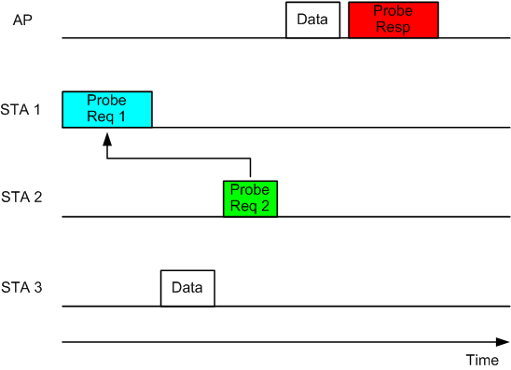
Review of Key Concepts Proposed (1)
STA may send out a simplified Probe Request by referencing to a regular Probe Request received earlier from another STA
The simplified Probe Request includes a Probe Request Reference IE, which contains, e.g. the Source Address, in the received Probe Request, as the reference information.
The AP may broadcast a single Probe Response that provides response to both STAs’ Probe Requests.

Slide 5
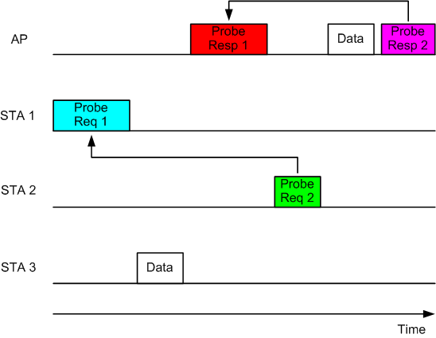
Review of Key Concepts Proposed (2)
AP may send out a simplified Probe Response by referencing to a Probe Response sent out earlier by the AP
The simplified Probe Response includes a Probe Response Reference IE, which contains , e.g. the Sequence Control number, in the Probe Response that is sent earlier, as the reference information.

Slide 6
Simulation Setup and General Assumptions
Results averaged over ten simulation runs, each lasting 20 seconds.
5 APs co-located.
On average 100 STAs arrive randomly per second throughout the run.
Each STA sends Wildcard Probe Request first, based on DCF rules.
Only 10% of all STAs, if succeeding in previous step, can proceed with Association, Authentication, EAPOL, and 4-way Handshake (in order not to overload the system with lengthy EAPOL traffics).
Assumed no hidden nodes. (So, every AP or non-AP STA can hear every other AP and non-AP STAs.)
Did not model the path loss nor decoding error. Packets are lost only due to collision.
Added artificial DL data traffics, which takes about 50% air time on average.

Slide 7
Simulation Parameters
Beacon Interval: 100 msec
Max Channel Time: 10 msec, after which if no Probe Response received, the STA leaves the simulation run unassociated.
Max Reference Time: 10 or 50 msec, after which a regular Probe Request or Response can not be used as reference any more.
Full Probe Request MPDU size: 120 Bytes.
Full Probe Response MPDU size: 120 Bytes.
Simplified Probe Request MPDU size: 40 Bytes (28 MAC header + 8 SA + 4 FCS).
Simplified Probe Response MPDU size: 36 Bytes (28 MAC header + 4 SC + 4 FCS).

Slide 8
Simulation Result – 1 Air Time Occupancy
 | Baseline | Simplified Probe with reference within 10 msec | Simplified Probe with reference within 50 msec
Beacon | 0.92% | 0.96% | 0.96%
Probe Request | 1.96% | 1.42% | 1.06%
Probe Response | 9.77% | 6.6% | 5.06%
Assoc., Auth., EAPOL, & 4-way Handshake messages | 0.9% | 1.41% | 1.67%
Data | 53.33% | 53.96% | 53.67%
Collision | 17.99% | 16.19% | 14.85%
ACK | 4.13% | 4.66% | 5.09%
Idle time including SIFS, DIFS, & backoff | 11% | 14.78% | 17.64%

Slide 9
Simulation Result - 2
 | Baseline | Simplified Probe with reference within 10 msec | Simplified Probe with reference within 50 msec
AP Discovery Delay | 12.978 msec | 10.959 msec | 10.184 msec
Link Setup Delay | 116.73 msec | 103.63 msec | 103.89 msec
Link Setup Success Rate | 33.33% | 43.75% | 51.52%
Probe_Req_Full/ Probe_Req_Simpl | NA | 10072/9922 | 3335/16662
Probe_Resp_Full/ Probe_Resp_Simpl | NA | 43029/56721 | 15518/84169

Slide 10
Benefits
Reduced AP discovery time and link setup time
Reduced air time occupied by Probe Request, Probe Response, collisions
Increased air idle time, meaning more data traffics may be accommodated
Simple MAC standard changes
i.e. adding optional IE in the Probe Request or Probe Response frame to provide reference information.
A detailed normative text proposal can be found in [2].

Slide 11
Straw Poll 1 (with results from [1])
Do you support that a FILS-capable STA may send a simplified Probe Request by referencing to another STA’s Probe Request that was received earlier, thereby removing the redundant information elements that are already in the referenced Probe Request from the simplified Probe Request?
Yes: 24
No: 9
Abstain: 4

Slide 12
Straw Poll 2 (with results from [1])
Do you support using the source address (SA) in the referenced Probe Request as the reference information in the Probe Request or the simplified Probe Request, based on which the AP may send the Probe Response in a broadcast manner?
Yes: 24
No: 8
Abstain: 5

Slide 13
Straw Poll 3
Do you support that a FILS-capable AP may send a simplified Probe Response by referencing to another Probe Response that was sent earlier, thereby removing the redundant information elements that are already in the referenced Probe Response from the simplified Probe Response?
Yes:
No:
Abstain:

Slide 14
Straw Poll 4
Do you support using the Sequence Control number in the referenced Probe Response as the reference information in the simplified Probe Response?
Yes:
No:
Abstain:

Slide 15
Motion 1
Move to add the following text to “Section 6.2 Active scanning” in the TGai SFD, 12/0151r12:
“6.2.10 Simplified Probe Request
A FILS-capable STA may send a simplified Probe Request by referencing to another STA’s Probe Request that was received earlier, thereby removing the redundant information elements that are already in the referenced Probe Request from the simplified Probe Request.”
Mover:
Seconder:
Result Yes No Abstain___________

Slide 16
Motion 2
Move to add the following text to “Section 6.2 Active scanning” in the TGai SFD, 12/0151r12:
“6.2.11 Triggering the broadcasted Probe Response transmission
The source address (SA) of the STA that sent the referenced Probe Request may be included in the Probe Request or simplified Probe Request. The AP may broadcast the Probe Response based on the triggering reference information (i.e., the source address of the STA that sent the referenced Probe Request) .”
Mover:
Seconder:
Result
Yes No Abstain_______________

Slide 17
Motion 3
Add the following text to “Section 6.2 Active scanning” in the TGai SFD, 12/0151r12:
“6.2.12 Simplified Probe Response
AP may send a simplified Probe Response by referencing to a regular Probe Response that was sent earlier, thereby removing the redundant information elements that are already in the referenced Probe Response from the simplified Probe Response.”
Mover:
Seconder:
Result Yes No Abstain___________

Slide 18
References
[1] IEEE 802.11-12/0791r3 Reducing-active-scanning-overhead.
[2] IEEE 802.11-12/1050r0 Spec-Text-for-Probe-Referencing .

