Slide 1
Band adjustment for fasat AP discovery
Date: 2012-09-19
Authors:
Name | Affiliations | Address | Phone | email
Giwon Park | LG Electronics | LG R&D Complex 533, Hogye-1dong, Dongan-Gu, Anyang, Kyungki, 431-749, Korea | +82-31-450-1879 | giwon.park@lge.com
Kiseon Ryu | LG Electronics | 10225 Willow Creek Rd, San Diego, CA, 92131, USA | +1 (858)-635-5209 | kiseon.ryu@lge.com
Jinsam Kwak | LG Electronics | LG R&D Complex 533, Hogye-1dong, Dongan-Gu, Anyang, Kyungki, 431-749, Korea | +82-31-450-7902 | Jinsam.kwak@lge.com

Slide 2
Abstract
This contribution introduces the band redirection (between 2.4GHz and 5GHz) for fast scan.

Slide 3
Conformance w/ TGai PAR & 5C
Conformance Question | Response
Does the proposal degrade the security offered by Robust Security Network Association (RSNA) already defined in 802.11? | No
Does the proposal change the MAC SAP interface? | No
Does the proposal require or introduce a change to the 802.1 architecture? | No
Does the proposal introduce a change in the channel access mechanism? | No
Does the proposal introduce a change in the PHY? | No
Which of the following link set-up phases is addressed by the proposal? (1) AP Discovery (2) Network Discovery (3) Link (re-)establishment / exchange of security related messages (4) Higher layer aspects, e.g. IP address assignment | 1

Slide 4
Current multiband operation (1/3)
Band steering (Implementation)
With the new dual-radio access points (APs) just introduced by HP Networking, it makes perfect sense to also add the intelligence to steer 5GHz-capable clients away from the crowded 2.4GHz band.
System only allow STAs to connect the 5GHz. AP ignores Probe Request or Authentication Request of 2.4GHz.
However, this band steering take such a long time (i.e., several seconds)
Moreover, the Wi-Fi standards did not define any mechanism to direct clients to connect a specific radio.
Thus, the 802.11ai standard shall define any mechanism to direct STAs to connect a specific radio.

Slide 5
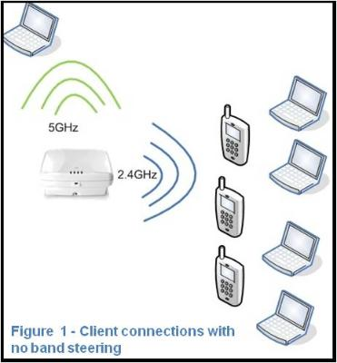
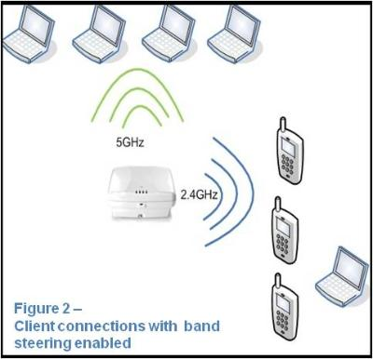
Current multiband operation (2/3)
Example of Band steering
http://h30507.www3.hp.com/t5/HP-Networking/How-to-make-the-most-of-cool-amp-fast-new-Wi-Fi-technology/ba-p/88817

Slide 6
Current multiband operation (3/3)
Other band neighbor AP information
In 6.1.3 Operational Channels of SFD 12/0151r12, a FILS STA may announce other band (or channel) information to the FILS non AP STAs. Based on this information, FILS non-AP STA can monitor the other band (or channel) for AP discovery.
Use case of using other band neighbor AP information
FILS non AP STA may use the other band neighbor AP information only when it performs the scanning procedure for discovering the APs which are operating on other band.
Thus, AP may include this other band neighbor information for band redirection (e.g., 2.4GHz → 5GHz) of the STAs.

Slide 7
Band redirection
Band redirection between 2.4GHz and 5GHz
FILS non-AP STA sends the Probe Request to the AP in 2.4GHz.
AP may respond to the Probe Request in 2.4GHz.
If the BSS load on the current band (e.g., 2.4GHz) is not enough to accommodate new coming STAs, the AP may redirect the STAs to the AP on other band (e.g., 5GHz) by including the neighbor AP information in the Probe Response or Beacon so that the STAs should scan and associate it.
Neighbor AP information may be included in Probe Response for band redirection.
e.g., Band ID, Operation class, Channel list, TBTT of the APs, Interworking IE of the APs.

Slide 8
Straw poll
Do you agree inserting the following text on clause 6 of the SFD (11-12/0151r12)?
6.4 Band adjustment
If the BSS load on the current band (e.g., 2.4GHz) is not enough to accommodate new coming STAs, the AP may redirect the STAs to the AP on other band (e.g., 5GHz) by including the neighbor AP information in the Probe Response or Beacon so that the STAs should scan and associate it.
Yes:
No:
Abstain:

Slide 9
Motion
Insert the following text on clause 6 of the SFD (11-12/0151r12):
6.4 Band adjustment
If the BSS load on the current band (e.g., 2.4GHz) is not enough to accommodate new coming STAs, the AP may redirect the STAs to the AP on other band (e.g., 5GHz) by including the neighbor AP information in the Probe Response or Beacon so that the STAs should scan and associate it.
Mover:
Seconder:
Result:
Yes No Abstain_______________

