Slide 1
11af Interframe Spacing
Date: 2012-07-16
Authors:

Slide 2
Introduction
Motions passed in Atlanta define the basic PHY structure for 11af.
However, interframe spacing values (SIFS time and slot duration) have not defined yet.
In this presentation, we investigate the components that makes up SIFS and Slot durations and propose values that are suitable for 802.11af

Slide 3
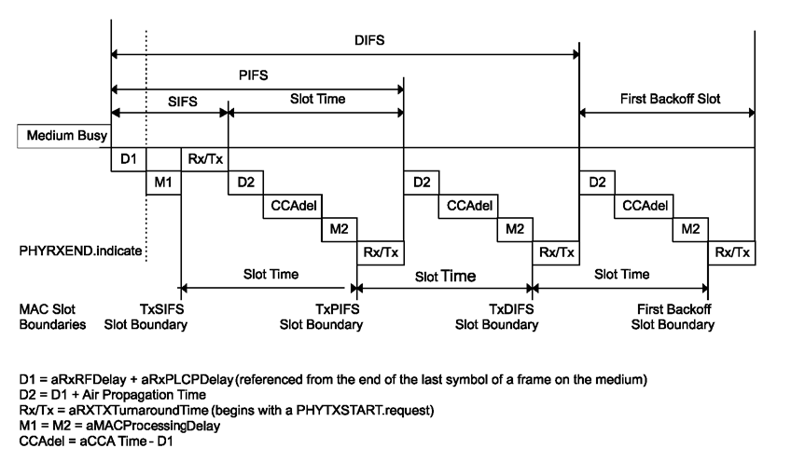
Definitions

Slide 4
Values
aAirPropagationTime
Twice the propagation time (in microseconds) for a signal to cross the maximum distance between the most distant allowable STAs that are slot synchronized.
Assuming 300 and 900 meters range for 11n/ac and 11ah respectively, corresponding values are 2us and 6us.
aRxPLCPDelay, aMACProcessingDelay, aTxPLCPDelay
These are digital processing delays and depend on the digital clock rate and need to be scaled by 40/5.33 or 40/7.11
MAC processing time for Slot is set to zero since the MAC calculation can be done before transmission.
aTxRampOnTime and aRxTxSwitchTime are assumed to be the same for 11n/ac and 11ah
aTxRFDelay and aRxRFDelay
Assuming the same filter order, delay increases by 20/5.333 due to bandwidth scaling
Furthermore, we assume Tx filter will be approximately 2x longer to meet the spectral mask requirements of regulatory domains.

Slide 5
CCA Time
Due to smaller BW, CCA needs to be increased by 20/5.33 (or 20/7.11) compared to 11n/ac
Hence, CCA time is
15us for 6MHz and 7MHz channels
11.25us for 8MHz channels

Slide 6
SIFS
 | 11ac | For 6/7MHz | For 8MHz
aRxRFDelay | .5 | 1.875 | 1.4
aRxPLCPDelay | 12.5 | 93.75 | 70.31
aMACProcessingDelay | 1 | 7.5 | 5.625
aRxTxTurnaroundTime (aTxPLCPDelay+aRxTxSwitchTime+aTxRampOnTime+aTxRFDelay) | 2 (1, 0.25, 0.25, 0.5) | 11.75 (7.5+0.25+0.25+3.75) | 8.93(5.625+0.25+0.25+2.81)
SIFS | 16 | 115 | 86

Slide 7
Slot Time
 | 11ac | For 6/7MHz | For 8MHz
CCA Time | 4 | 15 | 11.25
Air Propagation Time | 2 | 6 | 6
aMACProcessingDelay | 1 | 0 | 0
aRxTxTurnaroundTime (aTxPLCPDelay+aRxTxSwitchTime+aTxRampOnTime+aTxRFDelay | 2 (1, 0.25, 0.25, 0.5) | 4.25 (0+0.25+0.25+3.75) | 3.31(0+0.25+0.25+2.81)
SlotTime | 9 | 26 | 21

Slide 8
Strawpolls
Do you support SIFS and SLOT values given in slide 6 and 7?
Y:
N:
A:

