Slide 1
Access distribution in 802.11ai
Date: 2012-07-06
Authors:
Name | Affiliations | Address | Phone | email
Giwon Park | LG Electronics | LG R&D Complex 533, Hogye-1dong, Dongan-Gu, Anyang, Kyungki, 431-749, Korea | +82-31-450-1879 | giwon.park@lge.com
Kiseon Ryu | LG Electronics | 10225 Willow Creek Rd, San Diego, CA, 92131, USA | +1 (858)-635-5209 | kiseon.ryu@lge.com
Jinsam Kwak | LG Electronics | LG R&D Complex 533, Hogye-1dong, Dongan-Gu, Anyang, Kyungki, 431-749, Korea | +82-31-450-7902 | Jinsam.kwak@lge.com

Slide 2
Abstract
This contribution proposes the mechanism to distribute the access time of STAs attempting association with the AP in case of passive scanning mode.

Slide 3
Conformance w/ TGai PAR & 5C
Conformance Question | Response
Does the proposal degrade the security offered by Robust Security Network Association (RSNA) already defined in 802.11? | No
Does the proposal change the MAC SAP interface? | No
Does the proposal require or introduce a change to the 802.1 architecture? | No
Does the proposal introduce a change in the channel access mechanism? | No
Does the proposal introduce a change in the PHY? | No
Which of the following link set-up phases is addressed by the proposal? (1) AP Discovery (2) Network Discovery (3) Link (re-)establishment / exchange of security related messages (4) Higher layer aspects, e.g. IP address assignment | 1

Slide 4
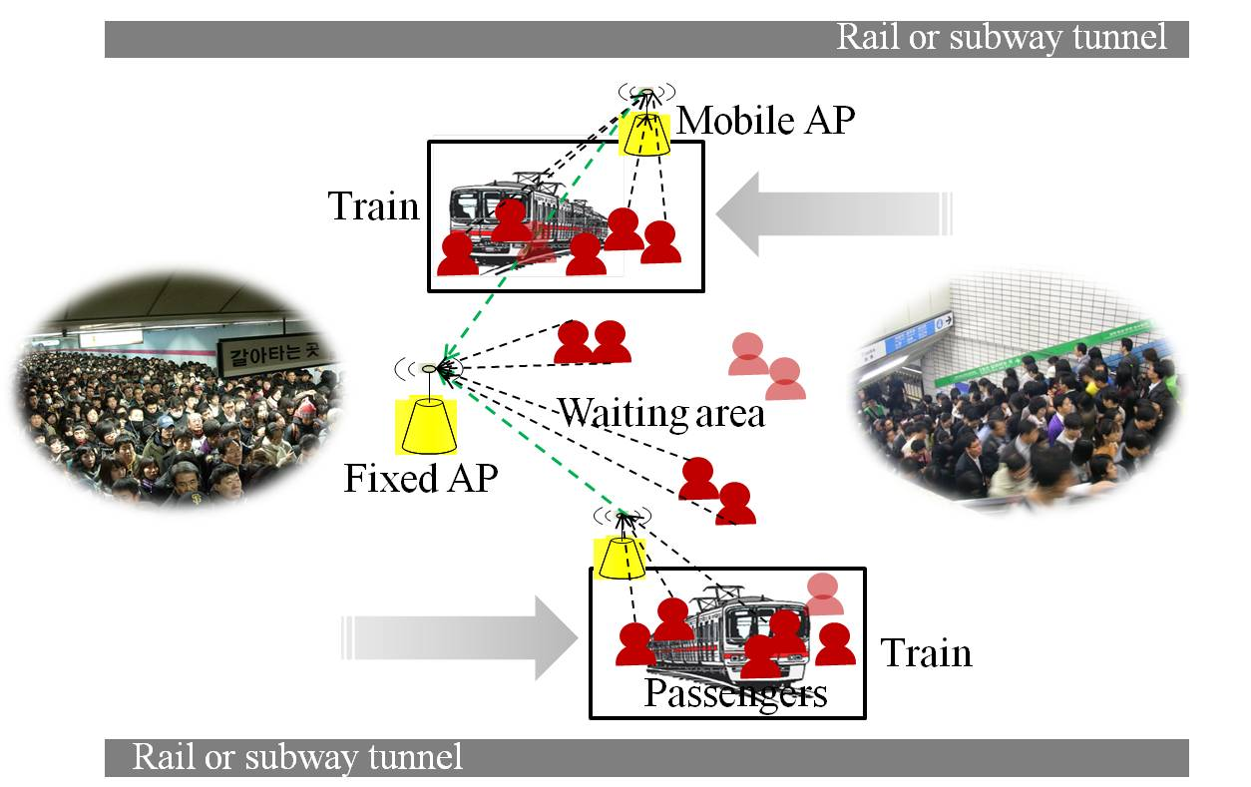
Background (1/4)
11ai use case
Figure 1. 11ai use case
Large number of devices simultaneously access to the AP.
It may produce the severe collisions.

Slide 5
Background (2/4)
Problem 1) Large number of STA’s initial link setup
Large number of STAs may transmit management frames (i.e. authentication, association frames) to associate with the AP in a bursty manner.
Probability of access collision can be highly increased, which causes degradation of the network performance (i.e., access quality, QoS, utilization of the wireless channel, etc).
Collision among STAs in passive scanning mode is more problematic than that of STAs in active scanning mode.
In addition, only some users may be able to successfully associate with the AP during a certain time interval.

Slide 6
Background (3/4)
Problem 2) Current access related parameters for management frame
Default QMF policy of IEEE 802.11ae-2012
It defines the access category of each management frame based on management subtype value, category value, and action value.
Access category of the Association Request frame is set to AC_VO.
Draft P802.11REVmb_D12.0
In 18.4.4 OFDM PHY characteristics, CWmin and CWmax are set to 15, 1023 respectively.
Based on the above description and Default EDCA parameter set element parameter(in Draft P802.11REVmb_D12.0), values of AIFSN, CWmin and CWmax of AC_VO are 2, 3 and 7 respectively.
CWmin of AC_VO in default EDCA parameter: (aCWmin+1)/4 – 1
CWmax of AC_VO in default EDCA parameter: (aCWmin+1)/2 – 1

Slide 7
Background (4/4)
Using the current values of access related parameters (i.e., AIFSN, CWmin and CWmax) for transmission of management frames does not fully support large number of STA’s initial link setup

Slide 8
Conclusion
11ai shall provide the mechanism for access distribution to achieve efficient utilization of the shared wireless channel by minimizing the access collision in case of large number of STA’s initial link setup.

Slide 9
Straw poll
Do you agree to add the sentence to TGai SFD, 12/0151r8.
6.3 Access Distribution
802.11ai shall provide the mechanism for access distribution to achieve efficient utilization of the shared wireless channel by minimizing the access collision in case of large number of STA’s initial link setup.
Yes:
No:
Abstain:

Slide 10
Motion
Move to add the following text to Section 6.3 of SFD?
6.3 Access Distribution
802.11ai shall provide the mechanism for access distribution to achieve efficient utilization of the shared wireless channel by minimizing the access collision in case of large number of STA’s initial link setup.
Mover:
Seconder:
Result
Yes No Abstain_______________

