Slide 1
Priority-Based Backoff Counter Selection
Date: 2012-3-15
Authors:

Slide 2
Introduction
802.11ah use cases target low rate, long range applications
Use cases accepted in [1] include meters, sensor applications, factory automation,…
There are various priority types of STAs in the 802.11ah use cases
QoS level, emergency level, etc.

Slide 3
Proposed Scheme
Proposed priority-based backoff counter selection
Utilize different distributions for backoff counter selection based on non-uniform distribution (e.g., linear distribution, exponential distribution)
Conventional 802.11 MAC uses uniform distribution for backoff counter selection
According to emergency levels or QoS levels, the probability function of backoff counter can be changed

Slide 4
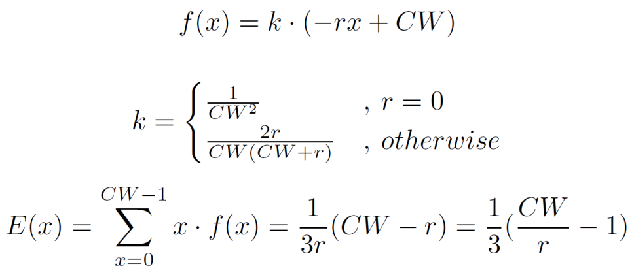
Proposed Scheme
Backoff counter selection using linear distribution
Notations
r: Emergency level
x: Selected CW size
Probability density function
Expected CW size
Probability distribution
Expected CW size
Possible value of CW
Emergency level

Slide 5
Proposed Scheme
Backoff counter selection using exponential distribution
Notations
r: Emergency level
x: Selected CW size
Probability density function
Expected CW size
Probability distribution
Expected CW size
Possible value of CW
Emergency level

Slide 6
Conclusions
STAs select backoff counter based on linear or exponential distribution according to their emergency level.
High-priority STAs obtain medium more easily.
Further investigate the improvement of the proposed scheme in various simulation environments.

Slide 7
References
[1] 11-11/0457r0, Potential Compromise for 802.11ah Use Case Document

