Slide 1
Recommended changes to 802.1Q-2011
Date: 2011-03-14
Authors:

Slide 2
Abstract
Annex C of 802.1Q-2011 defines the DMN implementation requirements for 802.11
During the comment resolution process of P802.11aa, some MIB attributes, MLME primitives and frames were renamed
This presentation lists the changes that should be made in the next revision of 802.1Q

Slide 3
Figures C-11, C-12 and C-13
Change MLME-ADDTS.Reserve to MLME-ADDTSRESERVE.request
Change ADDTS Reserve to ADDTS Reserve Request
Change ADDTS Complete to ADDTS Reserve Response
Below the line of ADDTS Complete, add a new line for MLME-ADDTSRESERVE.response

Slide 4
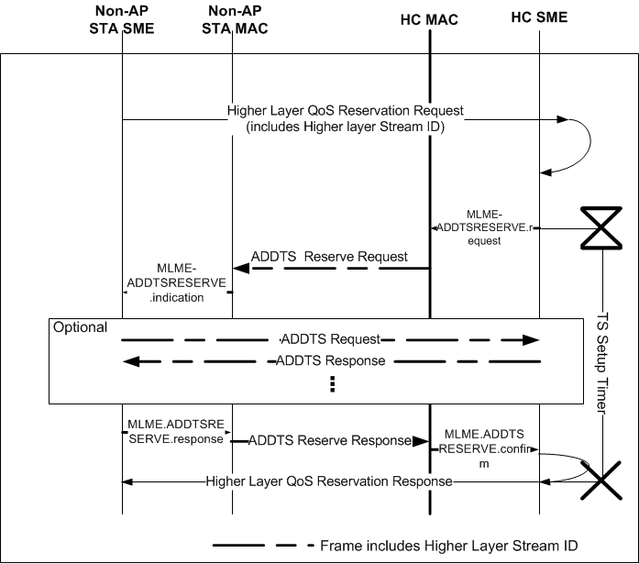
Figure 10-8a - TS setup when initiated by the AP

Slide 5
Page 1210
Change “HC where dot11RobustAvStreaming is set to true” to “HC where dot11RobustAVStreamingImplemented is true”
Change “The BSS QoS AP shall then generate an autonomous ADDTS Reserve frame” to “The BSS QoS AP shall then generate an ADDTS Reserve Request frame”

Slide 6
Page 1210
To the end of the paragraph “If the BSS QoS AP decides to accept the request …” add “The appropriate SRP Talker or Listener node replies to this ADDTS Reserve Request frame with an ADDTS Reserve Response frame indicating if the node accepts the reservation request. One or more ADDTS Request and ADDTS Response frames might be exchanged prior to the ADDTS Reserve Response frame.”
Change “If the BSS QoS AP decides to reject the request” to “If the BSS QoS AP or Listener/Talker node decides to reject the request”

Slide 8
References
IEEE P802.11aa™/D9.0
IEEE Std 802.1Q™-2011

