Slide 1
Providing extended range with limited transmission power in 802.11ah network
Date: 14-March-2012
Authors:

Slide 2
Abstract
This presentation proposes a solution to support extended coverage range with limited transmission power for 11ah network; and enquire if this study falls into the scope of the task group.

Slide 3
Extended coverage in 11ah PHY
Limited transmission power and spectrum
Due to regulatory constraints and spectrum availability
Limitation of battery powered sensor stations
Wide coverage area
Scattered sensor devices in the network (500 m radius requirement)
High station population and low total traffic load
Large number of sensor devices
Traffic from each sensor is very low
How to provide extended coverage for 11ah network efficiently?

Slide 4
Multi-AP network with extended range
All APs share the same set of channels with MAC coordination
To achieve spectrum efficiency
Provide ease of fast re-association for hand-over between APs
Better link quality with limited Tx power
Connect to the strongest AP to achieve macro (selection) diversity
Allowing deployment of low power and low cost APs
A good solution for countries/regions where Tx power constraints forbid high-power AP deployment
Complementary to single high-power AP deployment

Slide 5
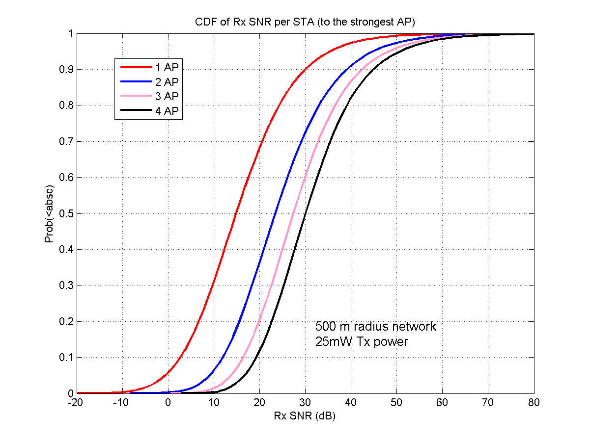
Improved link quality with multi-AP
1MHz BW
900MHz carrier
500m radius
25mW Tx power
NF=7dB
8dB shadowing

Slide 6
Tackle OBSS issues in multi-AP network
OBSS issues include
Undetermined sharing of medium among APs
Uncertainty of transmission delay
Interference/collision caused by hidden nodes
MAC coordination between APs
APs belonging to the same organisation can be fully coordinated
Enables deterministic sharing of medium and the avoidance of collision among hidden nodes
Between autonomously functioned APs , MAC coordination can be further extended to provide relief of OBSS issues

Slide 7
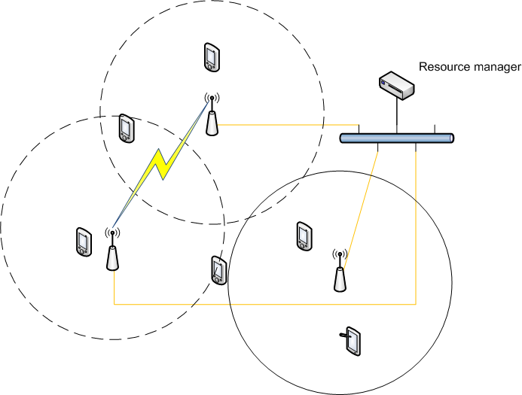
Coordinated multiple APs
Communication between APs can be through wired/wireless link
Using message relay as in mesh network for wireless inter-AP link
A logic resource manager function controlling the resource allocation
How to achieve coordination between APs is open

Slide 8
Station grouping based coordination
The idea of grouping stations has been proposed within the task group
This mechanism can be applied to all stations within OBSS
Stations from different APs do not compete for the medium access, which achieves the coordination

Slide 9
Straw poll 1
Does the study of providing extended coverage (1km radius) with lower transmission power (<250mW) fall into TG11ah scope?

Slide 10
References
Minho Cheong, IEEE 802.11-11/0905r4, TGah Functional Requirements and Evaluation Methodology
Rolf de Vegt, IEEE 802.11-11/1296r3, Potential Channelization for 802.11ah
Fei Tong, IEEE 802.11-11/1455r0, 802.11ah network outdoor deployment issues

Slide 11
Backup

Slide 12
Sharing medium among APs
All APs will send beacon frames with the same beacon interval to encourage synchronisation among APs
Each beacon frame at least contains BSSID and a list of medium access group IDs (ma_grp_ID); each interval, only one beacon frame contains non-null list
To protect the beacon frames, each interval starts and ends with beacon frame containing non-null list, the beginning beacon frame will reserve the medium

Slide 13
Sharing medium among STAs
Each STA associated or intend to associate with only one AP
This would prohibit active scanning, which is not needed as beacon frames are appearing close in time
Once associated, each STA is allocated to one or multiple MA groups
STA can only access the medium during the interval allocated to the associated AP and specified MA groups
It will be guaranteed that MPDU intended for the STAs will not appear in intervals allocated for other stations to encourage power saving micro-sleep

Slide 14
Initial association and re-association
Initial association
Select the strongest AP (identified by the BSSID in beacon frame)
Only send association request in the interval allocated to the destination AP (identified by the BSSID in the beacon frame carries non-null ma_grp_ID list)
Response to initial association
Upon receiving of the association request, AP allocates MA group ID/s for the STA
Re-association
Similar procedure as initial association; STA will be re-allocated to a different group as groups owned by exclusively owned by APs
Exchange of information between AP can accelerate the re-association

Slide 15
MA group and resource management
Each MA group belongs to only one AP
STA can belong to multiple MA groups, which can only belong to the same AP
Resource (access interval) is allocated to MA groups
Based on the resources allocated to the MA groups, AP decides on the content in the beacon frame (in particular the MA group ID lists) and the transmission order of beacon frames

